Slide 1
ERCOT Frequency Control Report
October 2020
ERCOT
Operations Planning
PDCWG | November 17th, 2020

Slide 2
Summary of October 2020
CPS1: 170.56%
Current CPS1 12-Month Rolling Average: 171.95%
5 BAAL Exceedances
5 hourly CPS1 score below 100%
BAAL-003 Events have updated through 2019
2019 BAAL-003 FRM Performance: -811.14
2020 RMS1 Statistics
Mean: 16.07 mHz
Min: 12.25 mHz
Max: 22.6 mHz
Energy Statistics
Total Energy: 31,210,036 MWh
Wind Energy: 7,264,919 MWh
Percent Energy from Wind: 23.28%
Solar Energy: 682,932 MWh
Percent Energy from Solar: 2.19%
Minimum System Inertia
Mean: 189,099 MW*s
Max: 242,576 MW*s on Oct 10th
Min: 147,889 MW*s on Oct 26th
Notes:
2018 BAAL-003 FRM Performance: -843.17

Slide 3
Frequency Control
CPS1, BAAL, & RMS1

Slide 4
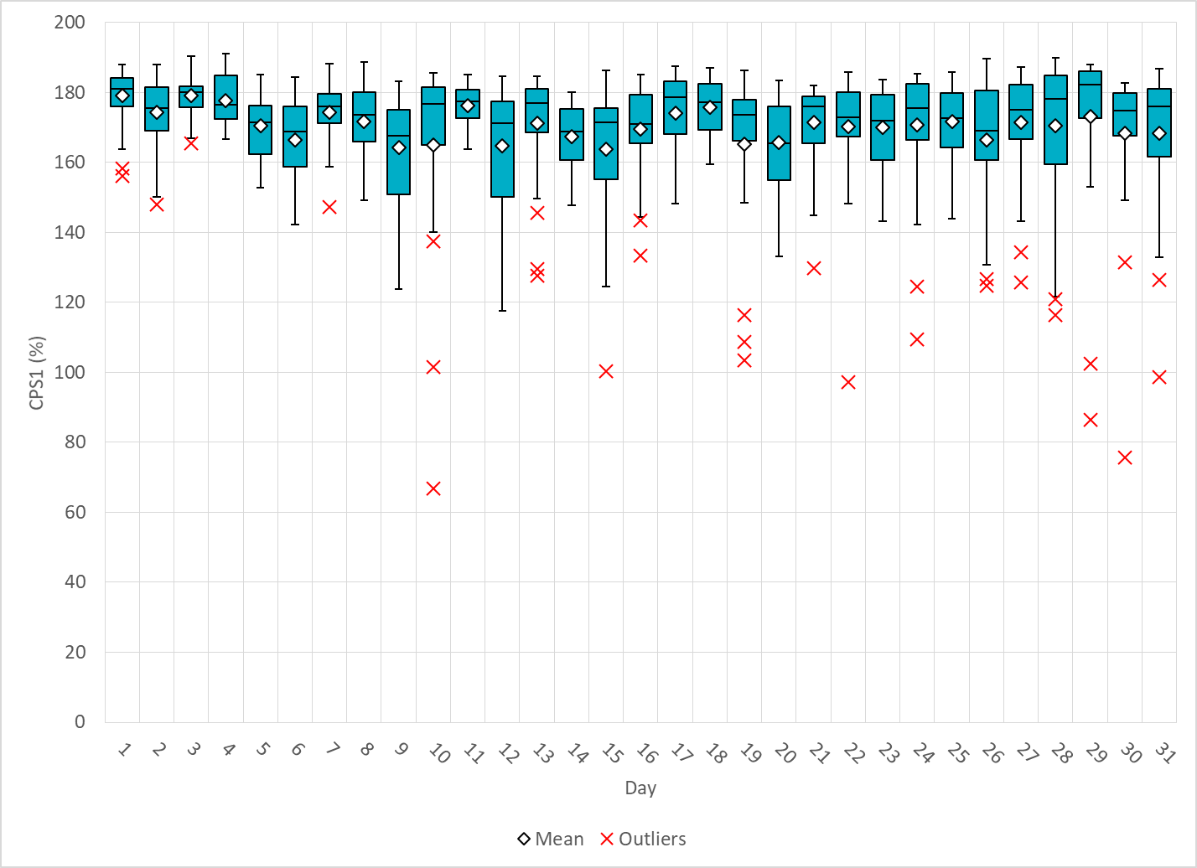
Hourly CPS1 by Day
Oct-20 CPS1 (%): 170.56
Notes:
Outliers:
1. 66.87% @ 10/10/2020 16:00
Unit Trip:
Loss of approximately 694 MW of generation @16:45.
1150 MW of RRS deployed.
97.11% @ 10/22/2020 22:00
Expected Gen Dev:
Expected gen dev remains negative for a third of the hour.
Large exp. Gen. dev of -1910 @ 22:22 mostly due to thermal units.
Several large units deviating due to configuration changes.
Wind/Solar Ramp: Wind and solar are fairly steady.
Regulation: Regulation up exhausted during the period of negative expected gen. dev.
Manual SCED Rest: A manual SCED reset at 22:17 due to frequency drag and reg up fully deployed.
86.36% @ 10/29/2020 17:00
Unit Trip:
Loss of approximately 130 MW of generation @17:17.
Expected Gen Dev: Expected gen dev is negative for most of the hour.
Large exp. Gen. dev of -1283 MW @ 17:25 mostly due to thermal units runback.
Wind/Solar Ramp:
Solar consistently ramps down throughout the hour from 3016 MW to 1572 MW.
Wind consistently ramps down throughout the hour from 7538 MW to 6270 MW.
Manual SCED Rest: Multiple manual SCED resets due to unit trip, runback and consistent wind/solar down ramps.
4. 75.66% @ 10/30/2020 17:00
Expected Gen Dev:
Large exp. Gen. dev of -1390 MW @ 17:52 mostly due to solar and thermal units
Wind/Solar Ramp:
A 616MW Solar down-ramp within a 15 minute period at the end of the hour.
Regulation: Regulation up exhausted for over half of the hour
Manual SCED Rest: A manual SCED reset at 17:50 due to solar down ramp and reg up fully deployed.
5. 98.72% @ 10/31/2020 15:00
Expected Gen Dev:
Large exp. Gen. dev of -916 MW @ 15:29 mostly due to thermal and a few solar units
A thermal unit running back to off from 580MW and all reg up deployed.
Wind/Solar Ramp:
A 337 MW Solar down-ramp within a 10 minute period @ 15:26.
Manual SCED Rest: A manual SCED reset at 15:27 due to a thermal unit runback and reg up fully deployed.

Slide 5
BAAL Exceedances & Violations
There was 5 BAAL exceedances in Oct

Slide 6
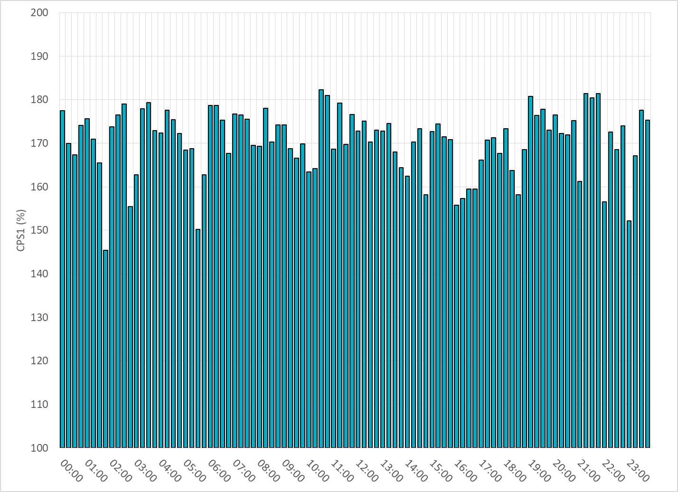
15-Minute Average CPS1%
Oct-20 CPS1 (%): 170.56

Slide 7
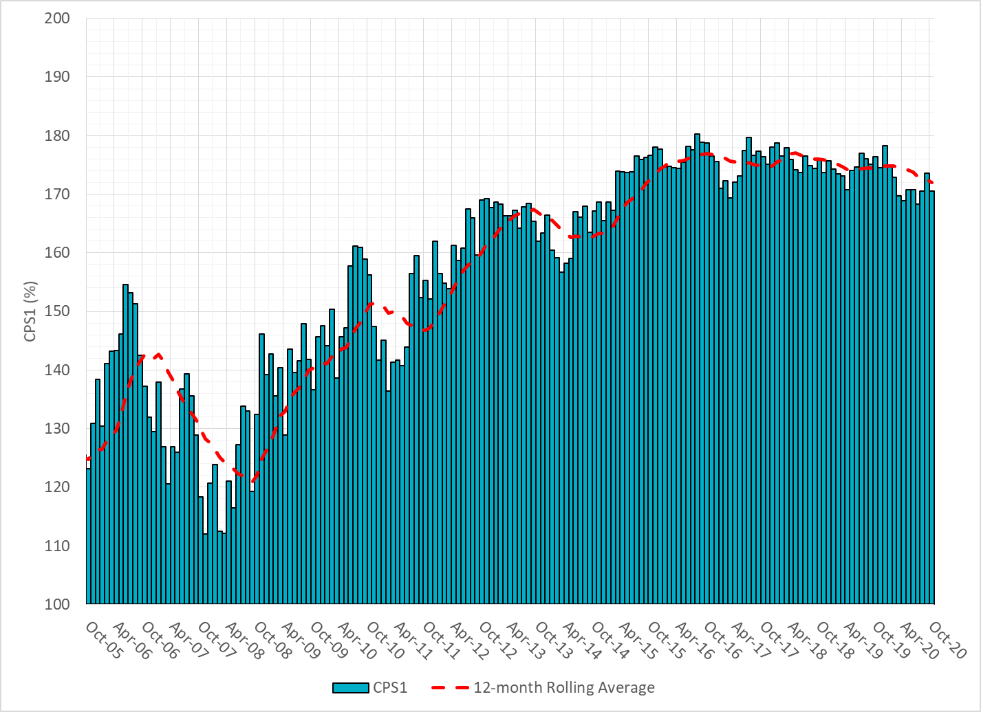
12-Month Rolling Average CPS1
Current 12-Month Rolling Average: 171.95%

Slide 8
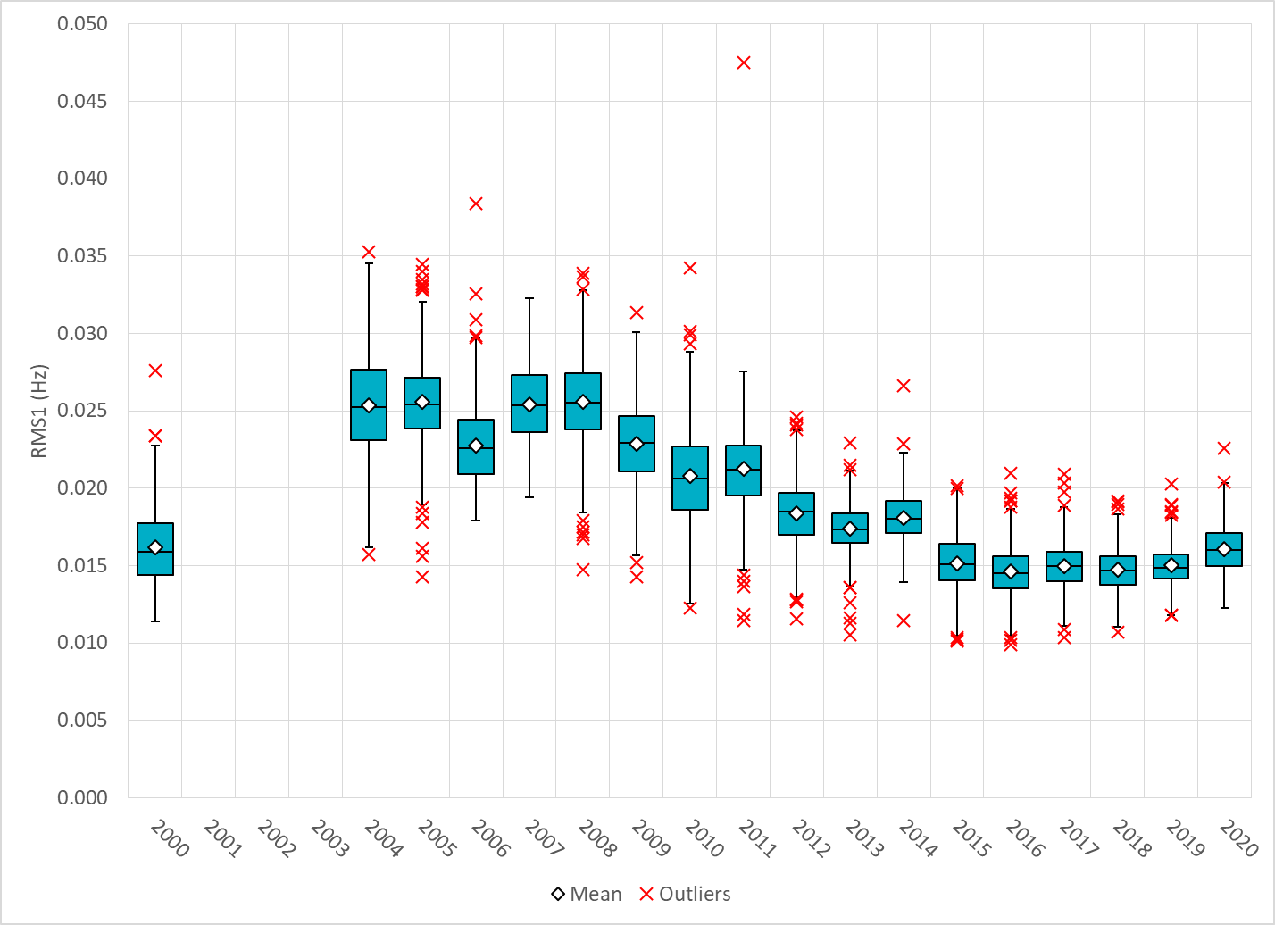
Daily RMS1 of ERCOT Frequency by Year
Notes:
Mean: 16.07 mHz
Min: 12.25 mHz
Max: 22.6 mHz

Slide 9
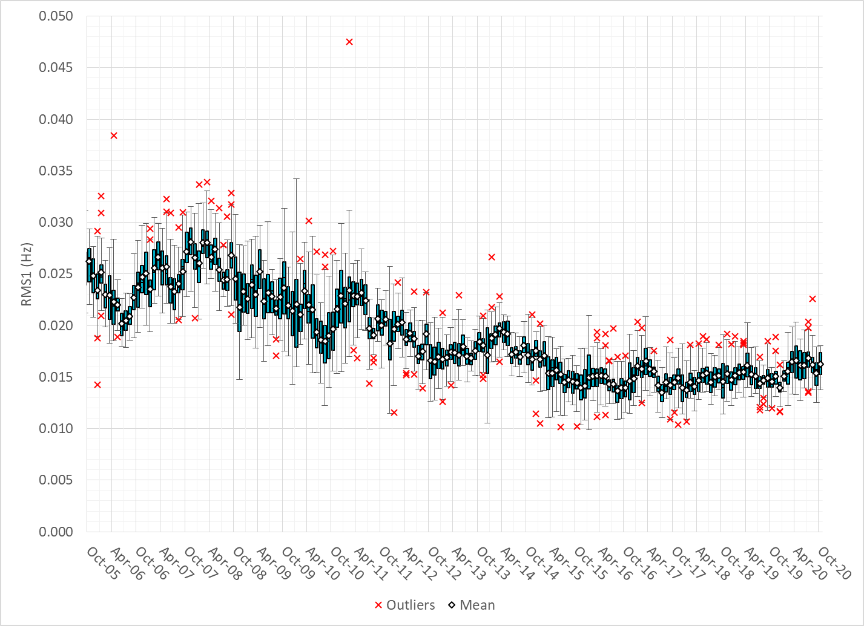
Daily RMS1 of ERCOT Frequency by Month

Slide 10
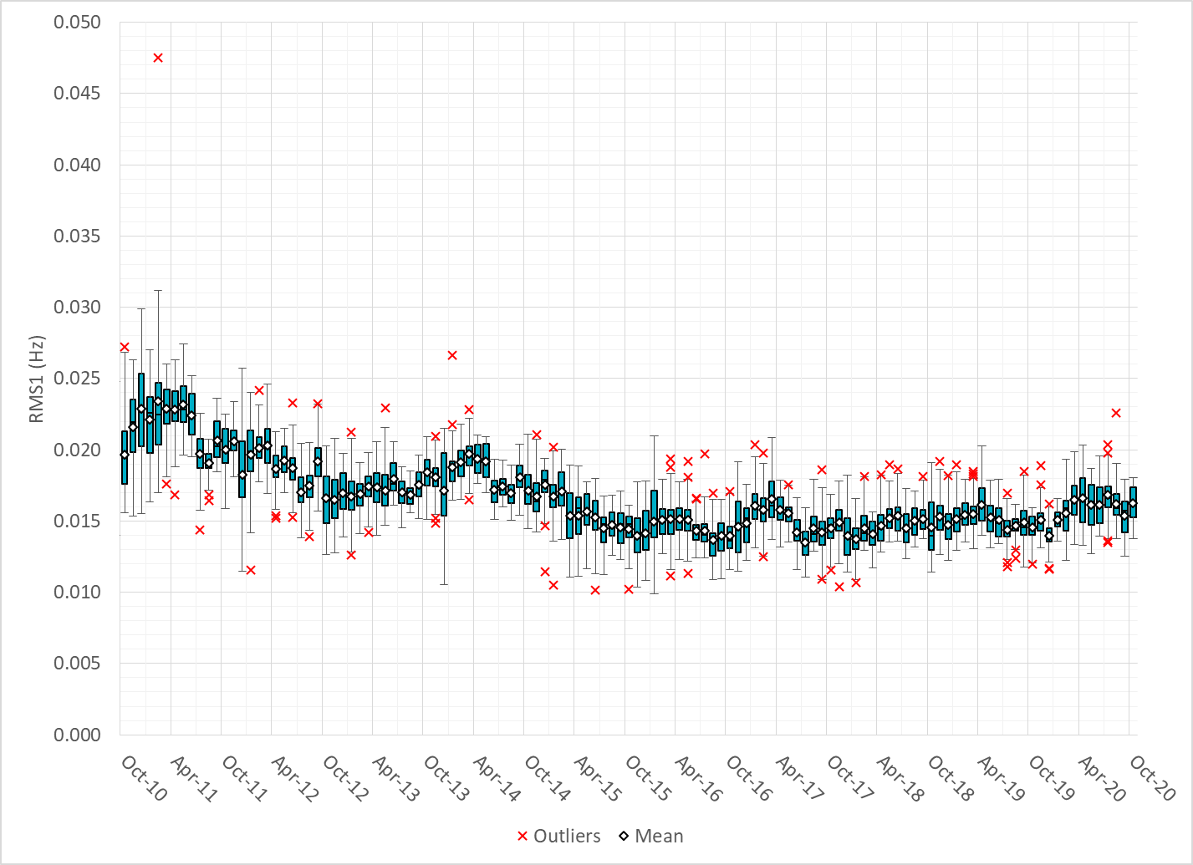
Daily RMS1 of ERCOT Frequency by Month

Slide 11
Frequency Profile Comparison

Slide 12
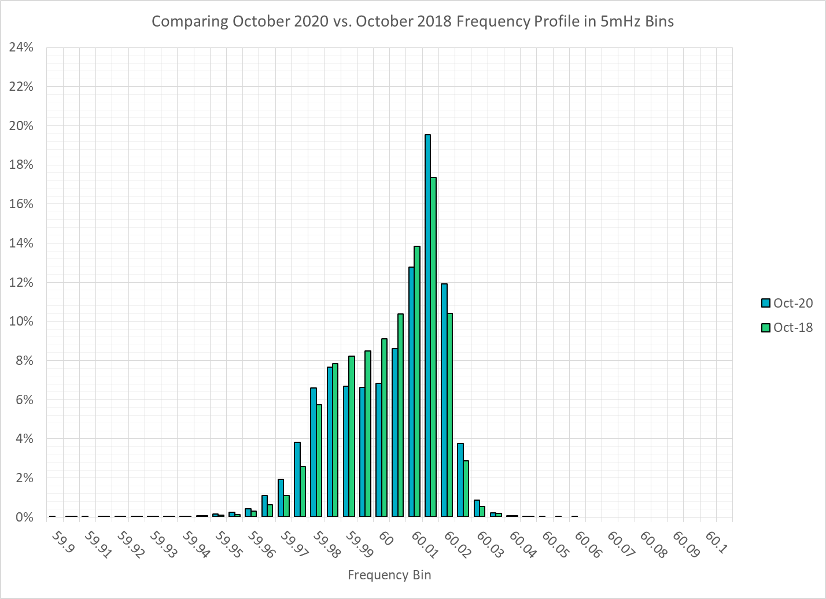
Frequency Profile Comparison

Slide 13
Frequency Profile Comparison

Slide 14
Time Error Correction

Slide 15
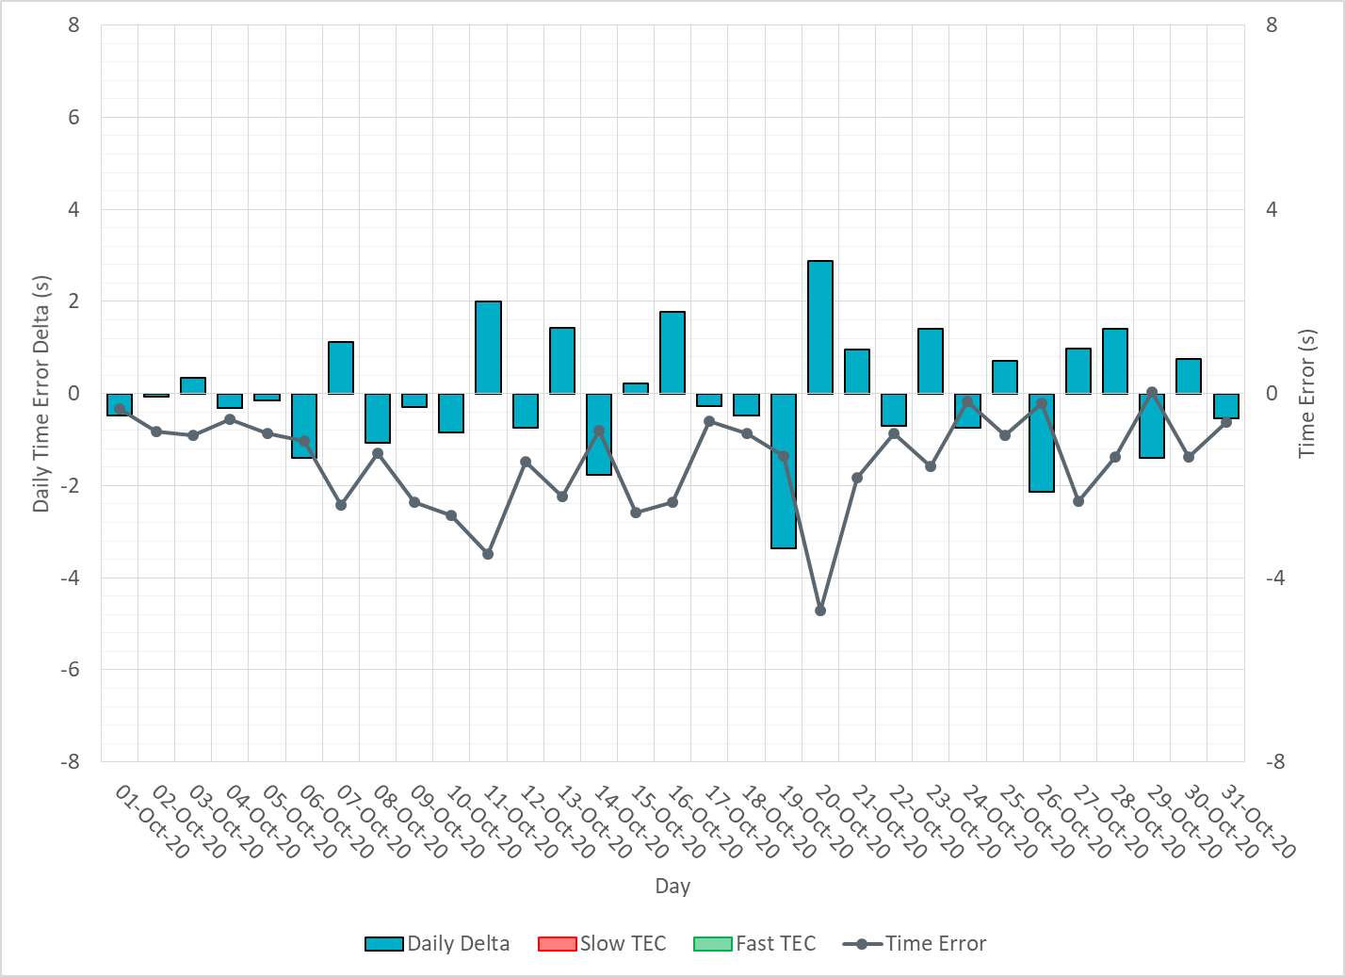
ERCOT Daily Time Error

Slide 16
Time Error Corrections Log Summary
There have been no time error corrections since December 2016

Slide 17
BAL-003 Performance

Slide 18
Op. Year 2019 BAL-003 Selected Events – Update
Notes:
BAL-003

Slide 19
Op. Year 2018 BAL-003 FRM Performance - Update
Notes:
OP2018: FRO = -381.0, FRM_median = -843.17, FRM_average = -959.7
OP2019: FRO = -381.0, FRM_median = -811.14, FRM_average = -892.5
OP2020: FRO = -425.0,

Slide 20
ERCOT Energy Statistics

Slide 21
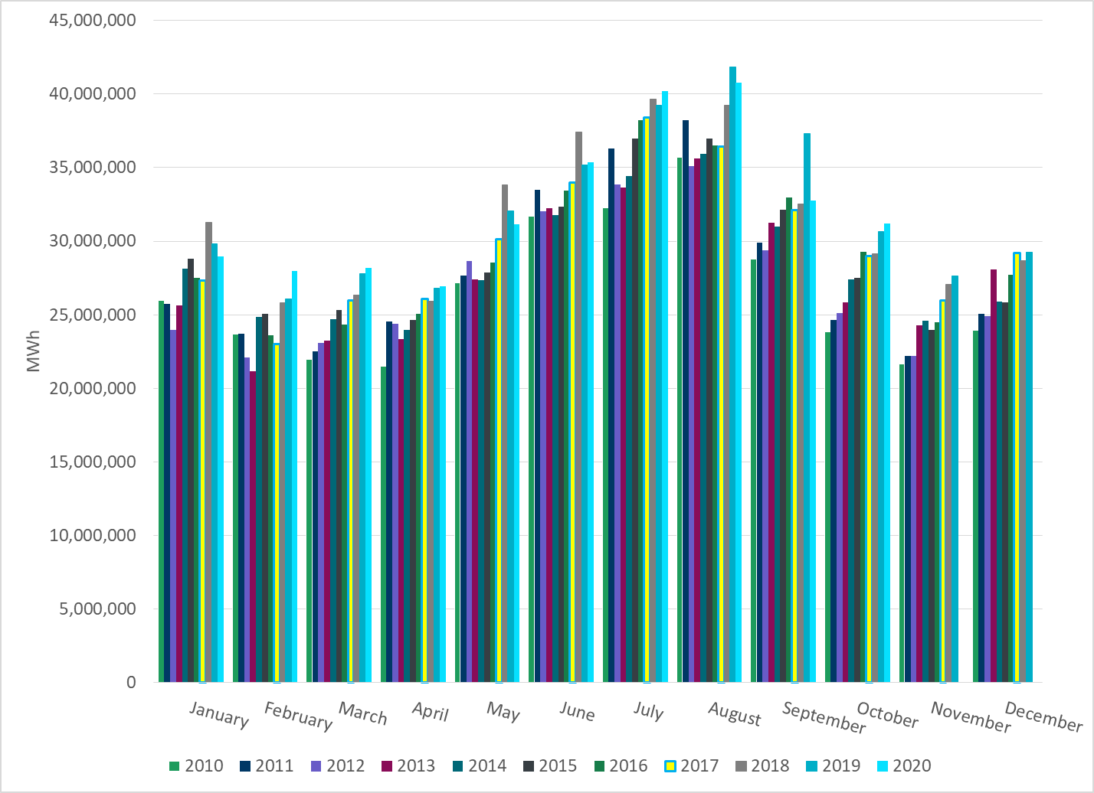
Total Energy
Notes:
31,210,036 MWh

Slide 22
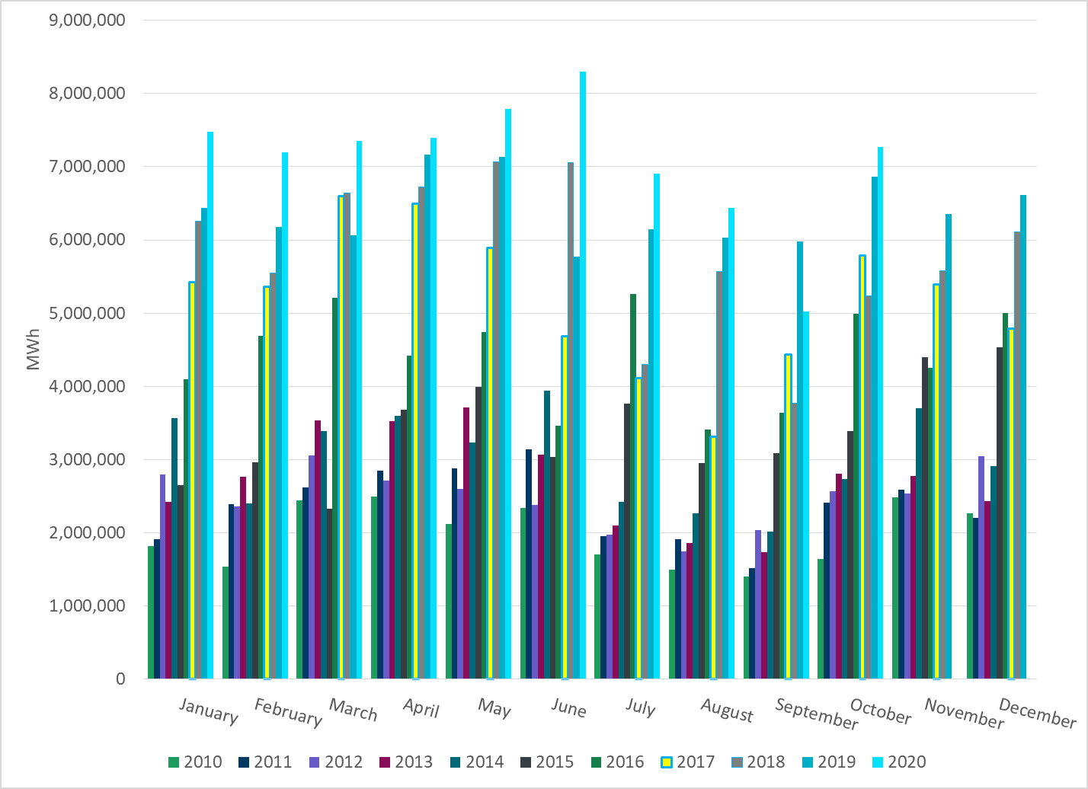
Total Energy from Wind Generation
Notes:
7,264,919 MWh

Slide 23
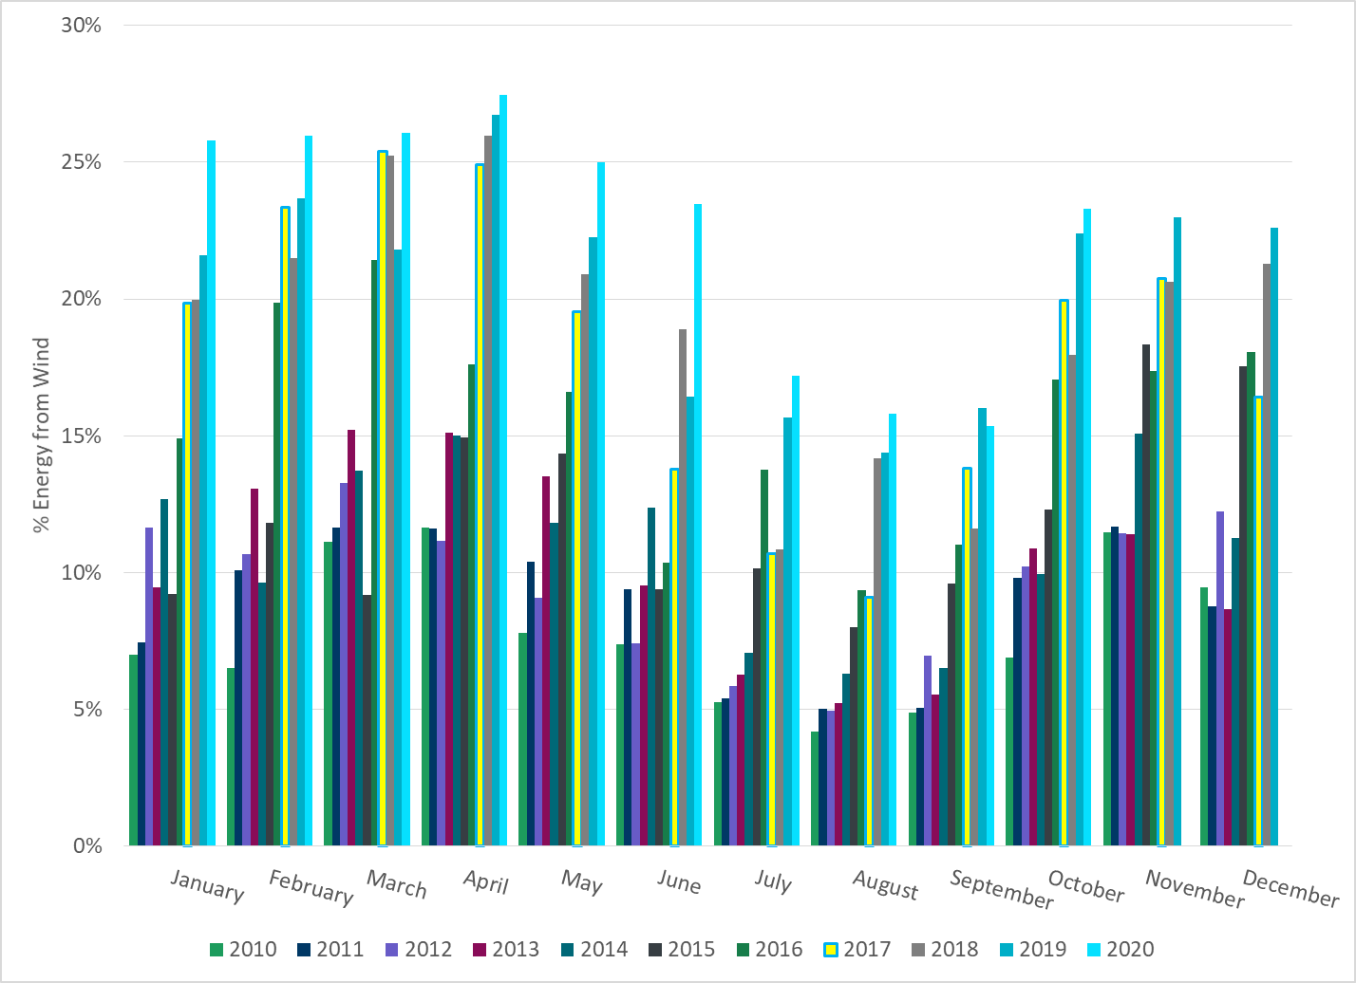
% Energy from Wind Generation
Notes:
23.28%

Slide 24
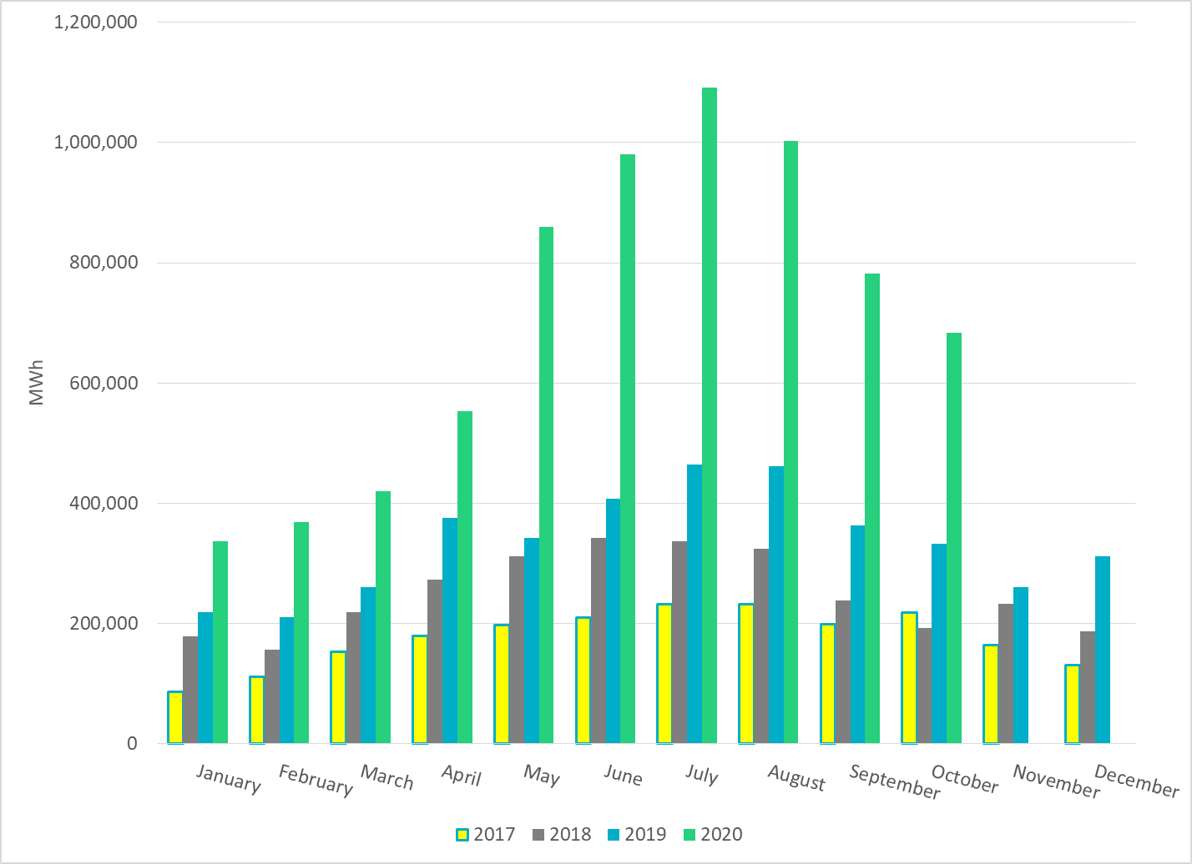
Total Energy From Solar Generation
Notes:
682,932 MWh

Slide 25
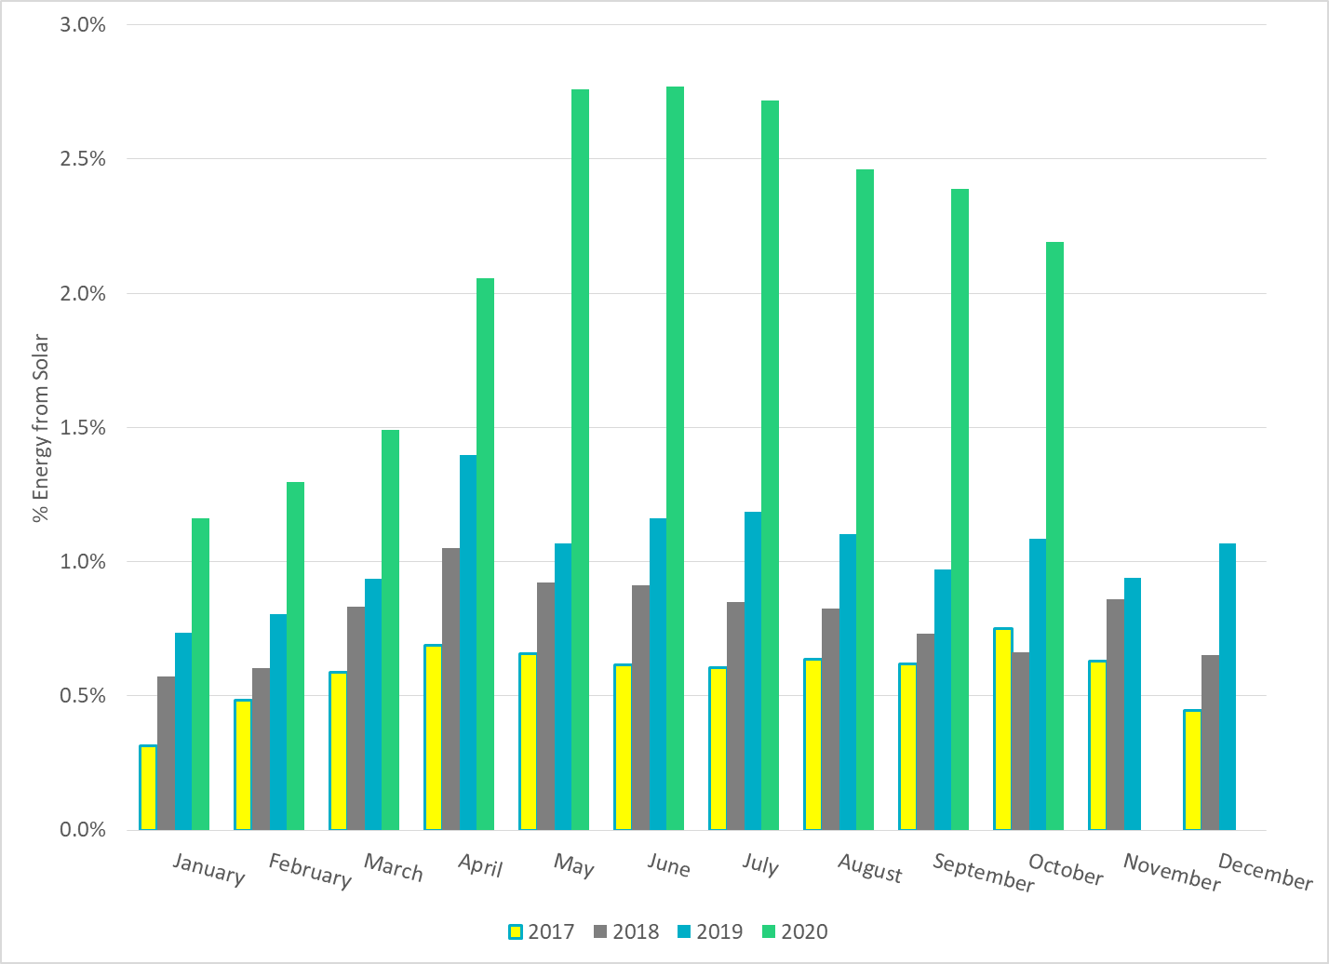
% Energy from Solar Generation
Notes:
2.19%

Slide 26
ERCOT System Inertia

Slide 27
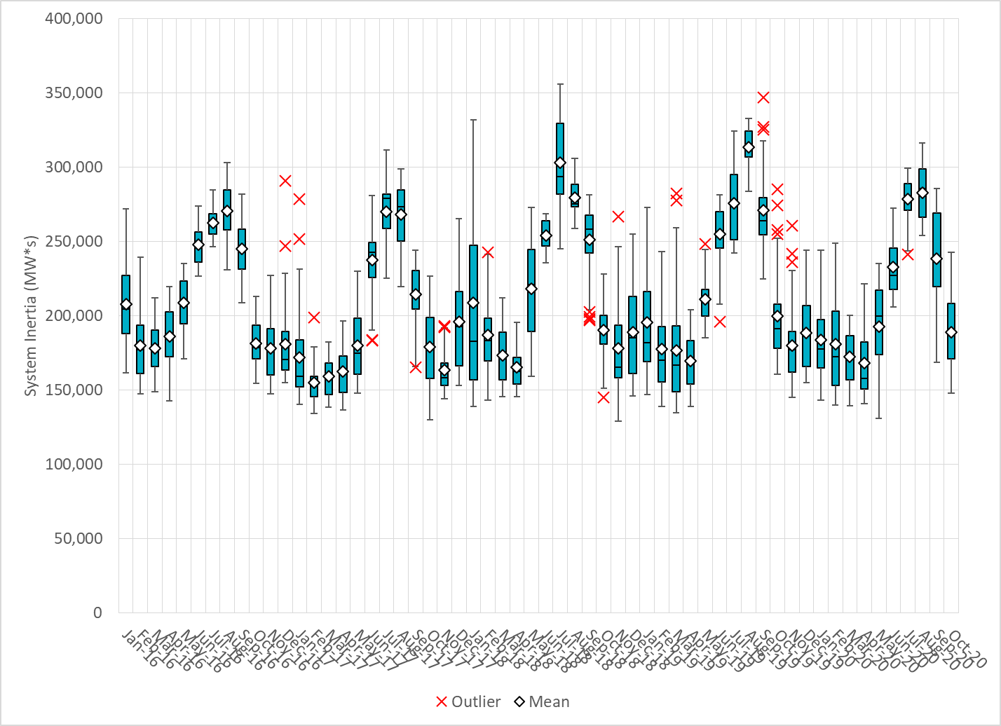
Daily Minimum System Inertia
Notes:
Minimum Inertia = 147,889 MW*s on 9/27/2020
Previous Minimum was 128,759 MW*s on 11/18/2018.
Data:
Mean: 189,099
Max: 242,576 on Oct 10th
Min: 147,889 on Oct 26th

Slide 28
Questions?
Thank you!

