Slide 1
SARA Probabilistic Model, Post-summer Performance Analysis
Supply Analysis Working Group
Pete Warnken
Resource Adequacy
November 19, 2020
Notes:
Welcome to

Slide 2
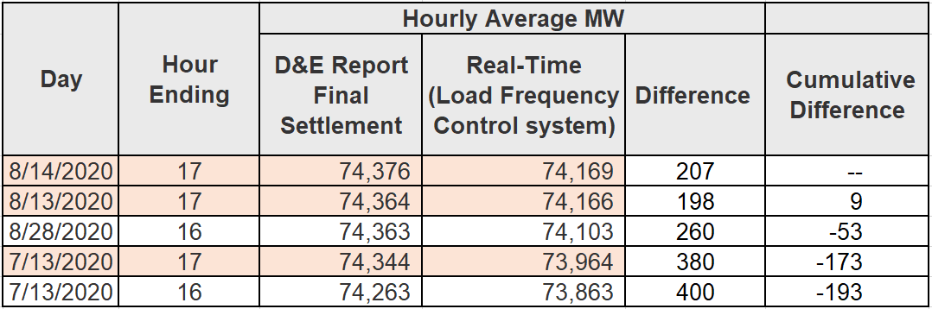
Summer Peak Load Days Selected for Analysis
Five highest summer peak load days:
Selected three peak load days for analysis based on highest HE 1700 values
  8/13 and 8/14 reveal how wind and solar varied across the two contiguous days with the highest (and almost identical) peak loads
  7/13 reveals how wind and solar varied for high peak load days in different summer months

Slide 3
“Capacity Available for Operating Reserves” (CAFOR) Estimation Performance Analysis

Slide 4
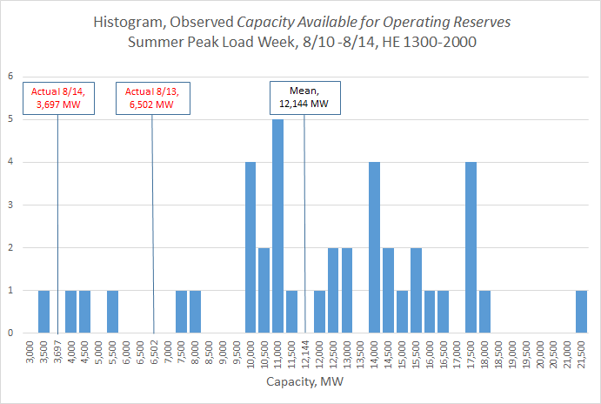
Actual CAFOR during August Peak Load Week, HE1300-2000
Notes:
P(50) model value = 5,018 MW
Actual, 8/13 HE17 = 6,502 MW
Actual, 8/14 HE17 = 3,697 MW

Slide 5
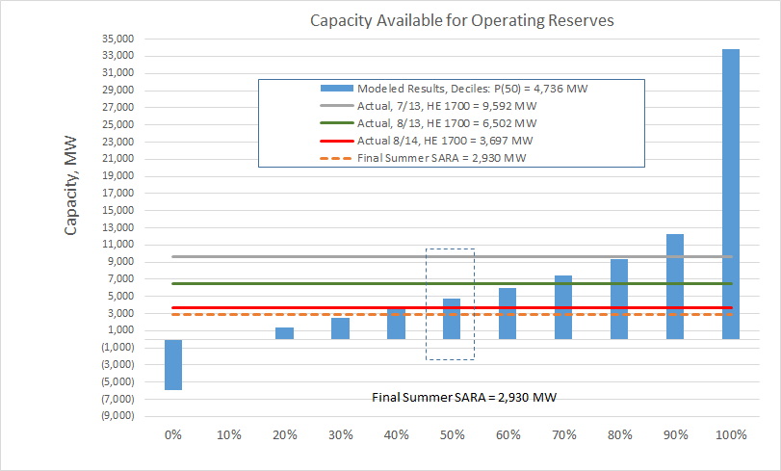
Modeled Results vs. Actual Observed
Notes:
P(50) model value = 5,018 MW
Actual, 8/13 HE17 = 6,502 MW
Actual, 8/14 HE17 = 3,697 MW

Slide 6
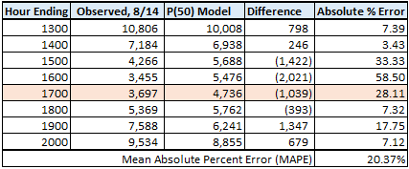
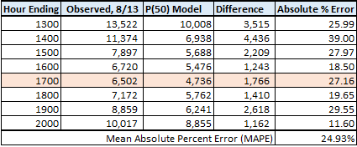
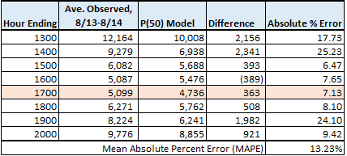
Multi-hour Forecast Error (HE 1300-2000)

Slide 7
Peak Demand Estimation Performance Analysis

Slide 8
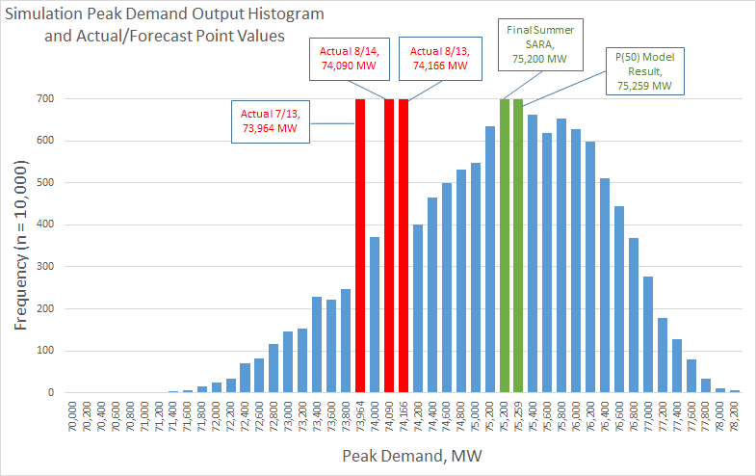
Histogram, Peak Demand Results vs. Actuals, HE1700
Notes:
P(50) model value = 5,018 MW
Actual, 8/13 HE17 = 6,502 MW
Actual, 8/14 HE17 = 3,697 MW

Slide 9
Wind Output Estimation Performance Analysis

Slide 10
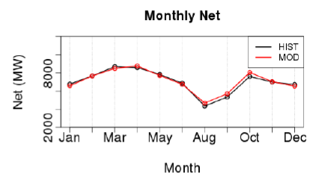
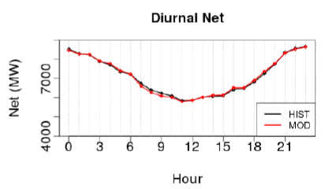
Aggregate Wind Profiles, Monthly & Diurnal Patterns and Fit Relative to Observed Generation
Source: Hourly Wind and Solar Generation Profiles (1980-2019) final report, prepared for ERCOT by UL, Ref No. 9-08-027944, July 9, 2020.
Calibration of actual wind speeds with the meteorological model results based on data from 40 met towers
The plant-specific profiles were validated against historical observed generation

Slide 11
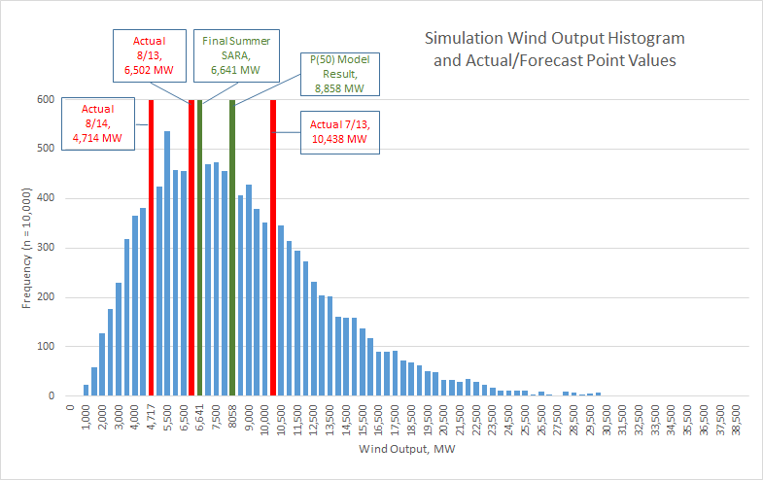
Histogram, Wind Results vs. Actuals, HE1700

Slide 12
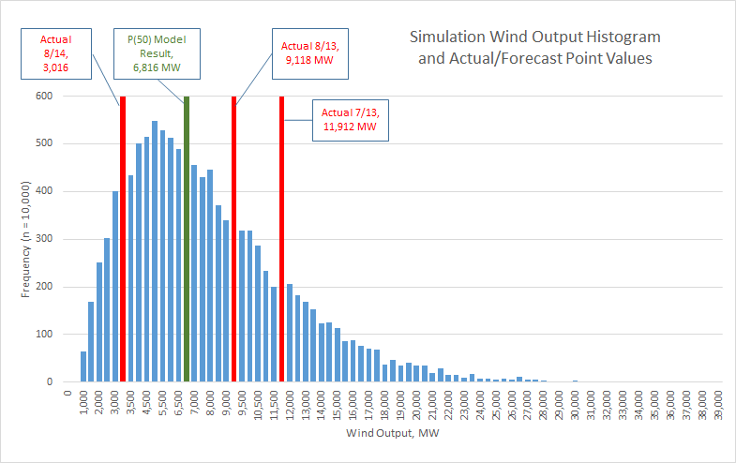
Histogram, Wind Results vs. Actuals, HE1500

Slide 13
Multi-hour Forecast Error (HE 1300-2000)

Slide 14
Multi-hour Forecast Error (HE 1300-2000)
Using only August profile data for wind distribution development results in a slight forecast error improvement
June-Sept Profile Data

Slide 15
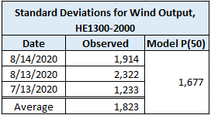
Hourly Variability Comparison, Observed vs. Modeled
For the three summer peak load days, the table below shows the standard deviations for the observed and modeled P(50) wind output values for the hourly range, HE1300-1700
Variability analysis of more days is needed, but the approach of using temporal correlations to determine inter-hour variability appears to be a sound approach

Slide 16
Solar Estimation Performance Analysis

Slide 17
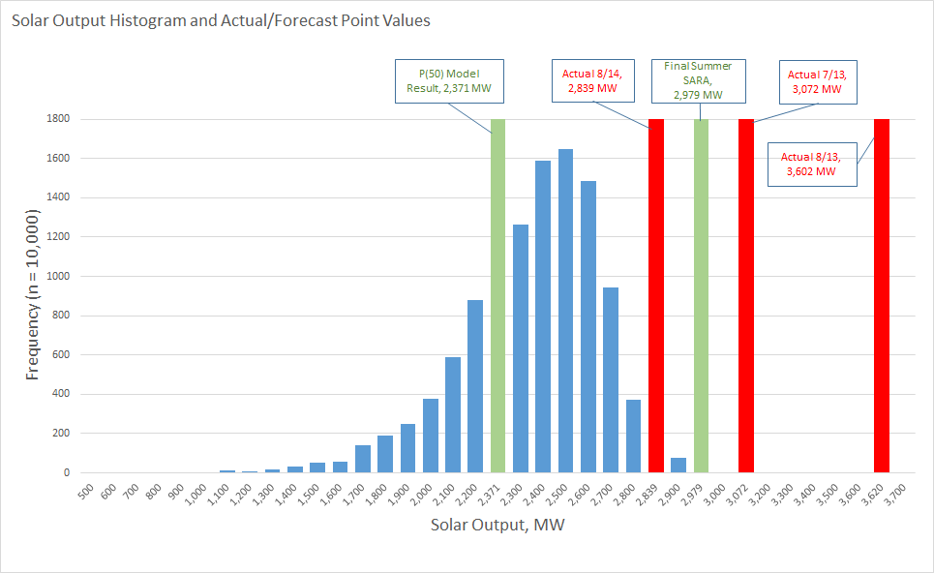
Histogram, Solar Results vs. Actuals, HE1700

Slide 18
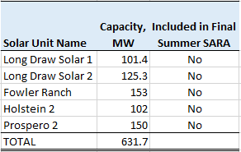
Anticipating Synchronization-approved Units
The following five solar units were synchronized and operating by the summer peak load week, but were not expected to be available based on developer information as of Spring 2020
Ran a simulation with an updated solar output distribution that includes these units

Slide 19
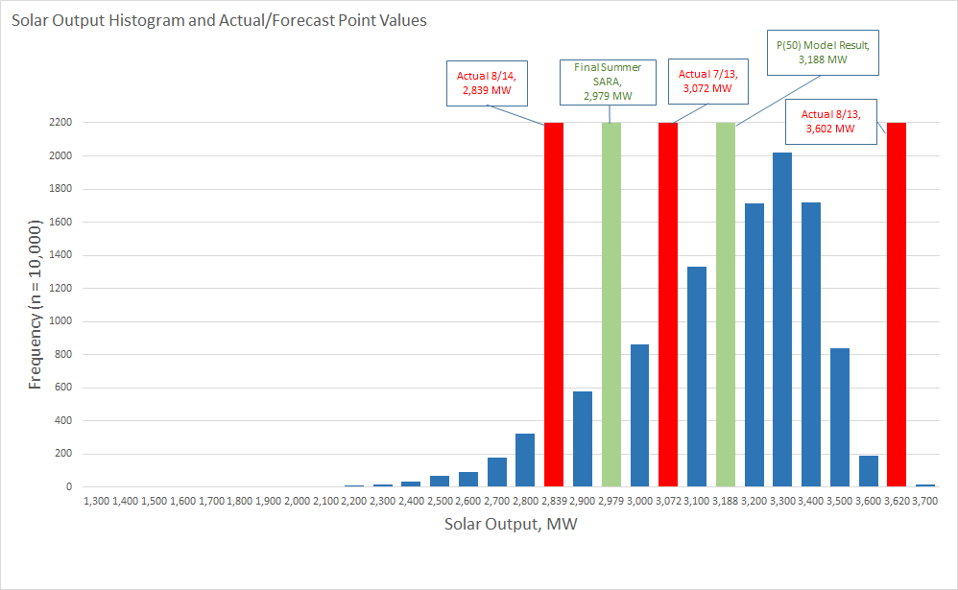
Histogram, Updated Solar Results vs. Actuals, HE1700
Updated solar distribution resulted in a 686 MW increase in Capacity Available for Operating Reserves

Slide 20
Thermal Forced Outage Estimation Performance Analysis

Slide 21
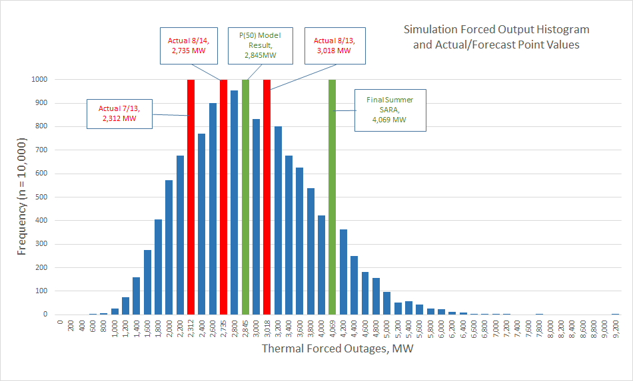
Histogram, Thermal Forced Outage Results vs. Actuals, HE1700

Slide 22
Private Use Network (PUN) Injection Estimation Performance Analysis

Slide 23
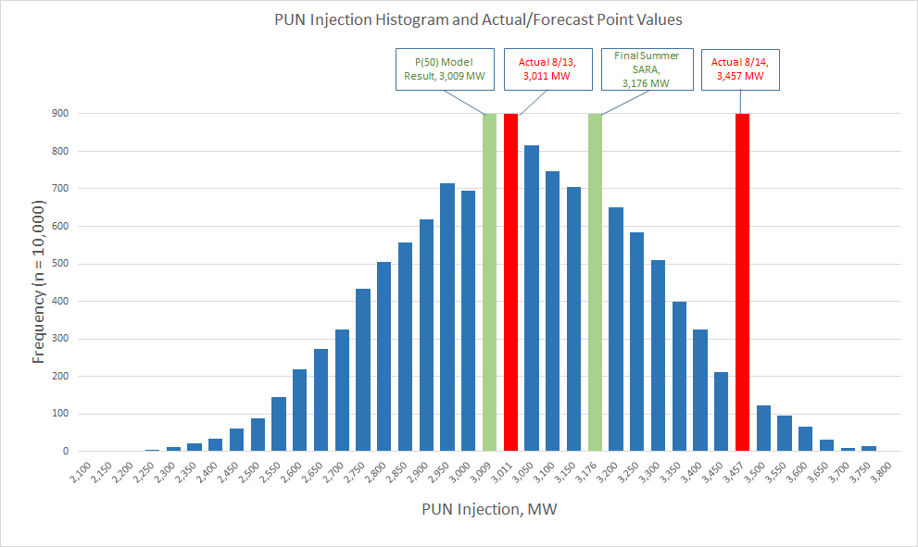
Histogram, PUN Injection Results vs. Actuals, HE1700

Slide 24
Conclusions and Findings

Slide 25
General Conclusions and Findings
As a proof-of-concept effort, satisfied with overall model performance based on a limited set of observed results
Summer peak load forecast accuracy was an issue for both the SARA and probabilistic model
For wind output, large forecast errors (when comparing the 50th percentile results to actual hourly values) are unavoidable when predicting several months in advance; nevertheless, modeling refinements can marginally reduce forecast error
Thermal forced outage and PUN injection modeling produces satisfactory results

Slide 26
General Conclusions and Findings, continued
Solar output prediction was adversely impacted by unexpected changes in operational availability of planned projects; in this case, projects approved for synchronization sooner than predicted
  Updating the planned resource data closer to the forecasted summer peak demand period may help to mitigate this issue

Slide 27
Next Steps
To assess EEA level 1 simulation performance, the model inputs will be modified to match the 2019 final summer SARA results; comparison to LFC results for the 8/13/2019 and 8/15/2019 EEA1 days will be made
Look into stakeholder recommendations for further validation efforts
Strategy and direction for the Probabilistic SARA model will be discussed at an executive level in December
Discuss potential wind and solar long-term probabilistic forecasting improvements with UL (our wind/solar output profile developer)

