Slide 1
Storage Historic Capacity Contribution Analysis
Battery Request For Information
New Battery Report
11/19/2020

Slide 2
Installed Capacity and Duration of the Batteries Included in Analysis
Resource Name | Unit Code | Installed Capacity, MW | Duration*, Hours | Operation Start
Notrees Battery Facility | NWF_NBS | 36 | 0.4 | 1/21/2013
OCI Alamo 1 | OCI_ALM1_ASTRO1 | 1 | 0.3 | 1/27/2016
TOS Battery Storage | TOSBATT_UNIT1 | 2 | N/A | 3/31/2017
Blue Summit Battery | BLSUMMIT_BATTERY | 30 | 0.4 | 8/11/2017
Inadale ESS | INDL_ESS | 9.9 | 1 | 1/3/2018
Pyron ESS | PYR_ESS | 9.9 | 1 | 1/4/2018
Castle Gap Battery | CASL_GAP_BATTERY1 | 9.9 | 4.2 | 12/31/2018
Rabbit Hill ESS | RHESS2_ESS_1 | 9.9 | N/A | 7/1/2019
West Columbia Storage | WCOLLDG_BSS_U1 | 9.9 | N/A | 8/2/2019
Worsham Battery | WRSBES_BESS1 | 9.9 | N/A | 8/28/2019
Flat Top Battery | FLTBES_BESS1 | 9.9 | N/A | 9/1/2019
Port Lavaca | PTLBES_BESS1 | 9.9 | N/A | 11/15/2019
* Duration is calculated based on Nameplate Capacity MW and Nameplate Energy Capacity MWh in Form EIA-860 2019
Notes:
US Energy Information Administration in the survey Form EIA-860 collects generator-level specific information about existing and planned generators and associated environmental equipment at electric power plants with 1 megawatt or greater of combined nameplate capacity
2019 EIA 860 form includes only generators that went into operation before 2019

Slide 3
Capacity Contribution over 20 Peak Load Hours, 2020
 | Unit 1 | Unit 2 | Unit 3 | Unit 4 | Unit 5 | Unit 6 | Unit 7 | Unit 8 | Unit 9 | Unit 10 | Unit 11 | Unit 12 | Load
13-Jul-20 15:00 | 6% | 3% | 3% | 4% | 3% | 7% | 0% | 0% | 0% | 1% | 0% | 0% | 73,668
13-Jul-20 16:00 | 19% | 0% | 10% | 4% | 12% | 14% | 50% | 1% | 1% | 3% | 1% | 1% | 74,225
13-Jul-20 17:00 | 8% | 0% | 4% | 1% | 5% | 9% | 83% | 1% | 1% | 1% | 1% | 0% | 74,311
13-Jul-20 18:00 | 9% | 0% | 5% | 13% | 6% | 10% | 54% | 0% | 0% | 1% | 0% | 0% | 74,001
16-Jul-20 17:00 | 13% | 10% | 7% | 10% | 8% | 14% | 0% | 0% | 0% | 1% | 0% | 0% | 73,699
12-Aug-20 16:00 | 6% | 6% | 3% | 9% | 6% | 5% | 49% | 0% | 0% | 1% | 0% | 7% | 74,046
12-Aug-20 17:00 | 0% | 6% | 2% | 6% | 0% | 1% | 0% | 1% | 0% | 1% | 0% | 3% | 74,072
12-Aug-20 18:00 | 14% | 12% | 7% | 12% | 13% | 11% | 0% | 0% | 1% | 2% | 0% | 1% | 73,706
13-Aug-20 15:00 | 11% | 11% | 6% | 11% | 10% | 9% | 99% | 0% | 0% | 1% | 0% | 1% | 73,625
13-Aug-20 16:00 | 9% | 7% | 5% | 7% | 8% | 5% | 100% | 0% | 0% | 0% | 0% | 0% | 74,153
13-Aug-20 17:00 | 3% | 8% | 4% | 8% | 8% | 1% | 100% | 1% | 1% | 3% | 1% | 1% | 74,328
13-Aug-20 18:00 | 3% | 3% | 2% | 3% | 3% | 3% | 0% | 0% | 1% | 2% | 0% | 1% | 74,053
14-Aug-20 16:00 | 3% | 3% | 2% | 6% | 3% | 3% | 100% | 3% | 0% | 20% | 0% | 0% | 74,008
14-Aug-20 17:00 | 0% | 0% | 0% | 4% | 0% | 0% | 67% | 8% | 0% | 6% | 0% | 0% | 74,294
14-Aug-20 18:00 | 16% | 15% | 8% | 15% | 15% | 12% | 0% | 0% | 1% | 2% | 1% | 1% | 74,091
15-Aug-20 18:00 | 14% | 16% | 8% | 16% | 13% | 7% | 0% | 3% | 1% | 3% | 1% | 0% | 73,808
16-Aug-20 18:00 | 8% | 8% | 4% | 8% | 7% | 7% | 8% | 1% | 1% | 1% | 1% | 0% | 73,503
28-Aug-20 15:00 | 10% | 10% | 8% | 10% | 4% | 3% | 97% | 0% | 1% | 2% | 1% | 16% | 73,770
28-Aug-20 16:00 | 0% | 0% | 0% | 0% | 0% | 0% | 93% | 0% | 0% | 1% | 0% | 25% | 74,323
28-Aug-20 17:00 | 3% | 2% | 2% | 3% | 2% | 4% | 53% | 1% | 1% | 2% | 1% | 16% | 74,113
Avg. Contribution | 8% | 6% | 4% | 8% | 6% | 6% | 48% | 1% | 1% | 3% | 1% | 4%
*Green color correspond to the lowest contribution, while red corresponds to the highest

Slide 4
AS Responsibility as Percentage of Capacity over 20 Peak Load Hours, 2020
 | Unit 1 | Unit 2 | Unit 3 | Unit 4 | Unit 5 | Unit 6 | Unit 8 | Unit 9 | Unit 10 | Unit 11 | Unit 12
 | Avg. FRRS | Avg. FRRS | Avg. FRRS | Avg. FRRS | Avg. FRRS | Avg. FRRS | Avg. RRS | Avg. RRS | Avg. RRS | Avg. RRS | Avg. RRS
13-Jul-20 15:00 | 92% | 92% | 47% | 100% | 60% | 100% | 75% | 98% | 100% | 48% | 49%
13-Jul-20 16:00 | 92% | 92% | 47% | 100% | 60% | 100% | 75% | 98% | 100% | 48% | 49%
13-Jul-20 17:00 | 92% | 92% | 47% | 100% | 60% | 100% | 75% | 98% | 100% | 48% | 49%
13-Jul-20 18:00 | 92% | 92% | 47% | 100% | 60% | 100% | 75% | 98% | 100% | 48% | 49%
16-Jul-20 17:00 | 92% | 92% | 47% | 92% | 60% | 90% | 100% | 98% | 90% | 75% | 98%
12-Aug-20 16:00 | 93% | 92% | 47% | 92% | 90% | 70% | 100% | 98% | 100% | 100% | 73%
12-Aug-20 17:00 | 92% | 92% | 47% | 92% | 90% | 70% | 100% | 98% | 100% | 100% | 73%
12-Aug-20 18:00 | 92% | 92% | 47% | 92% | 90% | 70% | 100% | 98% | 100% | 100% | 73%
13-Aug-20 15:00 | 92% | 91% | 49% | 91% | 90% | 70% | 100% | 98% | 100% | 100% | 73%
13-Aug-20 16:00 | 92% | 92% | 47% | 92% | 90% | 70% | 100% | 98% | 100% | 100% | 73%
13-Aug-20 17:00 | 92% | 92% | 47% | 92% | 90% | 70% | 100% | 98% | 100% | 100% | 73%
13-Aug-20 18:00 | 92% | 92% | 47% | 92% | 90% | 70% | 100% | 98% | 100% | 100% | 73%
14-Aug-20 16:00 | 92% | 92% | 47% | 92% | 90% | 70% | 77% | 98% | 0% | 100% | 98%
14-Aug-20 17:00 | 92% | 92% | 47% | 92% | 90% | 70% | 75% | 98% | 0% | 100% | 98%
14-Aug-20 18:00 | 92% | 92% | 47% | 92% | 90% | 70% | 75% | 98% | 0% | 100% | 98%
15-Aug-20 18:00 | 93% | 93% | 47% | 93% | 90% | 45% | 75% | 98% | 100% | 100% | 98%
16-Aug-20 18:00 | 92% | 92% | 47% | 92% | 90% | 70% | 100% | 98% | 100% | 74% | 99%
28-Aug-20 15:00 | 93% | 92% | 49% | 92% | 50% | 75% | 75% | 98% | 100% | 100% | 49%
28-Aug-20 16:00 | 93% | 93% | 47% | 93% | 50% | 75% | 75% | 98% | 100% | 100% | 49%
28-Aug-20 17:00 | 93% | 93% | 47% | 93% | 50% | 75% | 75% | 98% | 100% | 100% | 49%
Average | 93% | 92% | 47% | 94% | 77% | 77% | 86% | 98% | 84% | 87% | 72%

Slide 5
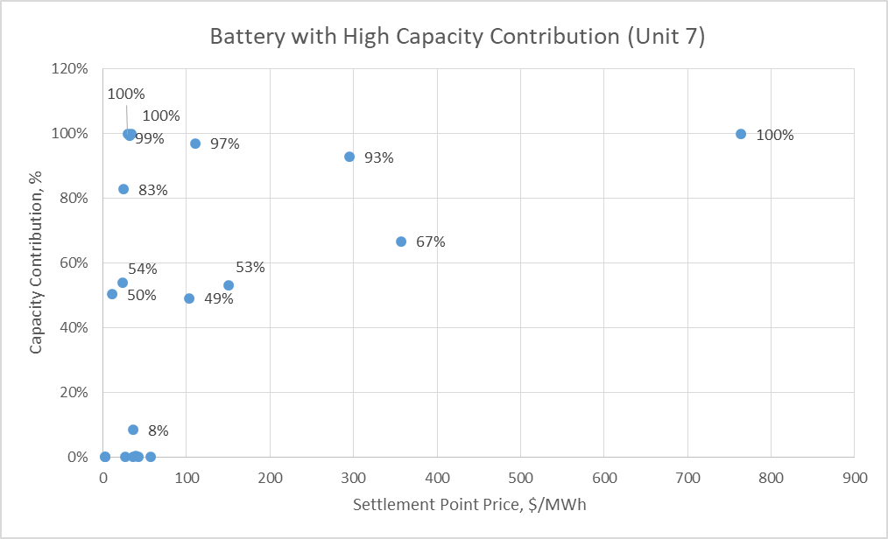
Capacity Contribution as a Function of SPP (over 20 peak load hours), 2020

Slide 6
Capacity Contribution over 20 Peak Load Hours, 2019
 | Unit 1 | Unit 2 | Unit 3 | Unit 4 | Unit 5 | Unit 6 | Unit 7 | Load
07-Aug-19 16:00 | 8% | 7% | 3% | 7% | 8% | 10% | 71% | 73,150
07-Aug-19 17:00 | 0% | 0% | 0% | 0% | 0% | 0% | 0% | 72,928
09-Aug-19 15:00 | 8% | 7% | 3% | 7% | 7% | 9% | 83% | 72,948
09-Aug-19 16:00 | 11% | 9% | 4% | 9% | 11% | 14% | 15% | 73,143
12-Aug-19 14:00 | 9% | 7% | 0% | 7% | 6% | 0% | 90% | 73,313
12-Aug-19 15:00 | 0% | 3% | 0% | 3% | 3% | 0% | 83% | 74,330
12-Aug-19 16:00 | 9% | 8% | 0% | 8% | 8% | 0% | 74% | 74,666
12-Aug-19 17:00 | 0% | 3% | 0% | 3% | 0% | 0% | 33% | 74,525
12-Aug-19 18:00 | 6% | 9% | 0% | 6% | 6% | 0% | 0% | 73,635
13-Aug-19 14:00 | 7% | 7% | 0% | 7% | 7% | 1% | 100% | 73,455
13-Aug-19 15:00 | 9% | 9% | 0% | 9% | 9% | 0% | 100% | 74,302
13-Aug-19 16:00 | 3% | 3% | 0% | 3% | 3% | 1% | 87% | 74,293
13-Aug-19 17:00 | 3% | 0% | 0% | 0% | 0% | 0% | 5% | 74,059
19-Aug-19 15:00 | 5% | 3% | 0% | 3% | 5% | 0% | 47% | 73,794
19-Aug-19 16:00 | 11% | 8% | 0% | 8% | 11% | 0% | 8% | 73,871
19-Aug-19 17:00 | 9% | 9% | 0% | 9% | 9% | 0% | 0% | 73,382
26-Aug-19 15:00 | 5% | 1% | 6% | 1% | 0% | 9% | 0% | 73,947
26-Aug-19 16:00 | 0% | 3% | 0% | 3% | 0% | 0% | 0% | 74,433
26-Aug-19 17:00 | 3% | 3% | 2% | 3% | 0% | 3% | 0% | 74,264
26-Aug-19 18:00 | 7% | 5% | 2% | 4% | 5% | 0% | 0% | 73,213
Average Contribution | 6% | 5% | 1% | 5% | 5% | 2% | 40%

Slide 7
AS Responsibility as Percentage of Capacity over 20 Peak Load Hours, 2019
 | Unit 1 | Unit 2 | Unit 3 | Unit 4 | Unit 5 | Unit 6
 | Avg. FRRS | Avg. FRRS | Avg. FRRS | Avg. FRRS | Avg. FRRS | Avg. FRRS
07-Aug-19 16:00 | 100% | 100% | 36% | 100% | 100% | 100%
07-Aug-19 17:00 | 100% | 100% | 36% | 100% | 100% | 100%
09-Aug-19 15:00 | 100% | 100% | 36% | 100% | 100% | 100%
09-Aug-19 16:00 | 100% | 100% | 36% | 100% | 100% | 100%
12-Aug-19 14:00 | 100% | 100% | 42% | 100% | 100% | 0%
12-Aug-19 15:00 | 100% | 100% | 42% | 100% | 100% | 0%
12-Aug-19 16:00 | 100% | 100% | 42% | 100% | 100% | 0%
12-Aug-19 17:00 | 100% | 100% | 42% | 100% | 100% | 0%
12-Aug-19 18:00 | 100% | 100% | 42% | 100% | 100% | 0%
13-Aug-19 14:00 | 100% | 100% | 42% | 100% | 100% | 0%
13-Aug-19 15:00 | 100% | 100% | 42% | 100% | 100% | 0%
13-Aug-19 16:00 | 100% | 100% | 42% | 100% | 100% | 0%
13-Aug-19 17:00 | 100% | 100% | 42% | 100% | 100% | 0%
19-Aug-19 15:00 | 100% | 100% | 42% | 100% | 100% | 0%
19-Aug-19 16:00 | 100% | 100% | 42% | 100% | 100% | 0%
19-Aug-19 17:00 | 100% | 100% | 42% | 100% | 100% | 0%
26-Aug-19 15:00 | 79% | 80% | 67% | 0% | 80% | 100%
26-Aug-19 16:00 | 79% | 80% | 67% | 0% | 80% | 80%
26-Aug-19 17:00 | 79% | 80% | 67% | 0% | 80% | 80%
26-Aug-19 18:00 | 100% | 98% | 44% | 100% | 98% | 0%
Average | 97% | 97% | 44% | 85% | 97% | 33%

Slide 8
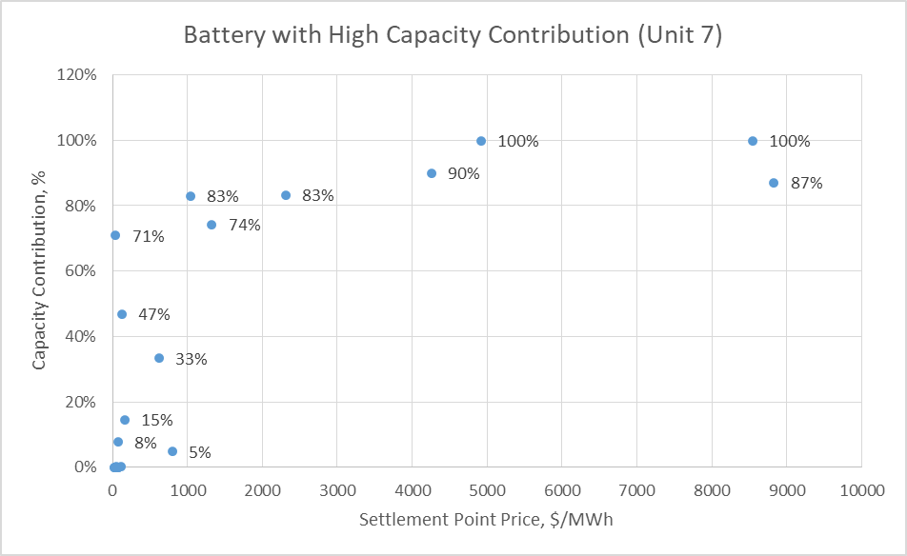
Capacity Contribution as a Function of SPP (over 20 peak load hours), 2019

Slide 9
Conclusions / Recommendations
Status | Duration | Historically only providing AS? | Capacity contribution (%)
Operational | <4 hours | Yes | 0%
Operational | <4 hours | No | % based on historic performance
Operational | 4+ hours | Yes | % based on historic average AS responsibility
Operational | 4+ hours | No | % based on historic performance
Planned | <4 hours | N/A | 0%
Planned | 4+ hours | N/A | Use same % as operational 4+ hour batteries providing energy

Slide 10
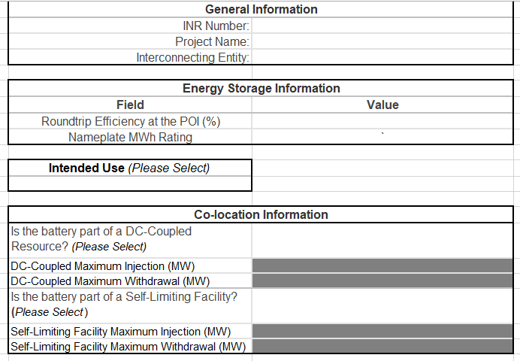
Request for Information
ERCOT does not have information on roundtrip efficiency, energy capacity MWh or if a battery is a part of Self-Limiting Facility (NPRR1026) or DC-Coupled Resource (NPRR1029)
Until approval of RRGRR023 and its implementation and in RIOO, ERCOT plans to collect this information via RFI
For planned projects, RFI data submission form to be submitted via RIOO-IS as an Excel file upload once an IA is signed
ERCOT will also send the RFI to REs with existing operational batteries
Notes:
NPRR1026 and NPRR1029 are at TAC for consideration

Slide 11
Reporting of DC-Coupled and Self-Limiting Facilities in GIS
NPRR1026, PGRR081, NPRR1029 and RRGRR023 related to Self-Limiting Resources, Self-Limiting Facilities and DC-Coupled Resources are currently at TAC for consideration.
RIOO currently does not have capability to explicitly capture Self-Limiting Facilities, Self-Limiting Resources or DC-Coupled Resources and their MW limits during the registration process.
Until approval and implementation of RRGRR023 in RIOO, ERCOT will use an approach similar to re-powers to track DC-Coupled Resources, Self-Limiting Resource and Facilities MW limit.

Slide 12
Reporting of Self-Limiting Facilities in GIS, Based on RI Proposal
To aid the GIS Report, a standard naming convention will be used for proposed Self-Limiting Facilities: [Common Name][space][“Solar” or “Storage”][space][“SLF”]
For Self-Limiting Facilities, whose total MW rating is equal to the rating of the non-battery resource (e.g. PVGR, WGR, etc.):
  The non-battery resource’s ratings in RIOO will be its true Maximum MW and Maximum Summer/Winter MW.
  The battery’s Maximum MW in RIOO will be its true rating, while Maximum Summer/Winter MW set to 0.
For Self-Limiting Facilities whose MW rating is higher than the rating of the non-battery resource:
  The non-battery resource’s ratings in RIOO will be its true Maximum MW and Maximum Summer/Winter MW.
  The battery’s Maximum MW in RIOO will be its true capacity, while Maximum Summer/Winter MW will be non-zero to reflect the MW needed to meet the intended Self-Limit.
Same approach will be used for DC-Coupled Resources.
GIS Report logic that handles re-powers uses both Maximum MW and Maximum Winter MW and thus will capture MW limit of Self-Limiting Resources, Self-Limiting Facilities and DC-Coupled Resources.

Slide 13
New Report on Batteries as a Supplement to GIS
As of October GIS there are 123 battery projects totaling 16,178 MW of capacity in the interconnection queue for which FIS has been requested.
  These are reported in detail in the GIS Project Details tab.
ERCOT has been asked to report on standalone batteries vs. batteries co-located with other Resources such as Solar, Wind, etc.
Currently there is nothing in RIOO that allows ERCOT to explicitly identify battery projects co-located with projects of a different resource type.
ERCOT currently manually identifies projects as co-located, if the projects have the same POI, the same IE or same parent company, and a similar name, e.g. XYZ Storage and XYZ Solar.

Slide 14
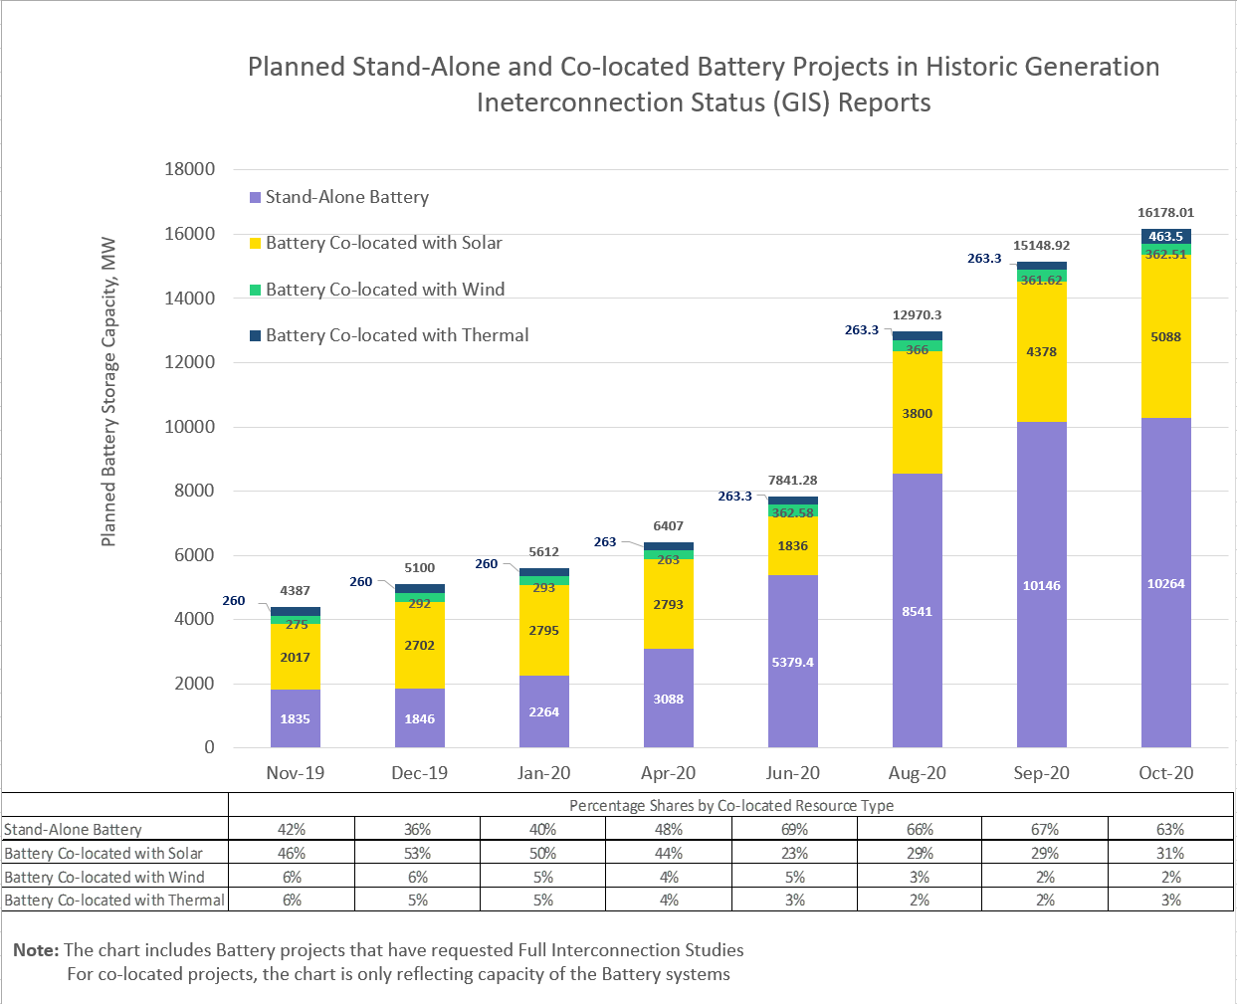
New Report on Batteries as a Supplement to GIS
Starting from November 2020 ERCOT publishes a battery report :
RPT.00015933.0000000000000000.Co-located_Battery_Identification_Report_Month_Year.xlsx.
The report parses battery projects from the Project Details tab of the GIS report into standalone, co-located with planned or operational Solar, Wind, or Thermal Resources.
Standalone batteries are listed in one tab.
If a battery is co-located with another Resource the report shows that Resource’s information as well on the respective tab.
The Report also includes a Summary and Historic GIS Trend

Slide 15

Thank you! Questions?
Julia Matevosyan
Julia.Matevosyan@ercot.com

