Slide 1
ERCOT Non-FME Frequency Events
October 2020
ERCOT
Operations Planning
PDCWG | November 17th, 2020

Slide 2
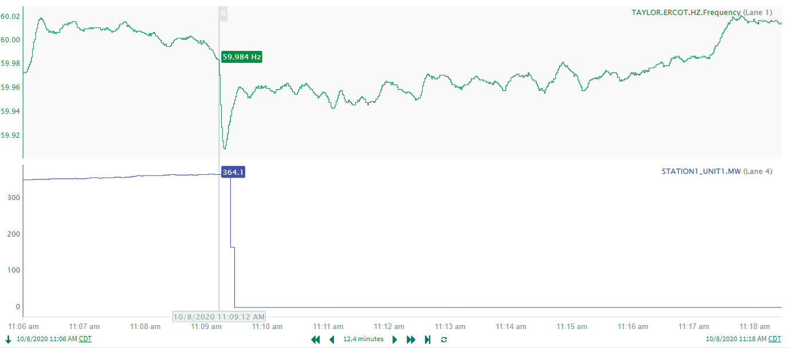
10/8/2020 11:09:12
Notes:
Resource tripped while carrying 365 MW.
Starting Frequency: 59.9840 Hz
Minimum Frequency: 59.909 Hz
A-C Time: 6 seconds
Recovery Time: 8 minutes and 9 seconds (no RRS or manual offset applied)
RRS Deployed: 0 MW
Trip Reason: Gas pressure issues
No Selection Reason: The event wasn’t large enough. Typically look for 550 MW of lost generation/load.

Slide 3
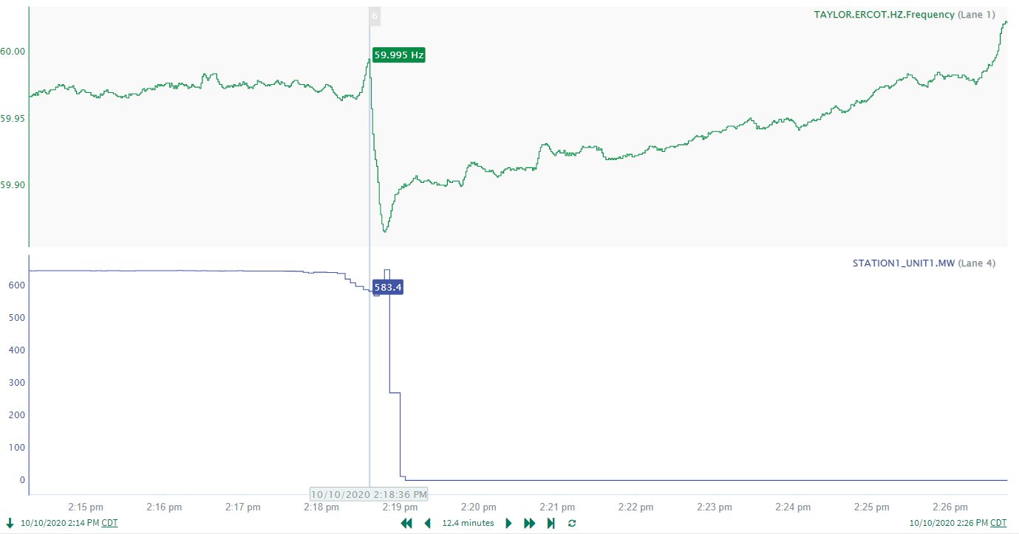
10/10/2020 14:18:36
Notes:
Resource experienced issues with the gas pressure while carrying about 645 MW. The resource tripped in segments.
Starting Frequency: 59.9950 Hz
Minimum Frequency: 59.8660 Hz
A-C Time: 12 seconds
Recovery Time: 6 minutes and 25 seconds
RRS Deployed: 974.50 MW
Trip Reason: gas pressure issues
No Selection Reason: Frequency fell to 59.965 Hz prior to the resource trip. The resource tripped in segments which elongated the A-C time.

Slide 4
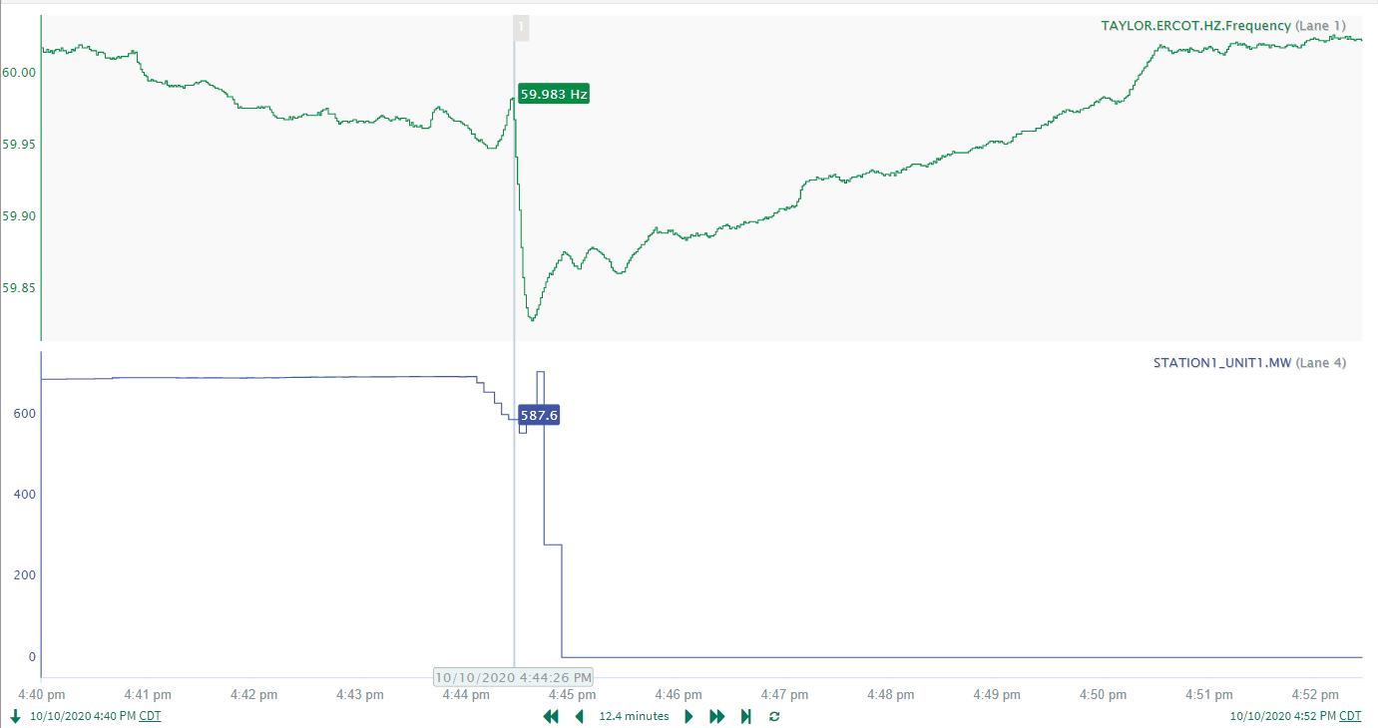
10/10/2020 16:44:26
Notes:
Resource experienced issues with the sites gas pipelines while carrying about 693 MW. The resource tripped in segments.
Starting Frequency: 59.9830 Hz
Minimum Frequency: 59.8280 Hz
A-C Time: 11 seconds
Recovery Time: 4 minutes and 43 seconds
RRS Deployed: 1150 MW
Trip Reason: Gas pipeline issues
No Selection Reason: Frequency was ramping down and was well below the lower dead-band prior to the resource tripping offline. The A-C time was also longer than the typical A-C time.

Slide 5
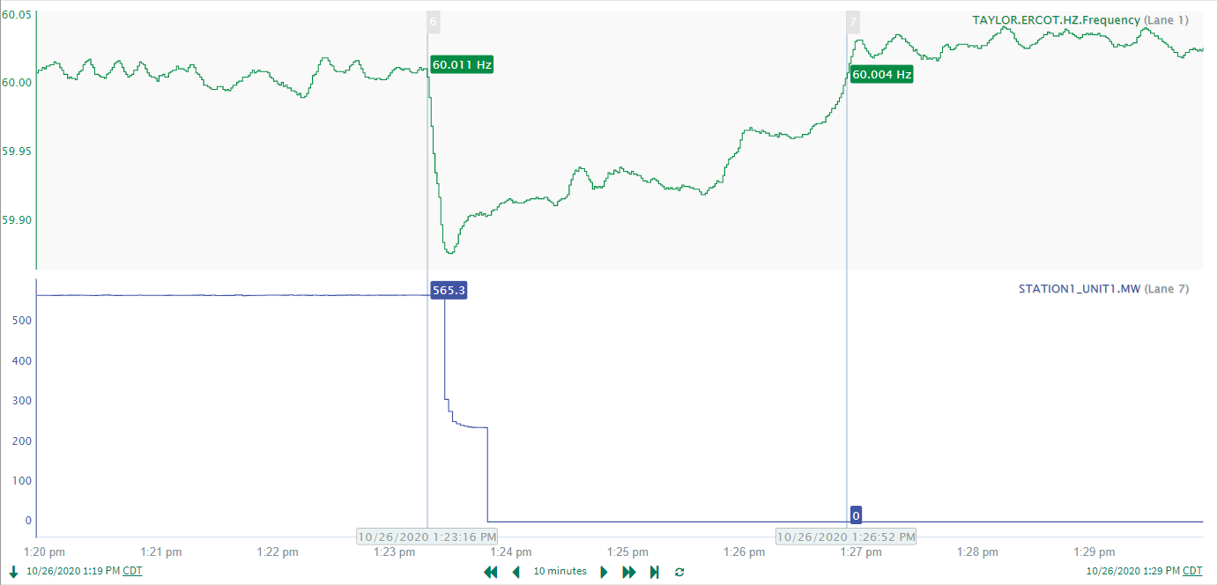
10/26/2020 13:23:17
Notes:
Resource experienced a complete trip while carrying 565.3 MW. The whole configuration did not trip immediately but rather in steps.
Starting Frequency: 60.008 Hz
Minimum Frequency: 59.8760 Hz
A-C Time: 12 seconds
Recovery Time: 3 minutes and 35 seconds
RRS Deployed: 606.1 MW
Trip Reason: Communication loss with Distributed Control System (DCS)
No Selection Reason: The resource trip was not clean and was longer than the typical A-C time

Slide 6
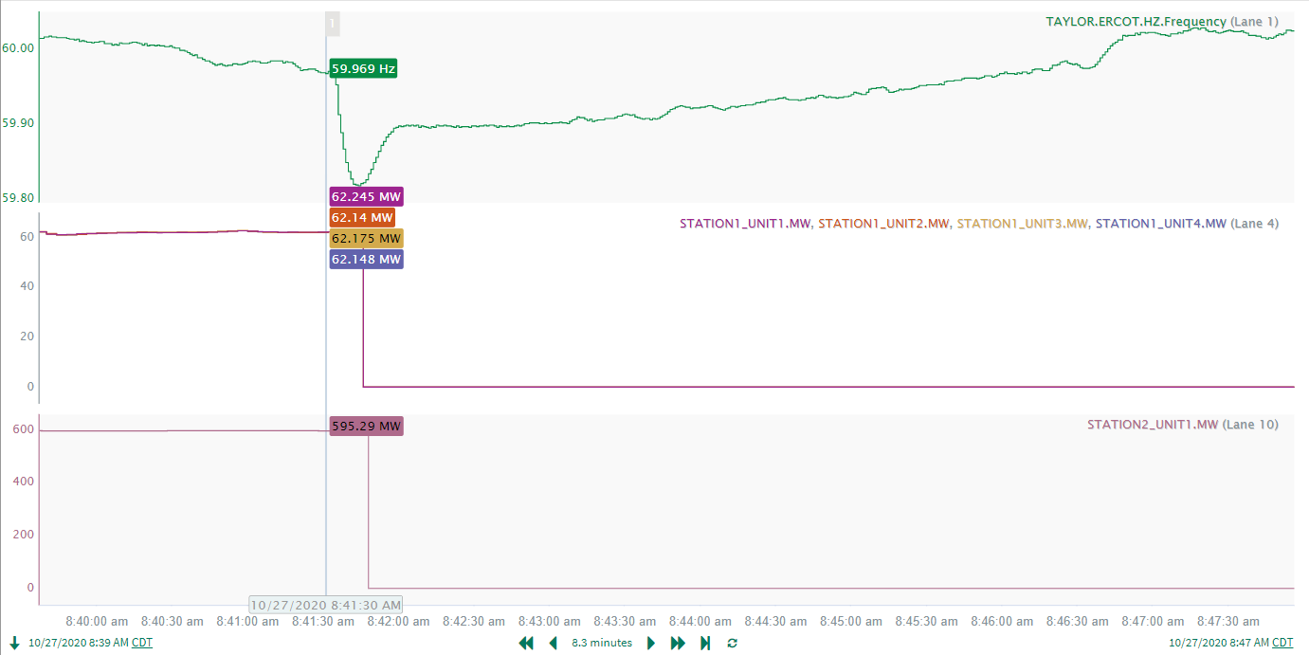
10/27/2020 08:41:34
Notes:
UNIT1, UNIT2, UNIT3, and UNIT4 at STATION1 tripped offline due to issues with the gas valve regulator (approx. loss of 250)
STATION2_UNIT1 tripped offline while carrying 595.3 MW due to filter issues
Starting Frequency: 59.9750 Hz
Minimum Frequency: 59.8180 Hz
RRS Deployed: 1150 MW
A-C Time: 10 seconds
Recovery Time: 4 minutes and 39 seconds (to dead-band), 5 minutes and 8 seconds (to 60 Hz)
No Selection Reason: Prior to resource trips, frequency fell below the lower dead-band with frequency reaching as low as 59.969 Hz. Initial observations suggest resource trips at STATION1 and STATION2 were independent of each other and did not occur simultaneously, which would explain the longer than typical A-C time.

Slide 7
Questions?
Thank you!

