Slide 1
Transmission Project Cost Comparison Improvement
PLWG
November 9, 2020

Slide 2
Background
For both reliability and economic projects, ERCOT compares the capital cost (overnight cost) of project options during the project alternative selection process, even when the alternatives utilize different technologies.
Different technologies have different life expectancies, e.g. a FACTS device is expected to be replaced sooner than an AC transmission line.
Thus, comparing the capital cost of project alternatives with different technologies is not an apples-apples comparison since alternatives with a shorter lifespan will have additional costs over the long term.

Slide 3
Solution: Modified Perpetual Lifetime Asset Cost¹
For convenience let’s define something called the Time Factor (Tf) to account for combined price escalation and discounting:
$$Tf=\frac{1+inflation rate}{1+discount rate}$$
Now let’s define something called the Replacement Factor, Rf, a closed-form factor that converts one life cycle to an infinite series (where LT is the life expectancy of the asset):
$$Rf=\frac{1}{{1−Tf}^{LT}}$$
The derivation of this factor is just algebra, representing an infinite series of x^{k} as 1/(1-x) if x<1. Here, x is Tf^LT.
1 Math from Jeffrey Roark, EPRI

Slide 4
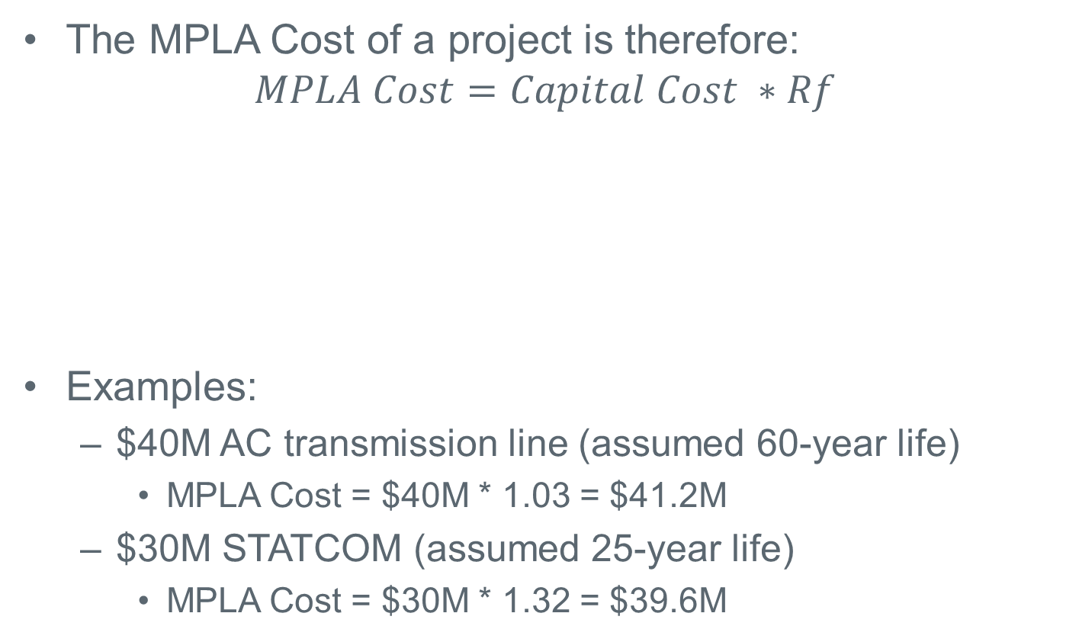
Modified Perpetual Lifetime Asset Cost
The MPLA Cost of a project is therefore:
$$MPLA Cost=Capital Cost ∗Rf$$
Examples:
$40M AC transmission line (assumed 60-year life)
MPLA Cost = $40M * 1.03 = $41.2M
$30M STATCOM (assumed 25-year life)
MPLA Cost = $30M * 1.32 = $39.6M
Project Life (Years) | 25 | 40 | 60
Rf* | 1.32 | 1.11 | 1.03
* Assumes 2% inflation rate and 8% discount rate

Slide 5
How Would ERCOT Apply This In Studies?
When comparing project alternatives, cost (and MPLA Cost) is one of many factors considered
ERCOT envisions using the Modified Perpetual Lifetime Asset Cost as an additional factor when comparing project alternatives with different technologies in an RPG project review or in the RTP
ERCOT would still use the cost estimate as a quantifiable comparison for project alternatives
Example:

Slide 6
Proposed Life Expectancies for MPLA Cost
Asset | Life Expectancy Assumption* (Years)
STATCOM or SVC | 25
HVDC Converter Station | 25
Transformer | 40
Substation Equipment | 40
Static Reactive Device | 40
Synchronous Condenser | 40
Transmission Line | 60
*Note: Life expectancies shown are assumed only for the purposes of calculating MPLA Cost to provide a reasonable comparative analysis of project alternatives and should not be used for other purposes. The actual life expectancy of a project depends on design, maintenance, and environmental exposure.

Slide 7
Next Steps
Please send me your comments: jbillo@ercot.com

Slide 8
Questions?

