Slide 1
NMMS Defects Update
MAGE Update
Network Modeling
10/20/2020

Slide 2
After Go-Live
After the MAGE update has gone live, it will be possible for users to update to the new version
Users will be prompted to update after opening MAGE for the first time after go live and must update
There are no changes to your digital certificate, it will function the same as before
The SGEM URL and Configuration will remain the same

Slide 3
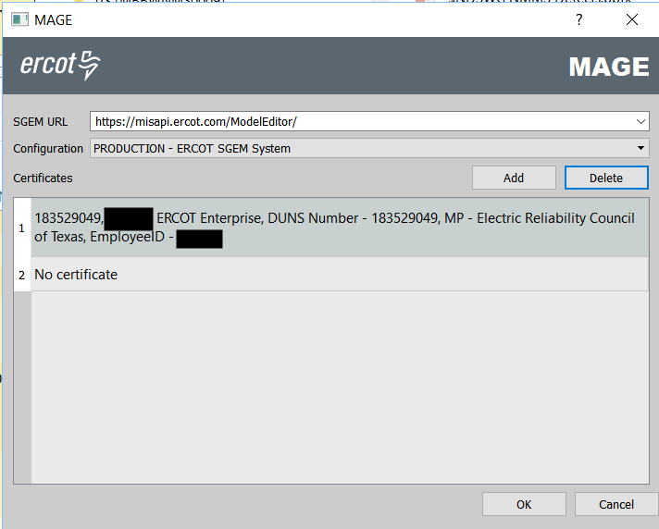
Initial Login
MAGE will look the same prior to updating

Slide 4
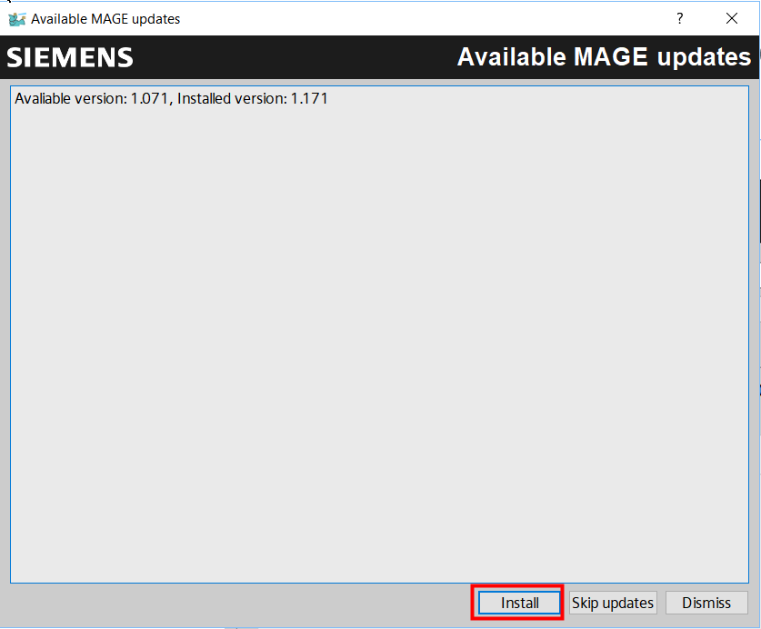
Update Prompt
After logging in – you will be prompted to update
You MUST click install updates
Note: There may or may not be more details under the updates – just install the updates

Slide 5
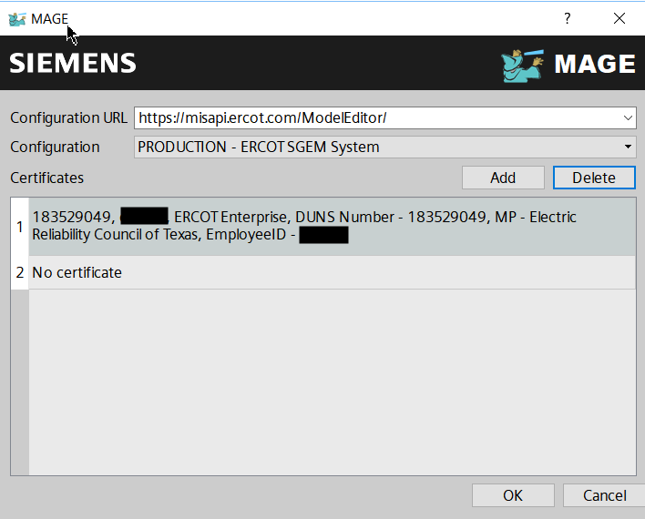
Post-Update
The initial MAGE login screen will look the same after the update

Slide 6
Changes In This Release
Purpose of this release is to fix defects that were left behind in the original SGEM release.
Minor changes to data submitter experience.

Slide 7
Release Date?
Originally planned for Oct 29.
Release date getting pushed out to a later date in 2020.
Do you all have preference for release date?
IT Related Issues?

Slide 8
Questions?
Email: NOMCRHelp@ercot.com

