Slide 1
PDCWG Report to ROS
Chair: Chad Mulholland, NRG
Vice Chair: Jimmy Jackson, CPS
ROS
November 5th, 2020

Slide 2
Report Overview & Notes
Report Overview
Meeting Minutes
BAL-001-TRE-2 FMEs & IMFR
1 FME in the month of August
1 FME in the month of September
Frequency Control Report

Slide 3
Meeting Minutes
PDCWG Meeting 10/14/2020
Southern Cross DC Tie – Directives 3 and 9
Draft Revision: ODBRR25 Procedure for Calculating RRS Limits for Units
Follow up – ERCOT 2020/2021 Ancillary Service Methodology & Analysis
NPRR 1040 – Compliance Metrics for Ancillary Service Supply Responsibility
ERCOT Reports and FME Discussion

Slide 4
Frequency Measurable Events Performance

Slide 5
Frequency Measurable Events
There was 1 FME in August and 1 FME in September
8/22/2020 23:46:53
Loss of 664 MW
Interconnection Frequency Response: 1383 MW/0.1 Hz
10 of 58 Evaluated Generation Resources had less than 75% of their expected Initial Primary Frequency Response.
10 of 58 Evaluated Generation Resources had less than 75% of their expected Sustained Primary Frequency Response.
9/19/2020 16:02:03
Loss of 493 MW
Interconnection Frequency Response: 978 MW/0.1 Hz
5 of 33 Evaluated Generation Resources had less than 75% of their expected Initial Primary Frequency Response.
6 of 33 Evaluated Generation Resources had less than 75% of their expected Sustained Primary Frequency Response.

Slide 6
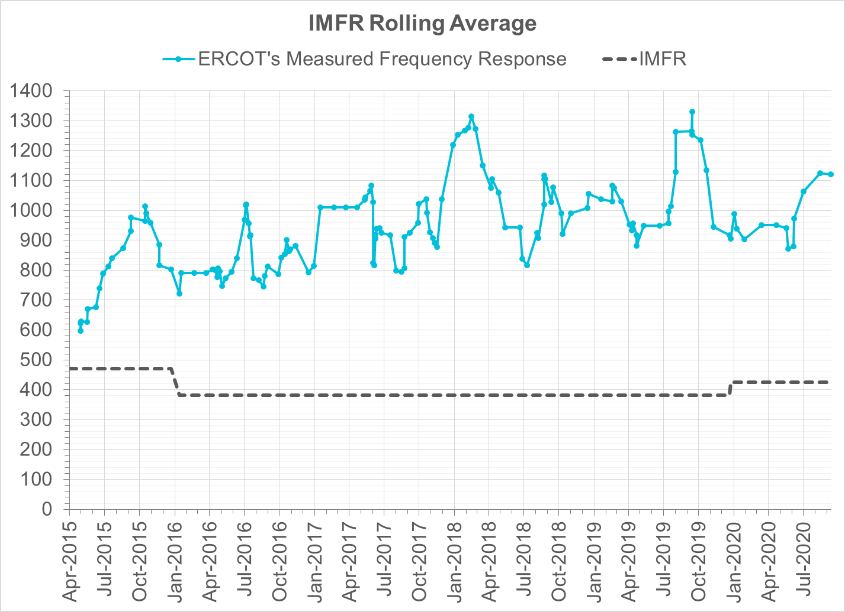
Interconnection Minimum Frequency Response (IMFR) Performance
IMFR Performance currently 1120.41 MW/0.1Hz
Frequency Response Obligation (FRO): 425 MW/0.1 Hz

Slide 7
Frequency Control Report
September 2020

Slide 8
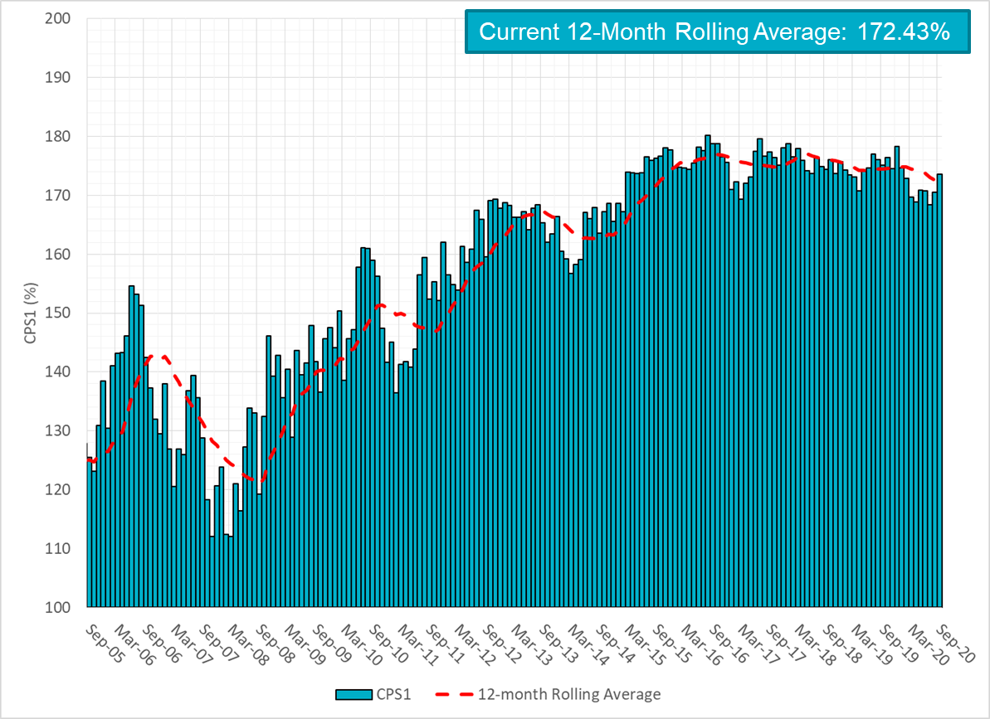
CPS1 Performance

Slide 9
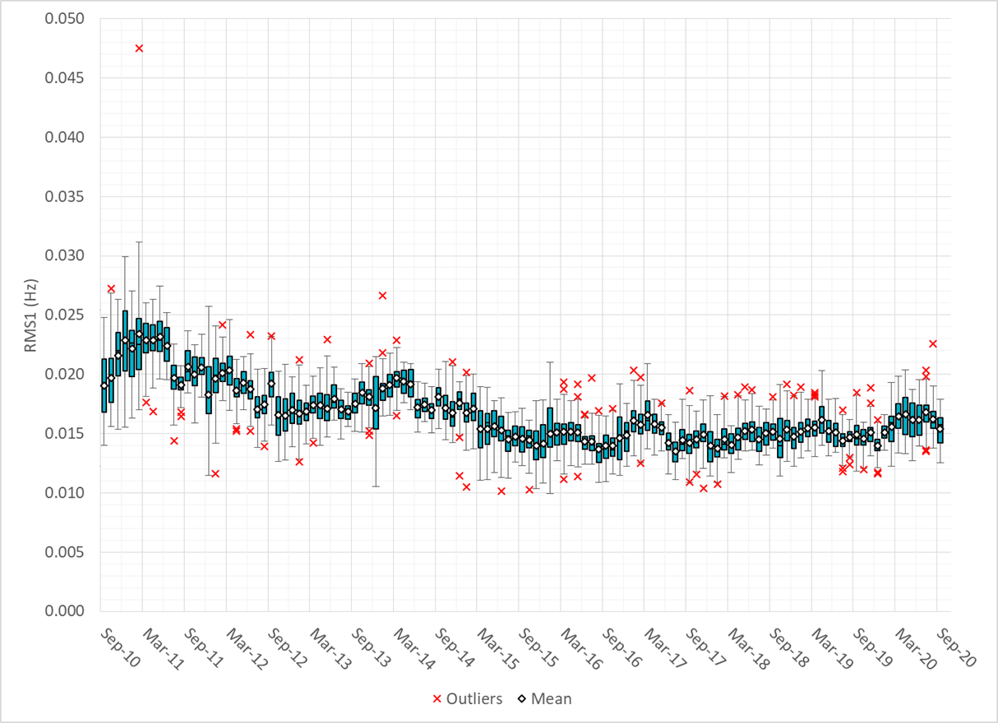
RMS1 Performance of ERCOT Frequency

Slide 10
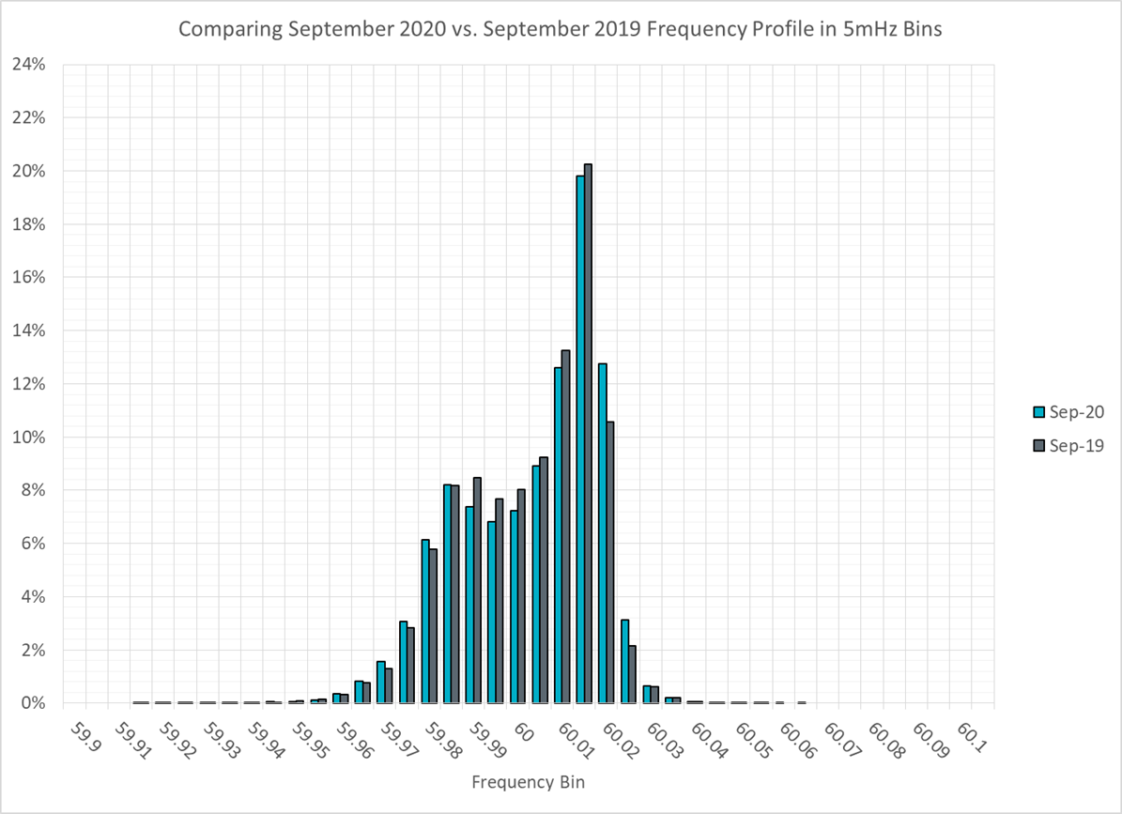
Frequency Profile Analysis

Slide 11
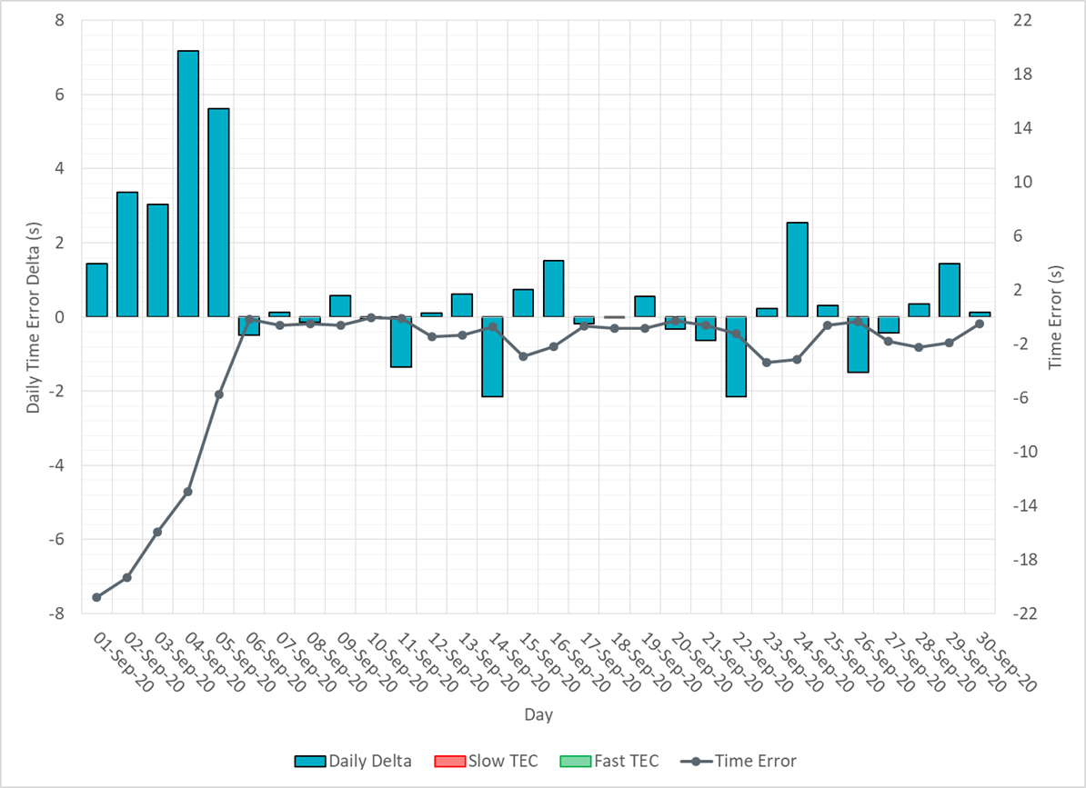
Time Error Corrections

Slide 12
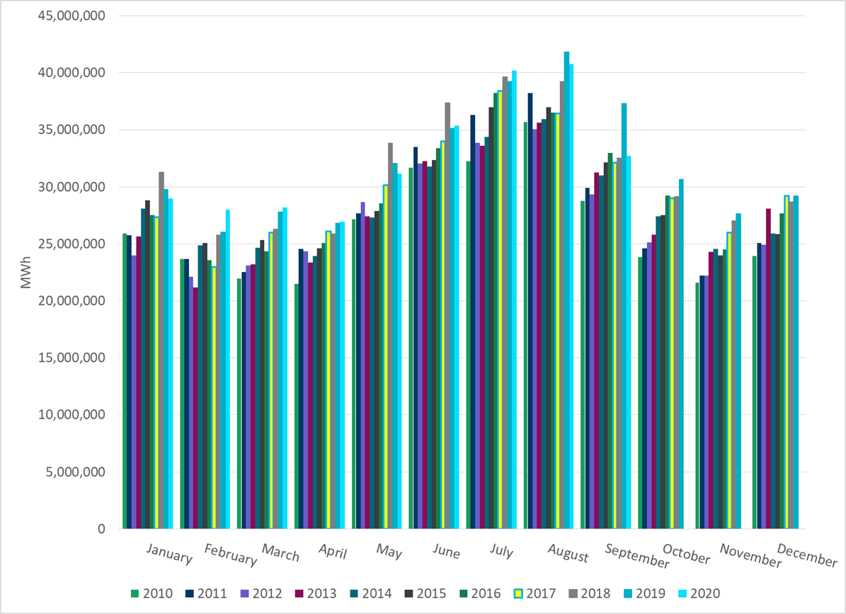
ERCOT Total Energy
Notes:
32,735,862 MWh

Slide 13
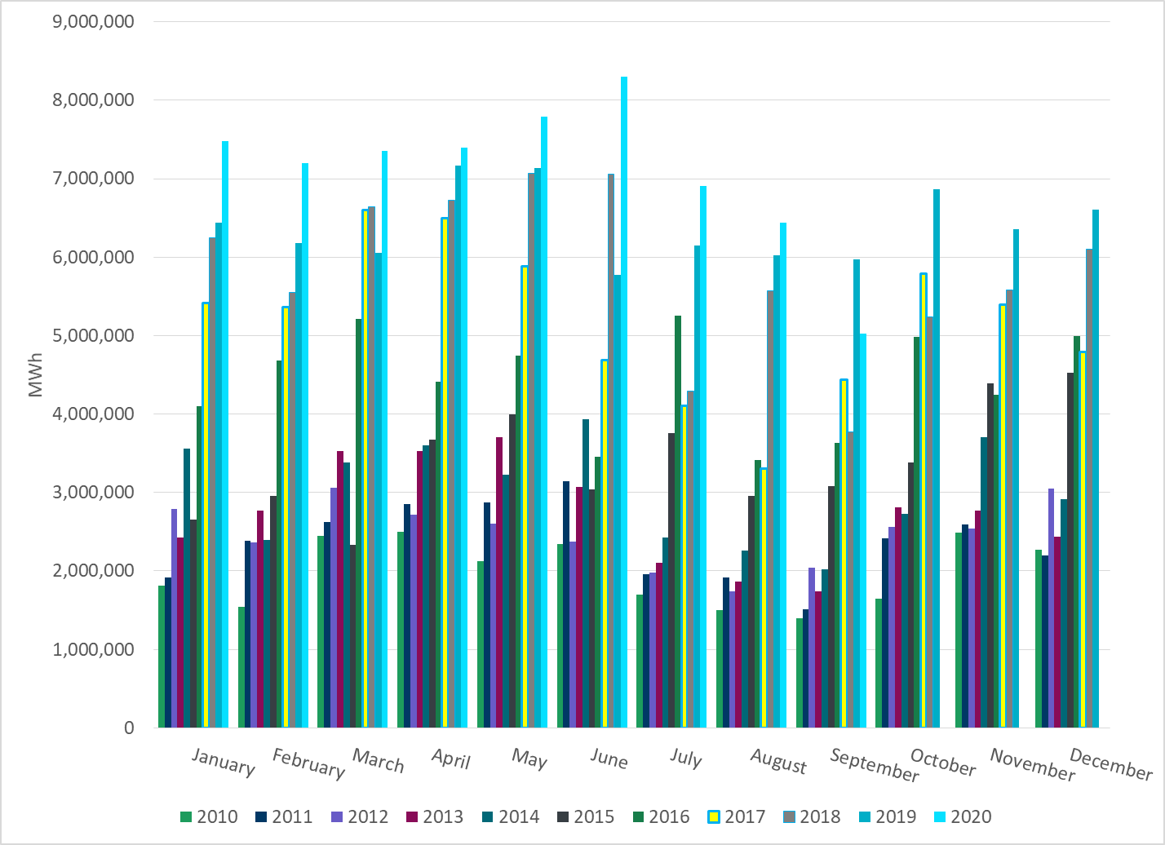
ERCOT Total Energy from Wind Generation
Notes:
5,026,960 MWh

Slide 14
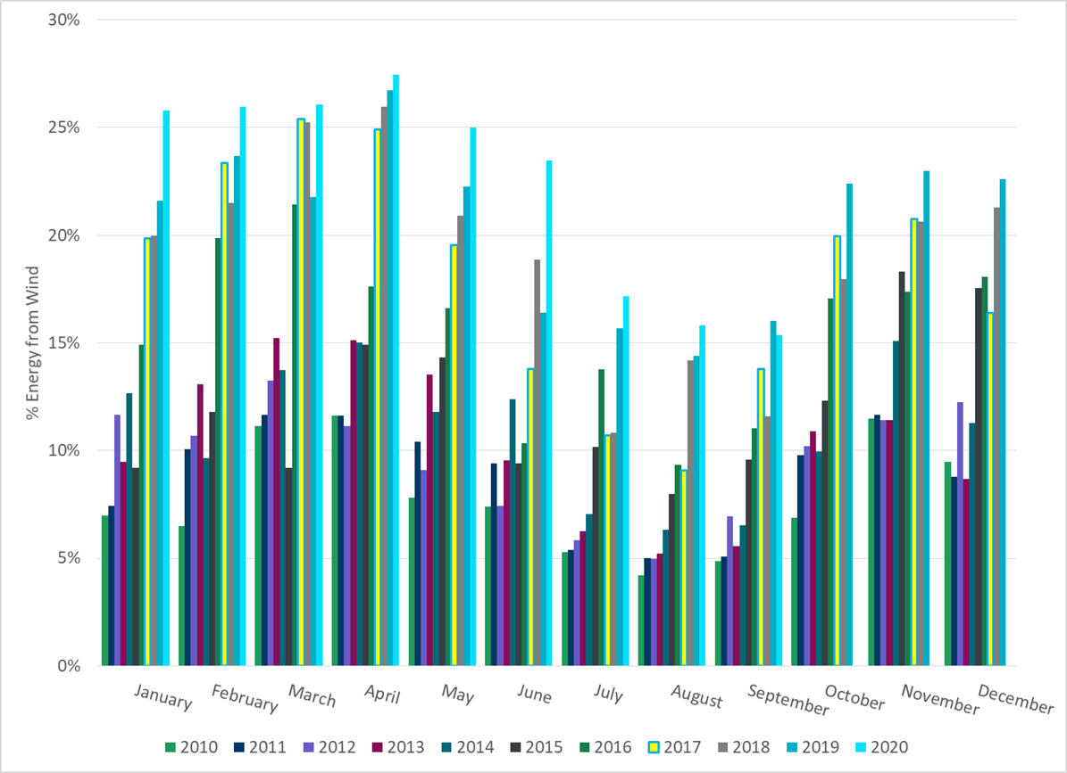
ERCOT % Energy from Wind Generation
Notes:
15.36%

Slide 15
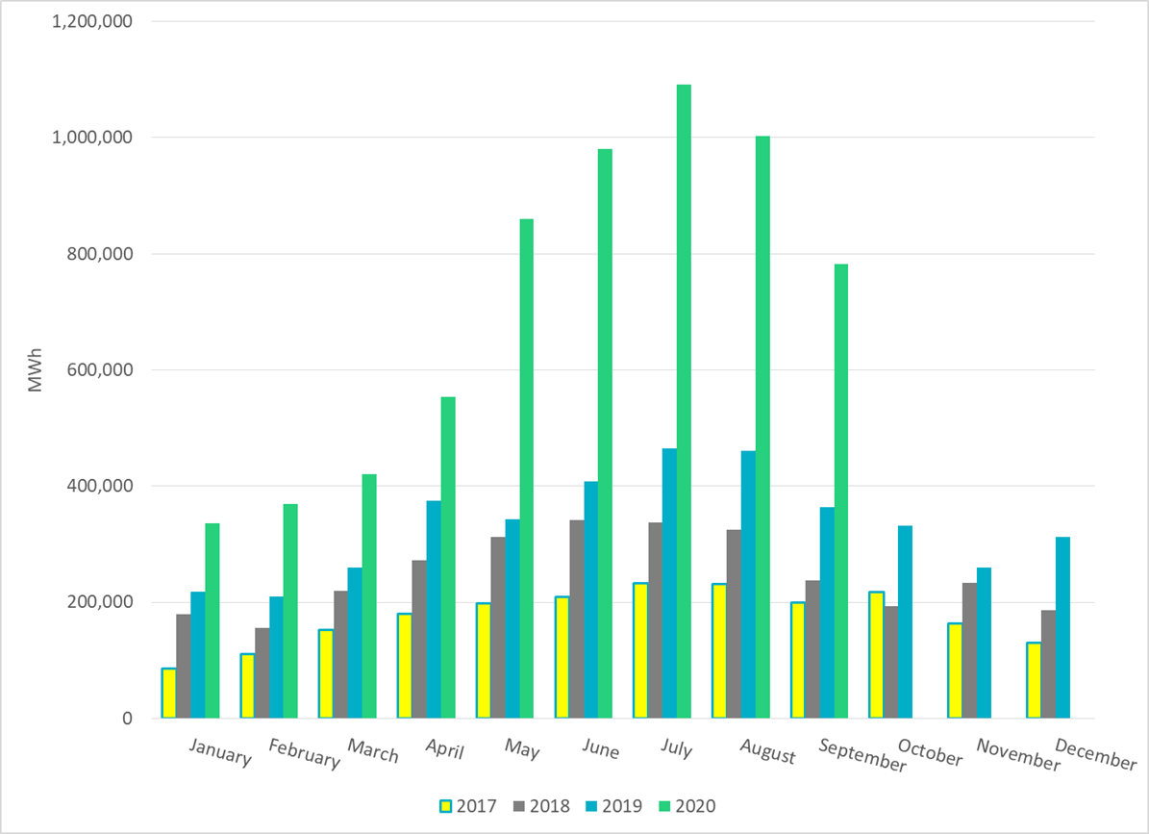
ERCOT Total Energy from Solar Generation
Notes:
782,376 MWh

Slide 16
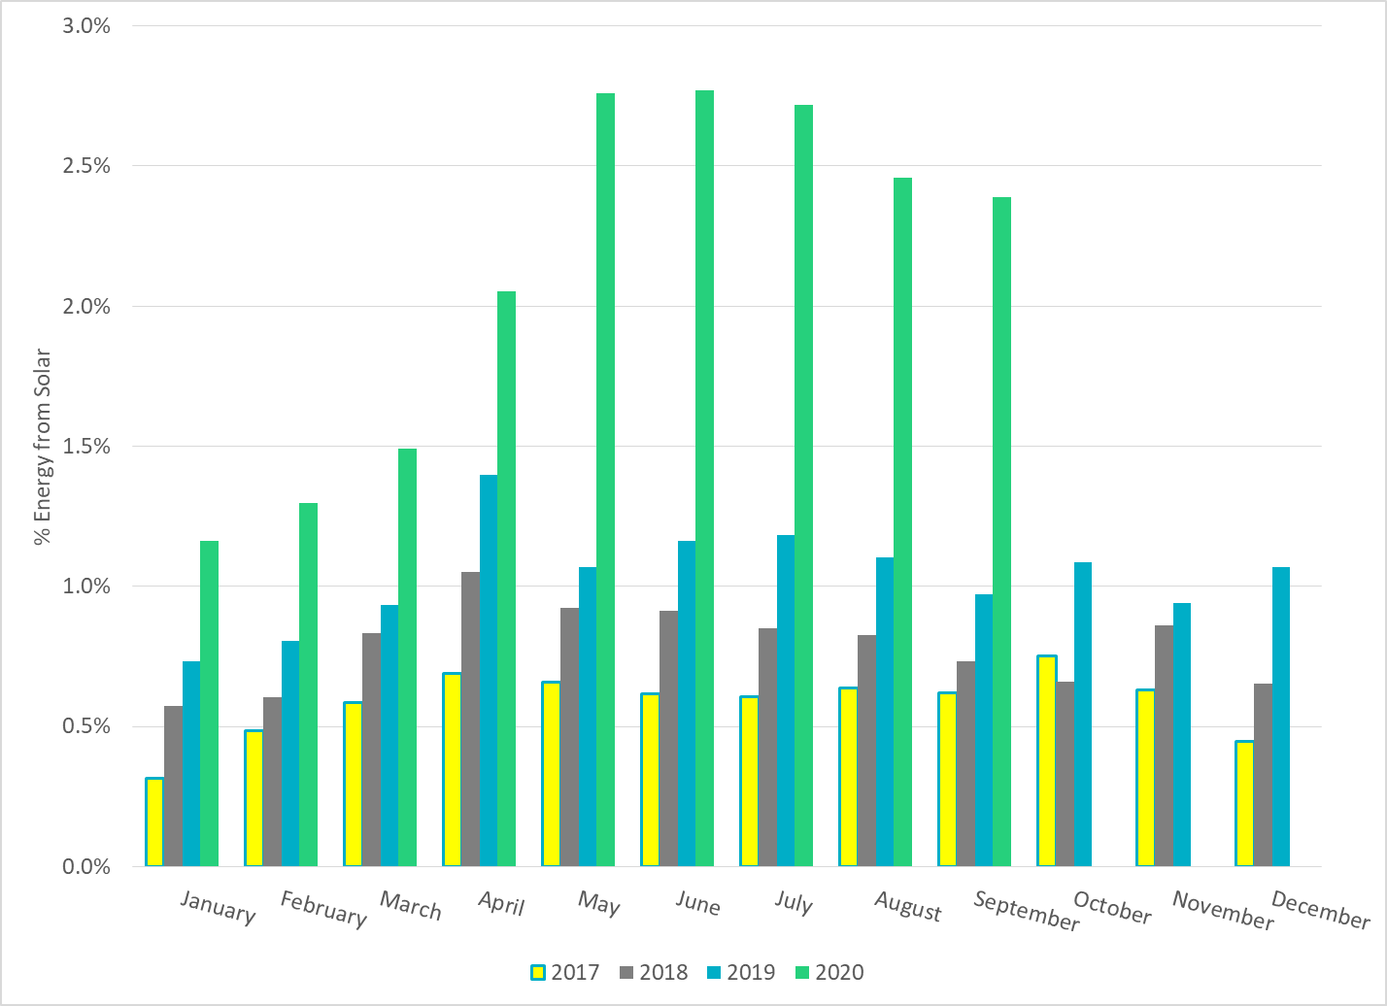
ERCOT % Energy from Solar Generation
Notes:
2.39%

Slide 17
Questions?

