Slide 1
BUSOGFLT Load Factor Analysis
PWG Meeting
November 6, 2020

Slide 2
Daily Load Factor Summary

Slide 3
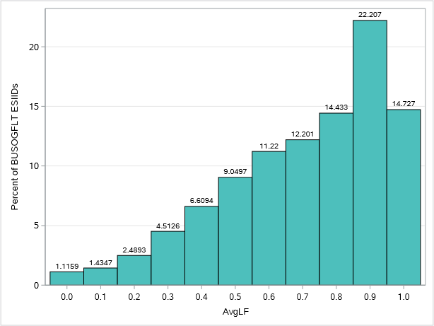
Histogram of AVG Daily Load Factor for BUSOGFLT

