Slide 1
Market Credit Working Group update to the Wholesale Market Subcommittee
Bill Barnes, NRG, Chair
Josephine Wan, Austin Energy, Vice Chair
11/04/2020

Slide 2
MCWG update to WMS
General Update
  October 16 Joint MCWG/CWG WEBEX Meeting
  7 NPRRs reviewed for their credit impacts
  1001NPRR Clarification of Definitions of Operating Condition Notice, Advisory, Watch, Emergency Notice, and Related Clarifications - No Credit Impact
  1026NPRR BESTF-7 Self-Limiting Facilities and Self-Limiting Resources - No Credit Impact
  1039NPRR Replace the Term MIS Public Area with ERCOT Website - No Credit Impact
  1042NPRR Planned Capacity Adjustment in the Report on Capacity, Demand and Reserves in the ERCOT Region - No Credit Impact
  1043NPRR Clarification of NPRR986 Language Related to Wholesale Storage Load - No Credit Impact
  1046NPRR Additional Revisions to Remove Dynamically Scheduled Resource (DSR) from the Protocols - No Credit Impact
  1047NPRR Consolidate Greybox re NPRR973 and NPRR1016 - No Credit Impact

Slide 3
MCWG update to WMS
Real-Time Co-optimization Update to Credit Work Group
Aug 19 CWG meeting (today)
  Highlight need for CWG review of NPRR1007-NPRR1013
  ERCOT provides initial summary of credit impacts
  Note that although RTCTF continues to meet until October 21, 2020, all Pricing and Settlement consensus items are complete and posted here: http://www.ercot.com/calendar/2020/9/9/191170-RTCTF
Sept 16 CWG meeting
  ERCOT Credit will review prior materials and ask if any issues
Oct 16 CWG meeting
  ERCOT Credit (Vanessa) and RTCTF Chair (Matt Mereness) asks if any questions or concerns with RTCTRRs from a credit impact perspective.
  Ask CWG for agreement on comments to be filed by Nov 17.
Nov 17 CWG meeting
  Last meeting before Board to file CWG comments on credit impacts

Slide 4
MCWG update to WMS
Real-Time Co-optimization Update to Credit Work Group
Revisions to Credit Exposure Calculations for AS Products Related to RTC
Update the Real Time Liability Completed and Not Settled (RTLCNS) component of Estimated Aggregate Liability (EAL) calculation to include Real-Time Co-Optimization (RTC) Ancillary Service (AS) activity
  Capture price risk between Day Ahead Market (DAM) Market Clearing Price for Capacity (MCPC) and Real-Time (RT) Market Clearing Price for Capacity (MCPC) for Virtual AS offers
Estimated Aggregate Liability
  EAL _{q} = Max [IEL during the first 40-day period only beginning on the date that the Counter-Party commences activity in ERCOT markets, RFAF * Max {RTLE during the previous lrq days}, RTLF] + DFAF * DALE + Max [RTLCNS, Max {URTA during the previous lrq days}] + OUT _{q} + ILE _{q}
  EAL _{t} = Max [RFAF * Max {RTLE during the previous lrt days}, RTLF] + DFAF * DALE + Max [RTLCNS, Max {URTA during the previous lrt days}] + OUT _{t}
The following ERCOT Protocols were modified:
  16.11.4.3 Determination of Counter-Party Estimated Aggregate Liability
  16.11.4.3.2 Real-Time Liability Estimate
Update the Minimum Current Exposure (MCE) component of Total Potential Exposure (TPE) calculation to include
  Capture price risk between Day Ahead Market (DAM) Market Clearing Price for Capacity (MCPC) and Real-Time (RT) Market Clearing Price for Capacity (MCPC) for Virtual AS offers
  Section 16.11.4.1 Determination of Total Potential Exposure for a Counter-Party

Slide 5
MCWG update to WMS
Credit Risk Assessment and Enforcement
Updated draft NPRR key provisions
Reorders Section 16 credit monitoring language
Credit scoring provisions – qualitative assessment and financial scoring model
Financial scoring details to be in a separate OBD
Financial score updated quarterly
Representative qualitative considerations
Qualitative assessment may be updated at any time
Annual review of financial scoring parameters by CWG / MCWG
Counter-Party credit scores are Protected Information
In the event of deterioration of credit quality, provisions for
Change to Unsecured Credit Limits,
Change to TPE, or
Designation as an unreasonable credit risk
TPE adjustment mechanism
Five Bank Business Day Notice before changes to TPE or Unsecured Credit Limit

Slide 6
MCWG update to WMS
Financial Scoring Models
Updated using 2019 Counter-Party financial data
For both testing models, revised data reduced the “fit” of the model score to the agency rating for rated entities. Therefore Market Participants prior to implementation should be comfortable that the financial ratios and weights are reasonable.
PLEASE REVIEW
http://www.ercot.com/calendar/2020/10/16/192878-CREDITWG-MCWG

Slide 7
MCWG update to WMS
Potential August 2020 DAM/CRR Credit Risk Misalignment
Observations
DALE (i.e. 7-day average of prior DAM activity) is multiplied by DFAF to capture changes in forward market expectations
Works well when congestion is minimal
CRR settlements are not projected forward using DFAF
CRR credits/charges netted only for days that are unbilled or invoiced
In instances where DALE*DFAF increases substantially due to congestion, there is not a corresponding projected offset at the Counter-party level for CRRAH activities, particularly for CRRAH with a book heavy with Options
Result is dramatic over-collateralization of Counter-Party, particularly when the CP, QSE, and CRRAH are the same legal entity
The entity can be owed millions by ERCOT, yet the TPEA calculations show the CP to be a significant credit risk to ERCOT, whereas the risk of default is in the opposite direction

Slide 8
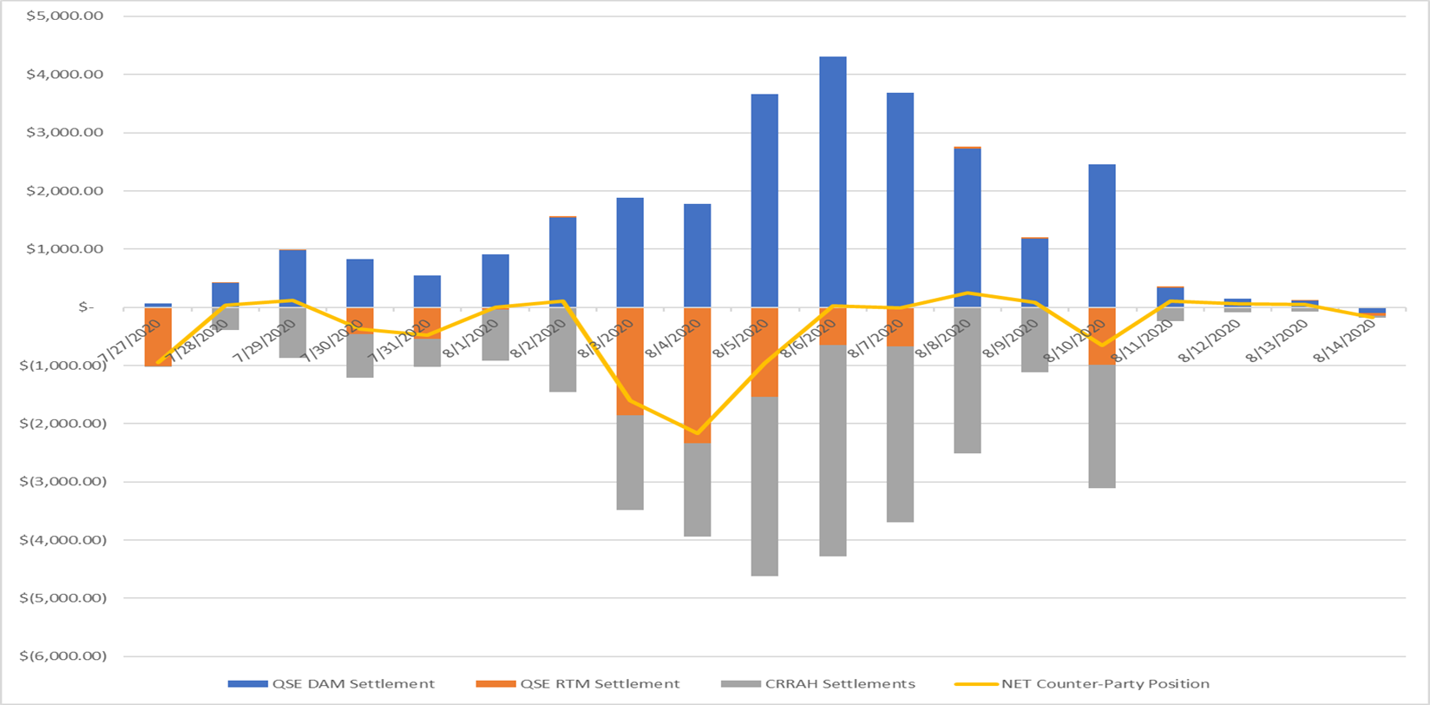
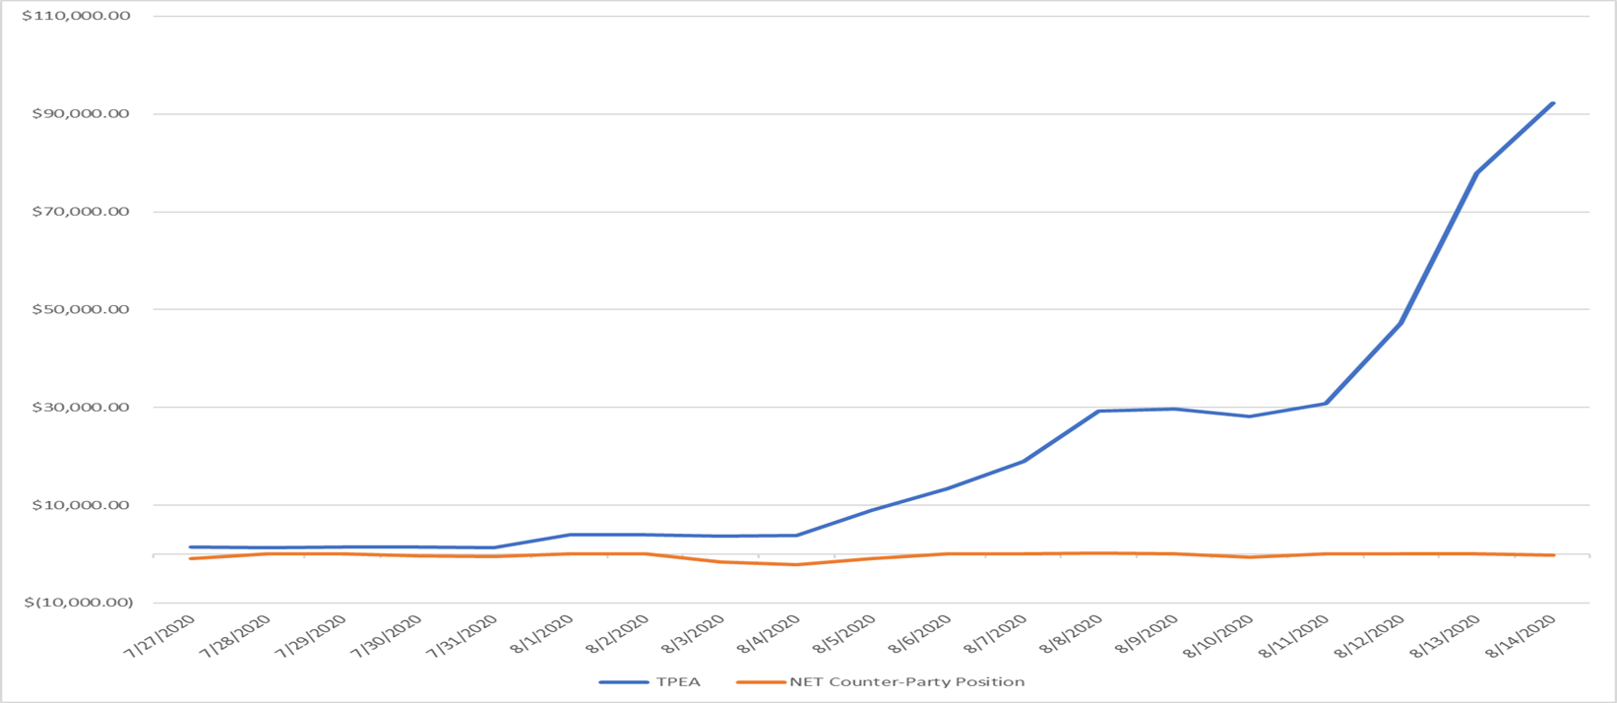
MCWG update to WMS
Potential August 2020 DAM/CRR Credit Risk Misalignment

Slide 9
MCWG update to WMS
Potential August 2020 DAM/CRR Credit Risk Misalignment
Potential Solutions?
Extrapolate CRRAH activities using a methodology substantially similar to DALE for qualifying Counter-Parties
Potential Qualifying Criteria
All entities registered to a CP must be the same legal entity
CRRAH book must consist of at least X% of options
Separate Issue: Should RTLE use an average similar to DALE rather than a max lookback over 45 days?

Slide 10
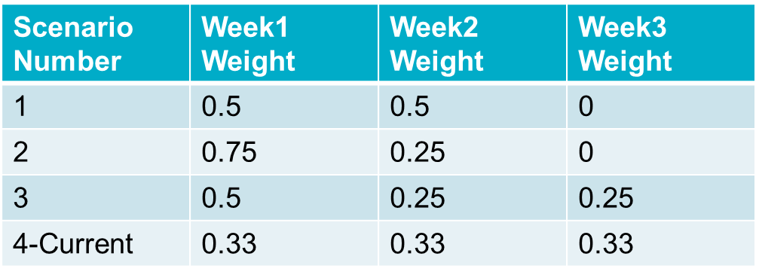
MCWG update to WMS
Review Forward Adjustment Factors
Requested estimated TPE backcast given the configurations below:

