Slide 1
Supply Analysis Working Group Report to WMS
November 4, 2020
Caitlin Smith, Chair
Pete Warnken, Vice Chair
Ian Haley, Vice Chair

Slide 2
October SAWG Meeting – Astrape 2020 Reserve Margin Study
October presentation:
Reviewed:
Scenarios:
High Renewables Penetration
Storage as change case
Gas CT as reference case
Equivalent Forced Outage Rate
Renewable Accounting
Draft Results
Storage Scenario
Next Steps:
Final EORM/MERM Study to be released by Astrape in the next couple of weeks
Notice to stakeholders and the PUCT
30-day comment period on final report
November 19 SAWG:
Final reserve margins results and associated sensitivities
Wind/Solar Effective Load Carrying Capabilities (ELCCs)
Battery storage scenario – Battery storage as the reference technology, combined with high renewables penetration

Slide 3
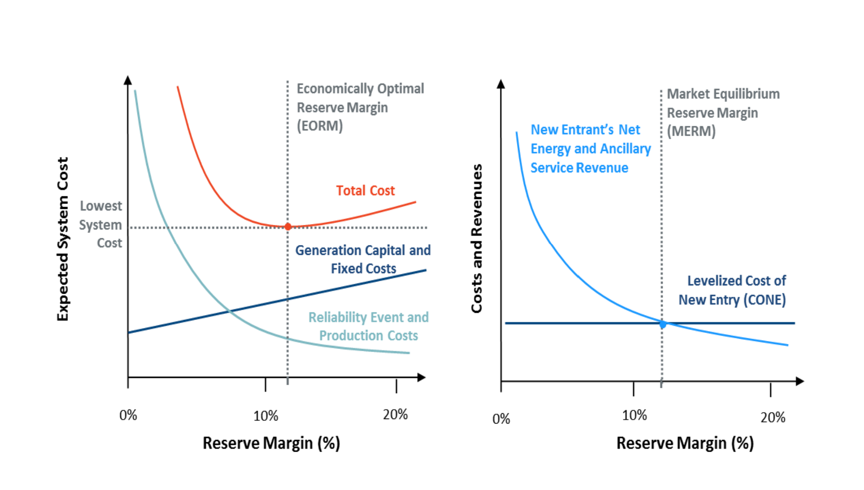
October SAWG Meeting – Astrape Update on 2020 Reserve Margin Study
**draft results, not final, as presented by Astrape

Slide 4
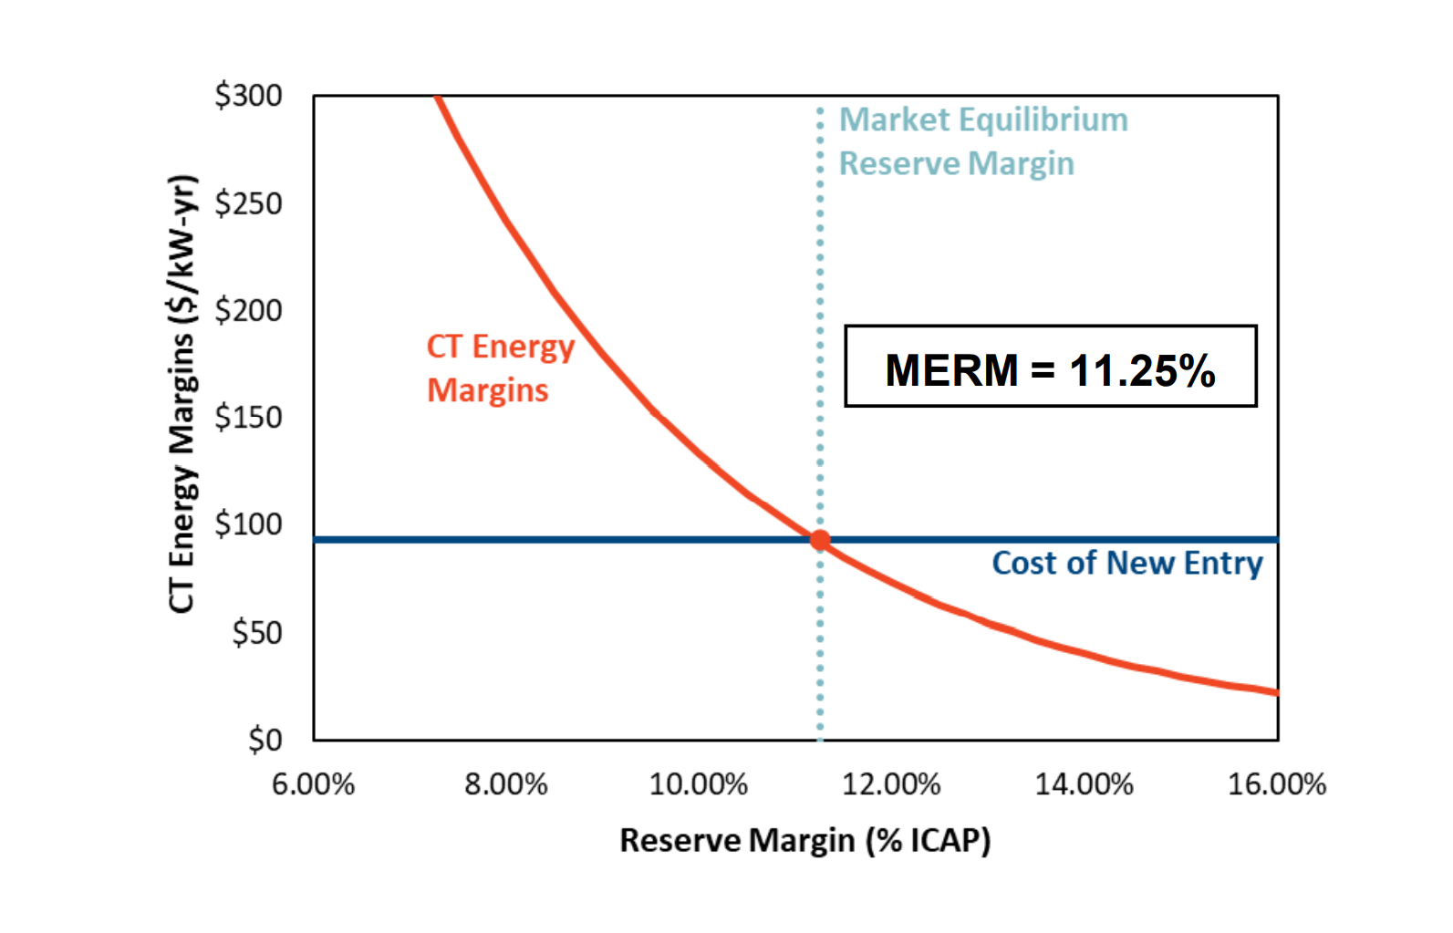
October SAWG Meeting – Astrape Update on 2020 Reserve Margin Study
**draft results, not final, as presented by Astrape

Slide 5
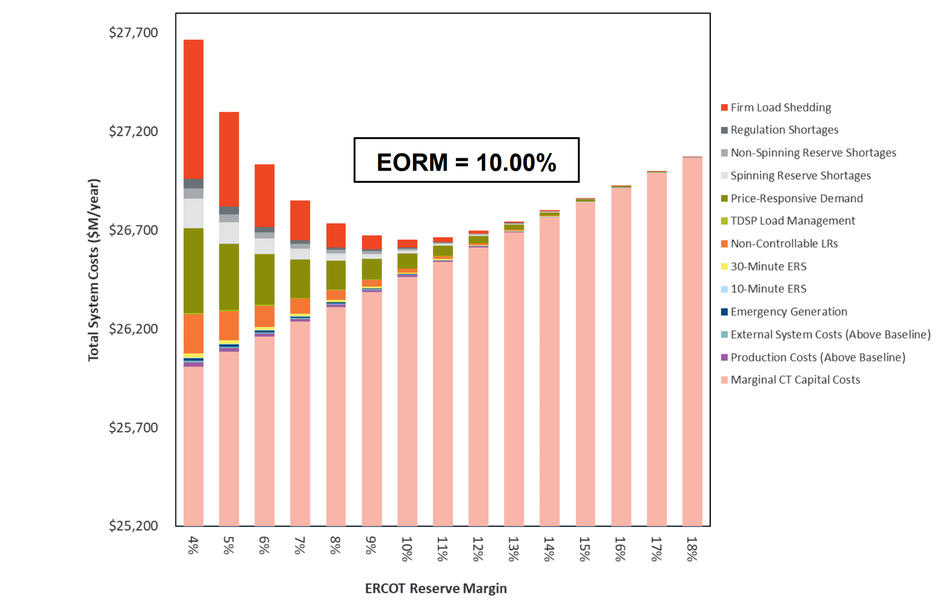
October SAWG Meeting – Astrape Update on 2020 Reserve Margin Study
**draft results, not final, as presented by Astrape

Slide 6
SAWG Open Action Items
Review of Resource Adequacy forecasts and development of a Net Load forecast - include possible evaluation and implementation of possible supplemental forecasts to CDR and SARA
Assigned: 07/08/2020
Status: will continue to discuss probabilistic SARA (expected at 11/20 meeting) and net load forecast (expected at 12/20 meeting)
TAC Assignment: Develop and implement updated methodology used to determine cost of new entry (CONE)
Assigned: 07/08/2020; 01/29/20; 06/05/2019
Status: ERCOT is finalizing NPRR
Recommendation: Keep this action item open until NPRR through the process and then add review of CONE study to SAWG scope
In addition to CONE study, also believe the review of MERM/EORM studies should be added to SAWG scope in 2021
**Current SAWG Scope (approved in 2014):
At the direction of the Wholesale Market Subcommittee (WMS), SAWG evaluate proposals for market design as they pertain to Resource adequacy and the resource reporting methodologies. SAWG Annually reviews the components and construction of the Capacity, Demand, and Reserves Report (CDR), the Seasonal Assessment of Resource Adequacy Report (SARA), the Long Term Load Forecast, the NERC Long Term Reliability Assessment, and recommend necessary changes to WMS. SAWG also reviews and recommends market design principles, issues, and proposals related to supply side adequacy as assigned by WMS.

Slide 7
SAWG Open Action Items
Review impacts on CDR from monthly generation interconnection report
Assigned: 09/04/2019
Recommendation: Request to close this action item, unless WMS has specific direction

Slide 8
SAWG 2020 Continuing Topics
Astrape 2020 Reserve Margin Study
Wind/Solar ELCCs
Battery storage reference technology sensitivity
Battery energy storage capacity contribution
Post-summer discussion/update on probabilistic SARA
Winter SARA fuel limitation outage capacity adjustments
Rooftop Solar – load forecast and CDR contributions
December – new Long Term Load Forecast
Net Load Forecast
Regions for Solar Capacity Contribution CDR

Slide 9
SAWG Upcoming
SARA out November 5th ~8:30am
Next SAWG meeting November 19th

