Slide 1
Review of August RENA
Jian Chen
Market Analysis and Validation
CMWG
Nov. 2nd, 2020

Slide 2
Monthly Sum of RENA

Slide 3
Daily RENA with RT Congestion
The total RENA in August was around -$13.3M, while the total SCED congestion rent was around $197M.

Slide 4
Daily RENA and Estimated DAM oversold on RT congestion
The total estimated DAM oversold amount in August was around
-$17.0M.

Slide 5
OD 8/3/2020~ 8/5/2020 and 8/10/2020
Large amount of negative RENA were observed on OD 8/3/2020~ 8/5/2020 and 8/10/2020. All the RENA was related to the RT constraints in Valley area.
Hurricane Hanna went through South Texas area on 7/25 and caused multiple transmission outages in Valley area. The RT constraints showed up after the Hurricane, which mostly were related to the forced transmission outages on the lines from North Edinburg to McColl Road and North McAllen.
The “undersold” on those RT constraints was related to two causes: 1) LDF difference between DAM and RTM; 2) RT flow in the constraint was higher than the constraint limit.

Slide 6
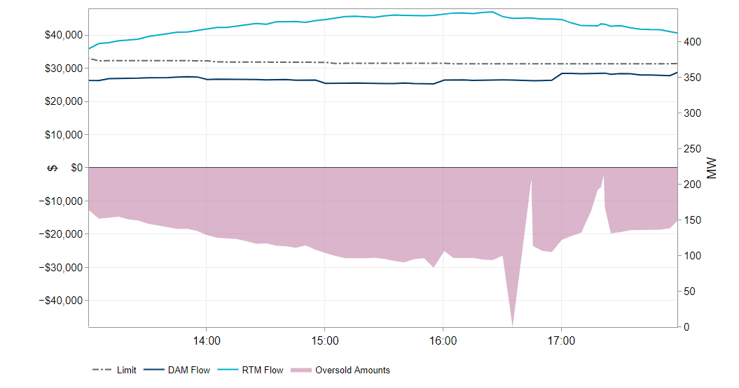
OD 8/3/2020~ 8/5/2020 and 8/10/2020 (Cont.)
The negative RENA happened when the collected RT congestion rent were actually higher than the total values of DAM awards. Here is a example for the analysis on the RT constraint.
Oversold Amount ($)
Flow / limit (MW)

Slide 7
Summary
A total of -$13.3M RENA observed in August, 2020. Large amount of negative RENA were observed in the early month, after Hurricane Hanna went through South Texas area in late July.
The negative RENA in the early August was related to the DAM “undersold” on the RT constraints in Valley area, which were further related to the difference between RT flow and limit, as well as the LDF in DAM.
PTP w/ links to options also contributed part of RENA in August, around $2.6 million. Mostly of them happened in early month and related to the Valley constraints.

Slide 8
July CRR Balance Account

Slide 9
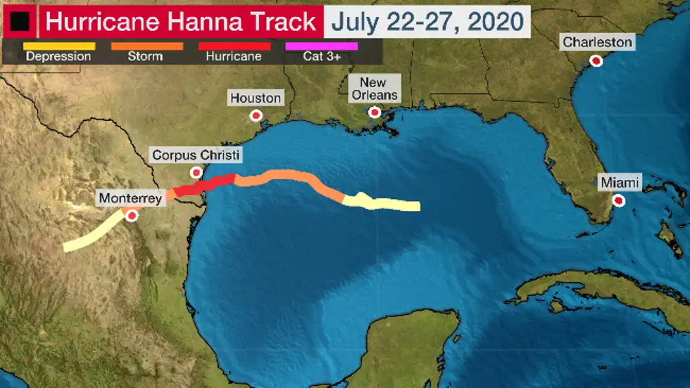
Hurricane Hanna and Valley Congestion

Slide 10
Transmission Outages 7/25 ~8/10
When Hurricane Hanna passed through South Texas, it caused multiple transmission line outages throughout Valley area, including 345kV, 138kV and 69 KV lines.
Most of lines were able to return back to service in a few days. After 8/2, all transmission line came back, except the two 138kV lines from North Edinburg to McColl Road and North McAllen, which had structured damaged during the Hurricane Hanna.
North Edinburg to McColl Road and North McAllen lines came back to service at the night of 8/10.

Slide 11
RT Congestion 7/25 ~ 8/10
There was a total of $204M RT congestion rent from 7/25 to 8/10. Most of constraints were located in Valley area, and related to the outages caused by Hurricane Hanna.

Slide 12
Locations of Constraints
Between 7/25 and 8/10, all constraints with congestion rent over $10M were located in West Valley area, and all related to the forced transmission outages on the lines from North Edinburg to McColl Road and North McAllen.
For the constraints with congestion rent over $1M in Load Zone South, all of them were located inside Valley area.
Constraint | Sum of Congestion Rent ($M)
DNEDWED8: AZTECA_HEC1_1 | 62.3
SMV_ALT8: 479T479_1 | 33.8
SPHAWES8: KEY_SW_N_MCAL1_1 | 27.5
SMV2NED8: NEDIN_MVWED_1A_1 | 22.0
XNED258: NEDIN_138H | 15.6

Slide 13
Daily RT Congestion 7/25 ~ 8/10
The RT congestion rent in Valley was also related the high load demands in early August.

Slide 14
Price impact to HB_SOUTH and LZ_SOUTH

