Slide 1
Unregistered Distributed Generation Report:
2020 Q3 Update
Resource Adequacy
11/4/2020

Slide 2
2020 Q3 Unregistered Distributed Generation Report
Load Zone | 2020 Q3 Distributed Generation Installed Capacity in MW (AC)
 | SOLAR |  | WIND |  | OTHER RENEWABLE |  | OTHER NON-RENEWABLE |  | TOTAL
 | < 50 kW | ≥ 50 kW | < 50 kW | ≥ 50 kW | < 50 kW | ≥ 50 kW | < 50 kW | ≥ 50 kW | < 50 kW | ≥ 50 kW | Combined
LZ_AEN | 63.17 | 23.62 | - | - | - | - | - | - | 63.17 | 23.62 | 86.79
LZ_CPS | 145.58 | 31.84 | 0.01 | - | 1.50 | - | - | 16.52 | 150.09 | 48.36 | 198.45
LZ_HOUSTON | 65.91 | 2.16 | 0.36 | - | - | 0.11 | 0.05 | 3.70 | 66.32 | 5.97 | 72.29
LZ_LCRA | 51.02 | 14.01 | 0.23 | - | - | - | 0.22 | - | 51.46 | 14.01 | 65.47
LZ_NORTH | 219.23 | 23.80 | 1.85 | 1.01 | - | - | - | 0.63 | 221.07 | 25.44 | 246.51
LZ_RAYBN | 13.90 | 2.97 | 0.24 | 0.05 | - | - | - | - | 14.14 | 3.02 | 17.16
LZ_SOUTH | 66.57 | 15.65 | 0.64 | 0.25 | - | - | - | 0.63 | 67.21 | 16.52 | 83.73
LZ_WEST | 27.82 | 5.04 | 0.55 | 0.25 | - | - | - | 0.34 | 28.37 | 5.63 | 34.01
TOTAL | 656.20 | 119.09 | 3.88 | 1.56 | 1.50 | 0.11 | 0.26 | 21.80 | 661.84 | 142.56 | 804.41

Slide 3
2020 Q2 → Q3 Change
Load Zone | 2020 Q2 → Q3 Change in Distributed Generation Installed Capacity in MW (AC)
 | SOLAR |  | WIND |  | OTHER RENEWABLE |  | OTHER NON-RENEWABLE |  | TOTAL
 | < 50 kW | ≥ 50 kW | < 50 kW | ≥ 50 kW | < 50 kW | ≥ 50 kW | < 50 kW | ≥ 50 kW | < 50 kW | ≥ 50 kW | Combined
LZ_AEN | +2.91 | +1.41 | - | - | - | - | - | - | +2.91 | +1.41 | +4.32
LZ_CPS | +4.23 | +0.86 | - | - | +0.39 | - | - | +6.72 | +4.62 | +7.58 | +12.20
LZ_HOUSTON | +16.41 | +0.11 | - | - | - | - | - | - | +16.41 | +0.11 | +16.52
LZ_LCRA | +2.02 | +0.33 | - | - | - | - | +0.08 | - | +2.10 | +0.33 | +2.43
LZ_NORTH | +26.35 | +0.88 | +0.01 | - | - | - | - | - | +26.36 | +0.88 | +27.25
LZ_RAYBN | +1.49 | - | -0.01 | - | - | - | - | - | +1.48 | - | +1.48
LZ_SOUTH | +5.18 | +0.13 | - | - | - | - | - | +0.63 | +5.19 | +0.75 | +5.94
LZ_WEST | +9.83 | +0.60 | - | - | - | - | - | - | +9.83 | +0.60 | +10.43
TOTAL | +68.42 | +4.32 | - | - | +0.39 | - | +0.08 | +7.35 | +68.89 | +11.66 | +80.55

Slide 4
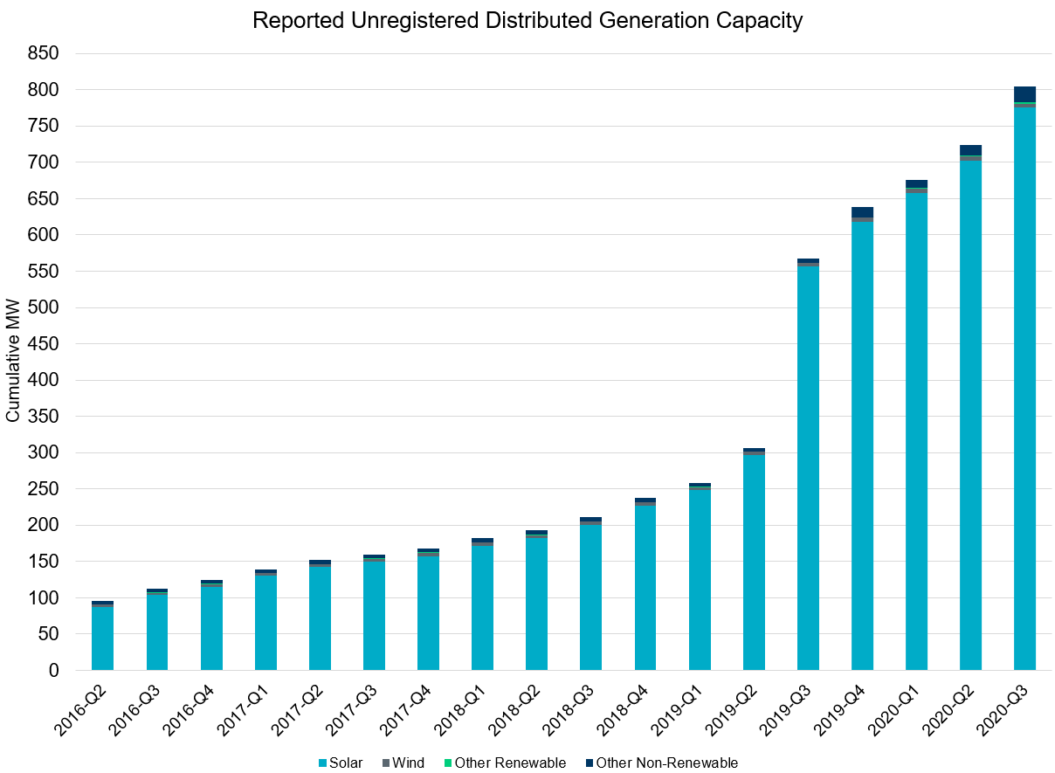
Unregistered DG Growth: 2016-Q2* to 2020-Q3
Large increase due to reporting requirement change**
* 2016-Q2 was the first report published after implementation of report changes per NPRR794/COPMGR044
** 2019-Q3 was the first report published after implementation of report changes per NPRR891

