Slide 1
Settlement Stability
2020 Q3 Update to WMS
Austin Covington
ERCOT
11/04/2020

Slide 2
8.2(2)(c)(i) Track number of price changes
Reporting Period: 2020 Q3
Operating Day | # of Corrected Settlement Point Prices |  |  |  | # of Intervals Affected
 | DASPP | RTSPP | RTRMPR | ORDC Adders | DASPP | RTSPP | RTRMPR | ORDC Adders
- | - | - | - | - | - | - | - | -
Notes:
There were no price changes in Q3 2020.
The price changes reported on this slide display the price corrections that have been done after the Settlement Statement has posted for the Operating Day.

Slide 3
8.2(2)(c)(iv) Track number of resettlements due to non-price errors
Reporting Period: 2020 Q3
Operating Day Resettled | Reason for Resettlement | Affected Charge Types | Market Notice Number
10/21/2019 | Error in manual process in Emergency Settlements | EMREAMT, LAEMREAMT, RTEIAMT, LARTRNAMT | M-A080720-02

Slide 4
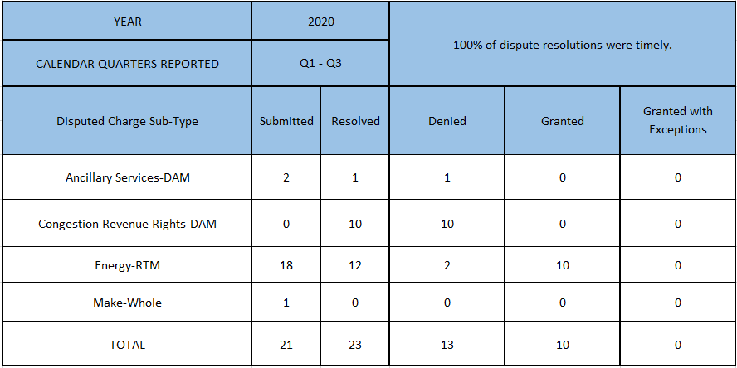
8.2(2)(c)(ii) Track number and types of disputes submitted
8.2(2)(c)(iii) Compliance with timeliness of response to disputes
Submitted but not resolved disputes may be:
Not started
Open
Rejected
Withdrawn

Slide 5
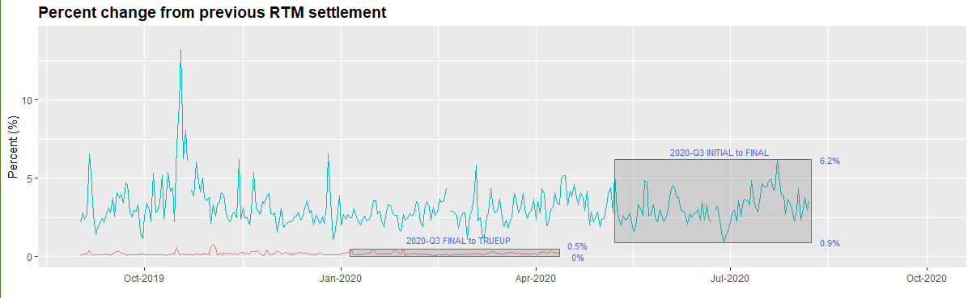
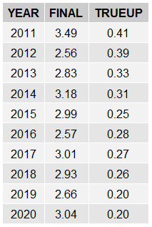
8.2(2)(c)(iv) Other Settlement Metrics
NOTE: ERS Final settlement OD data is not represented in graph.
Average percent change

Slide 6
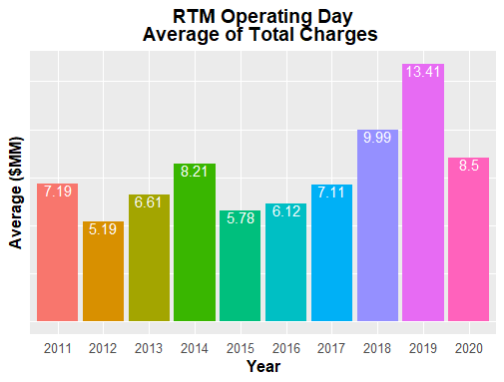
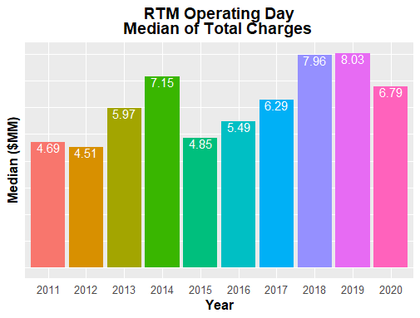
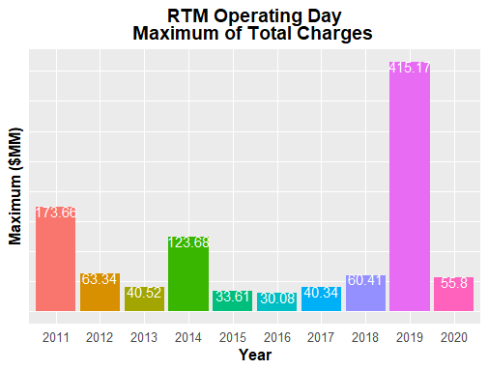
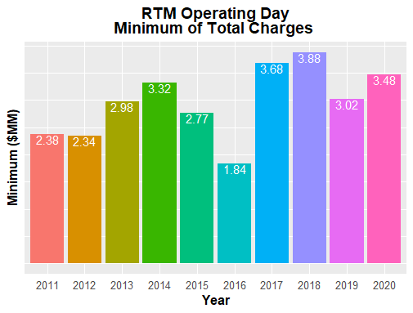
8.2(2)(c)(iv) Other Settlement Metrics

Slide 7
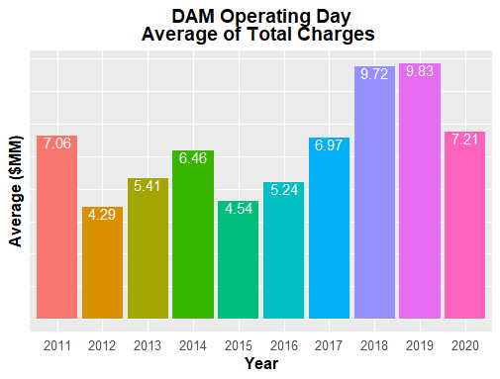
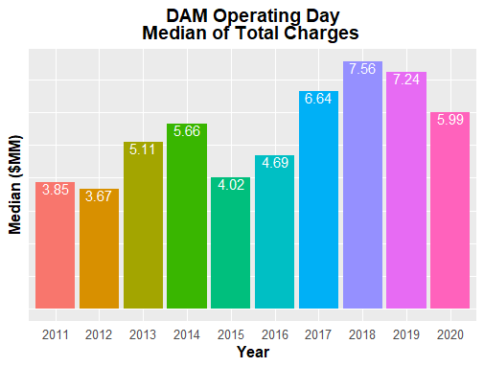
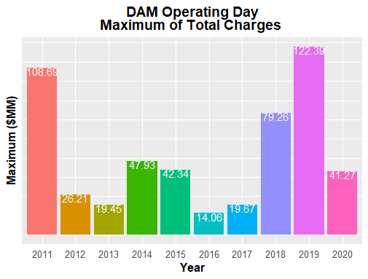
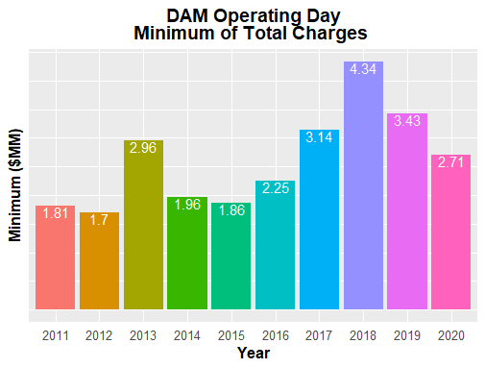
8.2(2)(c)(iv) Other Settlement Metrics

Slide 8
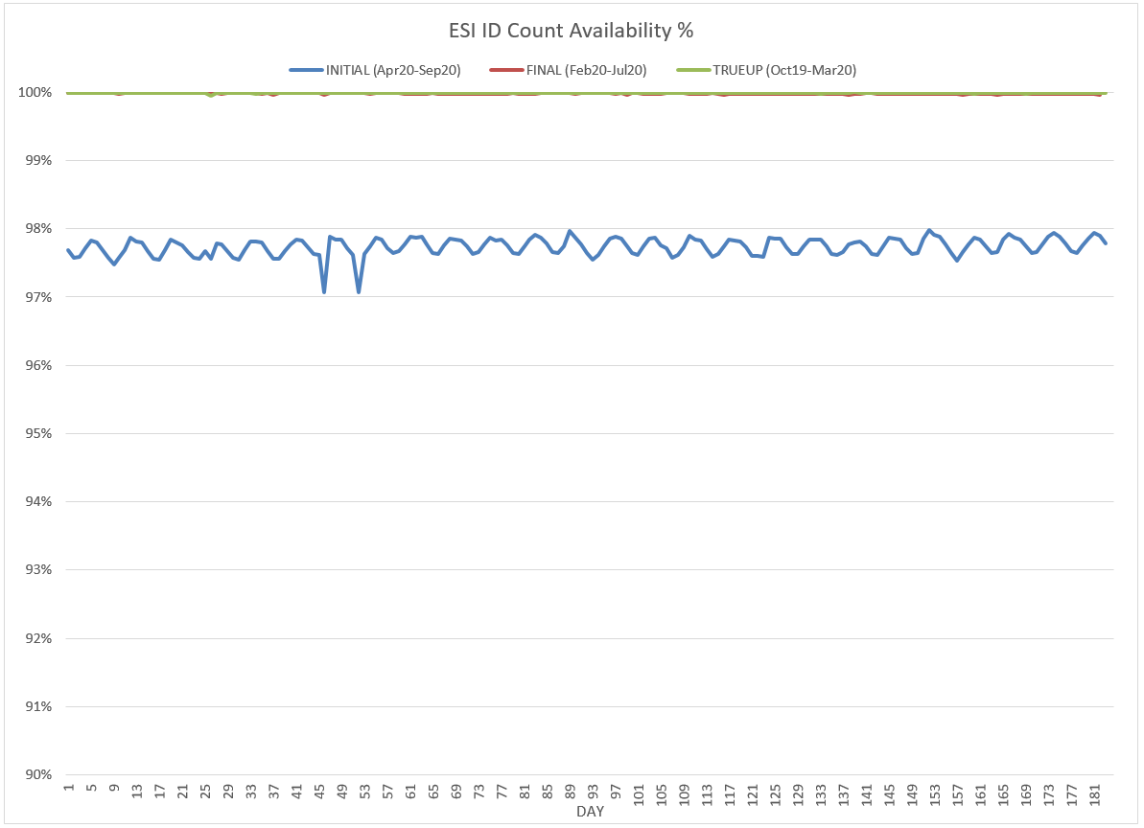
8.2(2)(c)(v) Availability of ESIID consumption data

Slide 9
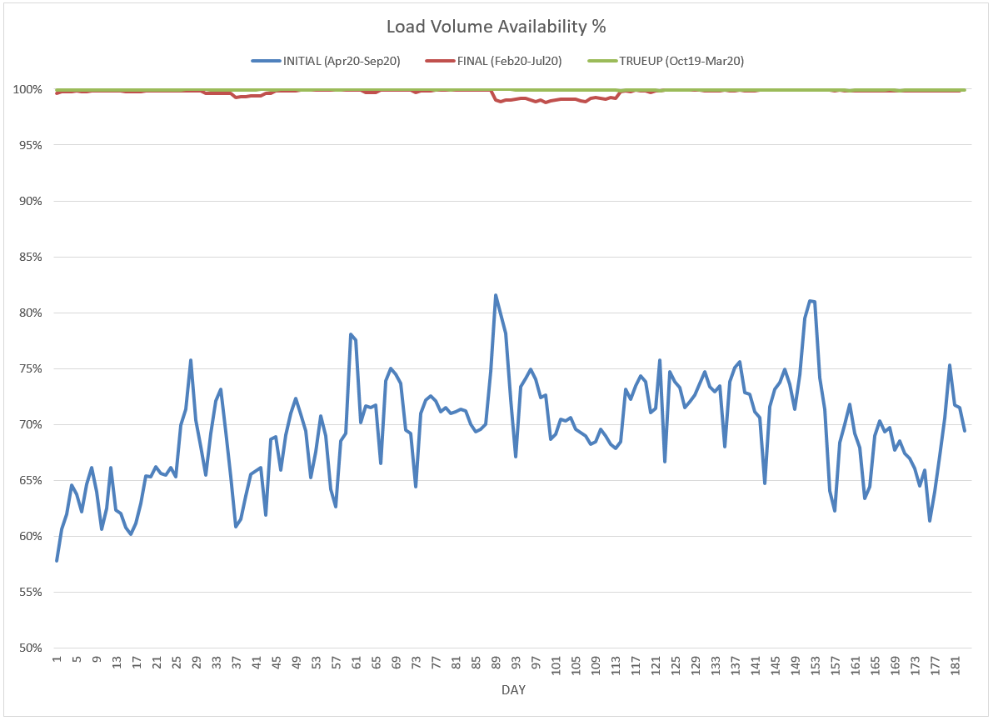
8.2(2)(c)(v) Availability of ESIID consumption data

Slide 10
8.2(2)(g) Net Allocation to Load - Totals and $/MWh
NET ALLOCATION TO LOAD ($M)
 | Sep 2019 | Oct 2019 | Nov 2019 | Dec 2019 | Jan 2020 | Feb 2020 | Mar 2020 | Apr 2020 | May 2020 | Jun 2020 | Jul 2020 | Aug 2020 | Sep 2020
Ancillary Service Settlement | 158.6 | 48.9 | 35.1 | 20.8 | 15.6 | 20.2 | 29.2 | 27.2 | 19.1 | 16.9 | 17.7 | 45.4 | 13.5
Balancing Account Payout to Load | -15.3 | -15.5 | -19.5 | -21.3 | -6.7 | -11.0 | -11.6 | -12.5 | -11.6 | -4.8 | -7.7 | 0.0 | 0.0
Base Point Deviation Payments | -0.4 | -0.3 | -0.2 | -0.1 | -0.1 | -0.2 | -0.2 | -0.2 | -0.2 | -0.2 | -0.2 | -0.3 | -0.2
Black Start Service Settlement | 0.6 | 0.6 | 0.6 | 0.6 | 0.6 | 0.5 | 0.6 | 0.6 | 0.6 | 0.6 | 0.6 | 0.5 | 0.5
Block Load Transfer Settlement | 0.0 | 0.0 | 0.0 | 0.0 | 0.0 | 0.0 | 0.0 | 0.0 | 0.0 | 0.0 | 0.0 | 0.0 | 0.0
Emergency Energy Charges | 0.2 | 3.5 | 0.1 | 0.0 | 0.1 | 0.2 | 0.2 | 0.1 | 0.2 | 0.0 | 0.1 | 0.1 | 0.1
ERCOT Admin Fee Settlement | 20.8 | 17.1 | 15.5 | 16.3 | 16.1 | 15.6 | 15.7 | 15.0 | 17.4 | 19.7 | 22.4 | 22.7 | 18.2
ERS Settlement¹ | 3.5 | 4.1 | 4.1 | 4.1 | 4.1 | 2.9 | 2.9 | 2.9 | 2.9 | 0.0 | 0.0 | 0.0 | 0.0
High Dispatch Limit Override | 0.0 | 0.0 | 0.0 | 0.0 | 0.0 | 0.0 | 0.0 | 0.0 | 0.0 | 0.0 | 0.0 | 0.0 | 0.0
Non-Zonal Auction Distribution | -7.3 | -11.2 | -11.1 | -8.5 | -8.2 | -9.9 | -14.5 | -15.4 | -14.6 | -13.1 | -10.1 | -10.9 | -10.6
ORDC Settlement | 6.9 | 0.6 | 0.2 | 0.0 | 0.0 | 0.1 | 0.5 | 1.2 | 0.9 | 0.1 | 2.0 | 10.2 | 1.5
Revenue Neutrality Total | 0.0 | 5.8 | -5.1 | 9.9 | 6.4 | 7.6 | 27.0 | 2.8 | 14.2 | -0.4 | 1.6 | -13.3 | 5.5
RMR Settlement | 0.0 | 0.0 | 0.0 | 0.0 | 0.0 | 0.0 | 0.0 | 0.0 | 0.0 | 0.0 | 0.0 | 0.0 | 0.0
RUC Settlement | 0.0 | -0.7 | 0.0 | 0.0 | 0.0 | -0.2 | 0.0 | 0.0 | 0.0 | 0.0 | -0.1 | -0.2 | 0.0
Voltage Services Settlement | 0.0 | 0.0 | 0.0 | 0.0 | 0.0 | 0.0 | 0.0 | 0.0 | 0.0 | 0.0 | 0.0 | 0.0 | 0.0
Zonal Auction Distribution² | -40.2 | -35.9 | -32.6 | -33.9 | -46.7 | -41.5 | -51.3 | -52.9 | -45.7 | -51.1 | -55.1 | -55.6 | -48.7
Total Allocation to Load | 127.4 | 17.0 | -12.9 | -12.1 | -18.8 | -15.7 | -1.5 | -31.2 | -16.8 | -32.3 | -28.8 | -1.4 | -20.2
Adjusted Metered Load (TWh) | 37.5 | 30.8 | 27.9 | 29.4 | 29.1 | 28.1 | 28.2 | 27.0 | 31.3 | 35.5 | 40.3 | 40.9 | 32.8
$/MWh³ | 3.4 | 0.6 | -0.5 | -0.4 | -0.6 | -0.6 | -0.1 | -1.2 | -0.5 | -0.9 | -0.7 | 0.0 | -0.6
Note: The Net Allocation to Load amounts provided in this presentation are for informational purposes only and cannot be relied upon for accurate measurements or forecasts of individual QSE charges and payments.
¹The total ERS charges have been evenly allocated across the contract period.
²Zonal Auction Distribution by 2003 Congestion Management Zone, shown below.
³The $/MWh value as calculated per PR 8.2 (2) g
⁴The $/MWh value by 2003 Congestion Management Zone, as calculated per PR 8.2(2) g

Slide 11
8.2(2)(g) Net Allocation to Load - Totals and $/MWh
ZONAL AUCTION DISTRIBUTION PER CONGESTION MANAGEMENT ZONE ($M)
 | Sep 2019 | Oct 2019 | Nov 2019 | Dec 2019 | Jan 2020 | Feb 2020 | Mar 2020 | Apr 2020 | May 2020 | Jun 2020 | Jul 2020 | Aug 2020 | Sep 2020
HOUSTON | -5.6 | -4.0 | -3.6 | -3.8 | -4.0 | -3.8 | -4.4 | -4.4 | -5.4 | -6.2 | -8.0 | -9.3 | -7.3
NORTH | -9.8 | -8.8 | -7.7 | -7.9 | -9.6 | -9.9 | -8.6 | -6.9 | -10.4 | -13.7 | -15.3 | -14.7 | -11.7
SOUTH | -12.4 | -10.7 | -9.2 | -9.8 | -11.4 | -11.0 | -10.5 | -10.5 | -12.5 | -14.5 | -16.2 | -16.8 | -14.0
WEST | -12.3 | -12.4 | -12.2 | -12.3 | -21.7 | -16.8 | -27.8 | -31.1 | -17.4 | -16.6 | -15.5 | -14.8 | -15.7
TOTAL | -40.2 | -35.9 | -32.6 | -33.9 | -46.7 | -41.5 | -51.3 | -52.9 | -45.7 | -51.1 | -55.1 | -55.6 | -48.7
REAL-TIME ADJUSTED METERED LOAD BY CONGESTION MANAGEMENT ZONE (TWh)
 | Sep 2019 | Oct 2019 | Nov 2019 | Dec 2019 | Jan 2020 | Feb 2020 | Mar 2020 | Apr 2020 | May 2020 | Jun 2020 | Jul 2020 | Aug 2020 | Sep 2020
HOUSTON | 9.7 | 8.2 | 7.1 | 7.5 | 7.4 | 7.0 | 8.0 | 7.5 | 8.8 | 9.6 | 10.6 | 10.9 | 9.3
NORTH | 13.6 | 10.4 | 9.7 | 10.4 | 10.4 | 10.2 | 9.1 | 8.8 | 10.4 | 12.7 | 14.6 | 14.7 | 11.1
SOUTH | 10.2 | 8.4 | 7.3 | 7.5 | 7.3 | 7.1 | 7.4 | 7.2 | 8.7 | 9.4 | 10.9 | 11.0 | 8.7
WEST | 3.9 | 3.8 | 3.7 | 3.9 | 3.9 | 3.7 | 3.7 | 3.5 | 3.5 | 3.8 | 4.3 | 4.3 | 3.8
TOTAL | 37.5 | 30.8 | 27.9 | 29.4 | 29.1 | 28.1 | 28.2 | 27.0 | 31.3 | 35.5 | 40.3 | 40.9 | 32.8
ZONAL AUCTION REVENUE PER CONGESTION MANAGEMENT ZONE ($/MWh)
 | Sep 2019 | Oct 2019 | Nov 2019 | Dec 2019 | Jan 2020 | Feb 2020 | Mar 2020 | Apr 2020 | May 2020 | Jun 2020 | Jul 2020 | Aug 2020 | Sep 2020
HOUSTON | -0.6 | -0.5 | -0.5 | -0.5 | -0.5 | -0.5 | -0.6 | -0.6 | -0.6 | -0.6 | -0.8 | -0.9 | -0.8
NORTH | -0.7 | -0.8 | -0.8 | -0.8 | -0.9 | -1.0 | -0.9 | -0.8 | -1.0 | -1.1 | -1.0 | -1.0 | -1.1
SOUTH | -1.2 | -1.3 | -1.3 | -1.3 | -1.6 | -1.5 | -1.4 | -1.5 | -1.4 | -1.5 | -1.5 | -1.5 | -1.6
WEST | -3.2 | -3.3 | -3.3 | -3.2 | -5.6 | -4.5 | -7.5 | -8.9 | -5.0 | -4.4 | -3.6 | -3.4 | -4.1
TOTAL | -1.1 | -1.2 | -1.2 | -1.2 | -1.6 | -1.5 | -1.8 | -2.0 | -1.5 | -1.4 | -1.4 | -1.4 | -1.5
NET ALLOCATION TO LOAD PER CONGESTION MANAGEMENT ZONE ($/MWh)⁴
 | Sep 2019 | Oct 2019 | Nov 2019 | Dec 2019 | Jan 2020 | Feb 2020 | Mar 2020 | Apr 2020 | May 2020 | Jun 2020 | Jul 2020 | Aug 2020 | Sep 2020
HOUSTON | 3.9 | 1.2 | 0.2 | 0.2 | 0.5 | 0.4 | 1.2 | 0.2 | 0.3 | -0.1 | -0.1 | 0.4 | 0.1
NORTH | 3.8 | 0.9 | -0.1 | -0.1 | 0.1 | -0.1 | 0.9 | 0.0 | -0.1 | -0.6 | -0.3 | 0.3 | -0.2
SOUTH | 3.3 | 0.4 | -0.6 | -0.6 | -0.6 | -0.6 | 0.4 | -0.7 | -0.5 | -1.0 | -0.8 | -0.2 | -0.7
WEST | 1.3 | -1.6 | -2.6 | -2.5 | -4.6 | -3.6 | -5.7 | -8.1 | -4.1 | -3.9 | -2.9 | -2.1 | -3.2
TOTAL | 3.4 | 0.6 | -0.5 | -0.4 | -0.6 | -0.6 | -0.1 | -1.2 | -0.5 | -0.9 | -0.7 | 0.0 | -0.6

