Slide 1
Real-Time Ancillary Service Shortages
Operations Analysis
WMWG
October 27, 2020

Slide 2
Introduction
ERCOT and the Independent Market Monitor (IMM) had noticed a consistent pattern of Ancillary Service (AS) Supply Responsibility shortages in Real-Time. This topic was discussed at the various stakeholder meetings in 2019 and subsequently NPRR 947 was submitted.
At that time, ERCOT improved its internal processes to better track the Real-Time AS Supply shortages. These processes are being used since then to monitor this issue. It is recognized that
ERCOT can address AS shortages prior to the end of adjustment period with the Supplemental Ancillary Service Market (SASM) mechanism
During the Operating Hour in Real-Time, QSEs are expected to work with the Control Room Operators to address any AS shortages
ERCOT withdrew NPRR 947 because in this environment it was not beneficial to invest resources in an issue that would be made obsolete by implementation of Real Time Co-Optimization (RTC) in 2024 and the current process to monitor AS Supply shortages can remain in place till then.
The proposed monthly metric in NPRR1040 is lenient. Included are some example of AS Supply shortages that will not fail the original NPRR1040 but will fail the proposed metric in ERCOT Comments dated Oct 13, 2020 (proposed metric).

Slide 3
Proposed Metric in ERCOT Comments
In ERCOT’s Comments dated Oct 13, 2020 (proposed metric), ERCOT is proposing to consider a QSE that is providing a specific Ancillary Service non-compliant if
it is short in Real Time by greater of 3% of its total obligation or 5 MW for more than 3% of the five-minute clock intervals that the QSE is carrying an Ancillary Service Supply Responsibility within the month
OR
it is short in Real Time by greater of 3% of its total obligation or 5 MW for more than twenty-five minutes (i.e. five consecutive five-minute clock intervals) in four or more instances within the month.
ERCOT is also proposing that the time period QSEs have to respond to an insufficient capacity notification that is sent to QSE pursuant to paragraph (3) of Section 8.1.1.3, Ancillary Service Capacity Compliance Criteria, be raised to 25 minutes.
Lastly, ERCOT is proposing to convert the variants in the proposed metric to be performance criteria variables S, T, and U that will be subject to review and approval by TAC and publically posted on Market Information System (MIS). ERCOT proposes to use “3”, “3”, and “5” as the starting values for these variables.

Slide 4
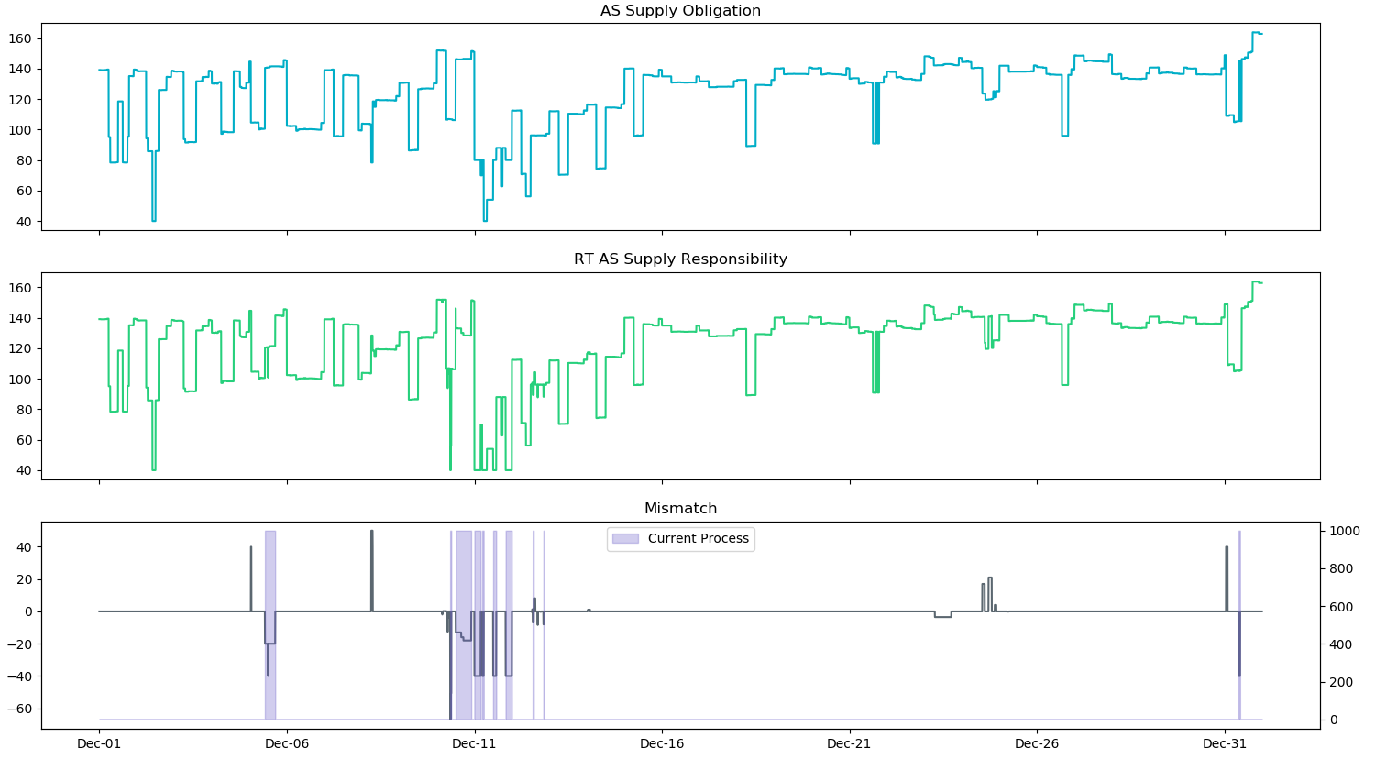
Example 1
This QSE was carrying RRS for all intervals (8944 intervals) in a month and had AS Supply shortages in 500 intervals (max shortage = 66.8 MW).
Per the original metric in NPRR1040, this QSE failed 367 intervals or 4.1% of the total intervals and will not be considered short on this AS for the month.
Per ERCOT’s current process this QSE had 9 instances with an shortage between 13.0 MW and 66.8 MW. This QSE will be considered short per ERCOT’s proposed metric.
Notes:
This QSE had 9 instances with an AS Supply shortage for RRS between 13.0 MW and 66.8 MW for 3 or more consecutive intervals
This QSE had 8 instances with an AS Supply shortage between 13.0 MW and 66.8 MW for more than 5 consecutive intervals.

Slide 5
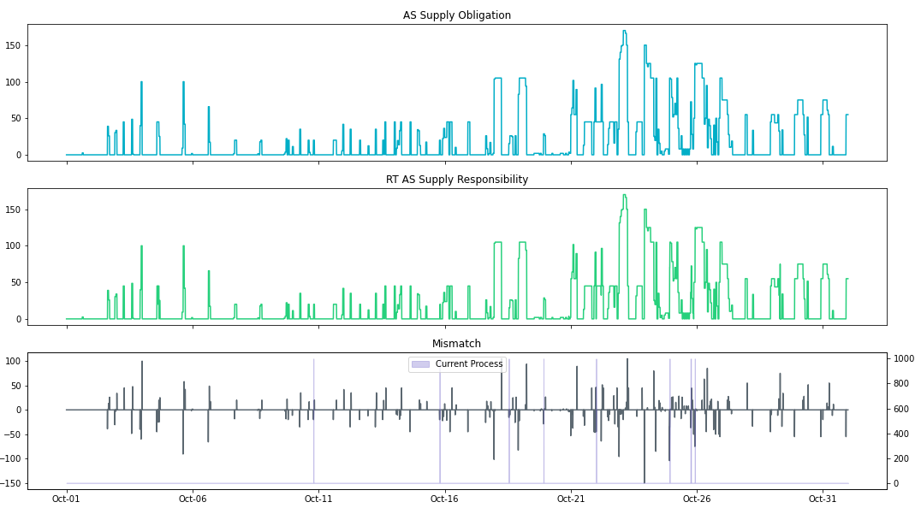
Example 2
This QSE was carrying RRS for 3195 intervals in the month and had AS Supply shortages in 151 intervals (max shortage = 150 MW).
Per the original metric in NPRR1040, this QSE failed 117 intervals or 3.7% of the total intervals and will not be considered short on this AS for the month.
Per ERCOT’s current process this QSE had 8 instances with an shortage between 15.4 MW and 104.2 MW. This QSE will be considered short per ERCOT’s proposed metric.
Notes:
This QSE had 8 instances with an AS Supply shortage for RRS between 15.4 MW and 104.2 MW for 3 or more consecutive intervals
This QSE had 1 instance with an AS Supply shortage of 36.5 MW for more than 5 consecutive intervals.

Slide 6
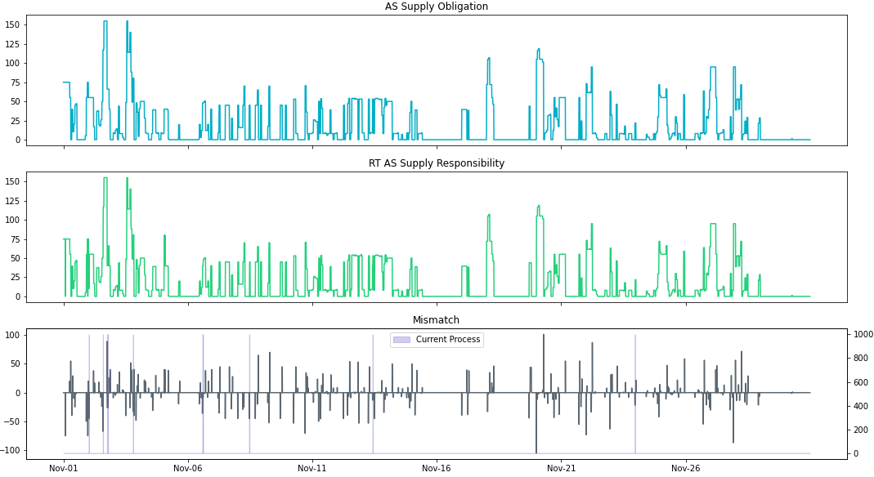
Example 3
This QSE was carrying RRS for 4106 intervals in the month and had AS Supply shortages in 161 intervals (max shortage = 105 MW).
Per the original metric in NPRR1040, this QSE failed 144 intervals or 3.5% of the total intervals and will not be considered short on this AS for the month.
Per ERCOT’s current process this QSE had 6 instances with shortage between 13.0 MW and 67.2 MW. This QSE will be considered short per ERCOT’s proposed metric.
Notes:
This QSE had 6 instances with an AS Supply shortage for RRS between 13.0 MW and 67.2 MW for 3 or more consecutive intervals
This QSE had 1 instances with an AS Supply shortage for RRS between 13.0 MW and 26 MW for more than 5 consecutive intervals.

Slide 7
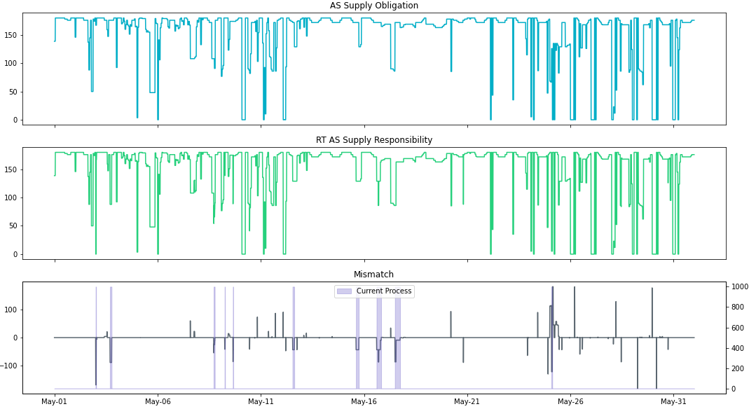
Example 4
This QSE was carrying RRS for all intervals (8547 intervals) in the month and had AS Supply shortages in 295 intervals (max shortage = 180 MW).
Per the original metric in NPRR1040, this QSE failed 287 intervals or 3.4% of the total intervals and will not be considered short on this AS for the month.
Per ERCOT’s current process this QSE had 10 instances with an shortage between 10.0 MW and 167.2 MW. This QSE will be considered short per ERCOT’s proposed metric.
Notes:
This QSE had 10 instances with an AS Supply shortage for RRS between 10.0 MW and 167.2 MW for 3 or more consecutive intervals
This QSE had 10 instances with an AS Supply shortage for RRS between 10.0 MW and 167.2 MW for more than 5 consecutive intervals.

Slide 8
Example 5
This QSE was carrying RRS for all intervals (8954 intervals) in the month and had AS Supply shortages in 109 intervals (max shortage = 42 MW).
Per the original metric in NPRR1040, this QSE failed 108 intervals or 1.2% of the total intervals and will not be considered short on this AS for the month.
Per ERCOT’s current process this QSE had 6 instances with an shortage between 12.0 MW and 42 MW. This QSE will be considered short per ERCOT’s proposed metric (4 or more instances shortfall lasted longer than 25 mins).
Notes:
This QSE had 6 instances with an AS Supply shortage for RRS between 12 MW and 42.0 MW for 3 or more consecutive intervals
This QSE had 6 instances with an AS Supply shortage for RRS between 12 MW and 42.0 MW for more than 5 consecutive intervals.

Slide 9
Real-Time AS Shortage Longer Term Analysis
For the duration between Jan 1, 2019 and Sep 30, 2020, Real-Time AS Shortages are calculated by averaging SCED telemetered responsibility with correct resource status codes compared to end of adjustment period AS Responsibility (which includes SASMs, AS Trades, etc.).
Daily Max shortage was computed in 3 different ways
with all intervals.
without the intervals from QSE that failed the original NPRR1040 metric
without the intervals from QSE that failed the proposed in ERCOT Comments dated Oct 13, 2020

Slide 10
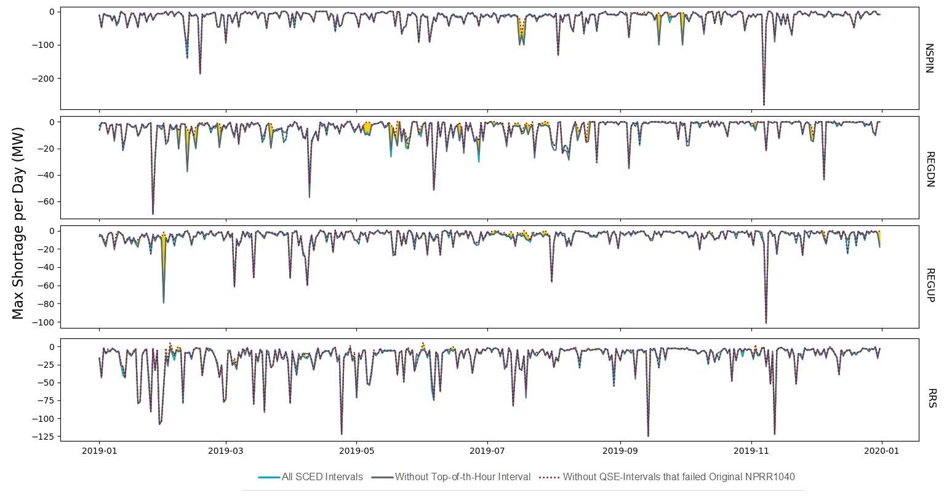
Real-Time Max AS Shortage (2019) Original
Each AS type max shortage could come from a different hour in the day and surpluses within the same AS hour are not included
Yellow shades show where the Daily Max shortage changed after failed QSE data was excluded.

Slide 11
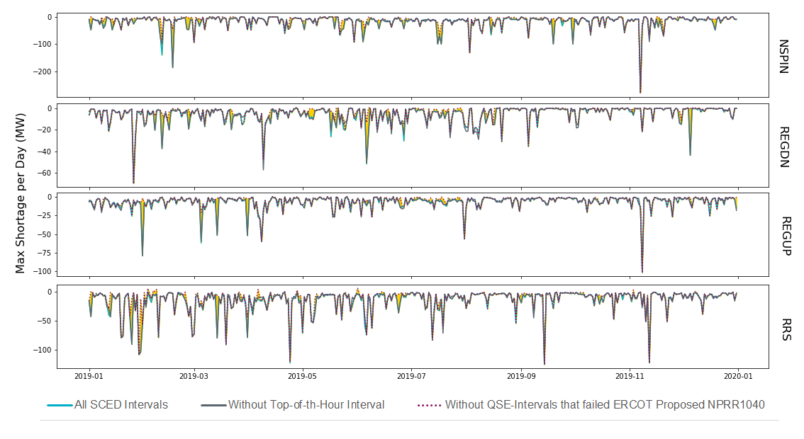
Real-Time Max AS Shortage (2019) Proposed
Each AS type max shortage could come from a different hour in the day and surpluses within the same AS hour are not included
Yellow shades show where the Daily Max shortage changed after failed QSE data was excluded.

Slide 12
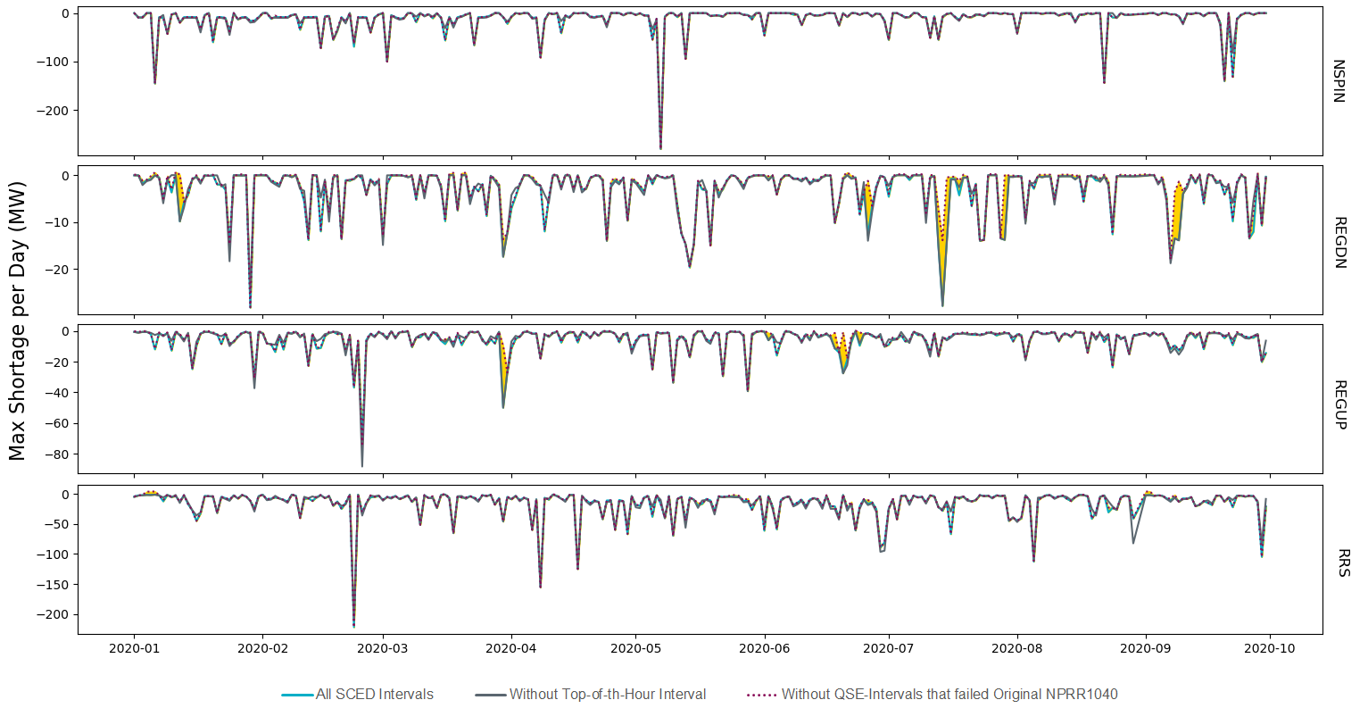
Real-Time Max AS Shortage (2020) Original
Each AS type max shortage could come from a different hour in the day and surpluses within the same AS hour are not included
Yellow shades show where the Daily Max shortage changed after failed QSE data was excluded.

Slide 13
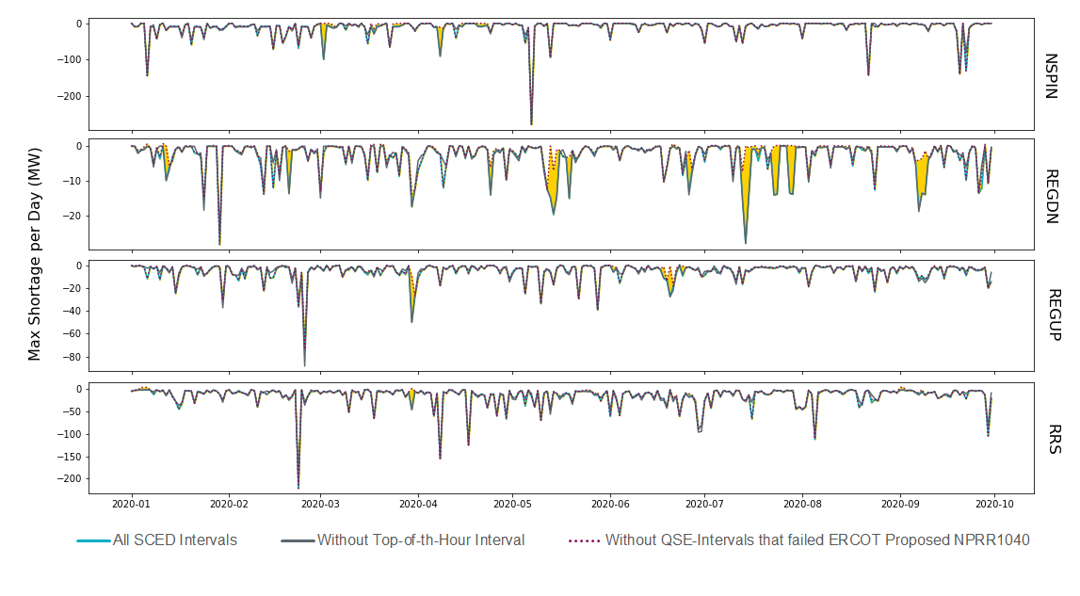
Real-Time Max AS Shortage (2020) Proposed
Each AS type max shortage could come from a different hour in the day and surpluses within the same AS hour are not included
Yellow shades show where the Daily Max shortage changed after failed QSE data was excluded.

Slide 14
Discussion

Slide 15
Common Reasons for Real-Time AS Shortages
Some common reasons for the AS Shortages we noticed were
QSE to QSE AS trade not submitted
Telemetry errors such as incorrect responsibilities
Incorrectly moving AS over the top of the hour or intra-hour
Outage in which QSE is unable to move AS in time
SASM executed but AS can’t be procured for first couple of hours
Incorrect resource status codes

Slide 16
Resource Status Codes for Providing AS
ERCOT EMS and SCED require both correct telemetered responsibilities and resource status code to properly deploy AS in Real-Time
Resource status codes per AS type:
Regulation Up: ONREG, ONOSREG, ONDSRREG, ONOPTOUT, ONRGL, FRRSUP
Regulation Down: ONREG, ONOSREG, ONDSRREG, ONOPTOUT, ONRGL, FRRSDN
Responsive Reserve Service: ONRUC, ONREG, ON, ONDSR, ONOSREG, ONDSRREG, ONEMR, ONRR, ONOPTOUT, ONRGL, ONCLR, ONRL, ONFFRRRS
Non-Spin Reserve Service: ONRUC, ONREG, ON, ONDSR, ONOS, ONOSREG, ONDSRREG, ONEMR, OFFNS, OFFQS, ONOPTOUT, ONRGL, ONCLR
Note: Non-Spin can be in STARTUP or SHUTDOWN when being deployed
Notes:
Resource status codes are specified in implementation for providing AS in order to mitigate gross telemetry issues when the telemetered AS responsibility may not be correct.

