Slide 1
MIS & ERCOT.com User Workshop
October 21, 2020

Slide 2
Agenda
MIS Project Background
  Scope of Changes
  Review MIS Go-Live Plan
  What Is and Isn’t Changing ?
Feedback on remaining technical issues
MIS Integrations

Slide 3
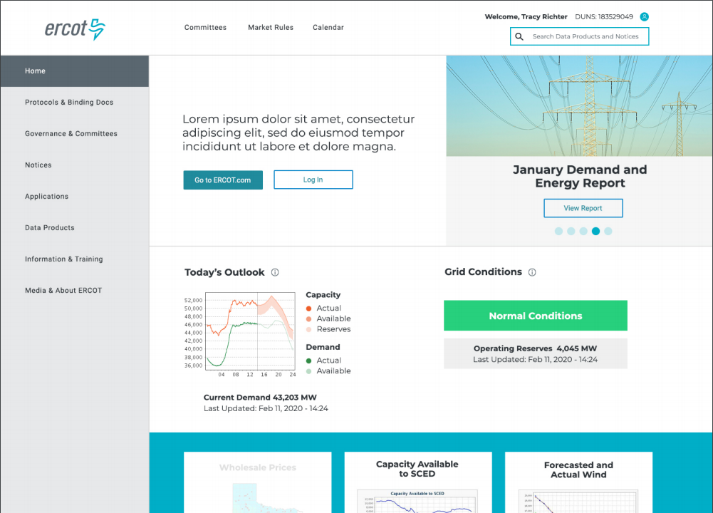
MIS Redesign Scope
Updated user interface
Improved search & metadata
Integrated EMIL & report links
Easier access to applications
Updated technology platform
More secure

Slide 4
MIS Redesign Benefits
Improved Market Data Transparency (MDT)
  What data is available?
  How often is data updated?
  Which reports have data?
One-Stop Information Clearinghouse
  Integrated platform with ERCOT.com
  Responsive design for use on multiple devices
  Applied taxonomy and improved search
Maintain Technical Health

Slide 5

MIS Release Timeline
EMIL Web Interface Release
Sandbox Version New MIS
MIS Production Soft Launch
MP Testing
MIS Production Go-Live
Decommission
Old MIS
Transition ERCOT.COM Content into Integrated Platform
Jan 30th
May 26th
Sept 16th
Nov 11th
Q1
Q1- Q4
2020
2021
2020
Jan 30th | EMIL web interface release ✓
May 26th | Sandbox version of new MIS ✓
Sept 16th | MIS Production soft launch for MP testing ✓
Nov 11th | MIS Production Go-Live
2021
Q1 | Decommission old MIS
Q1 – Q4 | Transition ERCOT.COM content into integrated platform

Slide 6
Impacts to data access
The following changes have been visible in the Soft Launch MIS released on September 16, 2020.
URL change
/public vs /secure
No more pop-up for data links
Underlying HTML source
No additional changes are expected to those aspects for the November 11, 2020 Go-Live.

Slide 7
Screen Scraping: URL Scenario #1
Q: We currently parse the HTML source of the predictable URL (https://mis.ercot.com/misapp/GetReports.do?reportTypeId= [6 digit REPORT TYPE ID])
in order to get a list of available files (since the source code contains <a href='/misdownload/servlets/mirDownload?mimic_duns=0805522512000&doclookupId=715089663'>zip</a>).
Can you tell me if the above predictable URL will continue to exist after November?
A: While ERCOT does not support screen scraping, MIS App Get Reports will remain in place until June 2021. ERCOT will communicate exact dates as more information is known.

Slide 8
Screen Scraping: URL Scenario #2
Q: Can MPs hit the new MIS JSON endpoints for document list and download as an alternative to screen scraping and hitting the MIS popup?
https://mis.ercot.com/misapp/servlets/IceDocListJsonWS?reportTypeId=XXXXX
A: ERCOT does not support screen scraping, but the above service is used to generate MIS report lists and download links and is not currently slated for modifications. Any changes to those endpoints will be communicated via Market Notice.
Use of that service should adhere to the ERCOT Terms of Use for all reports outlining the policy around download frequency.

Slide 9
Screen Scraping Supportability Challenges
Users engaging in parsing data from the ERCOT Market Information System (MIS) may cause system reliability issues.
Automated systems pulling data from a GUI based system have the potential to overwhelm the GUI systems.
ERCOT will deny access to IPs using poorly written code or macros that saturated the report download bandwidth.
ERCOT will make an attempt to contact the company that is found to be the cause of the degradation.
In severe cases, ERCOT will block offending IP to maintain reliability. Blocked IP addresses will not be allowed to reconnect until corrective action is taken by the user.

Slide 10
Integration Help and Documentation
ERCOT provides documentation on the EWS API system.
ERCOT provides Terms of Use for all reports outlining the policy around download frequency.
The ERCOT Market Information List (EMIL) details all market products required to be supplied by Protocols or other binding documents.
Client Services representatives are available to assist MPs in finding information that ERCOT has made available.
ERCOT is unable to provide API code as each MPs implementation is different.
ERCOT cannot consult on implementations other than basic troubleshooting.

Slide 11
Communication Moving Forward
MIS User Workshops will resume in November.
Contact your Client Services representative with questions.
Report bugs to the ERCOT HelpDesk.
Feedback at any time to webmaster@ercot.com
Redesign info: www.ercot.com/about/redesign

