Slide 1
DGRX workshop update
Bill Blevins

Slide 2
DGR Update
September 26, 2019 ERCOT issued market notice regarding DGR interconnection practices informing folks that ERCOT was going to put on a moratorium on new DGR until we wrote rules for incorporating DGR.
DGRs submitted affidavits to legal by October 28, 2019 and 41 total DGR projects were allowed to move forward under the DGR conditions specified. See map provided
February 2020 ERCOT system and model testing to decide what kind of interim solution and system changes would be needed to help support managing DGR in our systems.
ERCOT presented its findings from testing at the DGR workshop IV.
ERCOT filed NPPR 1016,NOGRR 212 and RRGRR026 addressing rules for DGR interconnection March 25, 2020.
DGR workshops after workshop V focused on methods for integrating and improving visibility of DGR and SODG
ERCOT filed PGRR 082 June 30, 2020 to address integrating DGR and SODG.
August of 2020 the NPRR 1016,NOGRR 212 and RRGRR 026 were approved.
PGRR81 and 82 were approved by ROS Oct 08 2020 (included additions for Self-Limiting Facilities applicable to GR and ESRs).

Slide 3
DGR items related NPRR system changes
July was last DGR workshop today’s workshop will focus on discussions related to Self-Limiting Settlement-Only Generators which were not covered in PGRR-81 or PGRR-82.
MPs will be interested in where we stand with the implementation of the project and system changes associated with the NPRR.
  Over the last several weeks we’ve kicked off the initial project phases for the DGR solution in the interim.
  The teams are just now going to the requirements and putting together the scope of necessary changes.
  Do not have a schedule of when that will be completed.
  The current IA says 12 to 18 months until the team completes the planning phase of this work.
  We don’t have anything more concrete to share on schedule but are hoping to have more info as the project gets further down the path.
  ERCOT understands a lot of MPs would like to see this work done as soon as possible and we have informed the project team to be expected to deliver it as efficiently as possible.

Slide 4
DGR items related to PGRR system changes
Associated with the PGRR 82 there will be system requirements for the RIOO application. So our goal is to get the PGRR-82 approved by this December.
ERCOT is currently rolling out improvements to the RIOO system for existing resources.
Once all those features are made available the team will focus on the create functions for new registrations of resources
They will work on features related to DGR, PGRR-81 and PGRR-82.
  So assuming that PGRR-81 and 82 are approved in Dec they can start that work sometime next year hopefully without any delay to their work plan.
So next year would be implementing the tool changes for this DGR related work and then all projects Large and small would be included in the RIOO system and we would have tool for managing them once they came on line.

Slide 5
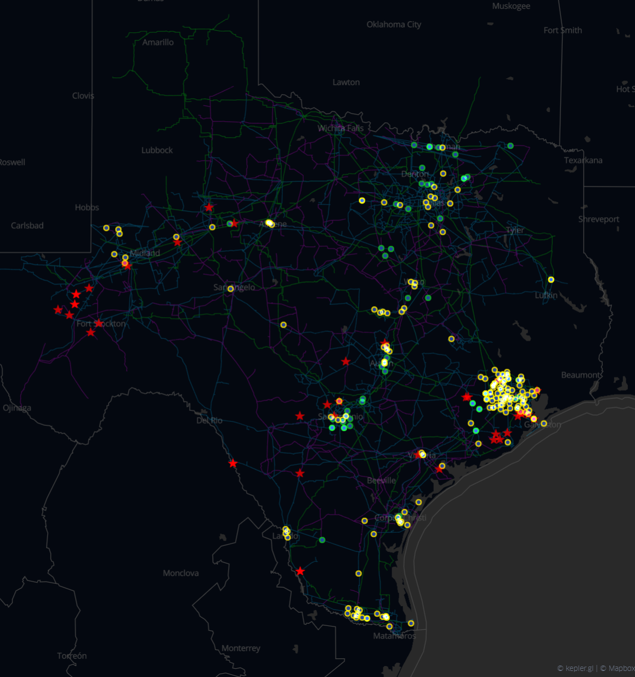
DGR and SODG current
Red Stars are DGR/DESR-41 site ~370 MW that were included before DGR moratorium.
Circles are SODG. Yellow being Controllable by the owner and green being non-Controllable
Total 241 sites ~850 MW

