Slide 1
Review Forward Adjustment Factors – Summer 2020
Spoorthy Papudesi
Credit Work Group
ERCOT Public
October 16, 2020

Slide 2
Forward Adjustment Factor Scenarios
Scenario Number | Week1 Weight | Week2 Weight | Week3 Weight
1 | 0.5 | 0.5 | 0
2 | 0.75 | 0.25 | 0
3 | 0.5 | 0.25 | 0.25
4-Current | 0.33 | 0.33 | 0.33

Slide 3
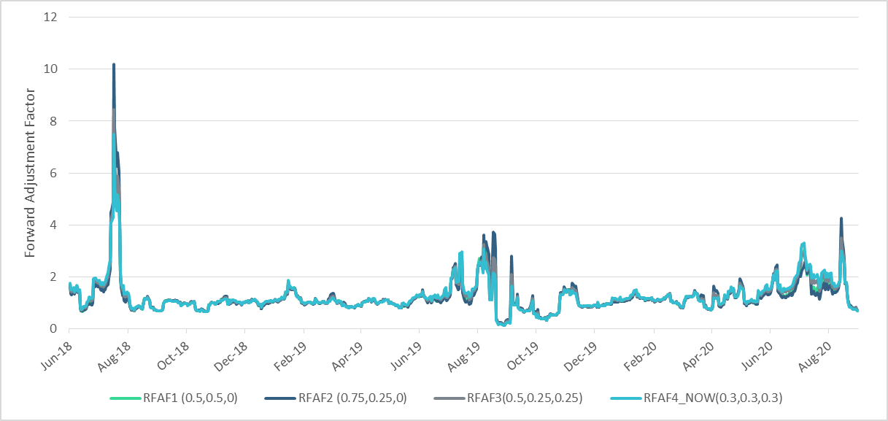
Real-Time Forward Adjustment Factor (RFAF)

Slide 4
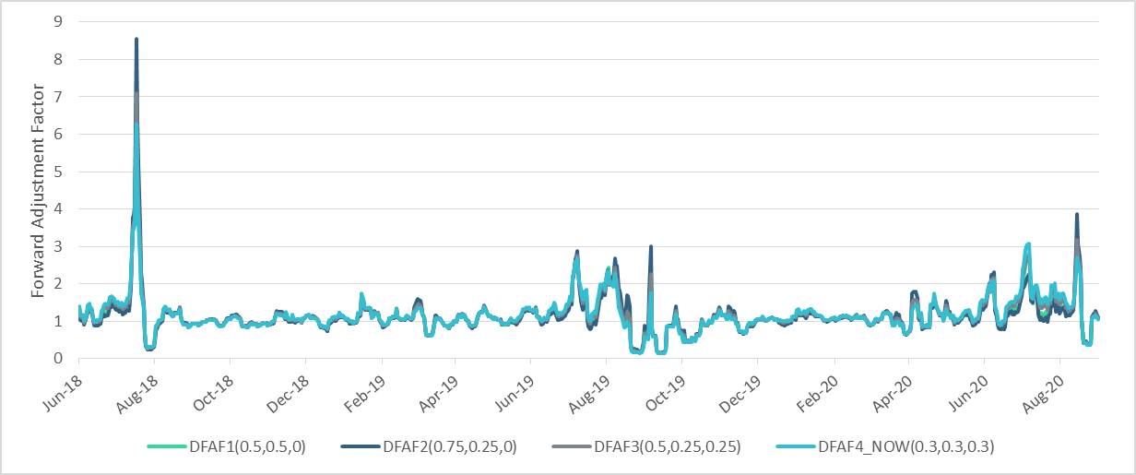
Day-Ahead Forward Adjustment Factor (DFAF)

