Slide 1
Potential August 2020 DAM/CRR Credit Risk Misalignment
CWG/MCWG – October 16, 2020
Clif Lange - STEC

Slide 2
Background
Hurricane Hanna impacted South Texas and the Rio Grande Valley on July 25, 2020
Outages of two AEP transmission lines in the area of Edinburg caused a significant amount of congestion through August 10, 2020 when the lines were returned to service
  South Load Zone prices were significantly higher in both DAM and RTM
Significant increases in collateral requirements were observed as a result of the congestion
The higher collateral requirements were exacerbated by higher DFAFs in mid-August

Slide 3
Identified Issue
DALE (i.e. 7-day average of prior DAM activity) is multiplied by DFAF to capture changes in forward market expectations
  Works well when congestion is minimal
CRR settlements are not projected forward using DFAF
  CRR credits/charges netted only for days that are unbilled or invoiced
In instances where DALE*DFAF increases substantially due to congestion, there is not a corresponding projected offset at the Counter-party level for CRRAH activities, particularly for CRRAH with a book heavy with Options
Result is dramatic over-collateralization of Counter-Party, particularly when the CP, QSE, and CRRAH are the same legal entity
The entity can be owed millions by ERCOT, yet the TPEA calculations show the CP to be a significant credit risk to ERCOT, whereas the risk of default is in the opposite direction

Slide 4
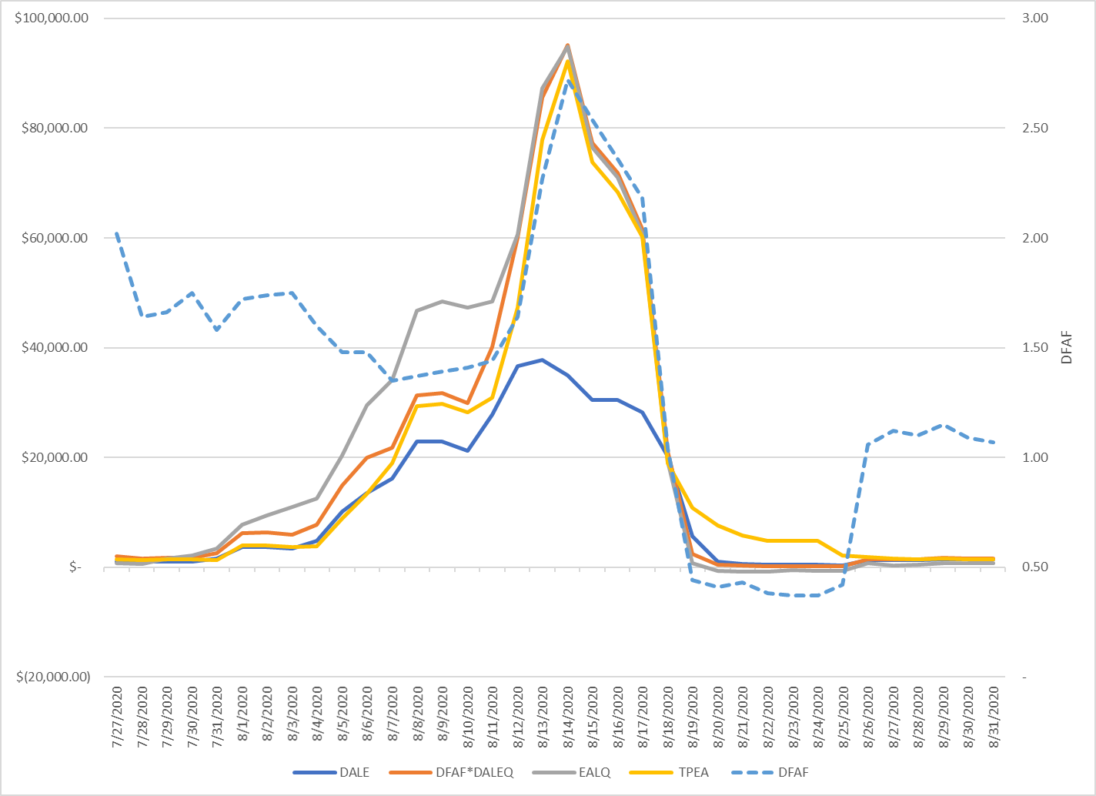
July 27 – Aug 31 Example
Notes:
DFAF increased mid-month as forward prices increased.

Slide 5
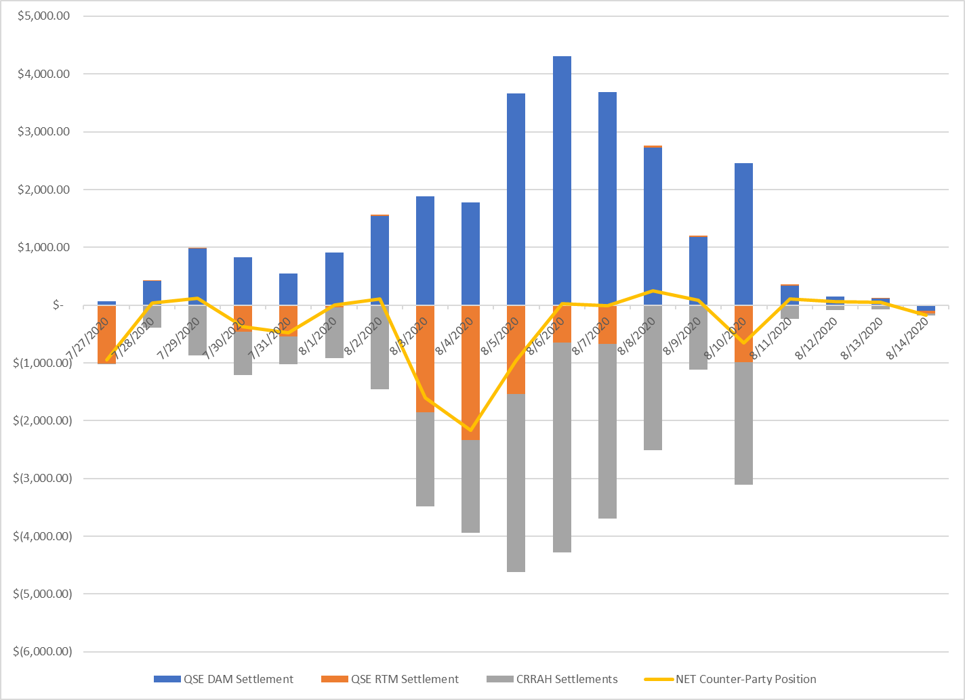
Counter-Party Constituent Settlements
Positive values imply monies paid to ERCOT

Slide 6
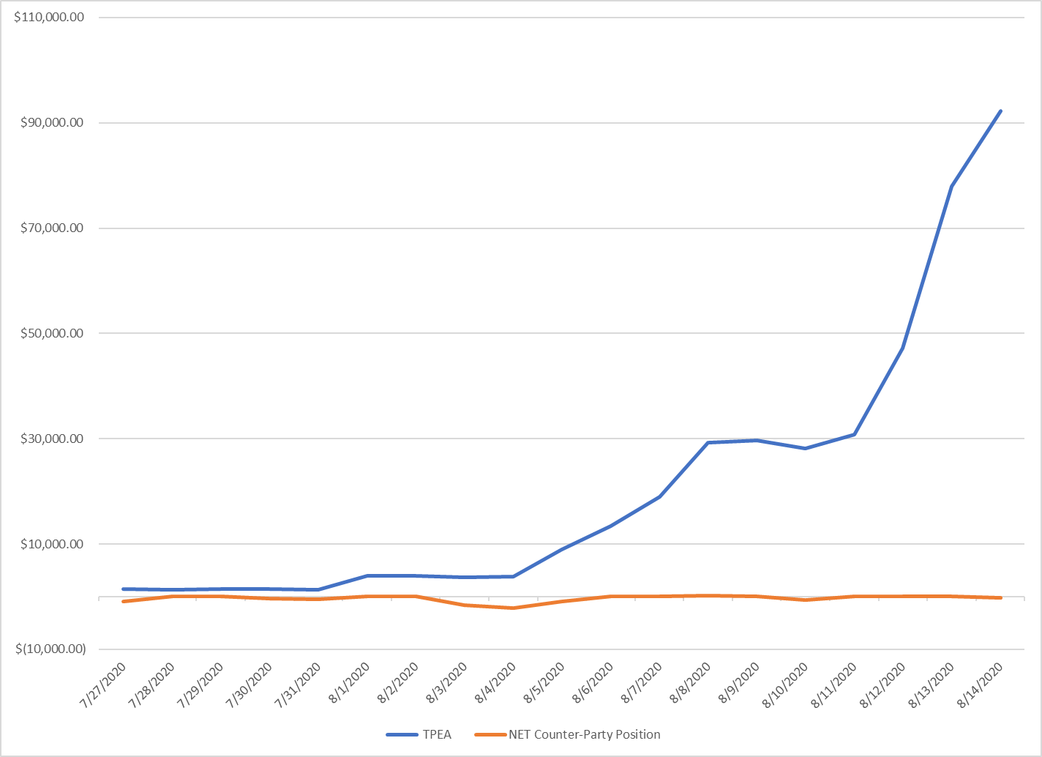
Disconnect Between Perceived Risk and Counter-Party Position

Slide 7
Potential Solution
Extrapolate CRRAH activities using a methodology substantially similar to DALE for qualifying Counter-Parties
Potential Qualifying Criteria
  All entities registered to a CP must be the same legal entity
  CRRAH book must consist of at least X% of options
Separate Issue: Should RTLE use an average similar to DALE rather than a max lookback over 45 days?

