Slide 1
ERCOT Frequency Control Report
September 2020
ERCOT
Operations Planning
PDCWG | October 14th, 2020

Slide 2
Summary of September 2020
CPS1: 173.56%
Current CPS1 12-Month Rolling Average: 172.43%
0 BAAL Exceedance
2 hourly CPS1 score below 100%
BAAL-003 Events have updated through 2019
2019 BAAL-003 FRM Performance: -811.14
2020 RMS1 Statistics
Mean: 16.05 mHz
Min: 12.25 mHz
Max: 22.6 mHz
Energy Statistics
Total Energy: 32,735,862 MWh
Wind Energy: 5,026,960 MWh
Percent Energy from Wind: 15.36%
Solar Energy: 782,376 MWh
Percent Energy from Solar: 2.39%
Minimum System Inertia
Mean: 238, 595 MW*s
Max: 285,477 MW*s on Sep 3rd
Min: 168,441 MW*s on Sep 27th
Notes:
2018 BAAL-003 FRM Performance: -843.17

Slide 3
Frequency Control
CPS1, BAAL, & RMS1

Slide 4
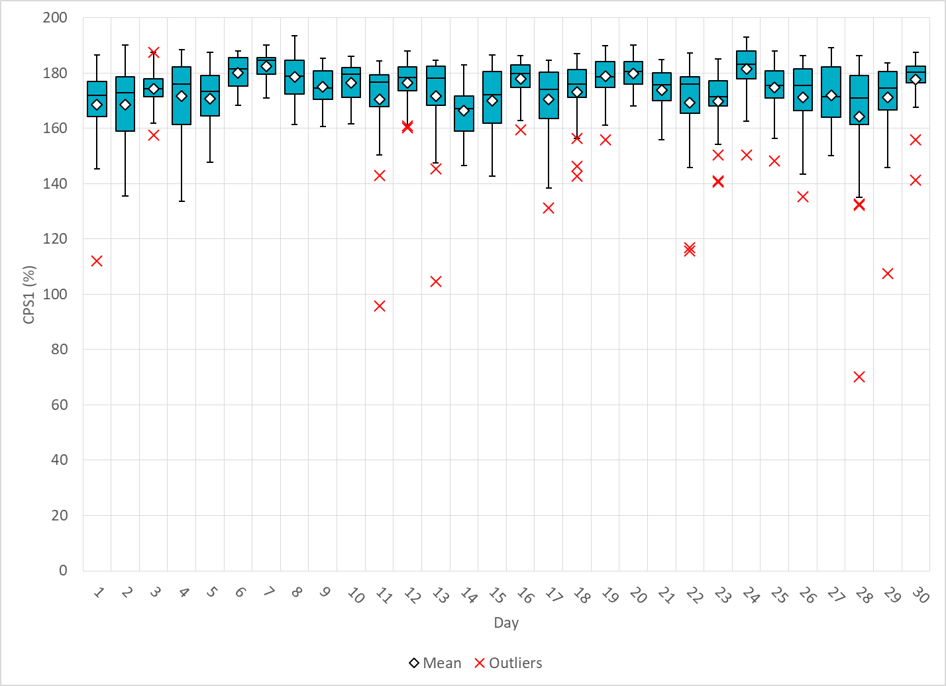
Hourly CPS1 by Day
Sep-20 CPS1 (%): 173.56
Notes:
Outliers:
1. 95.70% @ 9/11/2020 17:00
Expected Gen Dev:
Large exp. Gen. dev of -739 MW @ 17:59 mostly due to solar
Large exp. Gen. dev of -605 MW @ 17:23 mostly due to solar
Wind/Solar Ramp:
A 520 MW Solar down-ramp within a 23 minute period in the middle of the hour.
A 206 MW Solar down-ramp within a 5 minute period at the end of the hour.
Regulation: Regulation up exhausted for over half of the hour
70.10% @ 9/28/2020 18:00
Expected Gen Dev:
Expected gen dev remains negative throughout the entire hour.
Large exp. Gen. dev of -1969 @ 18:39 mostly due to solar and wind units
Large exp. Gen. dev of -2262 @ 18:39 mostly due to solar and wind units
Wind/Solar Ramp: Wind and solar consistently ramp down sharply during the second half of the hour.
Solar ramps down from 1452 MW to 438 MW between 18:30and 19:00
Wind ramp down from 13443 MW to 11799 MW between 18:30 and 19:00.
Regulation: Regulation up exhausted for the most part of the hour.
Manual SCED Rest: A manual SCED reset at 18:47 due to frequency drag, reg up fully deployed and renewables sharply ramping down.

Slide 5
BAAL Exceedances & Violations
There was 0 BAAL exceedance in Sep

Slide 6
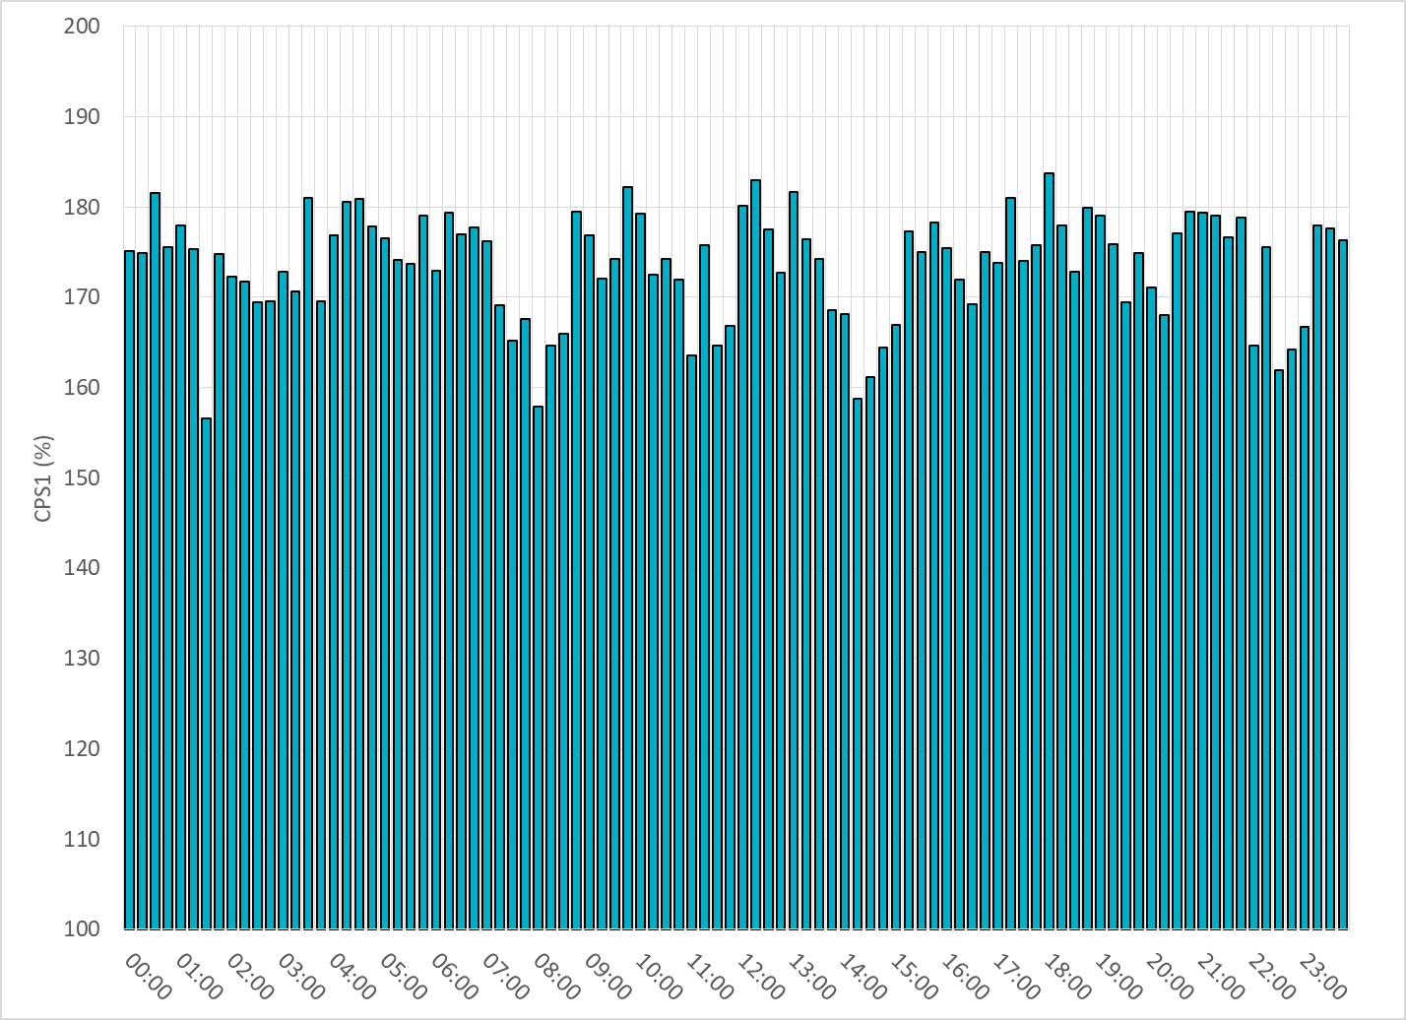
15-Minute Average CPS1%
Sep-20 CPS1 (%): 173.56

Slide 7
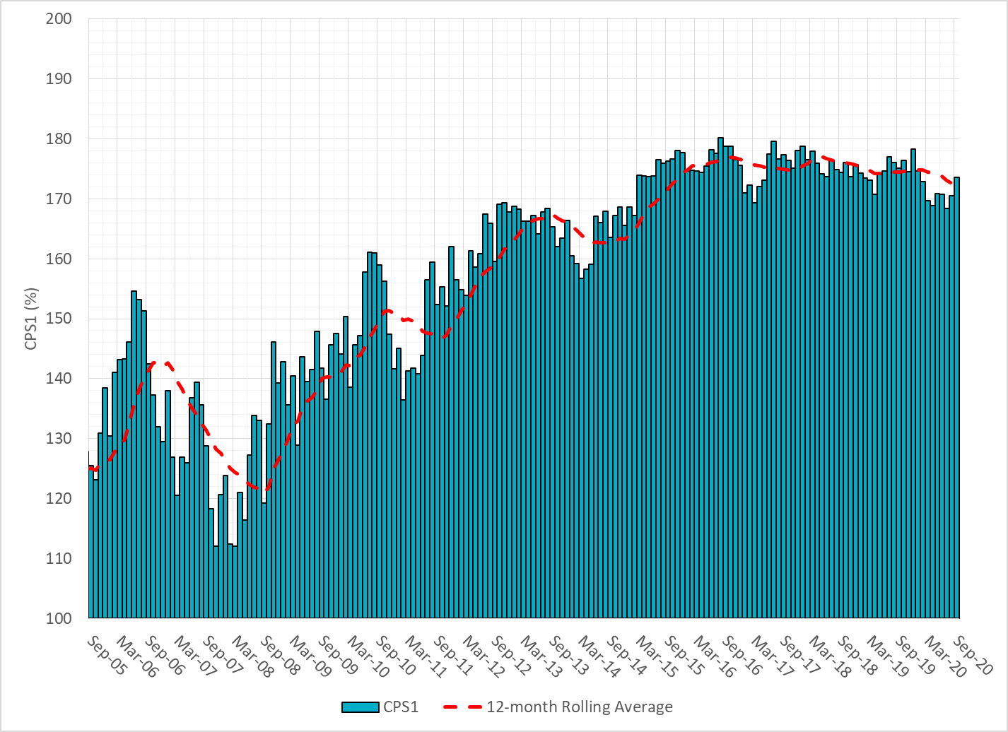
12-Month Rolling Average CPS1
Current 12-Month Rolling Average: 172.43%

Slide 8
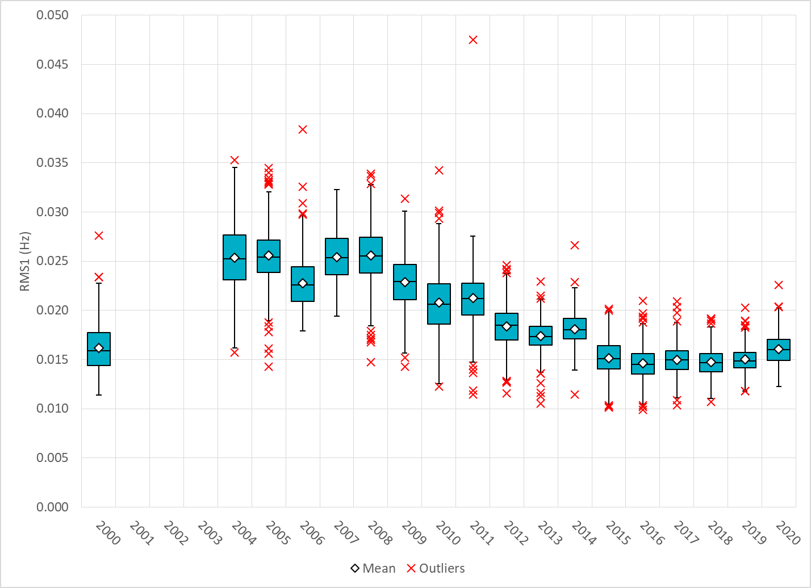
Daily RMS1 of ERCOT Frequency by Year

Slide 9
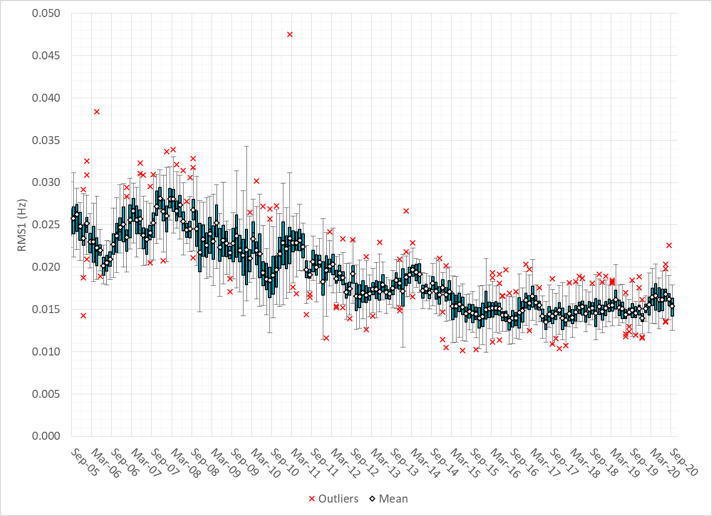
Daily RMS1 of ERCOT Frequency by Month

Slide 10
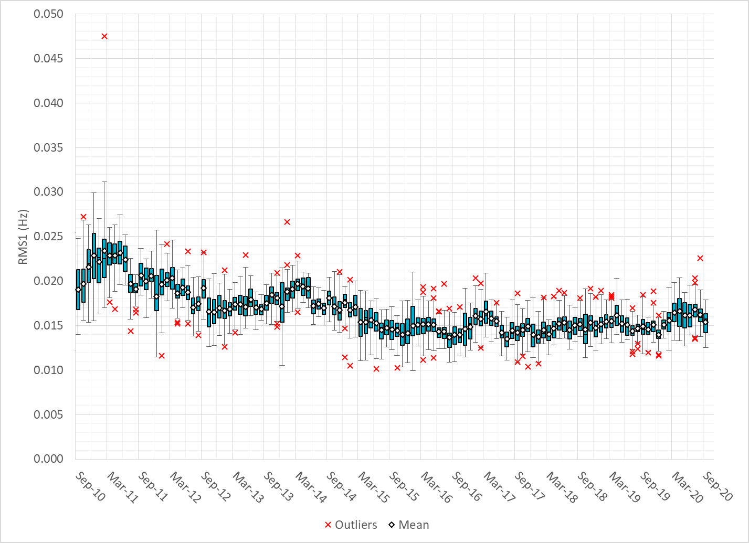
Daily RMS1 of ERCOT Frequency by Month

Slide 11
Frequency Profile Comparison

Slide 12
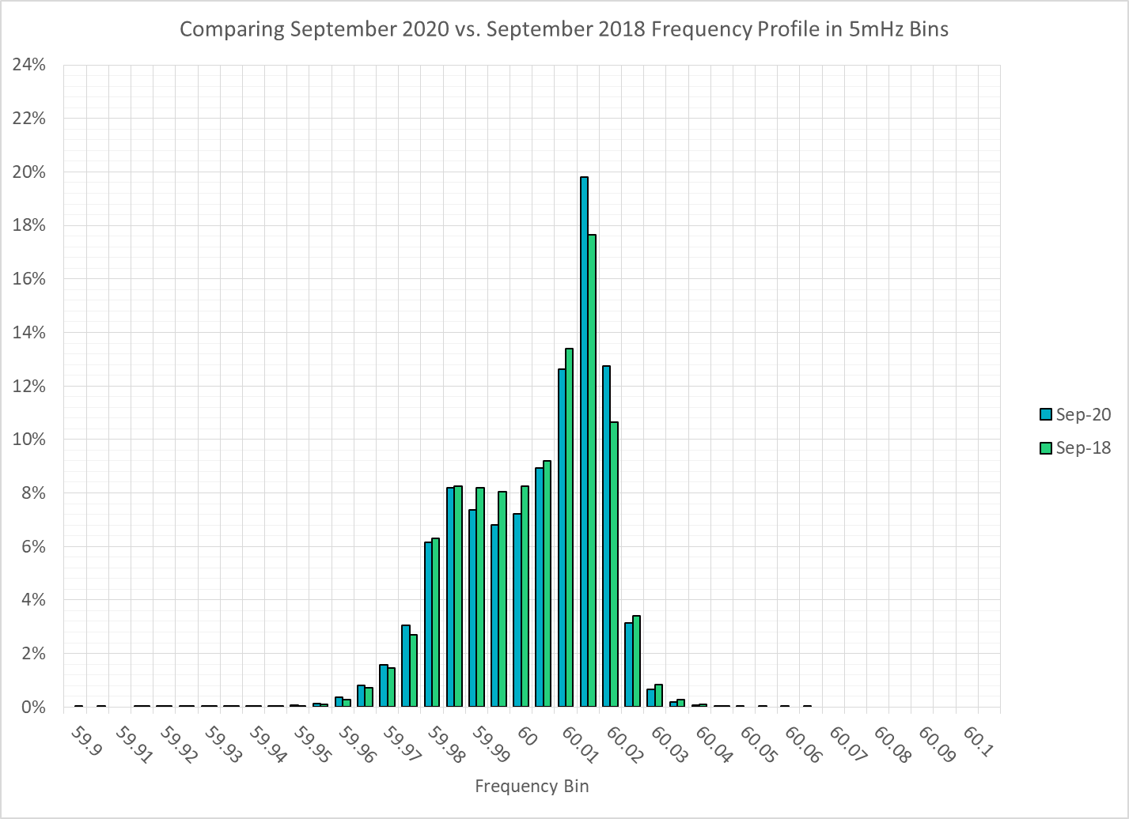
Frequency Profile Comparison

Slide 13
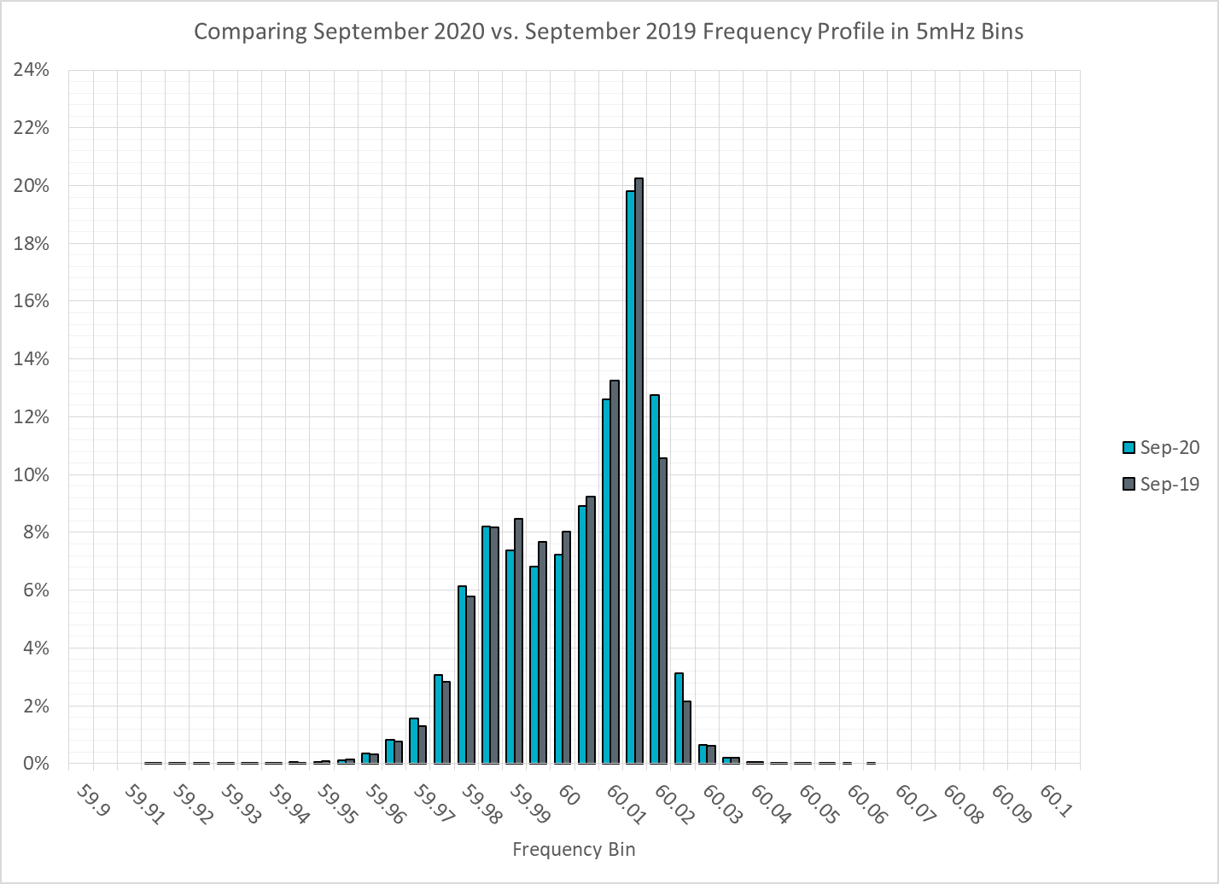
Frequency Profile Comparison

Slide 14
Time Error Correction

Slide 15
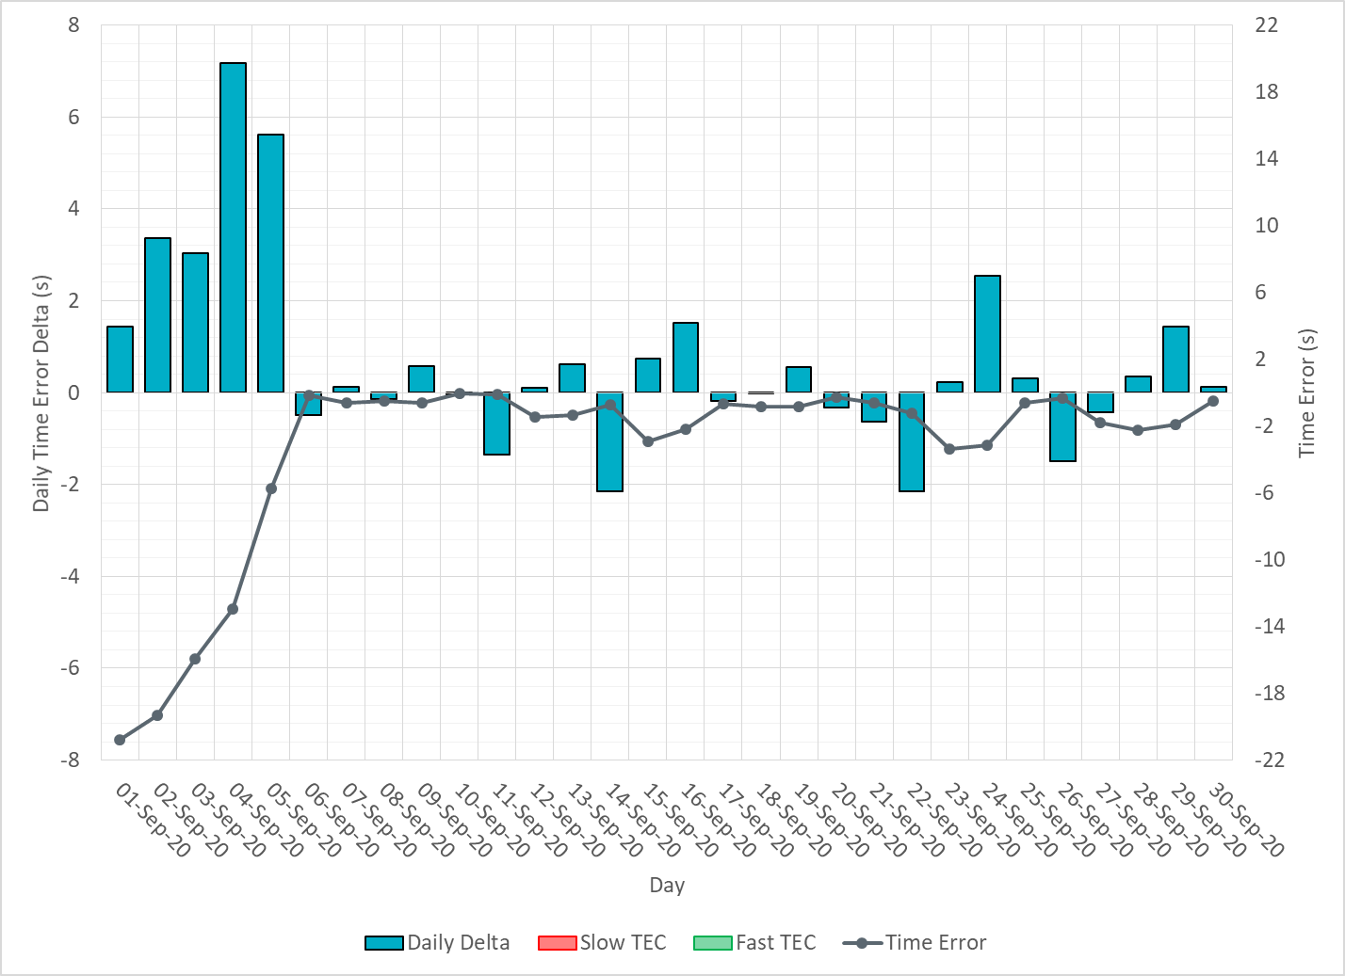
ERCOT Daily Time Error

Slide 16
Time Error Corrections Log Summary
There have been no time error corrections since December 2016

Slide 17
BAL-003 Performance

Slide 18
Op. Year 2019 BAL-003 Selected Events – Update
Notes:
BAL-003

Slide 19
Op. Year 2018 BAL-003 FRM Performance - Update
Notes:
OP2018: FRO = -381.0, FRM_median = -843.17, FRM_average = -959.7
OP2019: FRO = -381.0, FRM_median = -811.14, FRM_average = -892.5
OP2020: FRO = -425.0,

Slide 20
ERCOT Energy Statistics

Slide 21
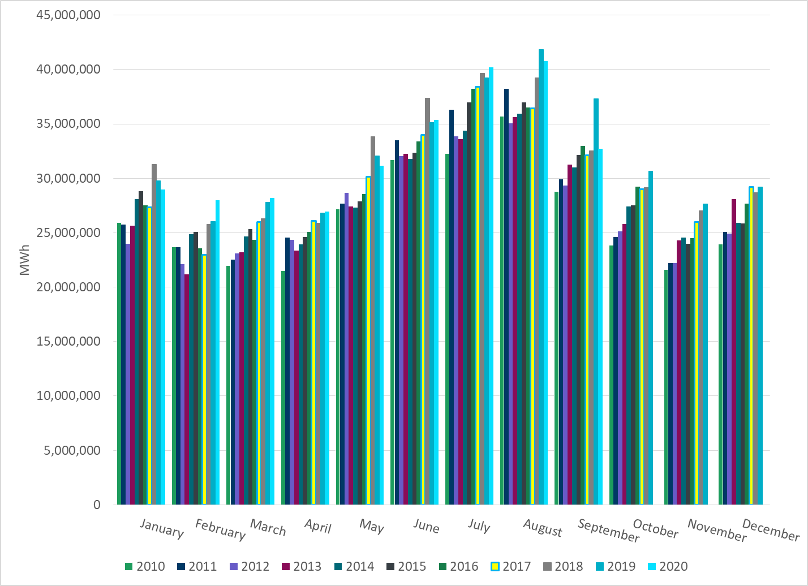
Total Energy
Notes:
32,735,862 MWh

Slide 22
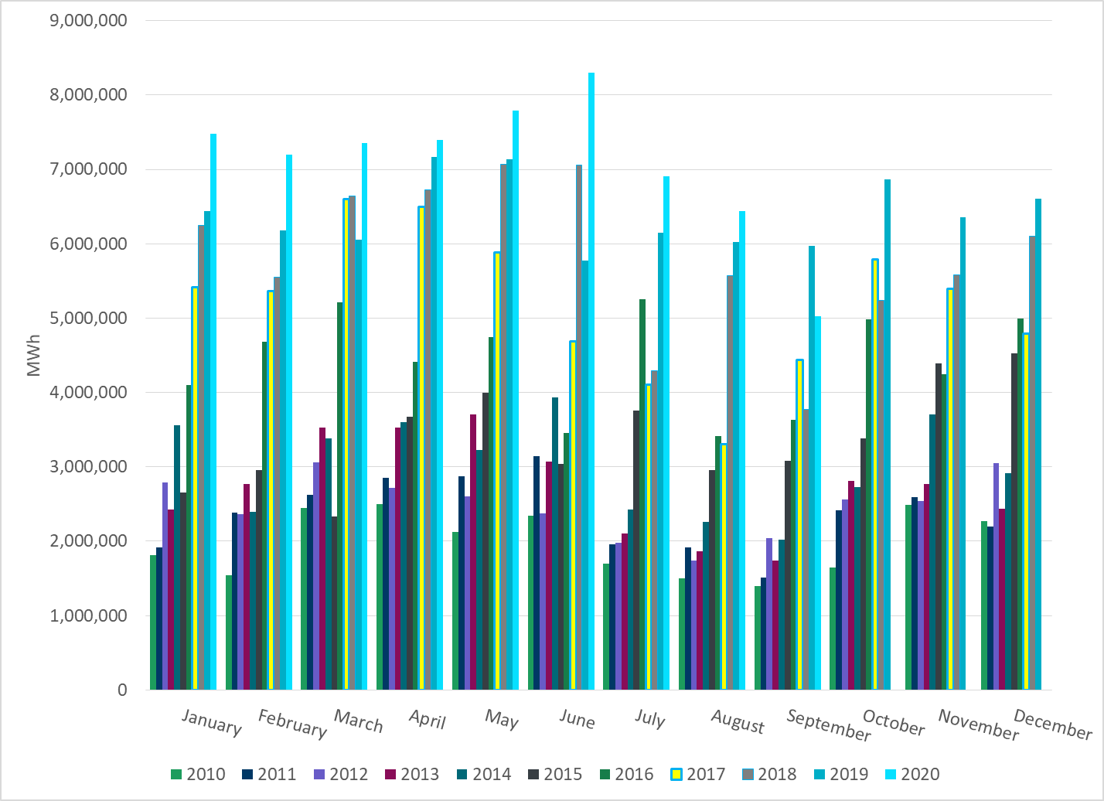
Total Energy from Wind Generation
Notes:
5,026,960 MWh

Slide 23
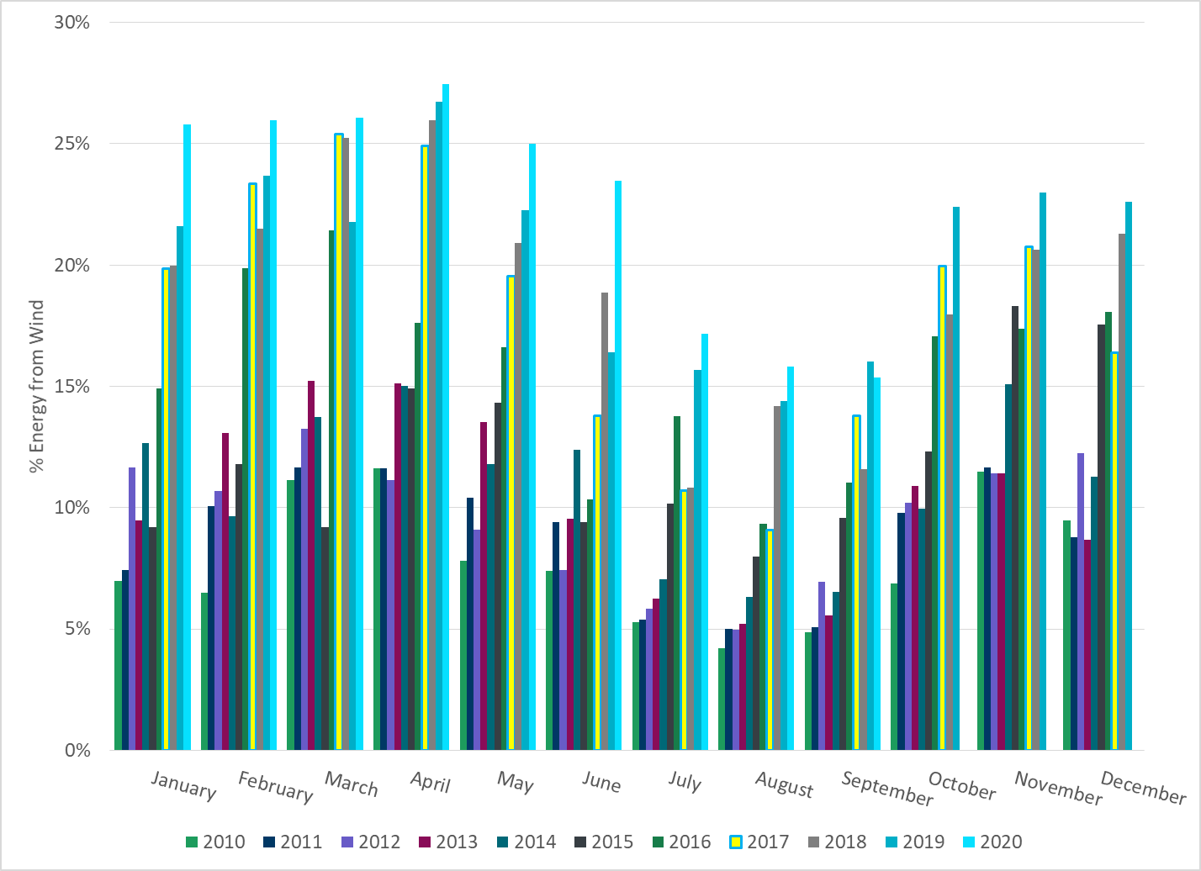
% Energy from Wind Generation
Notes:
15.36%

Slide 24
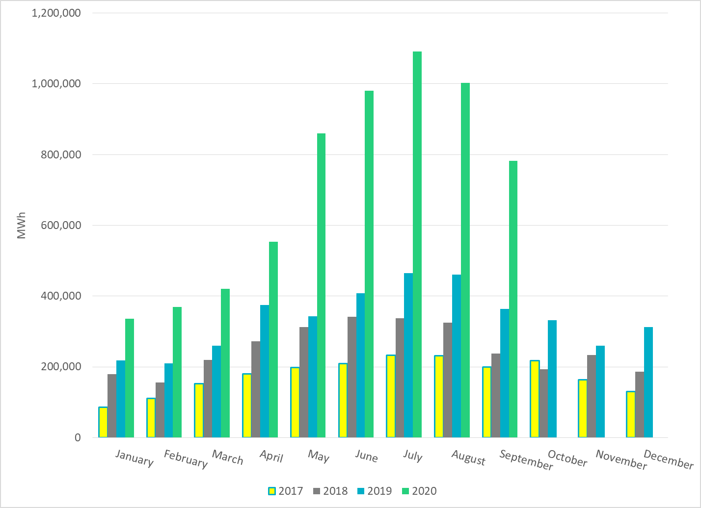
Total Energy From Solar Generation
Notes:
782,376 MWh

Slide 25
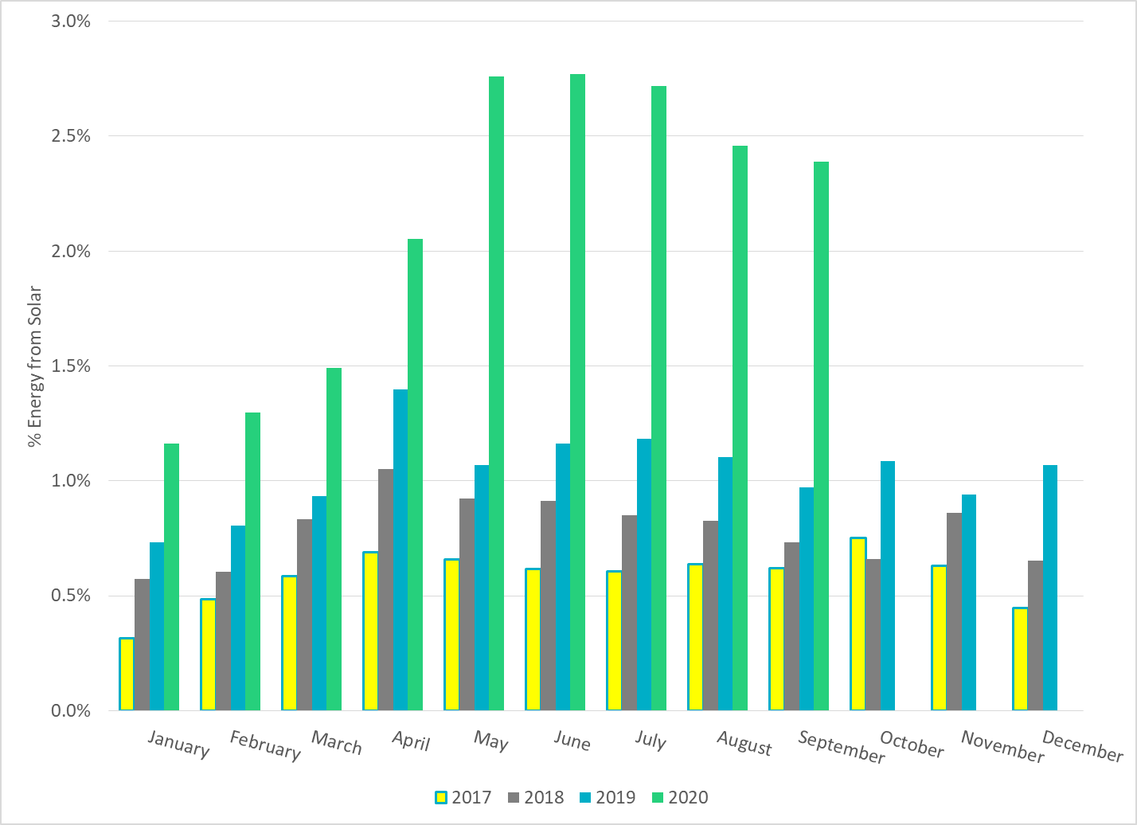
% Energy from Solar Generation
Notes:
2.39%

Slide 26
ERCOT System Inertia

Slide 27
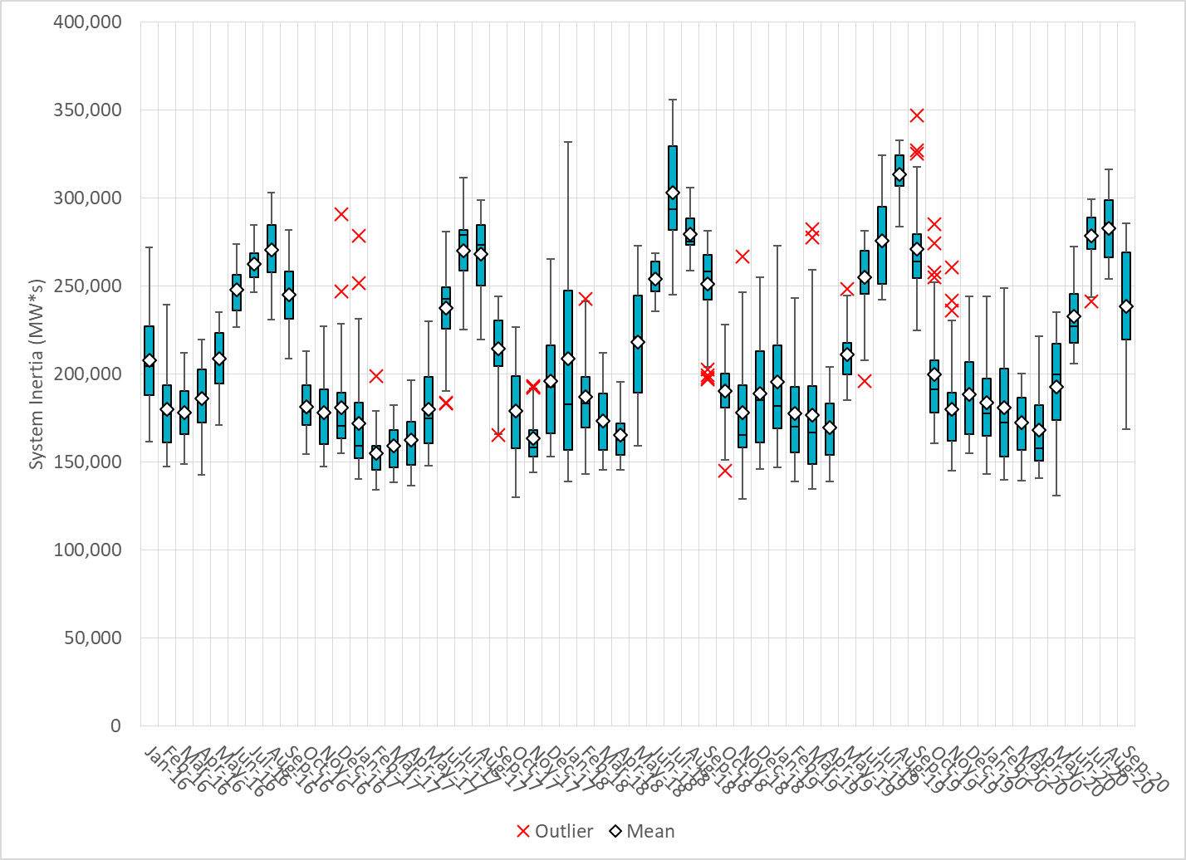
Daily Minimum System Inertia
Notes:
Minimum Inertia = 168,441 MW*s on 9/27/2020
Previous Minimum was 128,759 MW*s on 11/18/2018.
Data:
Mean: 238,595
Max: 285,477 on Sep 3rd
Min: 168,441 on Sep 27th

Slide 28
Questions?
Thank you!

