Slide 1
Notable Frequency Excursion Events
Operations Analysis
Oct.14 , 2020

Slide 2
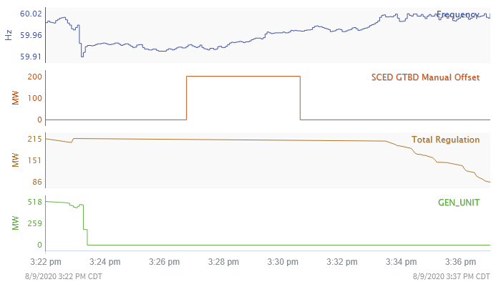
Aug 9, 2020 15:23 to 15:33
A
D
B
AC = 5 s
CD = 8 min
C
SCED run times
Frequency declined to as low as 59.911 Hz, Recovery time was 8 minutes.
Loss of generator (~480 MW).
Regulation up service fully deployed prior to the event.
RRS did not deploy, since the frequency did not dip below 59.910Hz. Missed the opportunity of the
automatic SCED run 1 minute after RRS.
Event occurred in the middle of the SCED run.
GTBD manual offset of 200 MW was applied at 15:26:40.

Slide 3
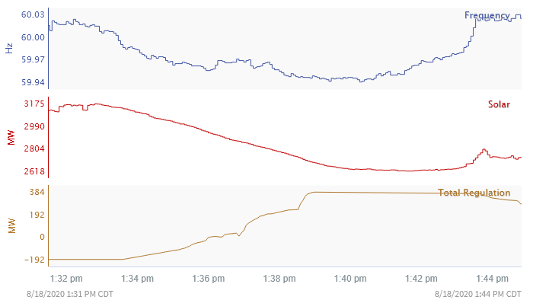
Aug 18, 2020 13:33 to 13:43
SCED run times
Frequency declined to as low as 59.938 Hz.
The main cause was solar ramp down of 550 MW from 3175MW (@13:32) to 2617 MW (@13:41).
A total of 384 MW of regulation up was deployed from 13:38 to 13:43.
No manual offsets were applied to the SCED.

