Slide 1
NERC GMD Data Collection Update
Mark Henry
Texas RE Reliability Services
October 6, 2020

Slide 2
GMD Data Collection Background
NERC GMD Background and Summary as of October 1, 2020
NERC Board approved Rules of Procedure Section 1600 data request for collecting GMD data in August 2018
Responds to FERC Order No. 830 directives for collecting data to “improve our collective understanding” of GMD risk
NERC developed the GMD Data Request with GMD Task Force (GMDTF) and technical committee input
NERC Staff has completed development of the GMD Data Portal for implementation in October 2020
All Generation Owner (GO) & Transmission Owner (TO) entities must confirm initial applicability by November 15, 2020 in the ERO Registration application
Reporting entities must report data annually by June 30 of each year
First collection deadline June 30, 2021
GMD Data Collection Update October 6, 2020
Notes:
[The Commission] also direct NERC, pursuant to Sections 1500 and 1600 of the NERC Rules of Procedure, to collect and make GIC monitoring and magnetometer data available. We determine that the dissemination of GIC monitoring and magnetometer data will facilitate a greater understanding of GMD events that, over time, will improve Reliability Standard TPL-007-1. The record in this proceeding supports the conclusion that access to GIC monitoring and magnetometer data will help facilitate GMD research, for example, by helping to validate GMD models.
- Order No. 830 P 93

Slide 3
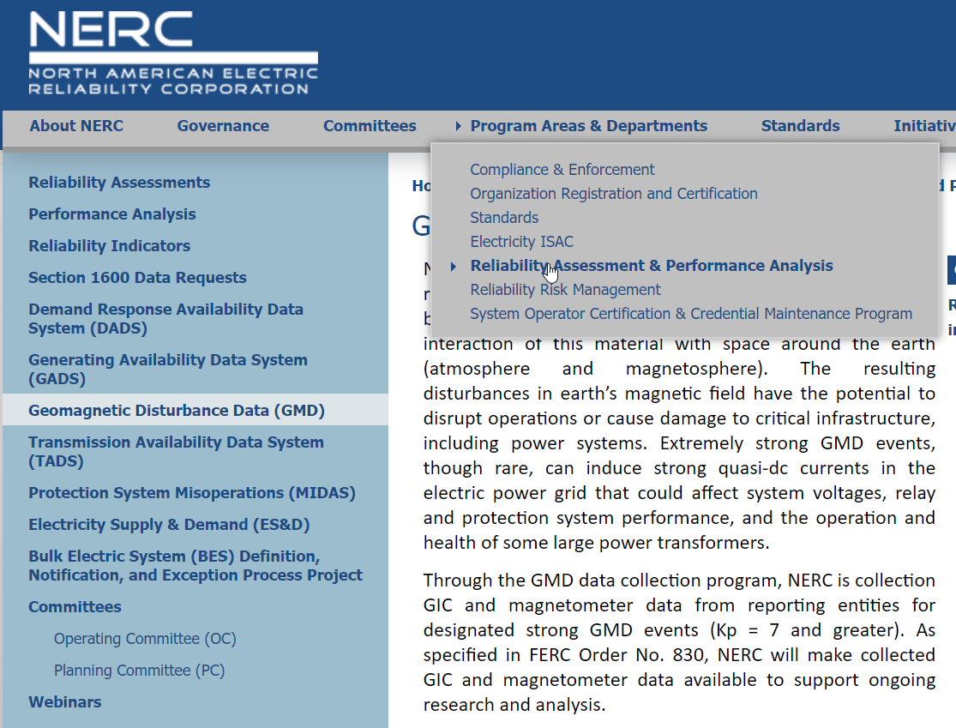
Data Reporting Information
Where Do I Get Information and Instructions?
NERC’s GMD Data web page has instructions and links
Data Reporting Instruction (DRI) has been developed by NERC with GMDTF support
Assists NERC and reporting entities in fulfilling the GMD Data Request reporting requirements
Specifies processes, formats, and timelines for data collection
NERC Planning Committee (PC) reviewed in January and provided comments
GMD Data Collection Update October 6, 2020

Slide 4
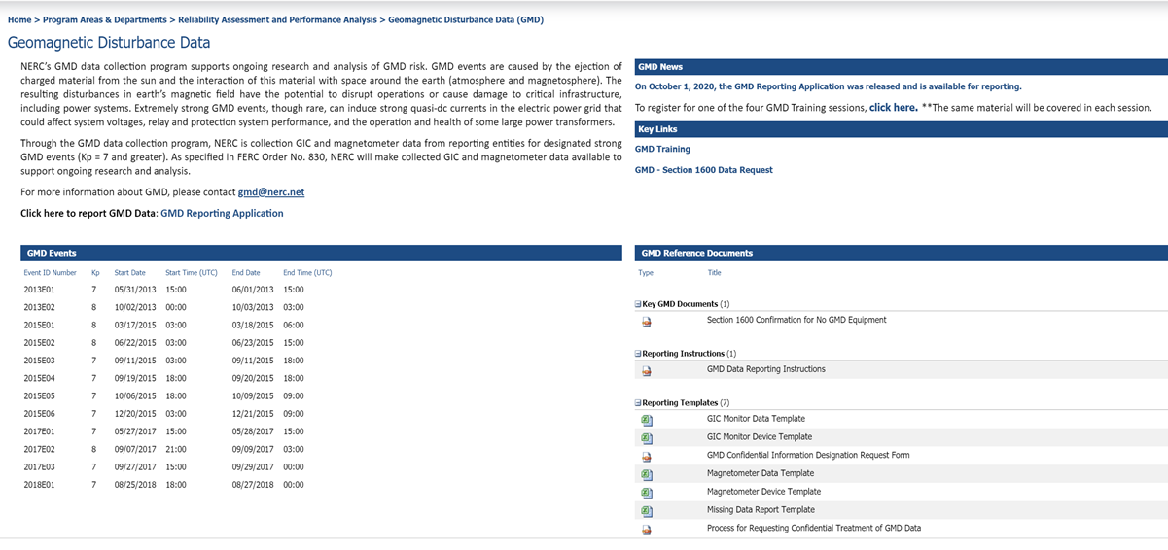
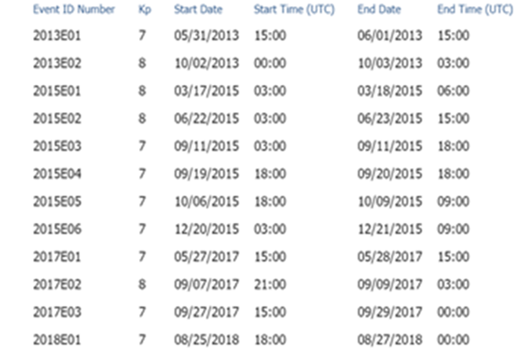
Current GMD Page
NERC GMD Webpage as of October 1, 2020
GMD Data Collection Update October 6, 2020
Notes:
12 events
Confirmation instructions
DRI
Templates
Confidentiality process

Slide 5
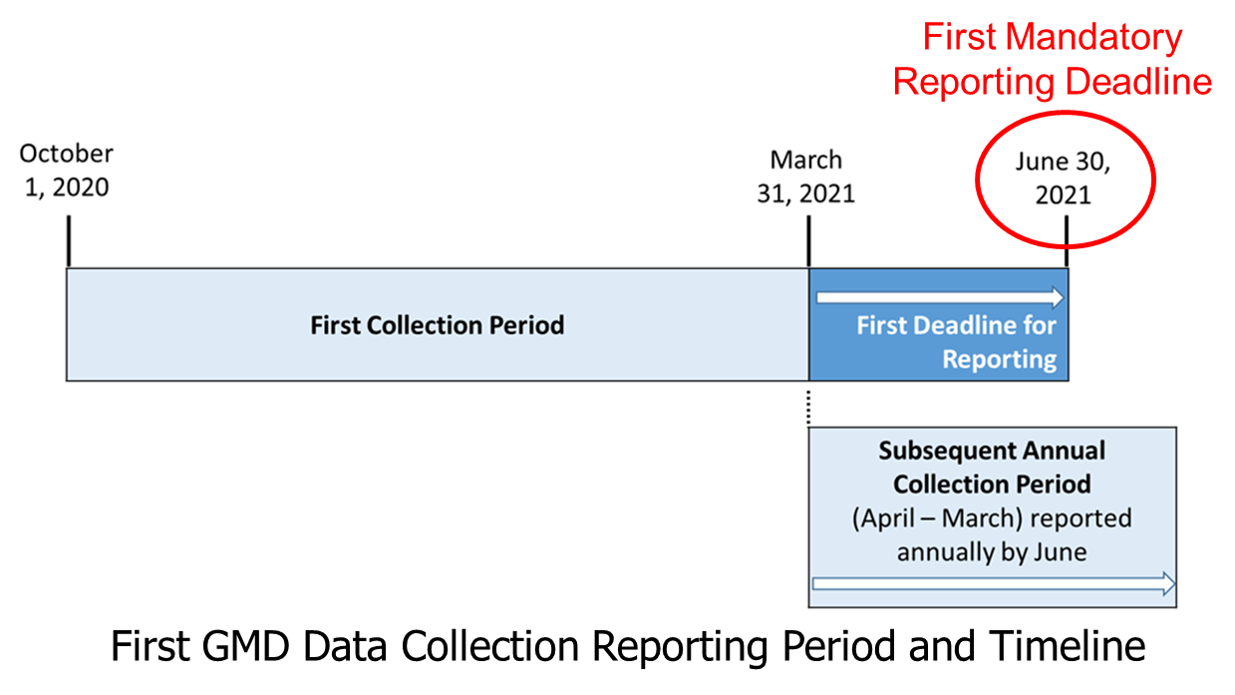
Rollout Plan
GMD Data Timeline and Training
NERC Data reporting training
2 sessions left:
Wednesday, October 7, 2020 1:00 – 2:30 p.m. Eastern
Wednesday, October 14, 2020 1:00 – 2:30 p.m. Eastern
Materia available later on NERC GMD webpage
Contact Texas RE for assistance Live – October 2020
Data Researcher training – Early 2021
Researchers will be able to Download GMD Data – Early 2021
Confirmation November 15, 2020
GMD Data Collection Update October 6, 2020

Slide 6
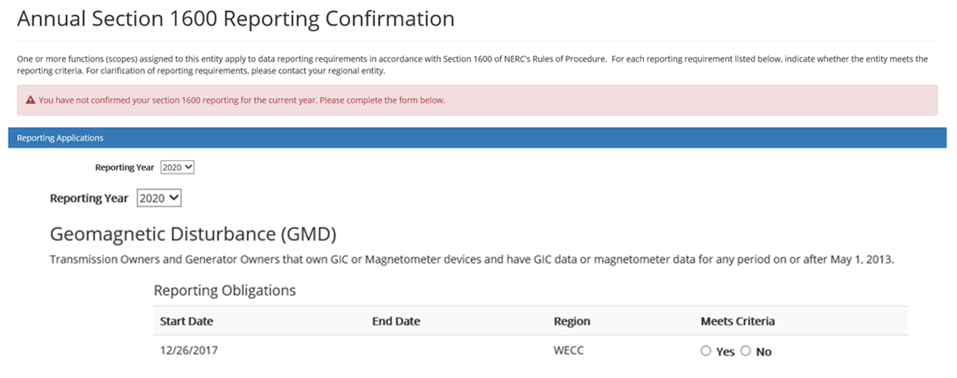
Section 1600 Reporting Confirmation – Entity Completion for GMD and MIDAS
GMD Annual Confirmation
With the GMD release, Section 1600 Reporting Confirmation applies to GMD and MIDAS
Will be expanded to all other Section 1600 applications for which Performance Analysis is responsible
All entities with TO and/or GO scope will be required to complete the 2020 Section 1600 Reporting Confirmation – by Nov. 15 - to indicate whether they have GMD data collection equipment and/or data)
https://www.nerc.com/comm/PC/Geomagnetic%20Disturbance%20Task%20Force%20GMDTF%202013/GMD_data_request_June_2018.pdf
Confirmation is done
through the ERO’s Registration application on the “My Entity” page
Future annual confirmation
will be due January 15 of
each year
GMD Data Collection Update October 6, 2020

Slide 7
Who Must Report
GMD Data Reporting
TOs and GOs that collect GIC data or magnetometer data are considered Reporting Entities for GMD events specified in the GMD Data Request
Reporting Entities will provide the following types of data for time periods during which GMD events K_{P}= 7 or greater
GIC data for designated GMD events
Geomagnetic field data for designated GMD events
Continuously-sampled GIC measurements (amps) (e.g., 10-second sample rate) throughout the GMD event
NERC will designate GMD events of interest in collaboration with NOAA Space Weather Prediction Center (SWPC)
On average, 200 K_{P}=7 or greater GMD events occur in 11-year solar cycle
NERC has a Process for Designating Confidential Information in the GMD Data Reporting System
GMD Data Collection Update October 6, 2020

Slide 8
Overview
GMD Data Reporting
Device information may be entered manually or through import of a file in Excel or CSV format
Event data may be submitted in CSV format
An ERO Portal account will be required for everyone providing or requesting GMD data
Event information will be displayed in the data collection application and posted on the NERC GMD webpage
GMD@nerc.net has been created to allow all GMD questions to be routed to the proper NERC staff (but you can ask Texas RE for assistance, too)
GMD Data Collection Update October 6, 2020

Slide 9
Data Collection Events
GMD Event Selection
NERC GMD Data Collection Event is Announced
A GMD Event is predicted
A GMD Alert is Issued
Return to normal (quiet)
GMD Event Timeline
Space Weather monitors issue prediction (e.g., NOAA SWPC)
Predictions issued 1-3 days prior to GMD event
Warnings issued ~30 minutes prior to onset
Space Weather monitors issue Alert (e.g., NOAA SWPC Alert message)
Will indicate onset of GMD above threshold (e.g., K_{P}-7)
Dashboards (e.g., NOAA SWPC website) provide continuous information that will indicate when normal conditions have returned
NERC Announces Start and End Date/Times for GMD Data Collection Period
NERC GMD Data Collection Period
GMD Data Collection Update October 6, 2020

Slide 10
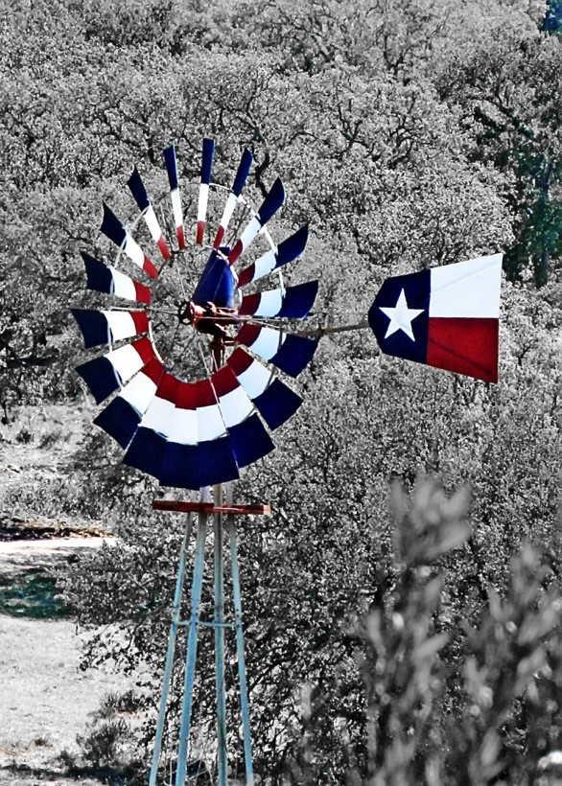
Questions?
General information and support:
Bob Collins
Bob.Collins@texasre.org
512-583-4986
Portal or application questions:
gmd@nerc.net

