Slide 1
Market Credit Working Group update to the Wholesale Market Subcommittee
Bill Barnes, NRG, Chair
Josephine Wan, Austin Energy, Vice Chair
10/07/2020

Slide 2
MCWG update to WMS
General Update
  September 16 Joint MCWG/CWG WEBEX Meeting
  7 NPRRs reviewed for their credit impacts
  945NPRR Net Metering Requirements - No Credit Impact
  1028NPRR RUC Process Alignment with Resource Limits - No Credit Impact
  1032NPRR Consideration of Physical Limits of DC Ties in RUC Optimization and Settlements - No Credit Impact
  1038NPRR BESTF-8 Limited Exemption from Reactive Power Requirements for Certain Energy Storage Resources - No Credit Impact
  1041NPRR Adjust Expiration of Protected Information Status for Wholesale Storage Load (WSL) Data - No Credit Impact
  1014NPRR BESTF-4 Energy Storage Resource Single Model - No Credit Impact
  1029NPRR BESTF-6 DC-Coupled Resources - No Credit Impact

Slide 3
MCWG update to WMS
Real-Time Co-optimization Update to Credit Work Group
Aug 19 CWG meeting (today)
  Highlight need for CWG review of NPRR1007-NPRR1013
  ERCOT provides initial summary of credit impacts
  Note that although RTCTF continues to meet until October 21, 2020, all Pricing and Settlement consensus items are complete and posted here: http://www.ercot.com/calendar/2020/9/9/191170-RTCTF
Sept 16 CWG meeting
  ERCOT Credit will review prior materials and ask if any issues
Oct 16 CWG meeting
  ERCOT Credit (Vanessa) and RTCTF Chair (Matt Mereness) asks if any questions or concerns with RTCTRRs from a credit impact perspective.
  Ask CWG for agreement on comments to be filed by Nov 17.
Nov 17 CWG meeting
  Last meeting before Board to file CWG comments on credit impacts

Slide 4
MCWG update to WMS
Real-Time Co-optimization Update to Credit Work Group
Revisions to Credit Exposure Calculations for AS Products Related to RTC
Update the Real Time Liability Completed and Not Settled (RTLCNS) component of Estimated Aggregate Liability (EAL) calculation to include Real-Time Co-Optimization (RTC) Ancillary Service (AS) activity
  Capture price risk between Day Ahead Market (DAM) Market Clearing Price for Capacity (MCPC) and Real-Time (RT) Market Clearing Price for Capacity (MCPC) for Virtual AS offers
Estimated Aggregate Liability
  EAL _{q} = Max [IEL during the first 40-day period only beginning on the date that the Counter-Party commences activity in ERCOT markets, RFAF * Max {RTLE during the previous lrq days}, RTLF] + DFAF * DALE + Max [RTLCNS, Max {URTA during the previous lrq days}] + OUT _{q} + ILE _{q}
  EAL _{t} = Max [RFAF * Max {RTLE during the previous lrt days}, RTLF] + DFAF * DALE + Max [RTLCNS, Max {URTA during the previous lrt days}] + OUT _{t}
The following ERCOT Protocols were modified:
  16.11.4.3 Determination of Counter-Party Estimated Aggregate Liability
  16.11.4.3.2 Real-Time Liability Estimate
Update the Minimum Current Exposure (MCE) component of Total Potential Exposure (TPE) calculation to include
  Capture price risk between Day Ahead Market (DAM) Market Clearing Price for Capacity (MCPC) and Real-Time (RT) Market Clearing Price for Capacity (MCPC) for Virtual AS offers
  Section 16.11.4.1 Determination of Total Potential Exposure for a Counter-Party

Slide 5
MCWG update to WMS
Credit Risk Assessment and Enforcement
As discussed last month, it appeared the ERCOT credit scoring model results were skewed by extreme financial ratio values. The model was rerun and re-optimized with truncated ratios.
An error in the MISO-based model was fixed, which better aligned segment scores with ERCOT model results.
The recalibrated MISO-based model retains a higher aggregate R^2 for model scores with respect to agency rating equivalents.
ERCOT recalibrated model score results by ERCOT-defined segment.
Note that higher scores indicate higher credit quality. Scores can be duplicated when different CPs have same guarantor.

Slide 6
MCWG update to WMS
Credit Release Process
Sep 17
Thursday
Sep 17
Thursday
21:00
Sep 18
Friday
5:00 AM
Sep 18
Friday
9:00 AM
Sep 19
Saturday
Auction Results Posted
CMM Receives CRR Awards at 20:00
FCE calculation starts 22:00
Credit Reports:
FCE includes awarded CRRs
ACL Summary Report shows CRR credit still locked
Auction invoice reflected as OIA Adjustment
Auction invoice issued/posted in MIS mid-day
CRR credit unlocked
ACL Summary Report regenerated with CRR credit unlocked
Credit Reports:
Auction invoice reflected in EAL Report (OIA Adjustment removed)
DAM ACLs sent 17:00 for Sep 18 auction
still reduced by CRR lock amount
DAM ACLs sent 17:00 for Sep 19 auction
excludes CRR lock amount

Slide 7
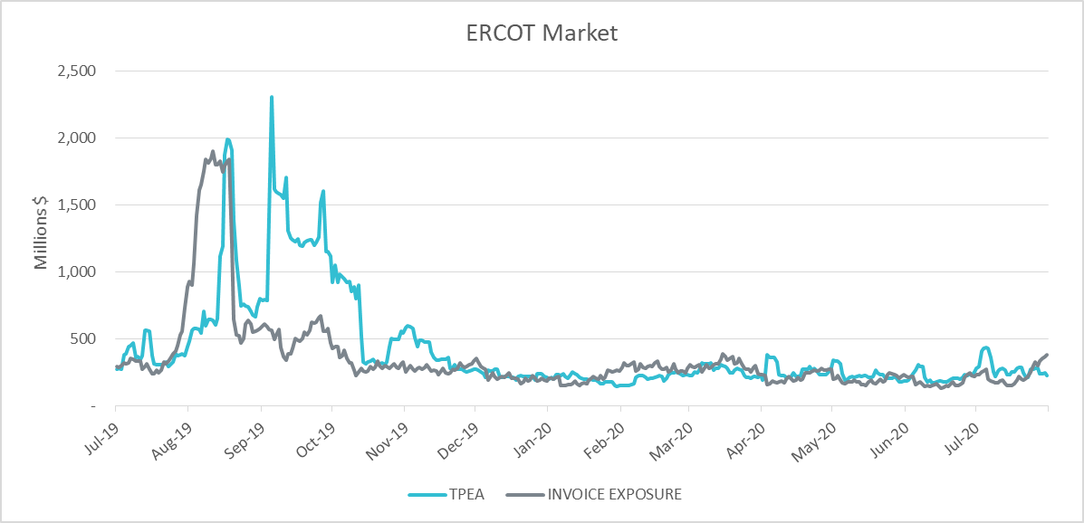
MCWG update to WMS
Credit Exposure Update

