Slide 1
Supply Analysis Working Group Report to WMS
October 7, 2020
Caitlin Smith, Chair
Pete Warnken, Vice Chair
Ian Haley, Vice Chair

Slide 2
September SAWG Meeting – Astrape Update on 2020 Reserve Margin Study
2020 Study Quantifies the following for 2024:
Economically Optimal Reserve Margin (EORM)
Market Equilibrium Reserve Margin (MERM)
1 in 10 LOLE reserve margin
Major Changes to 2020 Study from 2018:
Increased wind and solar penetration
Updated methodology for modeling PRD
ORDC Changes
Reference technologies
Gas Combustion Turbine
4 Hour Battery Storage
Previous study used Combined Cycle Gas Turbine

Slide 3
September SAWG Meeting – Astrape Update on 2020 Reserve Margin Study
Next Steps
Astrape will present updated 2020 report at next SAWG Meeting on October 26th
Astrape will post final 2020 report following October SAWG
Resources
Astrape presentation:
http://www.ercot.com/calendar/2020/9/24/195736-SAWG
2018 reserve margin report is on ERCOT’s Resource Adequacy page:
http://www.ercot.com/gridinfo/resource

Slide 4
September Meeting SAWG Meeting & Possible October WMS Voting Item – Summer cut-off date
Background from August SAWG:
ERCOT presented an update on NERC 2020 LTRA Preparation
Noted that July 15th is the summer cut-off date for including planned resources in NERC LTRA
Stakeholder question/discussion around moving CDR cut-off from June 1 to July 1 or July 15
September SAWG Meeting:
Note presentation updated post-meeting
http://www.ercot.com/calendar/2020/9/24/195736-SAWG

Slide 5
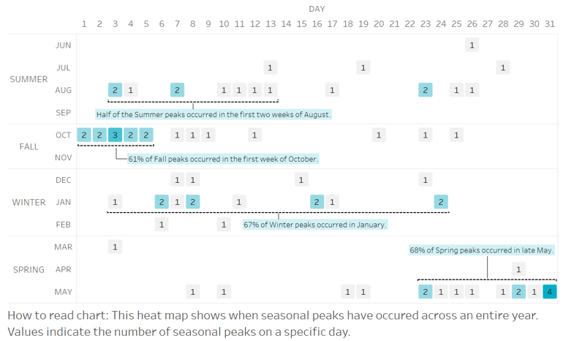
September Meeting SAWG Meeting & Possible October WMS Voting Item – Summer cut-off date
Are the season cut-off dates too conservative in light of when seasonal peaks typically occur?
Cut-off dates are beginning of season: Spring -- March 1st; Summer -- June 1st; Fall -- October 1st; Winter -- December 1st

Slide 6
September Meeting SAWG Meeting & Possible October WMS Voting Item – Summer cut-off date
Key Takeaway from ERCOT presentation:
With the exception of Fall, most seasonal peaks in ERCOT have not occurred at the start of the season
Five Options presented by ERCOT:
Option 1: For all planned units, push back three of the four seasonal cut-off dates based on current SARA and NERC LTRA practice:
For Spring, move the cut-off from March 1 to April 15
For Summer, move the cut-off from June 1 to July 15
For Fall, continue to use a cut-off of October 1
For Winter, move the cut-off from December 1 to December 15
Option 2: Push back cut-off dates for Spring and Summer only, with a shorter extension than Option 1:
For Spring, move the cut-off from March 1 to April 1
For Summer, move the cut-off from June 1 to July 1
For Fall, continue to use a cut-off of October 1
For Winter, continue to use a cut-off of December 1
Option 3: Apply Option 1 cut-off dates only for units with synchronization approvals expected by the start of the Spring/Summer/Winter seasons
Option 4: Apply Option 2 cut-off dates only for units with synchronization approvals expected by the start of the Spring/Summer seasons
Option 5: No changes to cut-off dates and report incremental planned unit capacity with extended cut-off dates for informational purposes only

Slide 7
September Meeting SAWG Meeting & Possible October WMS Voting Item – Summer cut-off date
Possible Motion:
Consensus about preliminary concept of Option 2 in presentation
Option 2: Push back cut-off dates for Spring and Summer only:
For Spring, move the cut-off from March 1 to April 1
For Summer, move the cut-off from June 1 to July 1
For Fall, continue to use a cut-off of October 1
For Winter, continue to use a cut-off of December 1
To implement this by Summer 2021, would need to pass ERCOT Board of Directors February 2021
ERCOT has a draft NPRR with language for changing Summer cut-off to July 1 for CDR
Change for Spring cut-off to April 1 is only needed for SARA report, which does not require NPRR
The changes affect the estimates for planned non-IRR capacity, IRR capacity, and planned DC tie capacity

Slide 8
September Meeting SAWG Meeting & Possible October WMS Voting Item – Summer cut-off date
Proposed Motion Language:
“Motion to endorse the concept as described (moving spring cutoff from March 1 to April 1 and moving Summer cut-off from June 1 to July 1), and direct ERCOT to move forward with the required changes, including draft NPRR to move the Summer cut-off date to July 1 for planned new CDR capacity”

