Slide 1
Planned Project In-Service Cut-off Dates for CDR/SARA Reports
SAWG Meeting
September 24, 2020

Slide 2
Background
For CDR and SARA reports, we currently use a cut-off date for each season to forecast which planned projects will be available for the peak load hour of an upcoming season
This presentation will cover the following:
An overview of when seasonal peaks in ERCOT
Are the season cut-off dates aligned with when our seasonal peaks typically occur?
In-service date trends for planned projects
Five options for discussion

Slide 3
Current Season Cut-Off Dates for Planned Projects in CDR/SARA Reports
Spring (March 1st)
Summer (June 1st)
Fall (October 1st)
Winter (December 1st)
For projects that have been approved for Synchronization (Part 2 Commissioning Checklist), the season cut-off dates are extended to the following for the SARA reports:
Spring (April 15th)
Summer (July 15th)
Fall (no extension)
Winter (Dec 15th)

Slide 4
Season Cut-Off Date in SARA for Planned Projects that have been Approved for Synchronization
Motivation for extending the cut-off date for these projects – In order to create better alignment with ERCOT Operations short-term wind and solar forecast reports
Implemented for the first time in the Final Spring 2020 SARA report
Report | MW contribution from projects approved for synchronization AND met extended cut-off dates | MW contribution from all planned projects in report | % of Total
Final Spring 2020 | 719 MW (1 gas, 6 wind) | 1,669 MW | 43%
Prelim. Summer 2020 | 72 MW (3 wind) | 2,198 MW | 3%
Final Summer 2020 | 237 MW (3 wind, 1 solar) | 1,772 MW | 13%
Prelim. Fall 2020 | 0 MW | 3,155 MW | 0%
Final Fall 2020 | 0 MW | 1,475 MW | 0%
Prelim. Winter 2020/21 | 0 MW | 1,359 MW | 0%

Slide 5
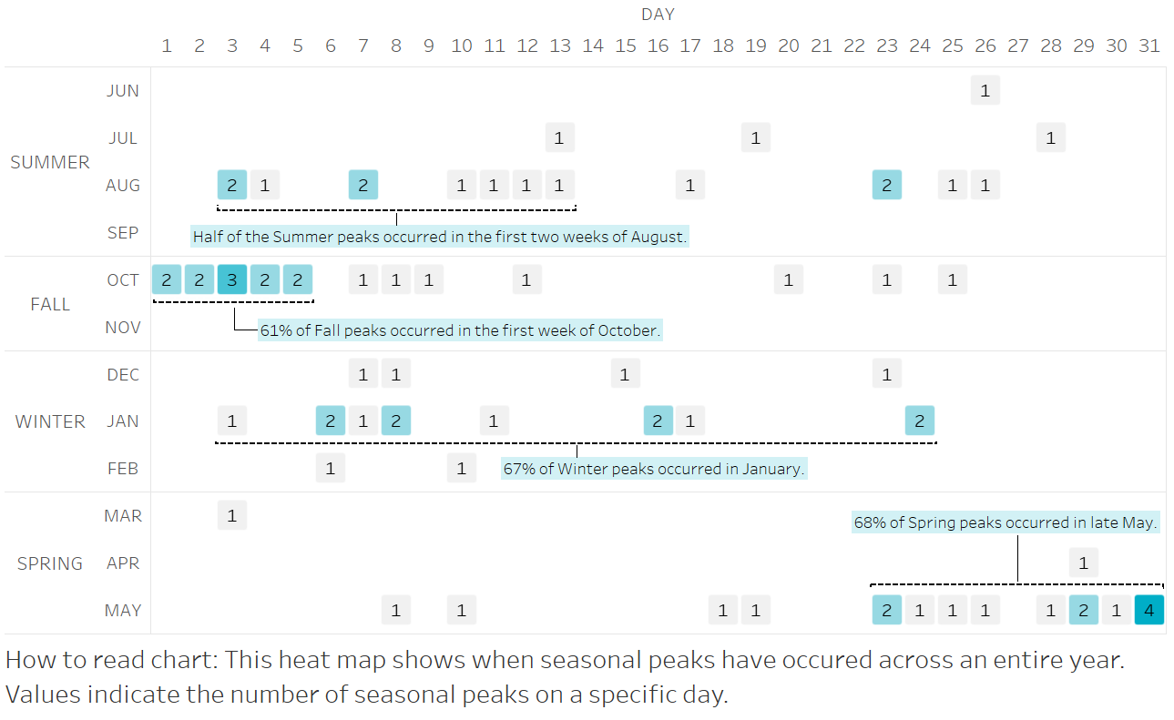
Seasonal peaks in ERCOT have historically not occurred at the beginning of a season
Data: ERCOT Hourly Load Data Archives (2002 – 2020) http://www.ercot.com/gridinfo/load/load_hist

Slide 6
Key Takeaways from Seasonal Peak Analysis
With the exception of Fall, most seasonal peaks in ERCOT have not occurred at the start of the season
Based on 18 years of historical data, the following are observations regarding the timing of the seasonal peak days:
Summer peaks usually occur in early August
Fall peaks usually occur in early October
Winter peaks usually occur in January
Spring peaks usually occur in late May
Data: ERCOT Hourly Load Data Archives (2002 – 2020) http://www.ercot.com/gridinfo/load/load_hist

Slide 7
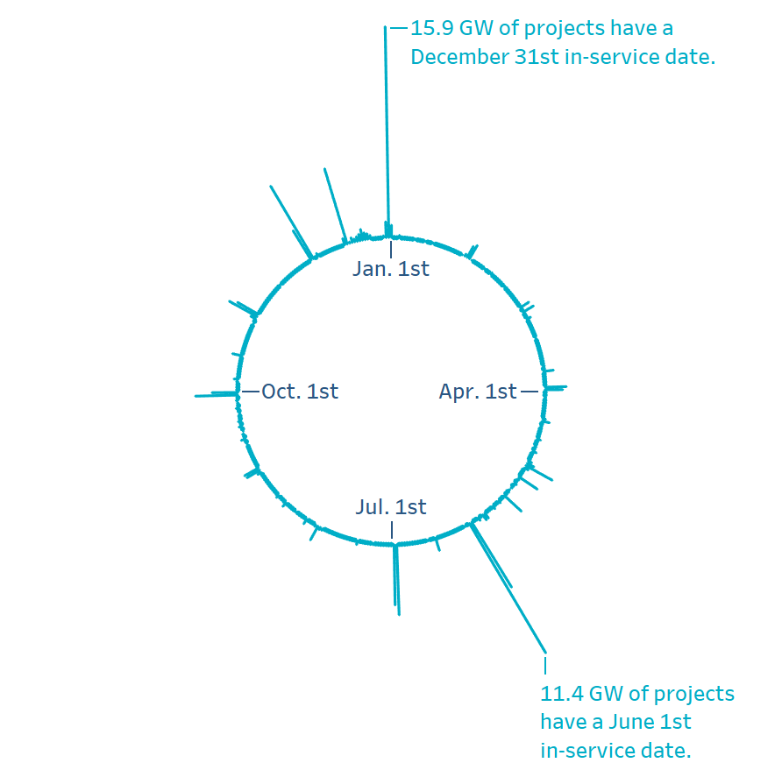
In recent years, the in-service dates for planned projects have clustered into the month of December
33% - 34,224 MW out of 103,980 MW planned projects in the August 2020 GIS report have in-service dates in the month of December
This behavior seems be to driven by PTC/ITC incentive deadlines and can be seen in GIS reports as far back as January 2015
Why is this important to our current discussion?
Extending season cut-off dates could add additional planned projects that have the potential of being delayed.
Data source:
August 2020 GIS Report - Project Details Tab
In-service date refers to the ‘Projected COD’

Slide 8
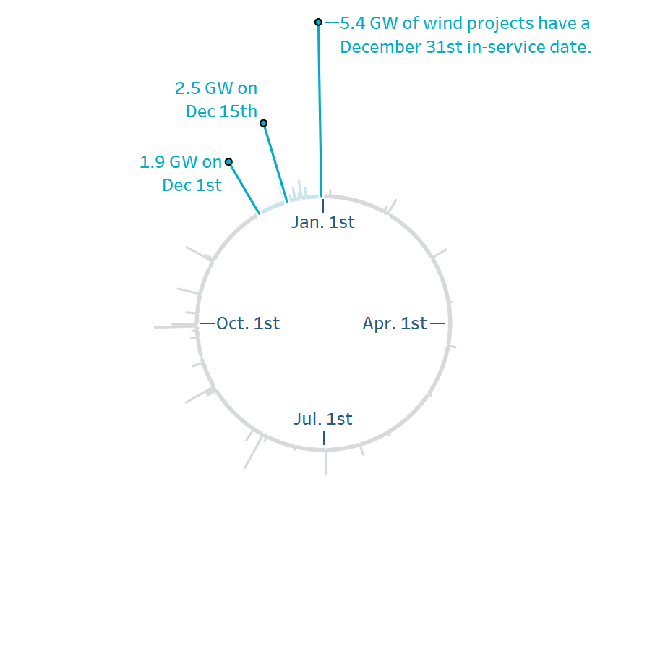
Half of all planned wind projects have in-service dates in the month of December
50% - 11,895 MW out of 23,660 MW planned wind is expected in month of December
Extending the winter cut-off date past December 1st could significantly increase the number of planned wind projects in future CDR and SARA reports
Data source:
August 2020 GIS Report - Project Details Tab
In-service date refers to the ‘Projected COD’

Slide 9
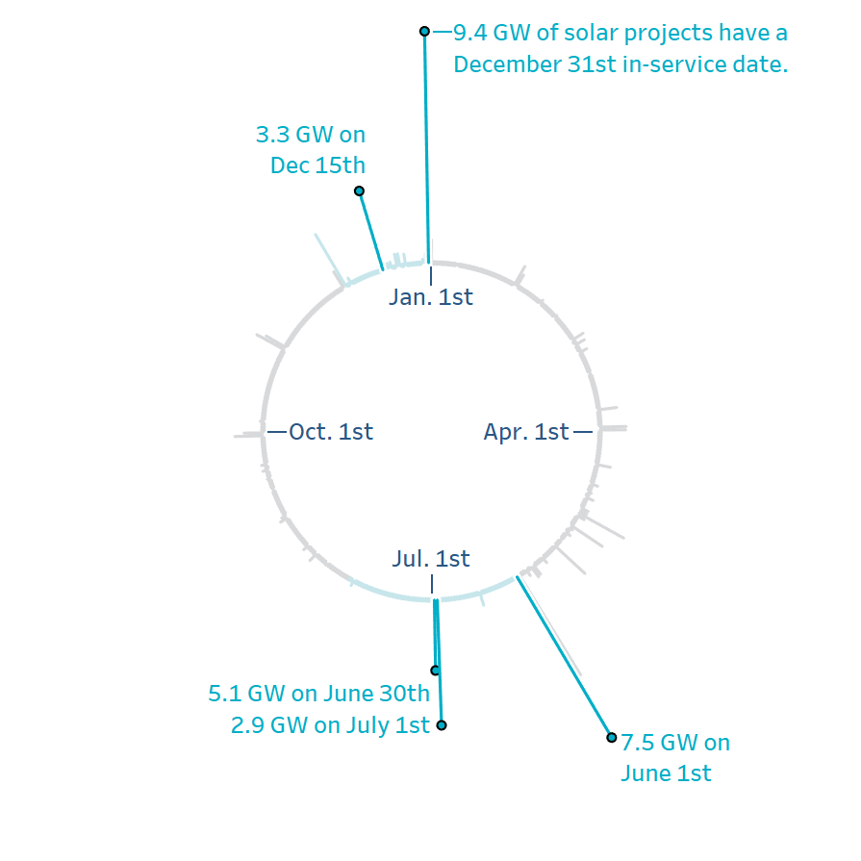
Half of all planned solar projects have in-service dates in the month of June or December
50% - 31,200 MW out of 61,816 MW planned solar is expected in months of June or December
Extending the summer and winter cut-off dates could increase the number of planned solar projects in future CDR and SARA reports
Data source:
August 2020 GIS Report - Project Details Tab
In-service date refers to the ‘Projected COD’

Slide 10
Five Options for Discussion
Option 1: For all planned units, push back three of the four seasonal cut-off dates based on current SARA and NERC LTRA practice:
For Spring, move the cut-off from March 1 to April 15
For Summer, move the cut-off from June 1 to July 15
For Fall, continue to use a cut-off of October 1
For Winter, move the cut-off from December 1 to December 15
Option 2: Push back cut-off dates for Spring and Summer only, with a shorter extension than Option 1:
For Spring, move the cut-off from March 1 to April 1
For Summer, move the cut-off from June 1 to July 1
For Fall, continue to use a cut-off of October 1
For Winter, continue to use a cut-off of December 1

Slide 11
Five Options for Discussion, continued
Option 3: Apply Option 1 cut-off dates only for units with synchronization approvals expected by the start of the Spring/Summer/Winter seasons
Option 4: Apply Option 2 cut-off dates only for units with synchronization approvals expected by the start of the Spring/Summer seasons
Option 5: No changes to cut-off dates and report incremental planned unit capacity with extended cut-off dates for informational purposes only

Slide 12
Issues to Consider
A June 1 summer cut-off date will likely exclude projects that become available before the typical peak demands occur
Although a June 1 summer cut-off date is conservative, it provides a buffer to account for typical project delays
A planned unit that has ERCOT synchronization approval (and not commercial operations approval) could be in test mode when peak demand occurs
If we change the CDR seasonal cut-off dates, we would align NERC LTRA reporting with those revised cut-off dates
Should summer/winter CDR and SARA cut-off dates be the same?

Slide 13
Appendix: Additional Analysis on ERCOT Seasonal Peaks (double-click to open the pdf)

Slide 14
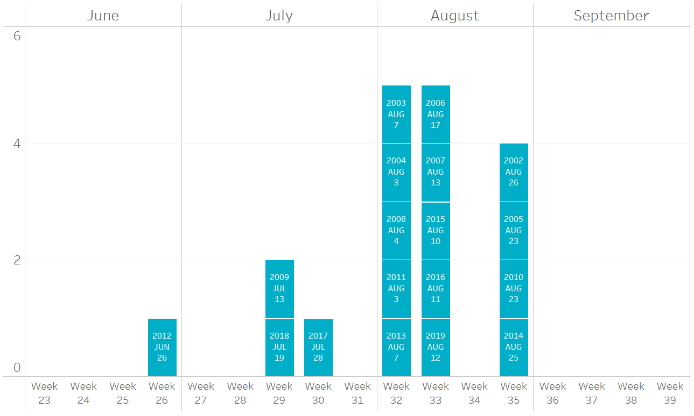
Appendix: Histogram of Historical Peaks for Summer

Slide 15
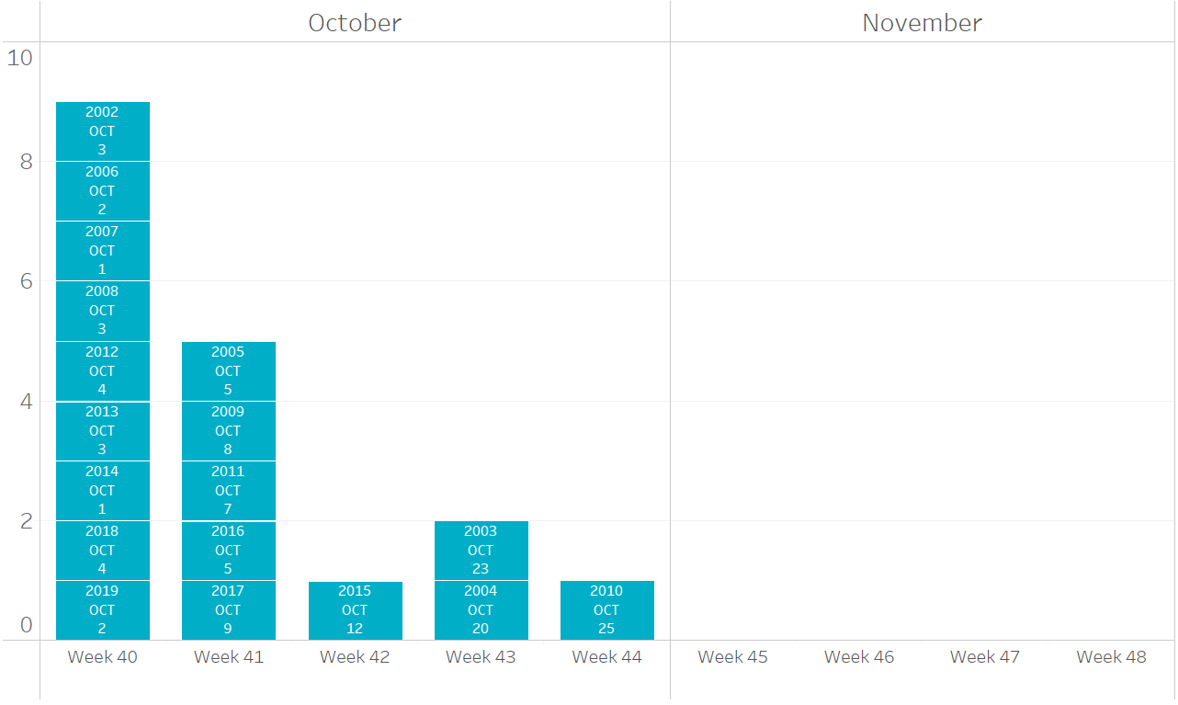
Appendix: Histogram of Historical Peaks for Fall

Slide 16
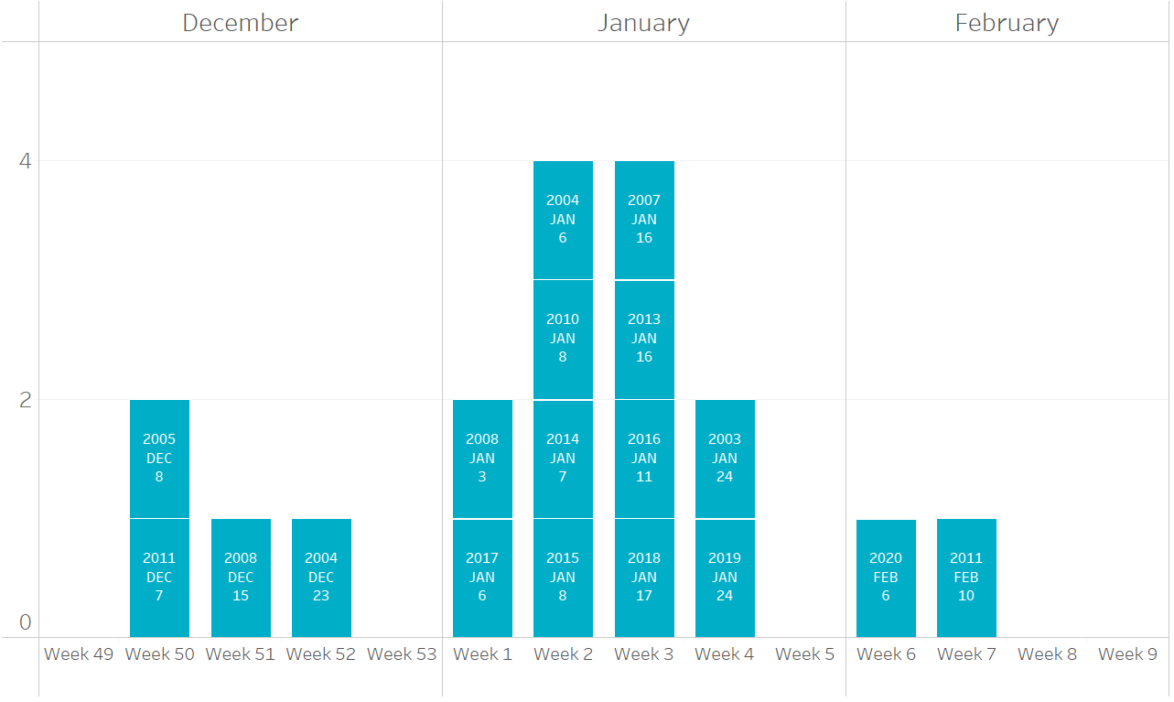
Appendix: Histogram of Historical Peaks for Winter

Slide 17
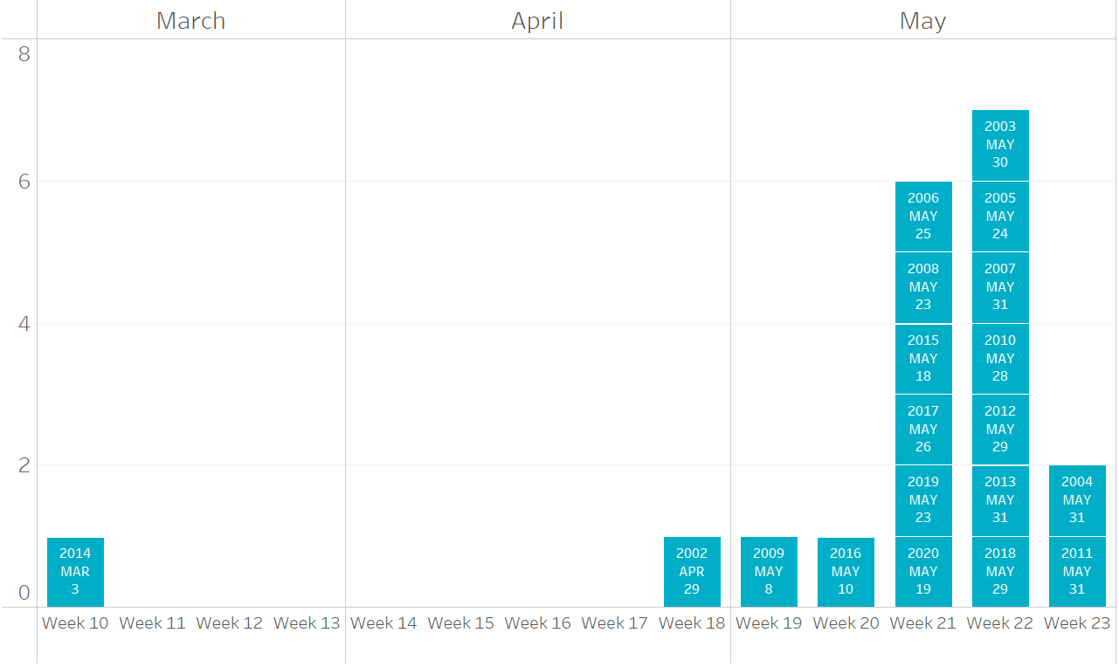
Appendix: Histogram of Historical Peaks for Spring

Slide 18
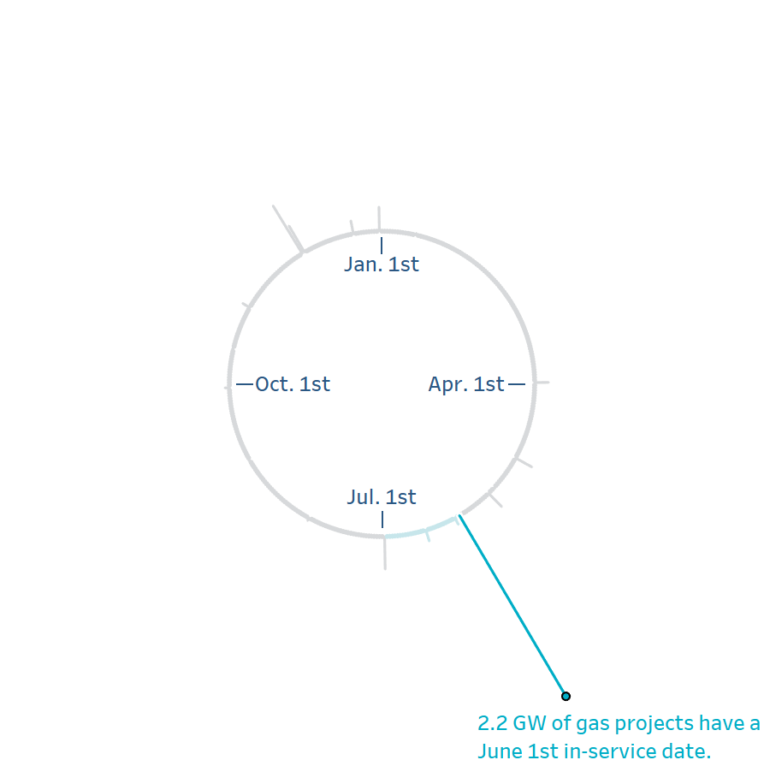
Appendix: Nearly half of all planned gas projects in the latest GIS report have in-service dates on June 1st
46% - 2,445 MW out of 4,900 MW of planned gas is expected on June 1st.
Data source:
August 2020 GIS Report - Project Details Tab
In-service date refers to the ‘Projected COD’

Slide 19
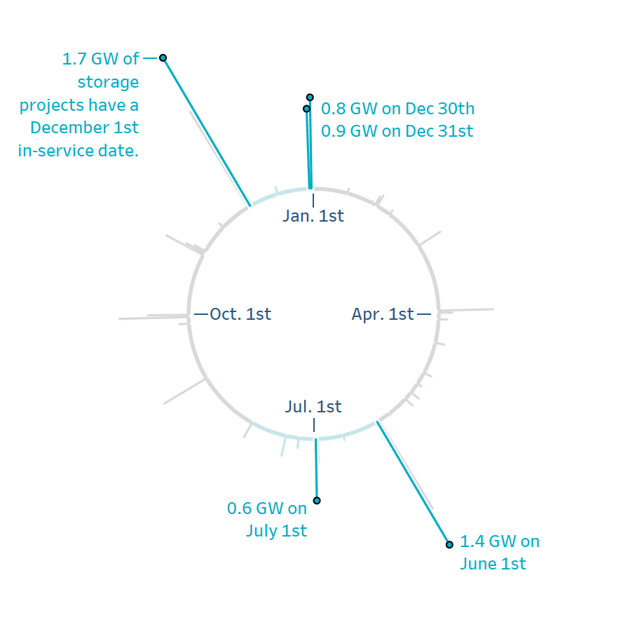
Appendix: Over half of all planned storage projects in the latest GIS report have in-service dates in the months of June, July, and December
51% - 6,619 MW out of 12,971 MW of planned storage is expected in the months of June, July, and December.
Data source:
August 2020 GIS Report - Project Details Tab
In-service date refers to the ‘Projected COD’

