Slide 1
MIS and ERCOT.com User Workshop
September 23, 2020

Slide 2
Agenda
Release Notes
Soft Launch MIS demo
Frequently Asked Questions
Next Steps

Slide 3
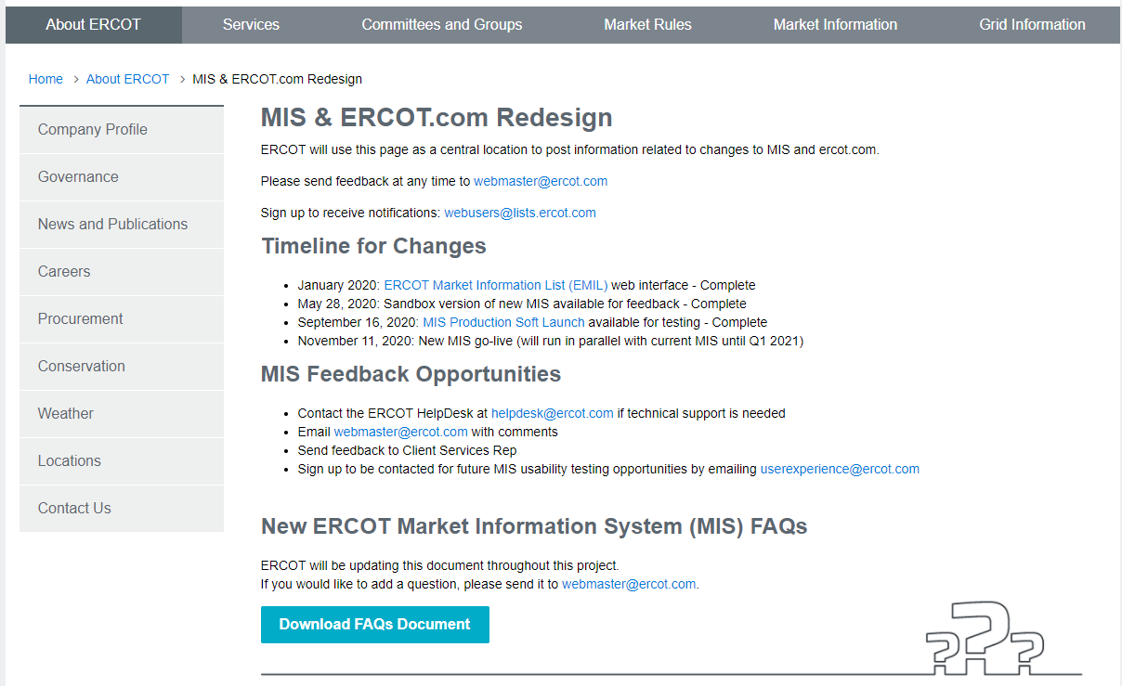
MIS & ERCOT.com Redesign Information
http://www.ercot.com/about/redesign

Slide 4
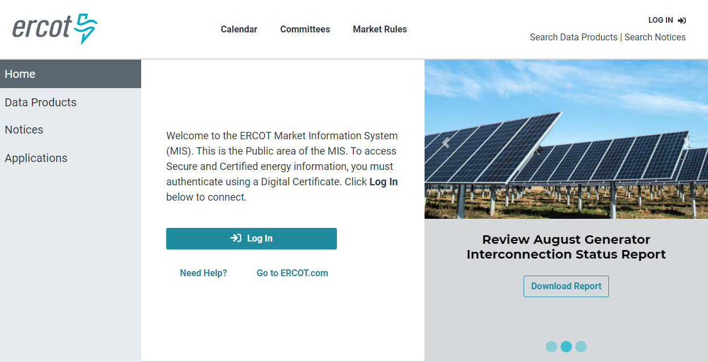
MIS Soft Launch
https://mis.ercot.com/public

Slide 5

Release Timeline
EMIL Web Interface Release
Sandbox Version New MIS
MIS Production Soft Launch
MP Testing
MIS Production Go-Live
Decommission
Old MIS
Transition ERCOT.COM Content into Integrated Platform
Jan 30th
May 26th
Sept 16th
Nov 11th
Q1
Q1- Q4
2020
2021
2020
Jan 30th | EMIL web interface release ✓
May 26th | Sandbox version of new MIS ✓
Sept 16th | MIS Production soft launch for MP testing ✓
Nov 11th | MIS Production Go-Live
2021
Q1 | Decommission old MIS
Q1 – Q4 | Transition ERCOT.COM content into integrated platform

Slide 6
Upcoming Conversations
Combined Site Map
  Link to exercise: https://5zy06184.optimalworkshop.com/optimalsort/services
  Password: ercotservices
Public Dashboards
Calendar and Revision Requests
Next MIS & ERCOT.com User Workshop will be October 21, 2020
Feedback to webmaster@ercot.com is welcome any time

