Slide 1
2020 EORM Study SAWG Presentation 9/24/2020
Prepared for Electric Reliability Council of Texas
Kevin Carden

Slide 2
2020 ERCOT Reserve Margin Study
Quantify 3 Significant Levels for 2024
Economically Optimal Reserve Margin (EORM)
Market Equilibrium Reserve Margin (MERM)
0.1 LOLE “physical standard” reserve margin
Major Changes from 2018 Study
Increased wind and solar penetration
Updated methodology for modeling PRD
ORDC Changes
Reference technologies
Gas Combustion Turbine
4 Hour Battery Storage

Slide 3
Renewable Portfolio Changes
Category | 2018 EORM Study | 2020 EORM Study
Wind – O | 27,809 MW | 27,184 MW
Wind – C | 4,131 MW | 5,371 MW
Wind – P | - | 4,841 MW
Solar | 3,611 MW | 16,001 MW
Total Nameplate Renewable Capacity | 35,552 MW | 53,397 MW
Implications for Reliability and Reserve Margin Accounting
Renewable ELCC

Slide 4
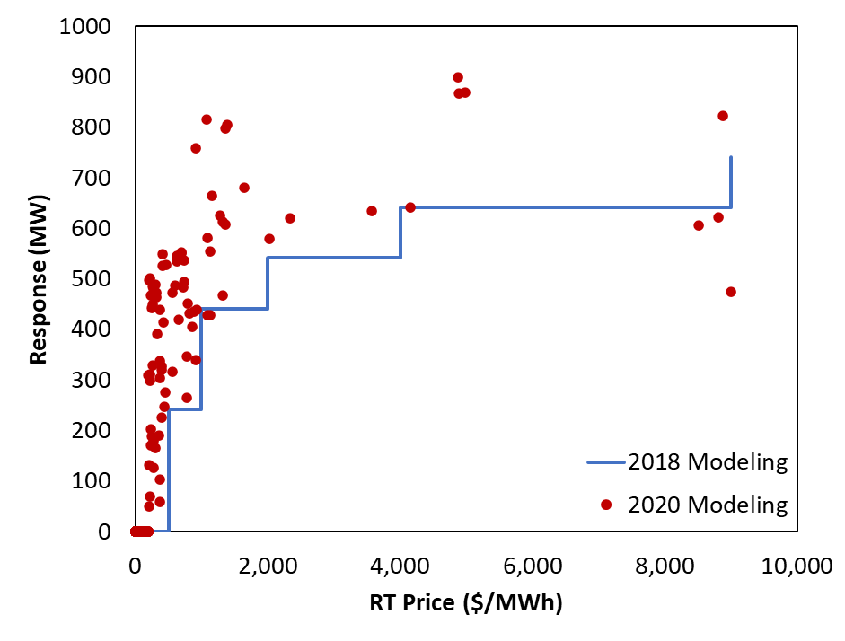
PRD Modeling Updates

Slide 5
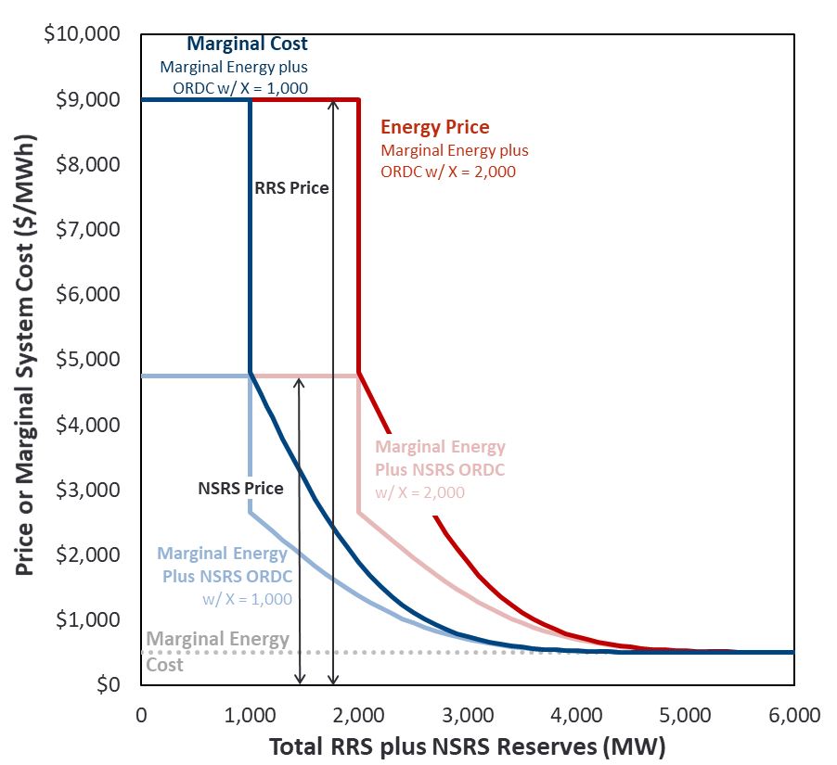
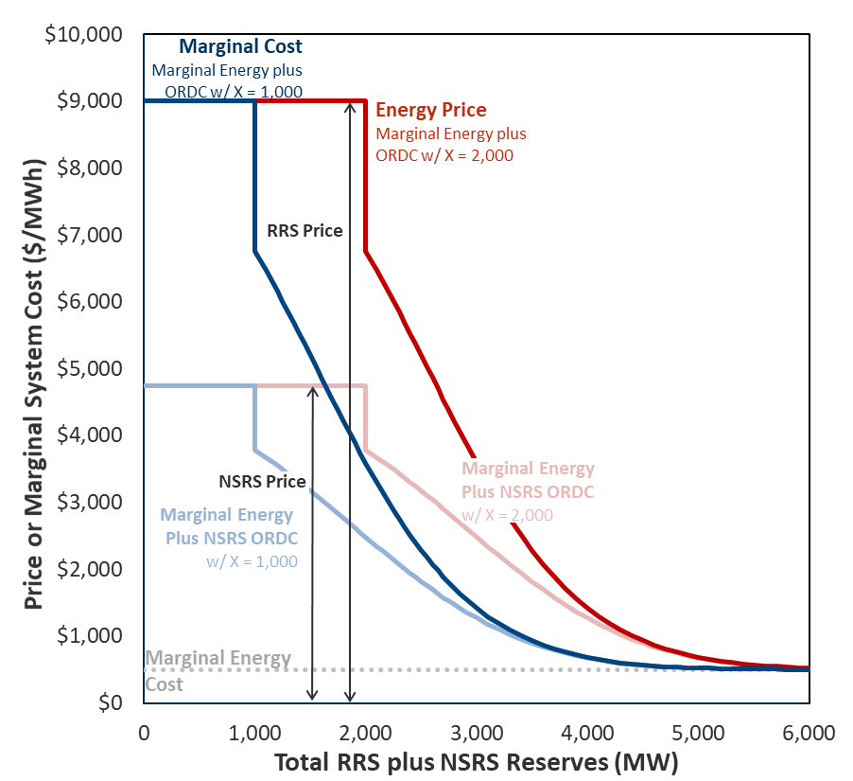
Operating Reserve Demand Curve
2018 Study ORDC
2020 Study ORDC
Sources and Notes:
ERCOT ORDC Calculation Methodology Paper
Summer Hours 15-18

Slide 6
Scarcity Conditions Emergency Procedures and Marginal Costs
Emergency Level | Marginal Resource | Amount of Resource (MW) | Trigger | Price | Marginal System Cost
n/a | Generation | Variable | Price | Approximately $20 - $250 | Same
n/a | Imports | Variable | Price | Approximately $20-$250 Up to $1,000 during load shed | Same
n/a | Non-Spin Shortage | 700 | ORDC x-axis = 3,000 MW | $2,753 (from ORDC)* $4,627 (from ORDC)* | $1,020* $1,966*
n/a | Price-Responsive Demand | 741 | Price | $500 - $9,000 | Same
n/a | Emergency Generation | 469.8 | ORDC x-axis = 2,300 MW | $3,787 (from ORDC) $5,850 (from ORDC) | $1,365 $2,752
n/a | PBPC | 200 | Price | $1,000 - $9,000 | Same
EEA 1 | 30-Minute ERS | 691** | Spin ORDC x-axis = 2,300 MW | $3,787 (from ORDC) $5,850 (from ORDC) | $1,365 $2,752
EEA1 | Spin Shortage A | 550 | Spin ORDC x-axis = 2,300 MW | $6,394 (from ORDC)* $7,492 (from ORDC)* | $1,847* $3,456*
EEA 2 | TDSP Load Curtailments | 262 | Spin ORDC x-axis = 1,750 MW | $3,787 (from ORDC) $9,000 (from ORDC) | $2,456 $4,374
EEA 2 | Load Resources in RRS | 1,172*** | Spin ORDC x-axis = 1,750 MW | $9,000 (from ORDC) $9,000 (from ORDC) | $2,456 $4,374
EEA 2 | 10-Minute ERS | 76** | Spin ORDC x-axis = 1,750 MW | $9,000 (from ORDC) $9,000 (from ORDC) | $2,456 $4,374
EEA3 | Spin Shortage B | 750 | Spin ORDC x-axis =1,750 MW | $9,000 (from ORDC)* $9,000 (from ORDC) | $3,544* $5,514*
EEA 3 | Load Shed | Variable | Spin ORDC x-axis = 1,000 MW | VOLL = $9,000 | Same
Blue font reflects 2018 Study Values
*: Price reflects the average price between the upper and lower level of each resource
**: 76 10NWS + 666 30NWS + 26 30WS = 767 total ERS (CDR Value). Both NWS and WS are included in the 30-Minute ERS
***: 60% of RRS

Slide 7
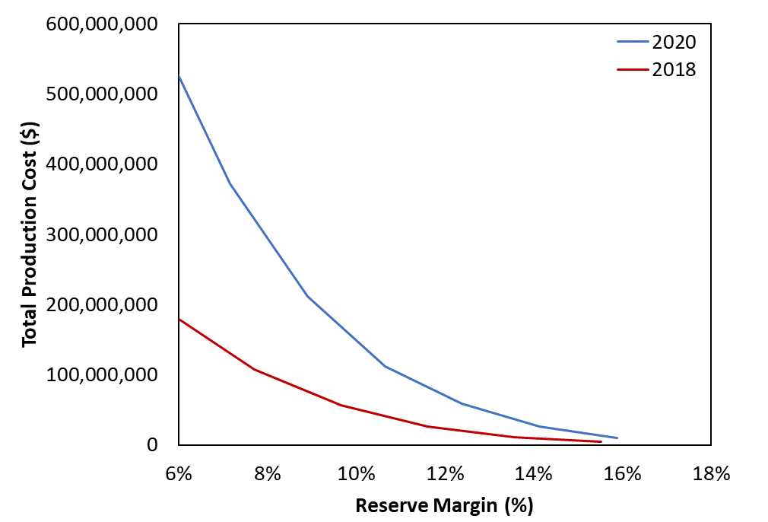
Emergency Procedure Production Cost Differences
Note: Figure includes 10-minute and 30-minute ERS, non-spin shortage, emergency generation, PBPC, spin shortage, TDSP, and LRs

Slide 8
Marginal Resource Technology
2018 Marginal Resource Technology Characteristics
2020 Marginal Resource Technology Characteristics
 |  | Simple Cycle | Combined Cycle
Plant Configuration
Turbine |  | GE 7HA.02 | GE 7HA.02
Configuration |  | 1 x 0 | 2 x 1
Heat Rate (HHV)
Base Load
Non-Summer | (Btu/kWh) | 9,138 | 6,270
Summer | (Btu/kWh) | 9,274 | 6,312
Max Load w/ Duct Firing
Non-Summer | (Btu/kWh) | n/a | 6,503
Summer | (Btu/kWh) | n/a | 6,553
Installed Capacity
Base Load
Non-Summer | (MW) | 371 | 1,073
Summer | (MW) | 352 | 1,023
Max Load
Non-Summer | (MW) | n/a | 1,202
Summer | (MW) | n/a | 1,152
Gross CONE | ($/kW-yr) | $89 | $95
 |  | Simple Cycle | Alternate: Battery Storage
Plant Configuration
Turbine |  | GE 7HA.02
Configuration |  | 1 x 0
Heat Rate (HHV)
Base Load
Non-Summer | (Btu/kWh) | 9,138
Summer | (Btu/kWh) | 9,274
Installed Capacity
Base Load
Non-Summer | (MW) | 371 | 100
Summer | (MW) | 352 | 100
Storage Capability | (MW) |  | 4
Gross CONE | ($/kW-yr) | TBD
Note: Based on ambient conditions of 92°F Max. Summer (55.5% Humidity) and 59°F Non-Summer.

Slide 9
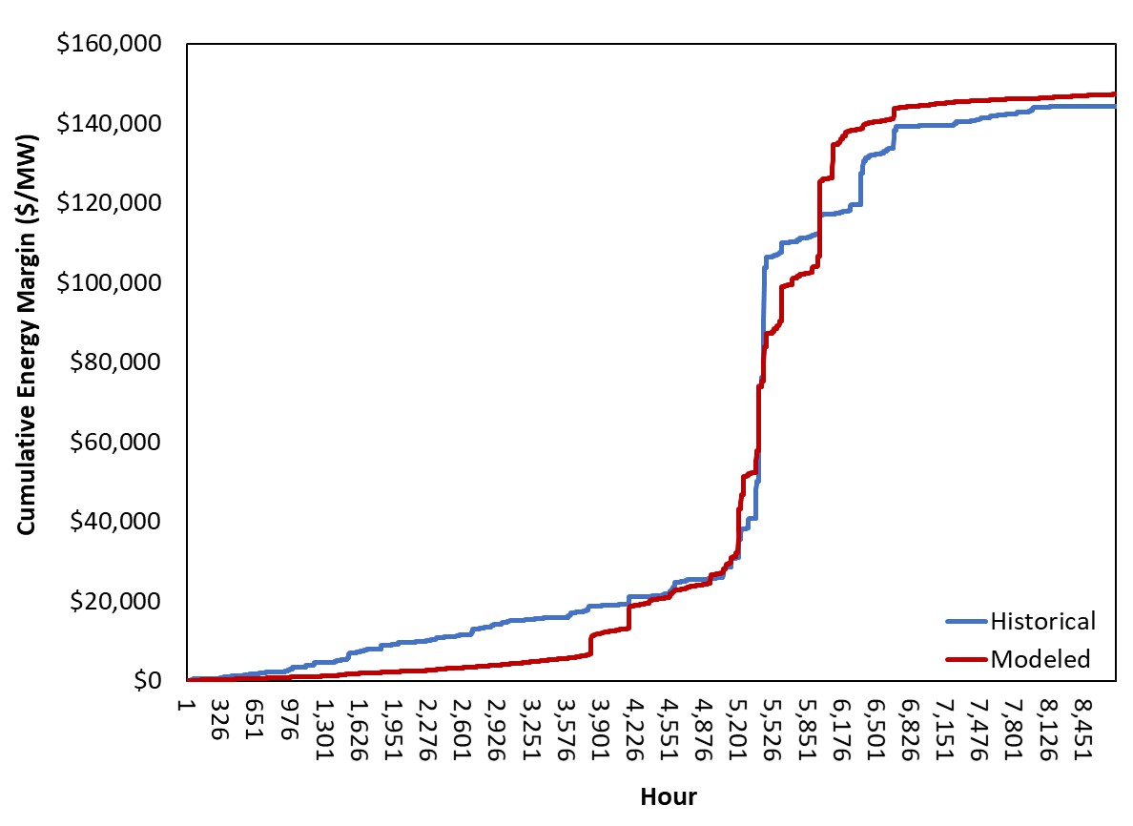
SERVM Simulation Setup and Benchmarking
2019 Market Price Calibration

Slide 10
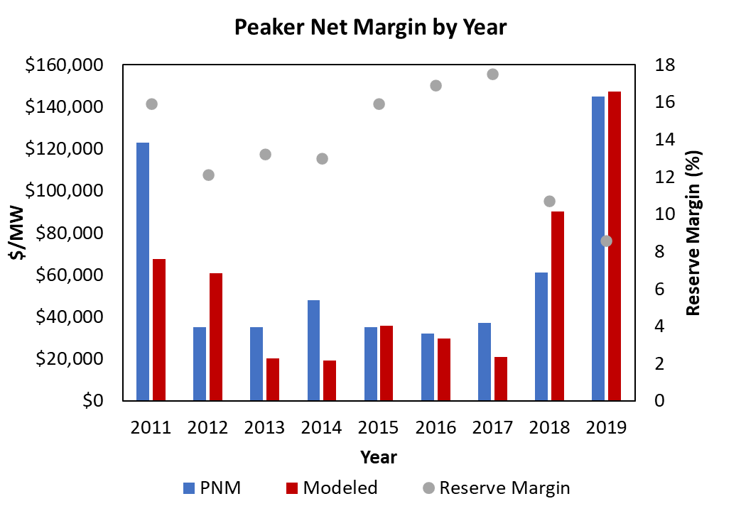
SERVM Simulation Setup and Benchmarking

Slide 11
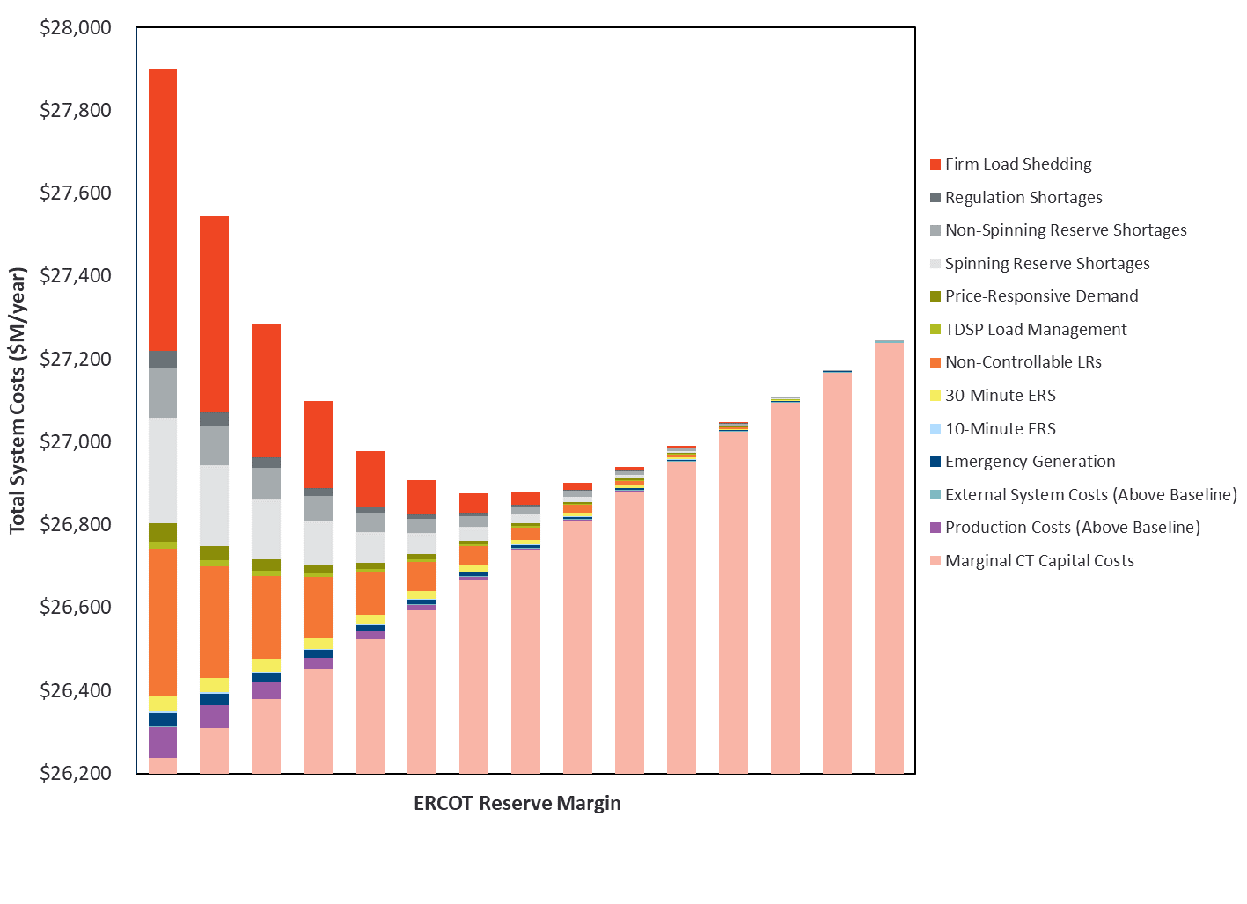
EORM

