Slide 1
Proposed Changes for BUSNODEM Tariffs
PWG WebEx
September 17, 2020

Slide 2
Proposed Changes for BUSNODEM Tariffs
ERCOT does not receive TDSP tariff assignments to ESI IDs.
In the Profile Decision Tree, Segment Assignment tab under III. BUS, C. - it states: “Assign the NODEM Profile Segment for non-residential ESI IDs which are not billed demand.“

Slide 3
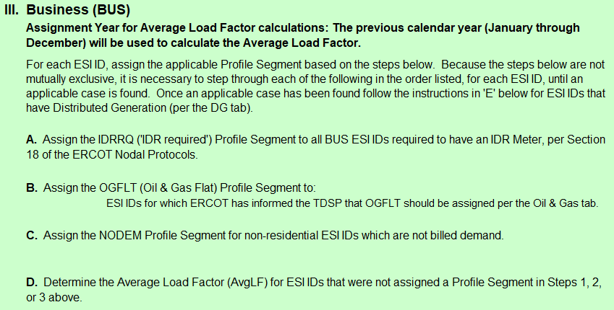
Proposed Changes for BUSNODEM Tariffs

Slide 4
Proposed Changes for BUSNODEM Tariffs
No changes need to be made to the Profile Decision Tree (PDT) to include specific TDSP tariff details. The PDT should remain a general statement on segment assignment.
ERCOT will change the annual validation SAS code to evaluate demand thresholds <10kW/kVA for AEP, CNP, and Oncor and <5kW for TNMP. There are two options.
  Convert BUSNODEM to BUS LF Profile Type when the demand threshold is reached at least one time during the AV period. ERCOT would not return the ESI ID to BUSNODEM leaving a return to the discretion of the TDSP.
  Do not include BUSNODEM evaluation in annual validation leaving the conversion from BUSNODEM to a BUS LF Profile Type (and possible return) to the discretion of the TDSP.

