Slide 1
ERCOT Transmission Planning
Pipeline Disruption Caused Generation Contingencies
Craig Wolf
Planning Engineer
September 2020

Slide 2
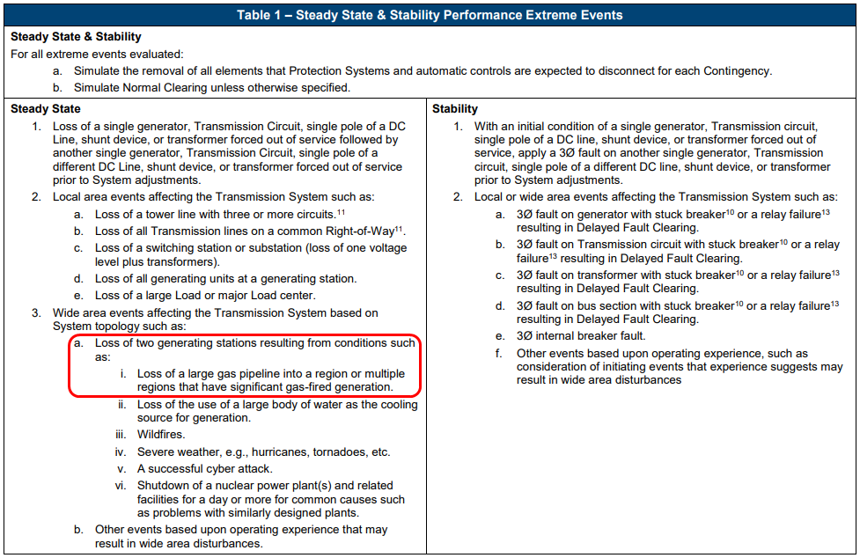
Why Is ERCOT Asking For This Information?
NERC TPL-001-4
Applies to PCs and TPs
March 2020 NERC Reliability Guide

Slide 3
Contingency Creation Effort – Gas Fired Generators
Prior to 2019:
ERCOT studied the loss of gas pipeline supplied generation clusters identified in a 2017 NERC Single Point of Disturbance (SPOD) study
These clusters were based on the proximity of gas generators to each other
The resulting contingencies were quite severe, showing significant disruption potential
In 2019:
The 2018-2019 Winter Fuel Survey contained information about pipeline connectivity to generators
This information (in addition to the gas pipeline connectivity map from the Railroad Commission) was used in the 2019 RTP to determine which generators may have redundant pipeline connections
Currently:
The Winter Fuel Survey for 2019-2020 was simplified
This simplified survey did not request information about gas pipeline connectivity
Going Forward:
ERCOT is looking for alternative ways to gather pipeline connectivity information

Slide 4
Contingency Creation Effort – Pipeline Companies
Prior to 2019:
ERCOT had not contacted gas pipeline companies
In 2019:
ERCOT contacted gas pipeline companies seeking information that could be used to meet the TPL-001-4 requirement pertaining to pipeline interruption scenarios which could impact multiple generation facilities
Less than 1/3 of the companies contacted responded

Slide 5
Why Are We Asking?
Participation is Needed
Railroad Commission data does not tell us everything
Which way natural gas is flowing
Which upstream pipelines are critical to downstream flow
What mitigation measures can be taken
Pipeline companies can more accurately model their pipeline network and loss of pipeline consequences
Accurate Outage Scenarios Are Also Beneficial to Pipeline Companies
Accurate outage scenarios would help us to appropriately represent the gas pipeline – electric grid risk

Slide 6
Going Forward
ERCOT Would Like to Improve Our Communication With Gas Pipeline Companies
ERCOT is asking GEWG members who represent natural gas pipeline companies to provide us contact information for the subject matter experts that could best help us improve our analyses pertaining to pipeline outages
Is there another forum or venue where this type of information already exists?
Please send suggestions and contacts to Craig.Wolf@ercot.com

Slide 7
Questions/Comments/Suggestions?
Craig.Wolf@ercot.com

