Slide 1
Gas Electric Working Group
September 18, 2020
Alan H. Allgower
Operations Analyst, Senior
alan.allgower@ercot.com
512-248-4613 (o)

Slide 2
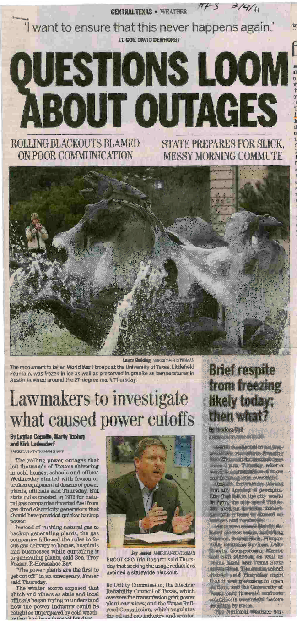
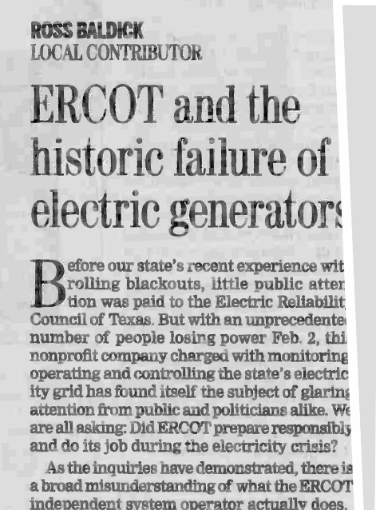
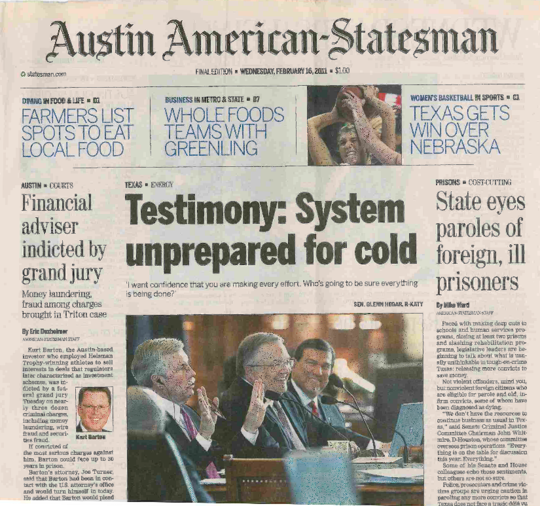
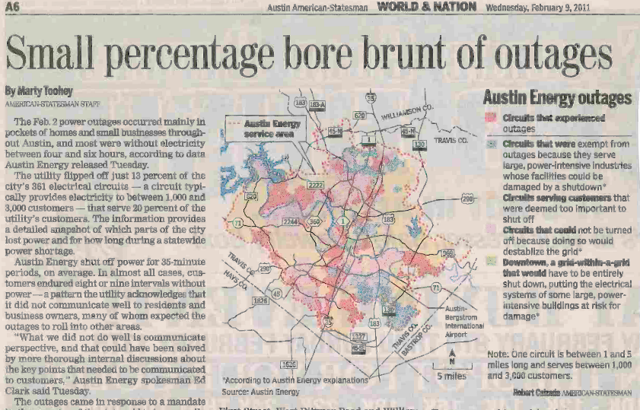
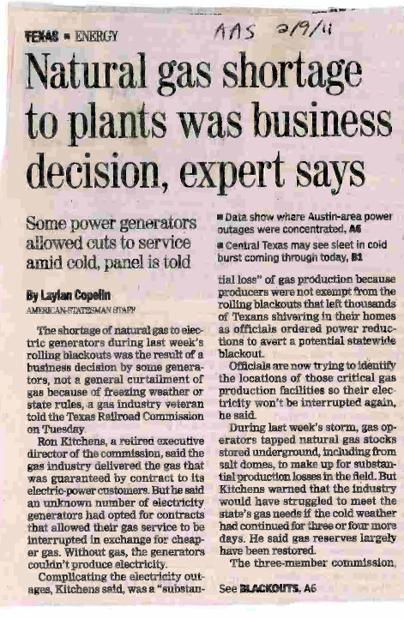
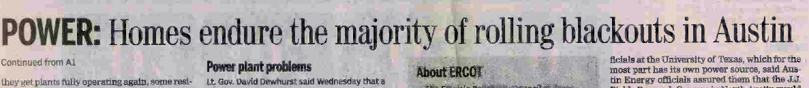
February 2011 Headlines….

Slide 3
PUCT Regulatory Requirements for Generator Preparedness
§25.53. Electric Service Emergency Operations Plans.
    (c)(1)(H) A plan for the inventory of pre-arranged supplies for emergencies.
    (c)(1)(I) A plan that addresses staffing during severe weather events.
    (c)(2)(A) A plan that addresses severely cold and severely hot weather.
    (c)(2)(B) A plan that addresses any known critical failure points, including any effects of weather design limits.
    (c)(2)(G) Checklists for generating facility personnel to address emergency events.
    (c)(2)(H) A summary of alternate fuel and storage capacity.
    (c)(2)(I) A plan for alternative fuel testing if the facility has the ability to utilize alternative fuels.
    (c)(2)(d) A Market entity shall conduct or participate in one or more drills annually to test its emergency procedures if its emergency procedures have not been implemented in response to an actual event within the last 12 months.

Slide 4
ERCOT Nodal Requirements
Nodal Protocol 3.21 (3)
  No earlier than November 1 and no later than December 1 of each year, each Resource Entity shall submit the declaration in Section 22, Attachment O, Declaration of Completion of Generation Resource Winter Weatherization Preparations, to ERCOT stating that, at the time of submission, each Generation Resource under the Resource Entity’s control has completed or will complete all weather preparations required by the weatherization plan for equipment critical to the reliable operation of the Generation Resource during the winter Peak Load Season.
  If the work on the equipment that is critical to the reliable operation of the Generation Resource is not complete at the time of filing the declaration, the Resource Entity shall provide a list and schedule of remaining work to be completed.
Section 22, Attachment O, Declaration of Completion of Generation Resource Weatherization Preparations
“I hereby attest that all weatherization preparations for equipment critical to the reliable operation of each of the above-listed Generation Resources during the time period stated above are complete or will be completed, as required by the weatherization plan applicable to each Generation Resource.”

Slide 5
Four coldest days in the past nine years
EEA3 – 4000MW
firm load shed
Normal
Operations
Normal
Operations
EEA2
Source: Chris Coleman, ERCOT

Slide 6
Hours at and below freezing (32 DegF or less) during four coldest days in ERCOT in the past nine years.
EEA3 – 4000MW
firm load shed
Normal
operations
Normal
operations
EEA2
Source: Chris Coleman, ERCOT

Slide 7
Two coldest days and hours below 32DegF this decade
 | 2/2/2011 | Hours below 32DegF | 1/17/2018 | Hours below 32DegF
Dallas | 13°/20MPH | 24 | 13°/5MPH | 19
Houston | 21°/16MPH | 14 | 19°/13 MPH | 18
San Antonio | 19°/25MPH | 24 | 23°/10 MPH | 12
Austin | 18°/26 MPH | 24 | 18°/10 MPH | 20
Brownsville | 32°/26 MPH | 0 | 30°/14 MPH | 10
Abilene | 7°/16 MPH | 24 | 8°/5 MPH | 19
Midland | 6°/16 MPH | 24 | 28°/7 MPH | 10
Source: Chris Coleman, ERCOT

Slide 8
3541MW
EEA2
750MW

Slide 9
Plant spot checks winter season 2019/2020 results
  80 units spot checked
    The purpose of spot checks is to verify plant personnel are following their weatherization plan.
    As necessary, plant personnel are left with a recommendation(s) based on PUCT requirements, lessons learned or best practices observed.
    Company senior management is emailed results.
  Fuel types spot checked
      71 gas fired units (conventional and combined cycle).
      3 coal fired units.
      6 gas fired black start contracted units.
    23 units agreed to improve preparations and/or records management and will be scheduled early in 2020 to verify improvements.
    57 units had no observed deficiencies in their plan or records management.

Slide 10
Natural gas portion of ERCOT spot checks
  Preparations needed in gas yard prior to winter.
  Alternate gas supplies that can be used during curtailments.
  Communicating curtailments to ERCOT.
  Sensing lines for main gas supply regulators.
      Recently, a plant experienced an instance of frozen instrument air to main gas supply. regulator.

Slide 11
Resistance temperature detector (RTD) failure – lesson learned
During the cold front on November 12, 2019 a CT experienced a trip due to transition steam flow showing a high reading.
Inspection of the transmitter box showed that the heater and heat trace was not energized.
  I&C technician found that the RTD that senses the ambient temperature for the heat trace panel had failed.
  RTD measures ambient temperature to energize heat trace circuits.
  Manufacturer default for a RTD failure is to de-energize heat trace circuits.
It was also discovered that the thermometer that measures inside transmitter box temperature was reading 15DegF higher than enclosure temperature. This temperature is recorded by operators on rounds and gave the operator a false reading.
Corrective action:
  RTD replaced on all heat trace panels of this type.
  All heat trace panels of this type were re-programmed to energize heat trace circuits for an RTD failure.
  All transmitter box thermometers that measure the inside temperature have been replaced.
  During the spring 2020 outage, GMS was upgraded to telemeter internal box temperatures for all critical transmitters into the control system for monitoring by the control room operators.
Lessons learned shared with the remainder of company fleet.

Slide 12
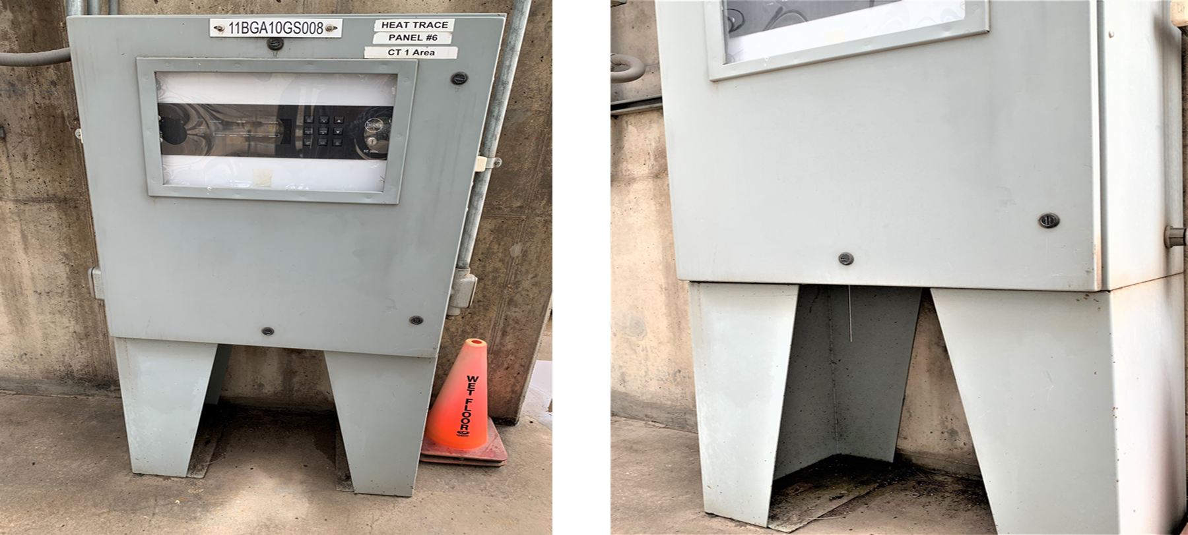
Heat trace panel – resistance temperature detector (RTD) failure

Slide 13
Common causes of transmitter manifolds and/or sensing lines freezing
  Tripped heat trace circuit breaker.
  Blown fuse in heat trace panel.
  Contractor error when terminating heat trace after testing.
  Insulating contractor damage to heat trace.
  Section of heat trace not functioning.
  Incorrect heat trace for application.
  Heat trace open ended and not grounded.
  Transmitter cabinet heater not functioning.
  Poor or lack of wind break measures.
  Transmitter(s) exposed to the elements.
  Gaps in insulation.

Slide 14
What have we learned since February 2011?
Identify critical components if frozen, will derate, trip or fail to start the unit and incorporate the measures to prevent from freezing into weatherization plan.
Heat trace failure rates in Texas on average are 10-15% from previous season.
Detailed testing of heat trace is necessary, identifying critical circuits. Repair at minimum, critical circuits.
Verify critical heat trace circuits are functioning prior to every extreme cold weather event.
Insulation inspections, focusing on critical components.
As an additional measure, install wind breaks and/or space heaters protecting critical components, focusing on the N and NE sides of unit. Avoid off the shelf tarps.

Slide 15
What have we learned since February 2011? (continued)
Review scope of contractor work and verify acceptable completion.
Verify instrument air dryers, dew point monitoring, blow downs are all operating correctly.
Conduct a refresher training drill in the fall with operators on extreme cold weather procedures.
Ensure critical transmitters are in a heated enclosure and inspect integrity of transmitter enclosures in the fall as part of weatherization plans.
Test critical components transmitter cabinet thermostat and heater as part of heat trace testing.
Weatherization plan portion of EOP should be updated annually as lessons are learned and sent to ERCOT at EOP@ercot.com.

Slide 16
The South Central United States Cold Weather Event – January 17, 2018

Slide 17
Scope of the NERC/FERC Report
Finding: The South Central U.S. Cold Weather BES Event of January 17, 2018 was caused by failure to properly prepare or “winterize” the generation facilities for cold temperatures.
Finding: Gas supply issues contributed to the Event, and natural gas-fired units represented at least 70% of the unplanned generation outages and derates.
  During January15-19, 2018 an area of the south central U.S. experienced unusually cold weather that resulted in outages to 183 generating units representing approximately 30,000MW.
  NERC/FERC report evaluated effects of weather on generation availability, forecasting, and transmission constraints in the SPP, MISO, TVA, and SeRC areas.
  Report included recommendations for improving generation availability during extreme cold weather events.
  The recommendations provide a useful basis for comparison to the improvements that ERCOT made after the February 2011 cold weather event.

Slide 18
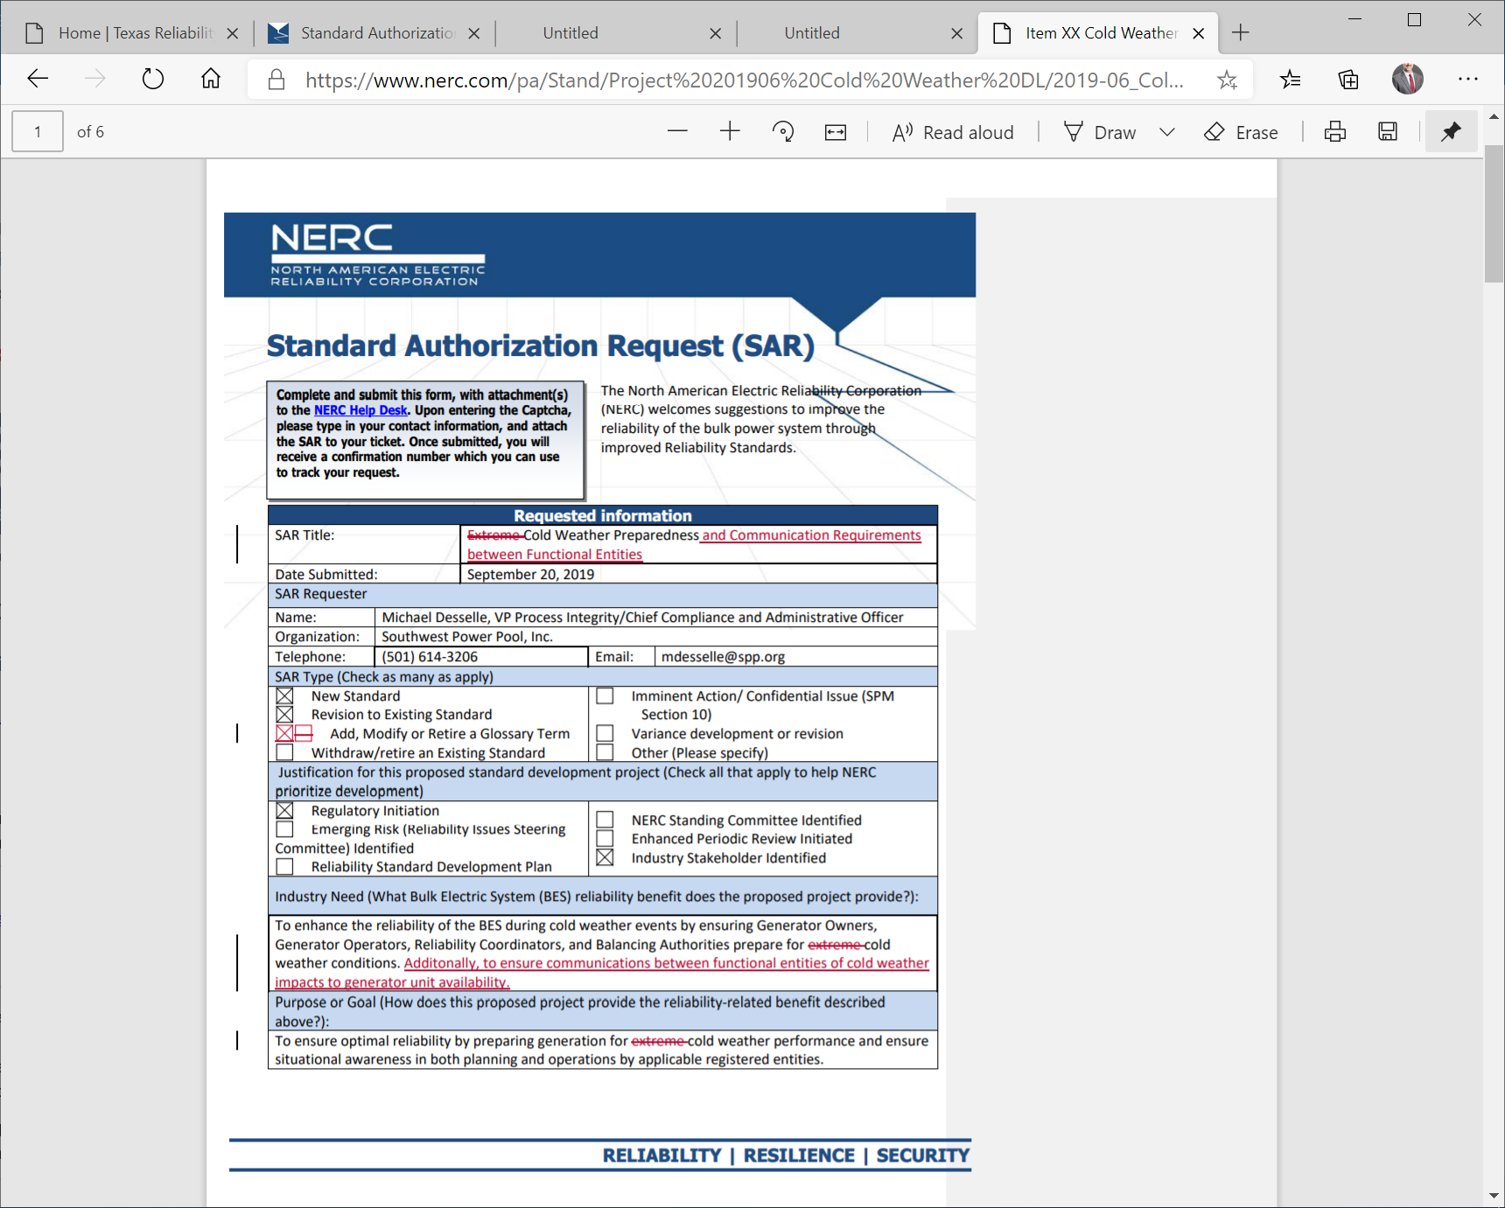
NERC Cold Weather Reliability Standard
NERC Project 2019-06:
Cold Weather Preparedness
3rd version posted and comments received May 21, 2020
Responses under review by a stakeholder drafting team

Slide 19
Closing comments……
ERCOT assists generators in preparing for winter operations with spot checks, sharing lessons learned, best practices, recommendations and the annual fall workshop.
Recent history has shown us that for every extreme cold weather event, a small amount of generation will experience freeze related derates or trips.
For winter 2020/2021, spot checks will begin November 16, 2020 and will conclude February 26, 2020.
Due to COVID-19, the majority of the spot checks will be table top WebEx with some on-site visits.

Slide 20
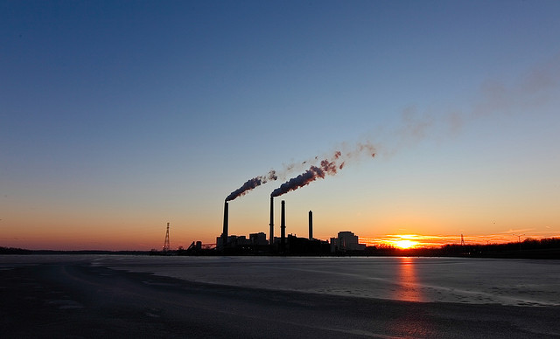
Thank you generator owners, operators, gas pipeline operators and Transmission Distribution Operators for you winter weatherization efforts!

