Slide 1
2020 LTSA Update
ERCOT System Planning
September, 2020

Slide 2
2020 LTSA Process
Current Trends Preliminary Capacity Expansion
Gather Stakeholder Feedback
Finalize Current Trends Capacity Expansion
Develop Current Trends Transmission Expansion
Develop Load Forecast for Other Scenarios
Develop Capacity Expansion for Other Scenarios
Develop Transmission Expansion for Other Scenarios
Report
Develop ~4 Other Scenarios

Slide 3
2020 LTSA Overall Update
Initial generation expansion analysis completed for all scenarios
  Current Trends, Renewable Mandate, High BESS, High Industrial Load, and Existing Transmission Constraints
Initial transmission improvements identified for Current Trends 2030 case
A second iteration of generation expansion analysis is being conducted for Current Trends
  Current Trends transmission expansion analysis will be finalized using the updated generation expansion results

Slide 4
Generation Expansion Update
Julie Jin

Slide 5
Input Assumptions for the Existing Transmission Constraints Scenario
A four-zone model including Panhandle, West, Valley and the rest of the system is used;
Interface limits including West Texas export, Valley import and Valley export are enforced in the model;
Zonal shift factors are applied to capture the relationship between zonal injections and interface flows.

Slide 6
Four-zone Model with Interface Limits
11,500 MW
3737 MW
1865 MW

Slide 7
Results for the Existing Transmission Constraints Scenario
Reserve margin in final year: 12%
Built 20,979 MW gas generation
Built 27,500 MW solar
Built 35,200 MW wind
Built 3,469 MW battery storage
Unserved energy in years 2025 through 2035. Shortages are seen in 7-8 PM before 2030 and concentrated in 7-10 PM in 2035 in summer months with maximum magnitude over 9,000 MW.

Slide 8
Results for the Existing Transmission Constraints Scenario (cont.)
West Texas export is binding in around 7% of time in 2021, but increases to 35% in 2035.
Valley Export starts to be binding slightly after 2025, Valley Import is only binding in a few hours through 2035.
Compared to the Current Trends scenario, this scenario adds more battery and combined cycle capacity, but less simple cycle CT and wind capacity.
All of the new combined cycle units are added in the Rest zone to relieve interface constraints. 56% of the new wind and 69% of the new solar capacities are added in the Rest zone as well.

Slide 9
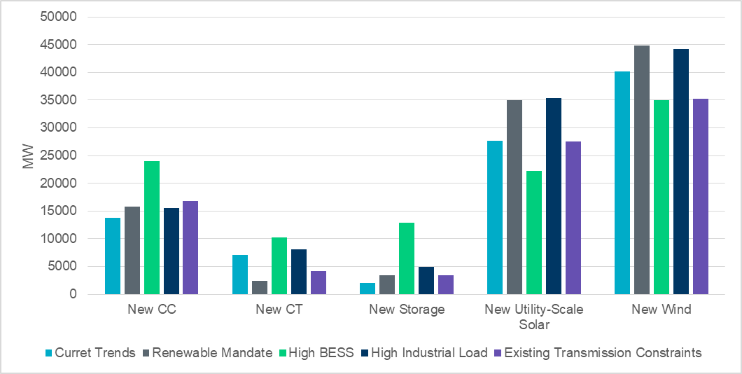
Summary- Generation Capacity Additions by 2035

Slide 10
Current Trends Transmission Expansion Update
Hong Xiao

Slide 11
General Status Update
Initial transmission improvements identified for 2030, Current Trends
Interfaces with updated limits will be fed into 2nd iteration of Current Trends analysis

Slide 12
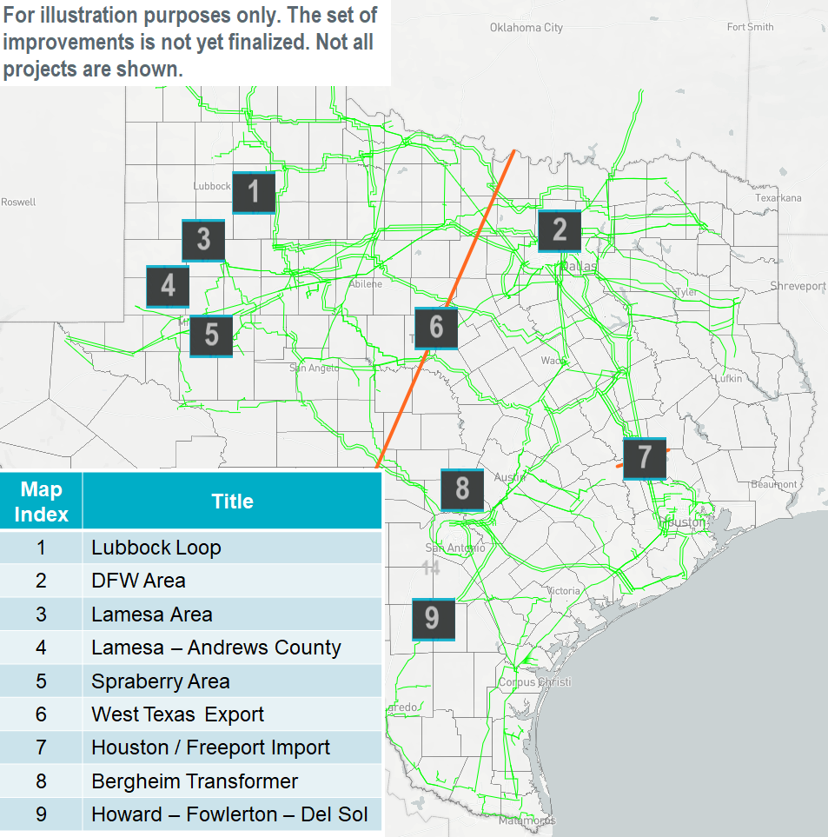
Current Trends 2030 Initial Improvements
Changes to System Indices with Initial Improvements
Load Curtailment Reduction | 95 GWh
Transmission Violation Cost Savings | $64M
Production Cost Savings | $1318M
Congestion Rent Reduction | $3309M
Constraint Comparison with Initial Improvements
Monitored Element | Voltage (kV) | Rank - before | Rank - after
West Texas Export | 345 | 1 | 1
Hicks Switch - Wagley Robertson - Blue Mound - Saginaw Switch | 138 | 2 | -
Liggett Switch - Norwood Switch | 345 | 3 | 127
McKenzie - Northeast | 115 | 4 | -
Kendall – Kerrville Stadium | 138 | 5 | -
Hicks Switch – Roanoke Switch | 345 | 6 | -
Zenith – TH Wharton | 345 | 7 | -
Laredo VFT North – Las Cruces | 138 | 8 | 49
Pomelo – North Edinburg | 345 | 9 | 79
Hicks Switch – Alliance | 345 | 10 | -

Slide 13
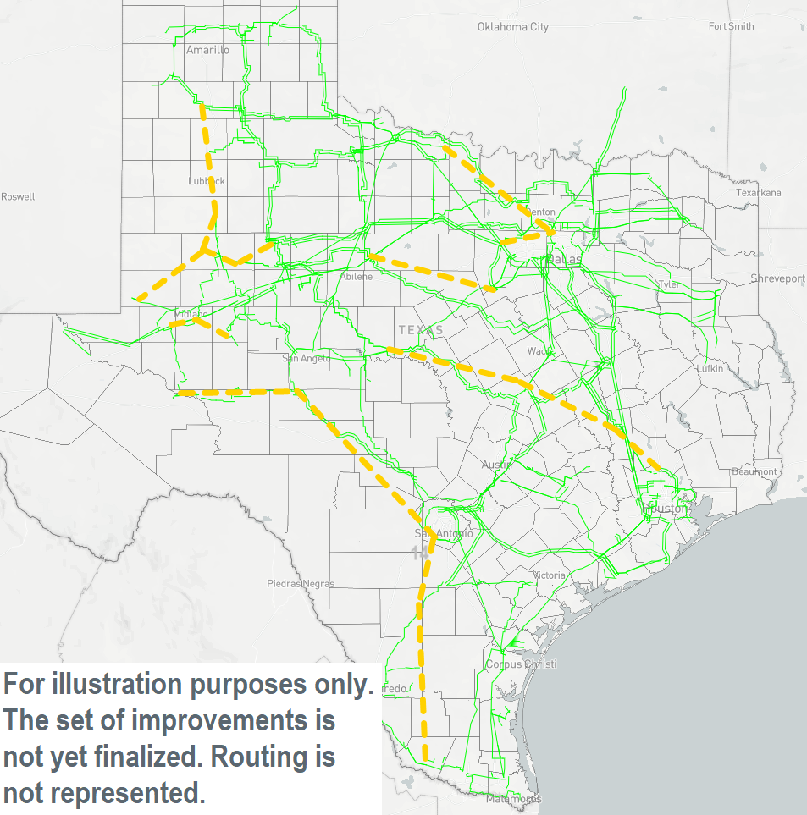
Initial EHV Transmission Line Additions

Slide 14
2nd Iteration Information
Enhanced pipe-and-bubble model
Four LTSA zones
  Panhandle, West, Valley, and Rest
Three interfaces with enforced transfer limits
  West Texas Export, Valley Import, and Valley Export
  Transfer limits are determined with knowledge gained previously
    For 2020 LTSA, each 345-kV double-circuit line provides 1000 MW increase in West Texas Export interface limit

Slide 15
Study Year | West Texas Export Limit | Valley Import Limit | Valley Export Limit
2025 and before | 11500 MW | 1865 MW | 3737 MW
2026 and 2027 | 13500 MW | 1865 MW | 3737 MW
2028 and after | 15500 MW | 1865 MW | 3737 MW

Slide 16
Next Steps
Work on 2nd iteration of Current Trends generation expansion followed by siting
Finalize Current Trends transmission expansion
Start Renewable Mandate transmission expansion

Slide 17
Questions
John Bernecker
John.Bernecker@ercot.com
512.248.4274
Julie Jin
Julie.Jin@ercot.com
512.248.3982
?

Slide 18
Appendix

Slide 19
Iterative Process of Capacity Expansion and Transmission Analysis
Long-term Capacity Expansion
Yes
New interface limits recommended?
Long-term Transmission Analysis
No
End

