Slide 1
DGR (Battery) equivalent impedance expectation
7/28/2020

Slide 2


Simplest model
Real equipment like circuit breaker is needed between line and node1
  To isolate DGR to grid
no pseudo-equipment is needed between
  DGR and node1
  CLR and node1
Advantage
  Minimize pseudo-equipment
  Simplify operation model
  Facilitate outage coordination
Line
node2
Breaker
node1
DGR
CLR

Slide 3
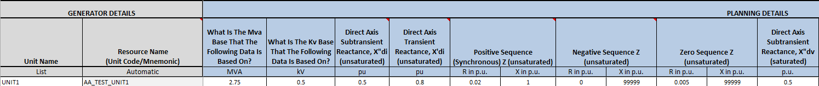
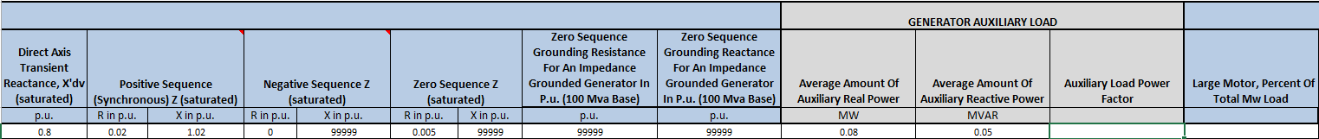
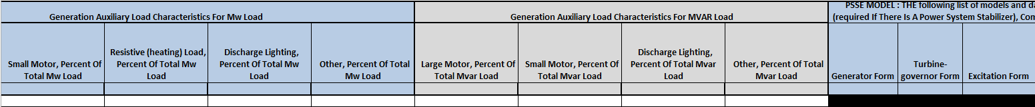
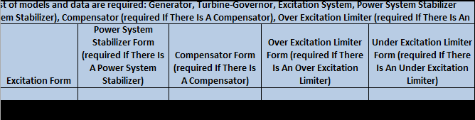
RARF – sample RARF Planning Gen Data

Slide 4
Impedance modeling issue
Impedance does not reflect equivalent impedance of entire generating unit
  RARF “Planning – GEN” tab
  one battery-inverter module
  Impedance does not reflect impedance of entire generating unit
  does not have pad-mount step up transformer data
    Transformer impedance derived from test report or word document which is not part of RARF data
  does not have GenUnit-Battery-inverter-transformer configuration
    Estimate based on one-line
    Example 1 unit with 4 batteries, each batteries connect to one inverter, each inverter to one transformer

Slide 5
Impedance modeling issue cont’d
Other generators using GEN FORM has equivalent impedance
impedance data in RARF not accurately reflected in ERCOT models affecting downstream systems

Slide 6
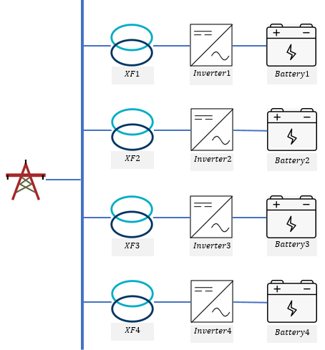






Equivalent impedance example
$$Z at 2.75 MVA$$
$$Z at 11 MVA$$
Module1
R=0.02 p.u.
X=1.02 p.u.
R=0.08 p.u.
X=4.08 p.u.
$$Z_{Module1}=Z_{Inverter1}$$
Module2
$$Z_{Module2}=Z_{Inverter2}$$
R=0.02 p.u.
X=1.02 p.u.
R=0.08 p.u.
X=4.08 p.u.
Module3
R=0.02 p.u.
X=1.02 p.u.
R=0.08 p.u.
X=4.08 p.u.
$$Z_{Module3}=Z_{Inverter3}$$
Module4
R=0.02 p.u.
X=1.02 p.u.
R=0.08 p.u.
X=4.08 p.u.
$$Z_{Module4}=Z_{Inverter4}$$

Slide 7

Equivalent impedance example cont’d
Test Step-up Transformer Specifications
  Voltage
    Low Side: 0.5 kV
    High Side: 12.5 kV
  MVA ratings: 2.75 MVA
  Positive sequence impedances: 6%
  Zero sequence impedance: 5%
  X/R: 10
  Available Taps: 5 (±2 x 3%)
$$Z_{XF}=6\%$$
$$X_{XF}=Z_{XF}×\sin\left(\tan^{−1}\left(X/R\right)\right)×\frac{11}{2.75}$$
= $6\%×\sin\left(\tan^{−1}{10}\right)×4$
$=0.23881 p.u.$
$$R_{XF}=Z_{XF}×\cos\left(\tan^{−1}\left(X/R\right)\right)×\frac{11}{2.75}$$
= $6\%×\cos\left(\tan^{−1}{10}\right)×4$
$=0.023881 p.u$.

Slide 8






Equivalent impedance example cont’d
$$Z_{T1}=Z_{XF1}+Z_{Module1}$$
$$R_{T1}=0.08+0.023881=0.103881 p.u.$$
$$X_{T1}=4.08+0.23881=4.31881 p.u.$$
$$Z_{T2}=Z_{XF2}+Z_{Module2}$$
$$R_{T1}=0.08+0.023881=0.103881 p.u.$$
$$X_{T1}=4.08+0.23881=4.31881 p.u.$$
$$Z_{T3}=Z_{XF3}+Z_{Module3}$$
$$R_{T1}=0.08+0.023881=0.103881 p.u.$$
$$X_{T1}=4.08+0.23881=4.31881 p.u.$$
$$Z_{T4}=Z_{XF4}+Z_{Module4}$$
$$R_{T1}=0.08+0.023881=0.103881 p.u.$$
$$X_{T1}=4.08+0.23881=4.31881 p.u.$$

Slide 9
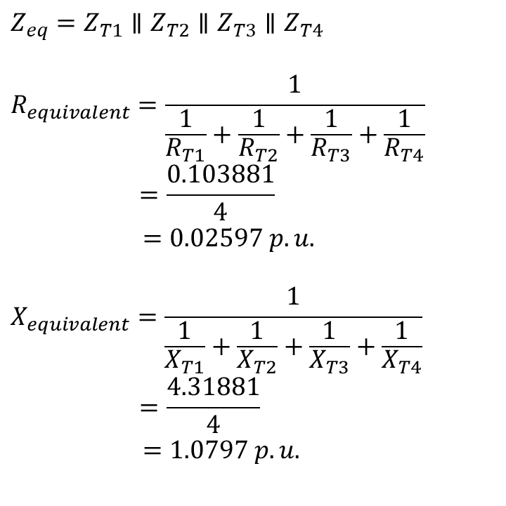
Equivalent impedance example cont’d
$$Z_{eq}=Z_{T1}∥Z_{T2}∥Z_{T3}∥Z_{T4}$$
$$R_{equivalent}=\frac{1}{\frac{1}{R_{T1}}+\frac{1}{R_{T2}}+\frac{1}{R_{T3}}+\frac{1}{R_{T4}}}$$
$$=\frac{0.103881}{4}$$
$=0.02597 p.u.$
$$X_{equivalent}=\frac{1}{\frac{1}{X_{T1}}+\frac{1}{X_{T2}}+\frac{1}{X_{T3}}+\frac{1}{X_{T4}}}$$
$$=\frac{4.31881}{4}$$
$=1.0797 p.u.$

Slide 10

Q & A
QUESTIONS?

