Slide 1
NPRR 995 Update
ERCOT Staff
BESTFORCE
Sept. 11, 2020

Slide 2
Recap of NPRR 995 discussions to date
ERCOT proposed and discussed the following provisions at WMS (July 8 and Sept. 2):
Settlement Only Distribution Energy Storage (SODES) and Settlement Only Transmission Energy Storage (SOTES) should be settled at nodal prices for both injections and withdrawals
SODES and SOTES should be eligible for Wholesale Storage Load (WSL) treatment
ERCOT has written comments to NPRR 995 to enable these principles

Slide 3
Summary of ERCOT comments
SODES and SOTES to be settled at nodal prices for both injections and withdrawals
Pricing nodes identified pursuant to methods developed in NPRR 917, Nodal Pricing for Settlement Only Distribution Generators (SODGs) and Settlement Only Transmission Generators (SOTGs)
SODES and SOTES eligible for WSL treatment, as long as charging Load can be separately metered or measured
Pursuant to current practice of separate metering, or sensor methodology approved in NPRR 1020, Allow Some Integrated Energy Storage Designs to Calculate Internal Loads

Slide 4
Summary of ERCOT comments
SODES and SOTES should be settled on nodal prices even if not receiving WSL treatment
Resource Entity may not request WSL
Charging Load may not be able to be separately metered
Preamble to PUC Rulemaking in Project 39917 implies that WSL should be optional, not mandatory
http://interchange.puc.texas.gov/Search/Documents?controlNumber=39917&itemNumber=41
New defined term “Non-WSL Settlement Only Charging Load:”
The metered or calculated charging Load withdrawn by a Settlement Only Distribution Energy Storage (SODES) or Settlement Only Transmission Energy Storage (SOTES) that is not receiving Wholesale Storage Load (WSL) treatment.

Slide 5
Summary of ERCOT comments
For SODES and SOTES that do not request or do not qualify for WSL treatment, charging Load shall be determined by either:
Separate metering
A default percentage (in cases where separate metering is not possible)
ERCOT proposes that the default percentage should be 85% charging Load (15% auxiliary Load)
ERCOT requests stakeholder input on the proper default percentage

Slide 6
Summary of ERCOT comments
For a SODES and SOTES where customer Load is present (along with charging Load and auxiliary Load), ERCOT proposes the ‘generation accumulator’ methodology to calculate charging energy eligible for nodal pricing
Energy injected to the ERCOT System will be tabulated in the gen accumulator
Subsequent charging energy withdrawals will be priced at nodal until the accumulator value is exhausted
When accumulator is exhausted, withdrawals will be priced at Load Zone until future injections occur

Slide 7
Summary of ERCOT comments
Pricing summary:
NODAL WSL: For charging Load with approved separate metering or validated sensor methodology per NPRR 1020
Not subject to Load Ratio Share-based charges
NODAL Non-WSL: For charging Load by SODES or SOTES not receiving WSL treatment
Subject to Load Ratio Share-based charges
ZONAL: Auxiliary Load
Subject to Load Ratio Share-based charges
ZONAL: Any additional customer Load co-located with the SODES or SOTES
Subject to Load Ratio Share-based charges

Slide 8
SOTSES
There is a third type of SOES
From NPRR 995, Section 2.1:
Settlement Only Transmission Self-Energy Storage (SOTSES)
An Energy Storage System (ESS) connected to the ERCOT transmission system with a rating of one MW or more and does not export energy to the ERCOT System.
Under this language, a SOTSES is presumed to never export, so nodal/nodal pricing is immaterial, and NPRR 995 Settlement provisions are unnecessary
SOTSES withdrawals will be settled at Load Zone and subject to applicable Load Ratio Share-based charges

Slide 9
Summary of ESS Attributes
Energy Storage System Type | Meter | Sensor option | Default % option | Pricing | Gen Accumulator Option | NPRR
ESR with WSL | Y | Y | N | Nodal | N | 986 clarification (coming soon) on top of 986 & 1020
ESR Non-WSL | Y | N | Y | Nodal | N | 986 clarification (coming soon) on top of 986 (1020 not applicable)
SODES/ SOTES with WSL | Y | Y | N | Nodal | Y | 995 (with ERCOT comments) on top of 1020
SODES/ SOTES Non-WSL | Y | N | Y | Nodal | Y | 995 with ERCOT comments (1020 not applicable)
SOTSES | N/A | N/A | N/A | Zonal (load only) | N/A | 995

Slide 10
Future ERCOT Comments to NPRR 995
ERCOT is developing an additional set of comments to NPRR 995 to address:
Operations and Planning provisions for SOES
Additional places in the Protocols where SOES references will be inserted to align SOES provisions with those of Settlement Only Generators (SOGs), or differentiate if appropriate

Slide 11
Appendix

Slide 12
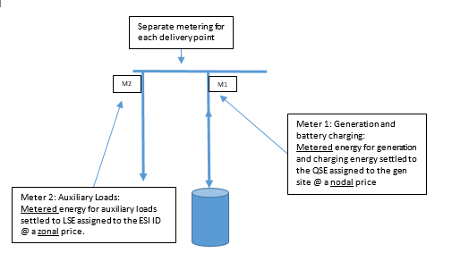
SODES / SOTES Scenario #1
Stand alone, auxiliary loads connected at a separate delivery point

Slide 13
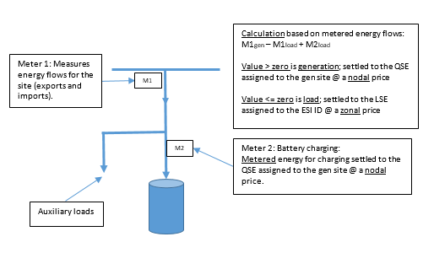
SODES / SOTES Scenario #2
Stand alone, auxiliary loads connected behind the same delivery point

Slide 14
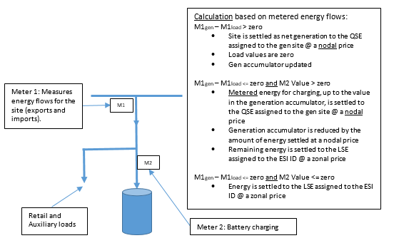
SODES / SOTES Scenario #3
Customer load and auxiliary loads connected behind the same delivery point (generation accumulator methodology)

Slide 15
Questions?

