Slide 1
Time Error between Aug 27 and Sep 1
ERCOT Staff
September 8, 2020
PDCWG

Slide 2
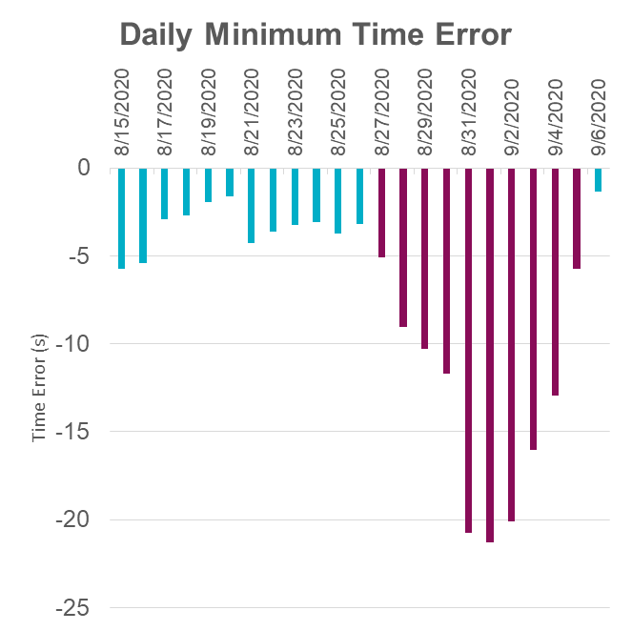
Large Time Error Accumulation
ERCOT’s Time Error saw a large negative accumulation between Aug. 27 and Sep. 1.
The lowest time error during this period was -21.22 on Sep. 1 at 3:34 am.
This accumulation in Time Error is attributive to a combination of,
under-forecast error in Short Term Load Forecast,
over-forecast error in Intra-Hour Wind Forecast,
solar ramp (diurnal pattern and cloud cover) and
increase in negative expected generation deviations (fueled by HSL and ramp rate error estimations).
GTBD tuning was conducted on
Sep 1 @11am |max ACE Integral| change from 200 to 250 MW
Sep 3 @3pm |max ACE Integral| change from 250 to 300 MW
Sep 4 @3pm |max ACE Integral| change from 300 to 250 MW
Time Error recovered to 0 on Sep 6 @1230am

Slide 3
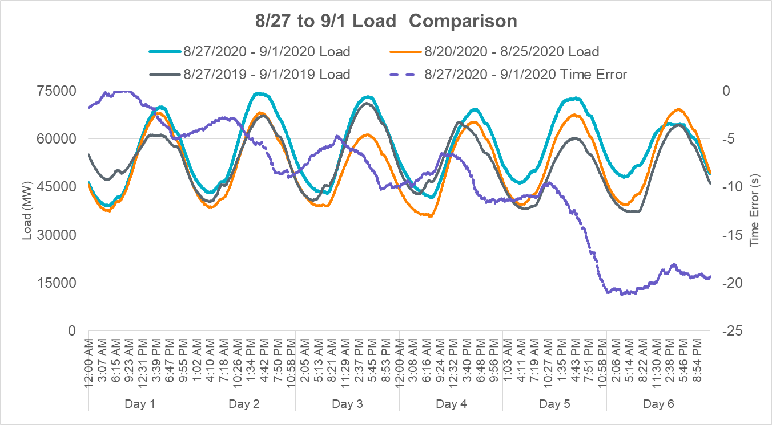
Hotter temperatures between Aug. 27 and Aug. 31 resulted in fairly high demands during this period in comparison to same time the week prior and same time the year prior.

Slide 4
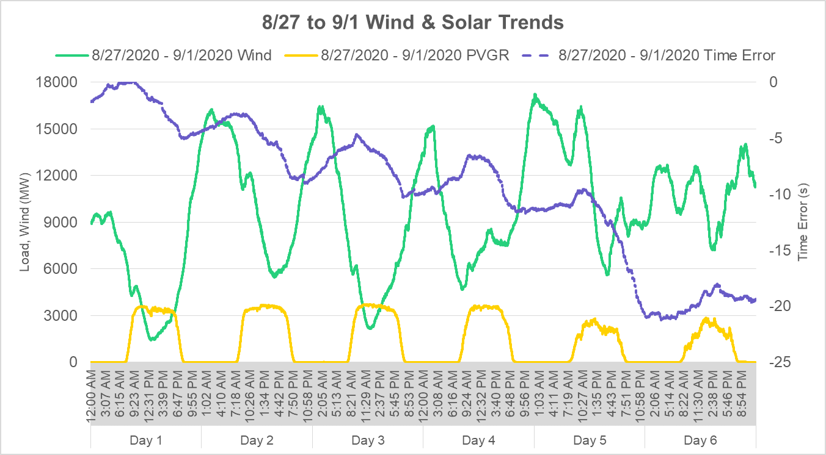
Wind and solar generation saw significant decreases between afternoon Aug. 31 and Sep 1.

Slide 5
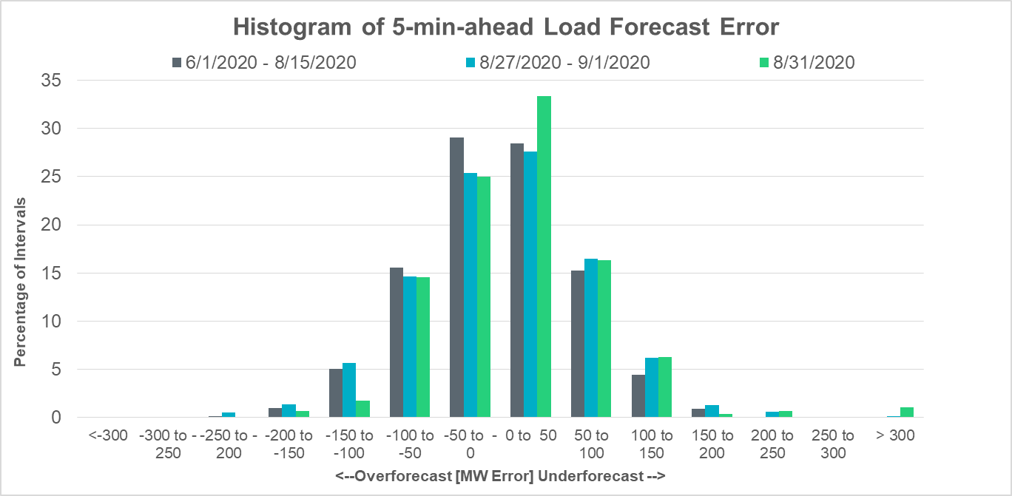
In comparison to rest of the summer season, Short Term Load Forecast (STLF) saw sustained periods of under-forecasts in load during Aug. 27 and Sep 1. The under-forecast had larger outliers on Aug. 31.

Slide 6
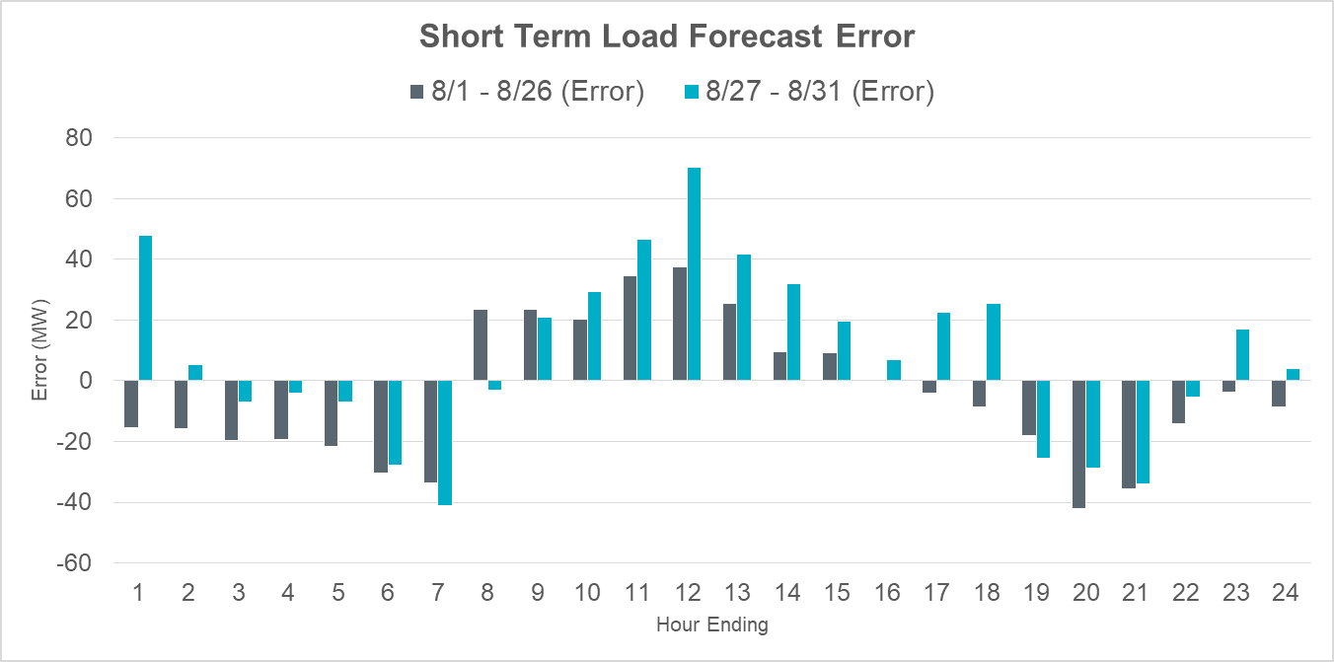
Most of the under-forecast in STLF between Aug. 27 and Aug. 31 was experienced during the load ramping hours between HE9 and HE18.

Slide 7
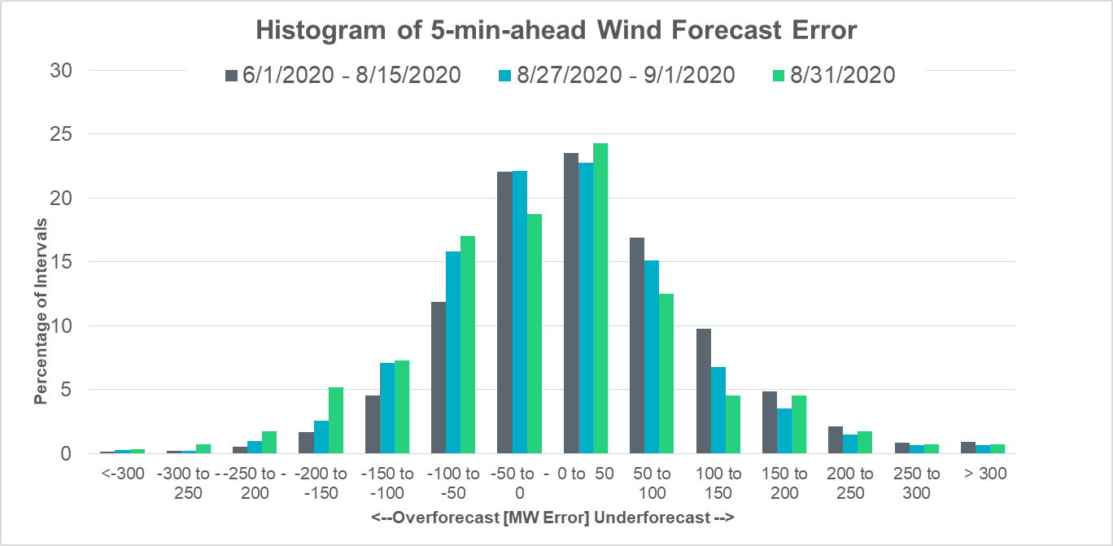
In comparison to rest of the summer season, Intra-hour Wind Forecast (IHWF) saw periods of over-forecasts in wind generation during Aug. 27 and Sep. 1. The over-forecast was more pronounced on Aug. 31.

Slide 8
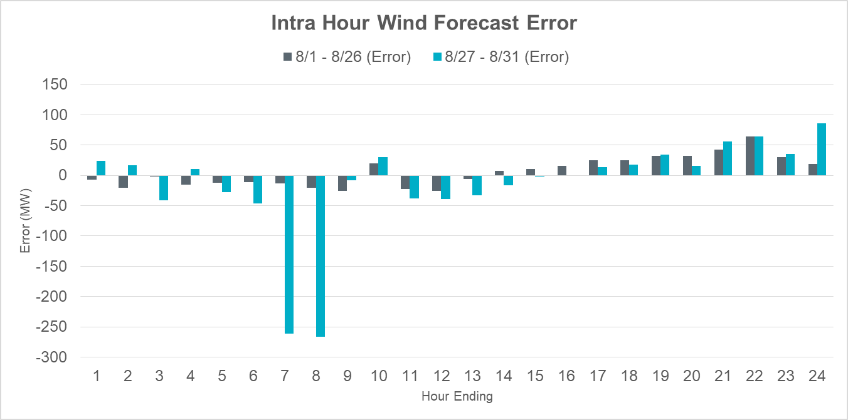
Most of the over-forecast in IHWF between Aug. 27 and Aug. 31 was experienced between HE5 and HE14.

Slide 9
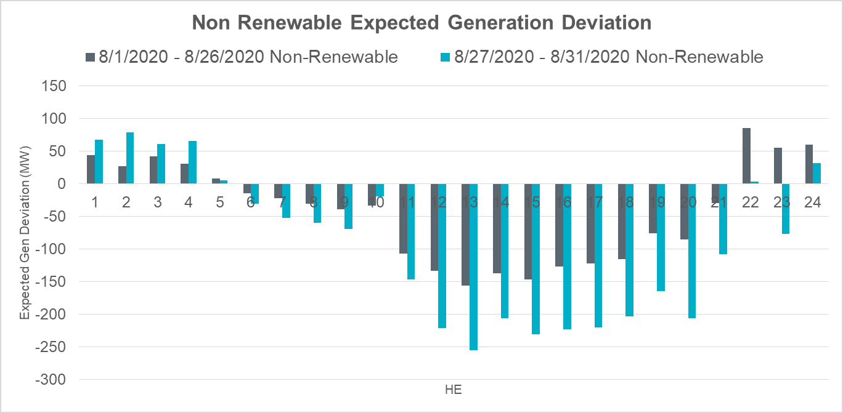
In comparison to the rest of the summer season, there was an increase in negative expected generation deviation from non-renewable resources during Aug. 27 and Aug. 31.

Slide 10
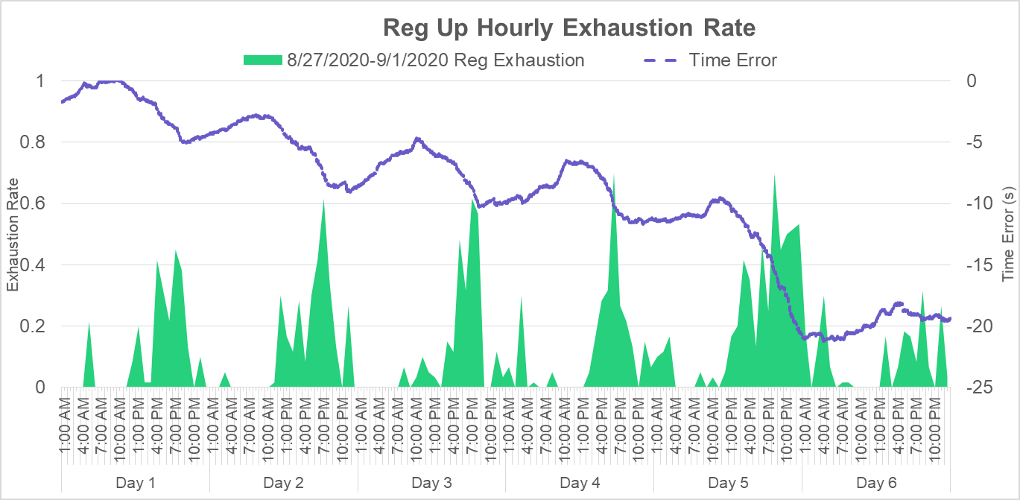
These errors resulted in exhaustion of Regulation reserves during several hours between Aug. 27 and Sep. 1. Aug. 31 had the most Regulation Exhaustion in comparison to the other days.

