Slide 1
ERCOT Frequency Control Report
August 2020
ERCOT
Operations Planning
PDCWG | September 9th, 2020

Slide 2
Summary of August 2020
CPS1: 170.49%
Current CPS1 12-Month Rolling Average: 175.57%
1 BAAL Exceedance
4 hourly CPS1 score below 100%
BAAL-003 Events have updated through 2019
2019 BAAL-003 FRM Performance: -811.14
2020 RMS1 Statistics
Mean: 16.14 mHz
Min: 12.25 mHz
Max: 22.6 mHz
Energy Statistics
Total Energy: 40,757,122 MWh
Wind Energy: 6,441,373 MWh
Percent Energy from Wind: 15.80%
Solar Energy: 1,002,605 MWh
Percent Energy from Solar: 2.46%
Minimum System Inertia
Mean: 283, 054 MW*s
Max: 316,104 MW*s on Aug 16th
Min: 253,877 MW*s on Aug 8th
Notes:
2018 BAAL-003 FRM Performance: -843.17

Slide 3
Frequency Control
CPS1, BAAL, & RMS1

Slide 4
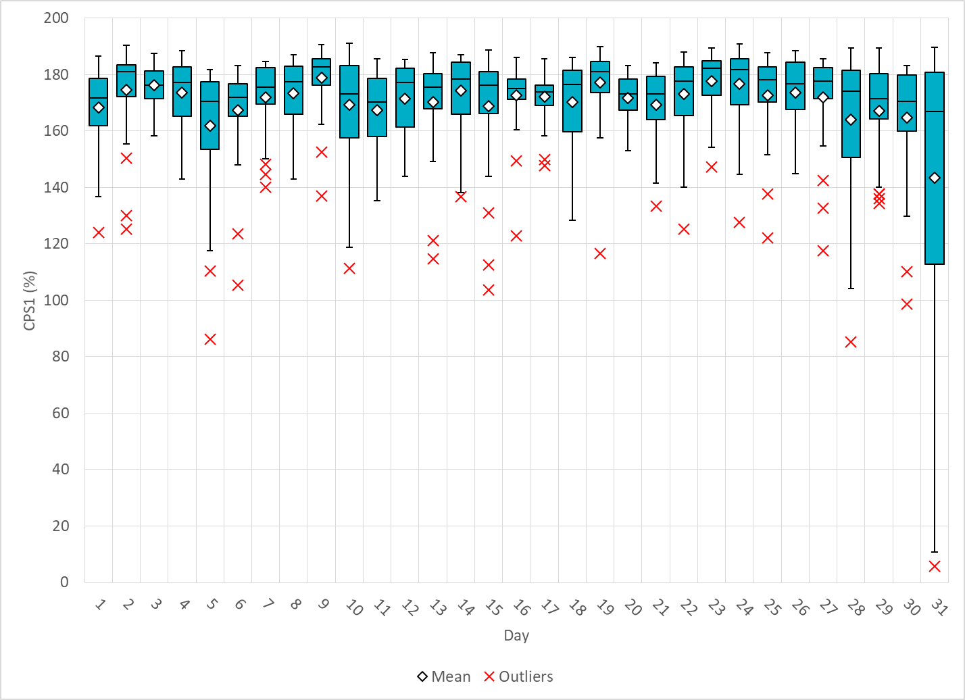
Hourly CPS1 by Day
Aug-20 CPS1 (%): 170.49
Notes:
Outliers:
1. 86.14% @ 8/5/2020 17:00
Expected Gen Dev:
Large exp. Gen. dev of -1377 @ 17:22 mostly due to solar
Wind/Solar Ramp: Solar ramp from 2236 to 2440 MW within 10 minutes.
Regulation: Regulation up exhausted for approximately half of the hour
SCED Offset : Enabled by operator to offset over 700MW of ACE
85.33% @ 8/28/2020 18:00
Frequency Event: @ 18:39, loss of about 186 MWs lost, and nadir of 59.928Hz
Expected Gen Dev:
Large exp. Gen. dev of -1421 @ 18:45 mostly due to thermal units shutting down
Wind/Solar Ramp: Solar ramp from 2805to 1834 MW between 18:30and 19:00
Regulation: Regulation up exhausted from 18:27-18:37 and 18:53-18:56
3. 98.61% @ 8/30/2020 17:00
Expected Gen Dev:
Large exp. Gen. dev of -948 @ 17:23 mostly due to solar ramps and thermal units shutting down
Wind/Solar Ramp: Solar ramp from 3247 MW to 2736 MW between 17:00 and 17:30
Regulation: Regulation up exhausted for most of the hour
4. 5.78% @ 8/31/2020 21:00
Expected Gen Dev:
Large exp. Gen. dev of -1816 @ 21:17 mostly due to wind and thermal units. Negative exp. Gen. dev throughout the hour.
Wind/Solar Ramp: There are 5 SCED intervals with wind forecast over-forecast error greater than 100 MW/5min (PWRR capped out to 30MW/min)
Regulation: Regulation up exhausted for half of the hour

Slide 5
BAAL Exceedances & Violations
There was 1 BAAL exceedance in Aug
Notes:
1 on 8/2/2020

Slide 6
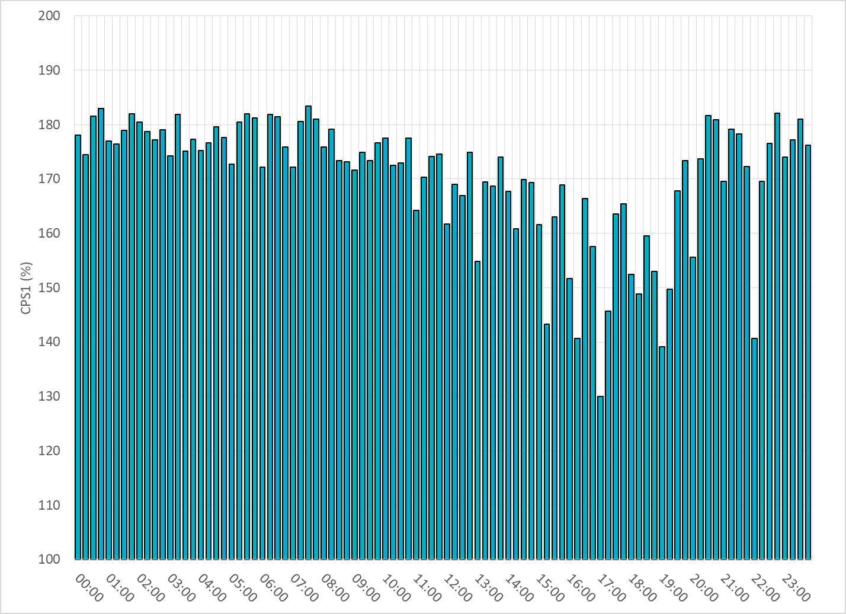
15-Minute Average CPS1%
Aug-20 CPS1 (%): 170.49

Slide 7
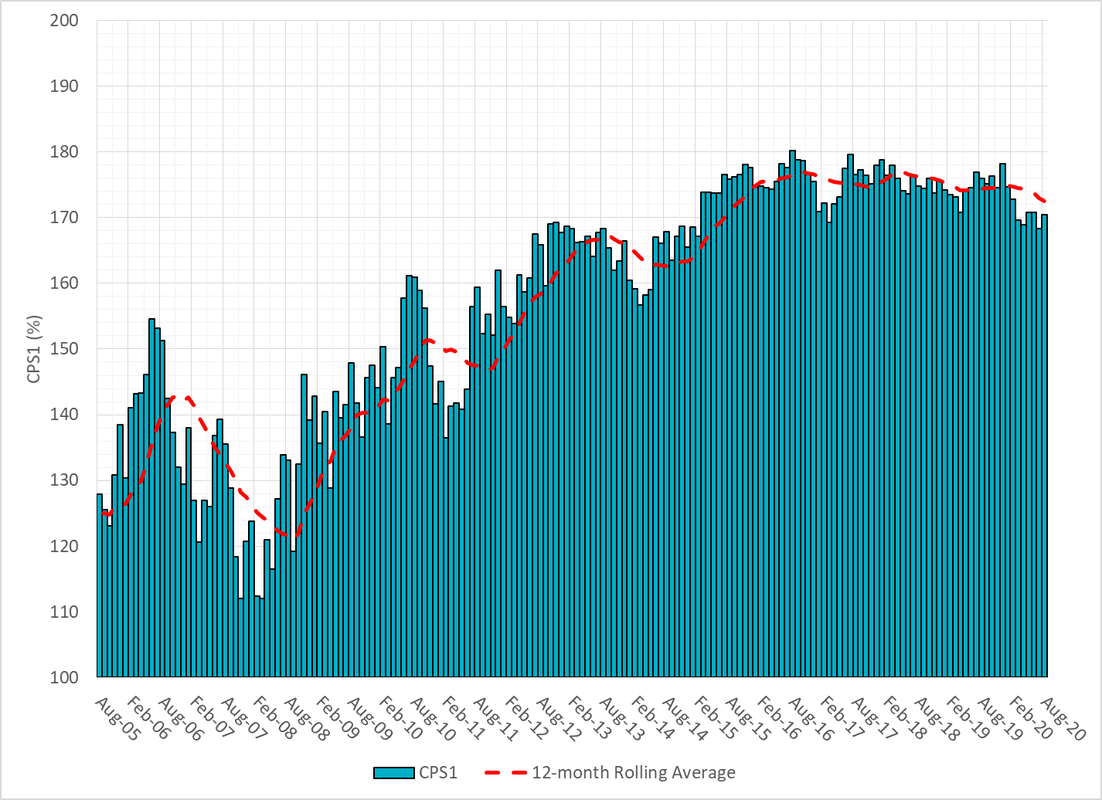
12-Month Rolling Average CPS1
Current 12-Month Rolling Average: 175.57%

Slide 8
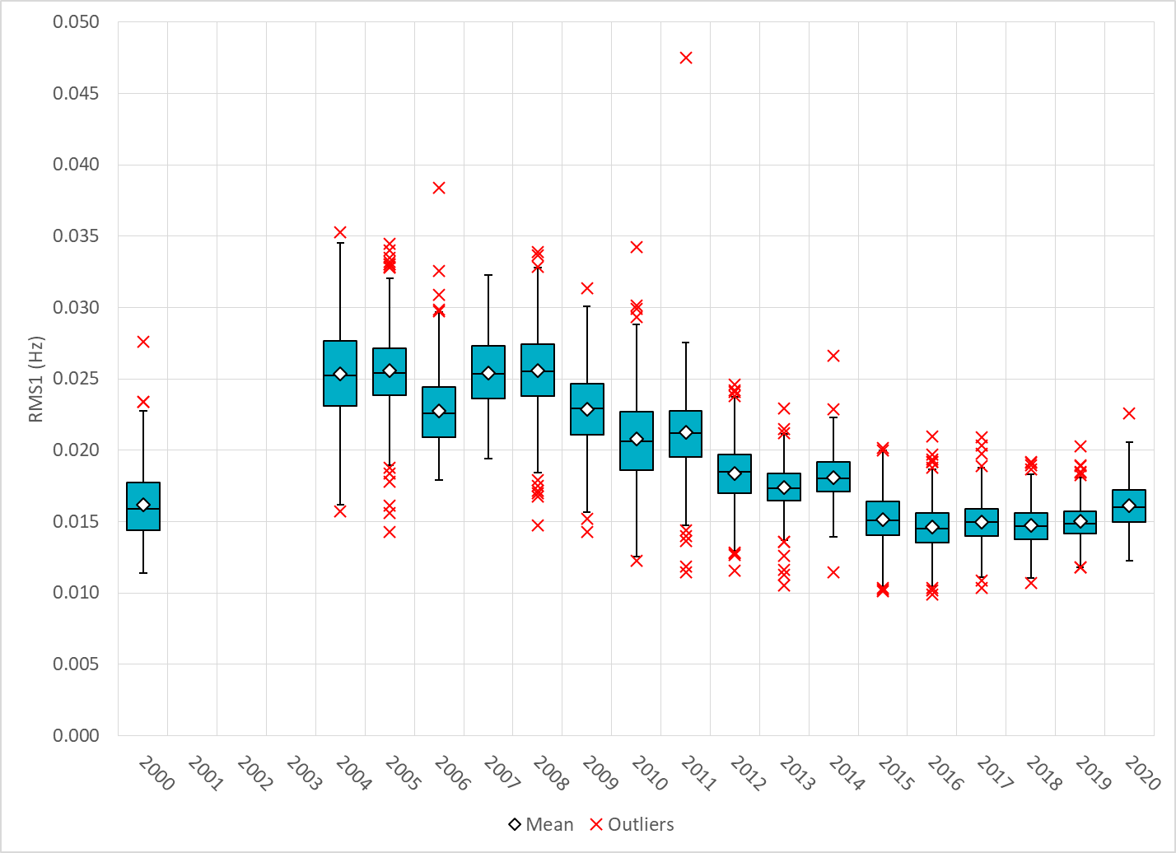
Daily RMS1 of ERCOT Frequency by Year

Slide 9
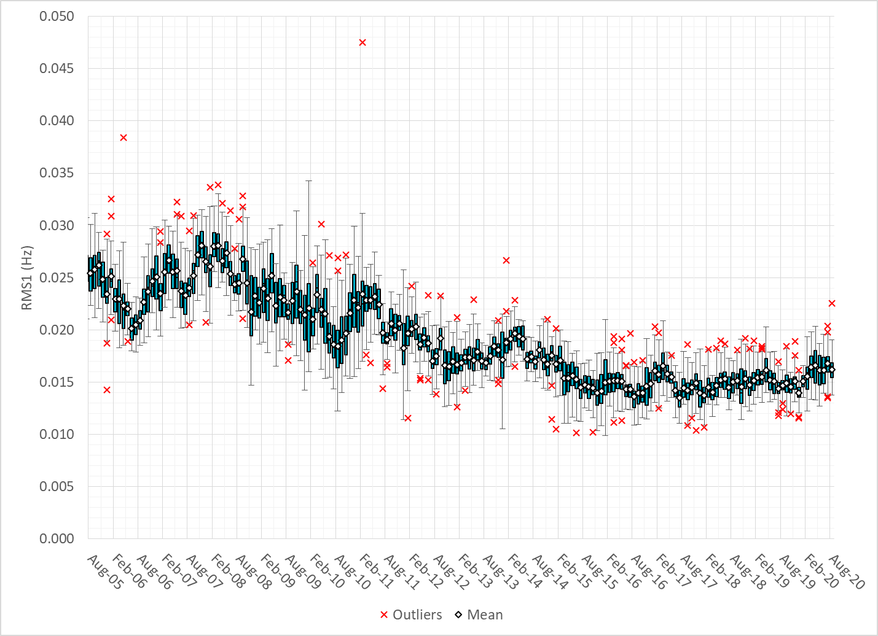
Daily RMS1 of ERCOT Frequency by Month

Slide 10
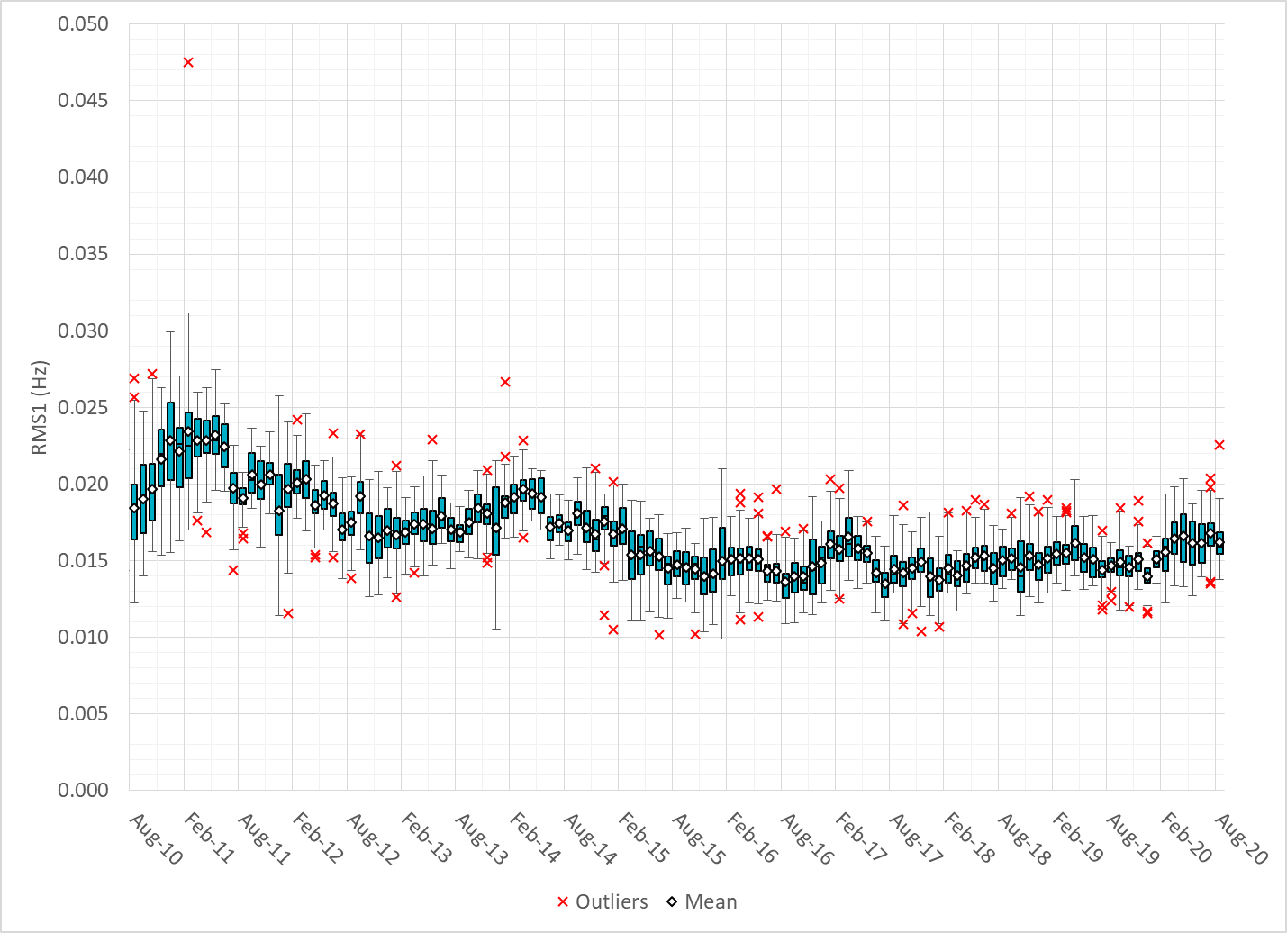
Daily RMS1 of ERCOT Frequency by Month

Slide 11
Frequency Profile Comparison

Slide 12
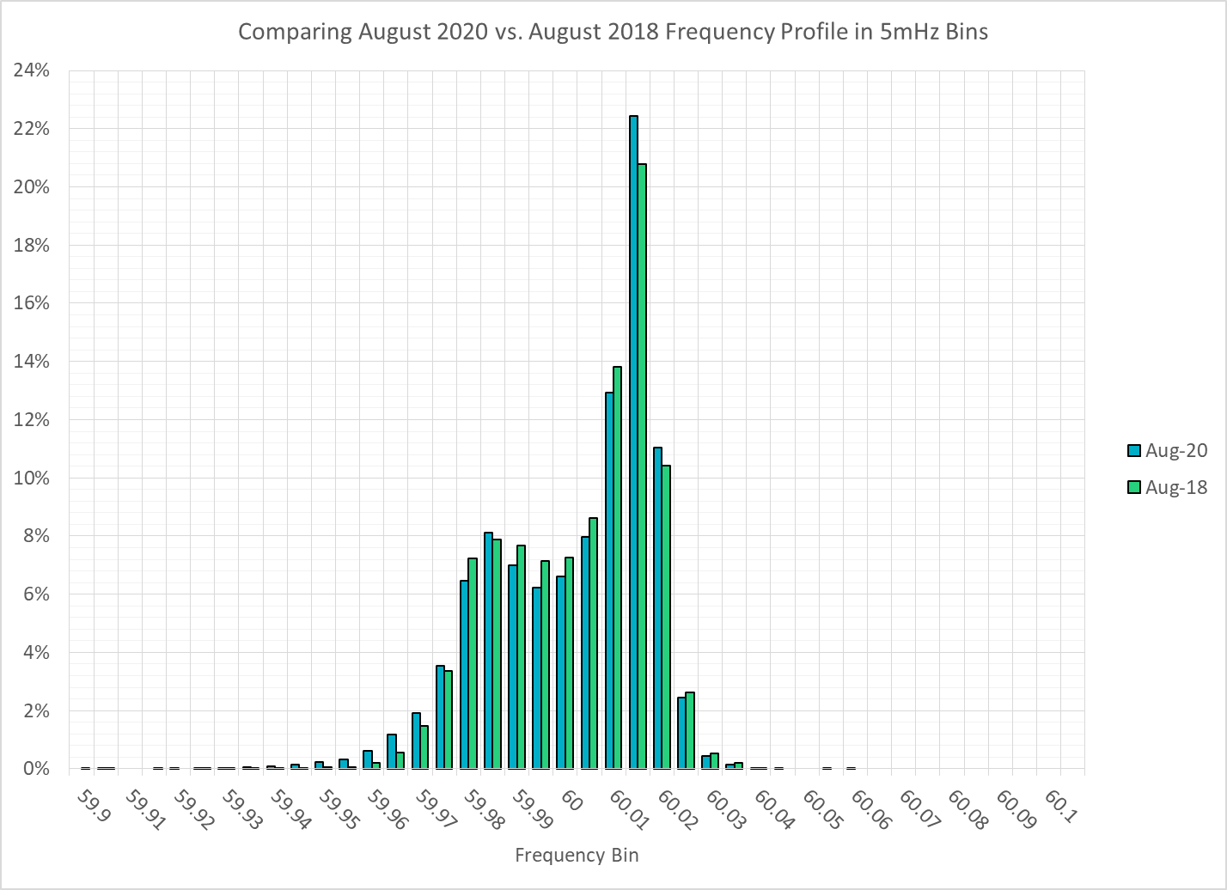
Frequency Profile Comparison

Slide 13
Frequency Profile Comparison

Slide 14
Time Error Correction

Slide 15
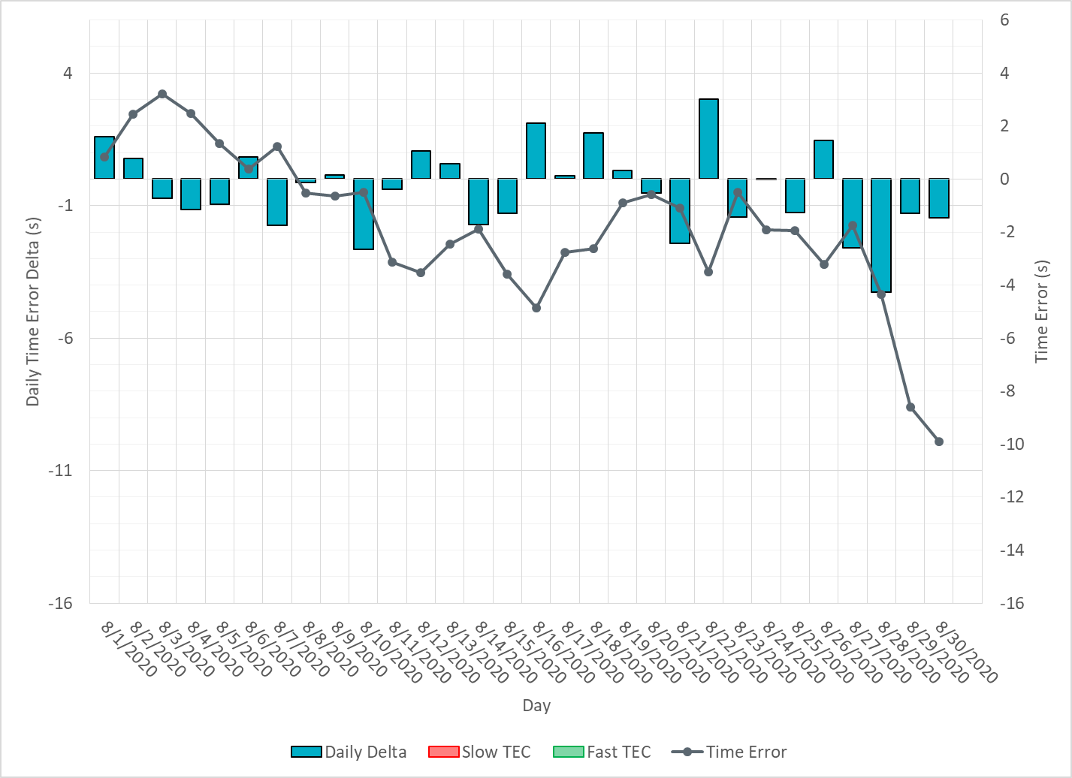
ERCOT Daily Time Error

Slide 16
Time Error Corrections Log Summary
There have been no time error corrections since December 2016

Slide 17
BAL-003 Performance

Slide 18
Op. Year 2019 BAL-003 Selected Events – Update
Notes:
BAL-003

Slide 19
Op. Year 2018 BAL-003 FRM Performance - Update
Notes:
OP2018: FRO = -381.0, FRM_median = -843.17, FRM_average = -959.7
OP2019: FRO = -381.0, FRM_median = -811.14, FRM_average = -892.5
OP2020: FRO = -425.0,

Slide 20
ERCOT Energy Statistics

Slide 21
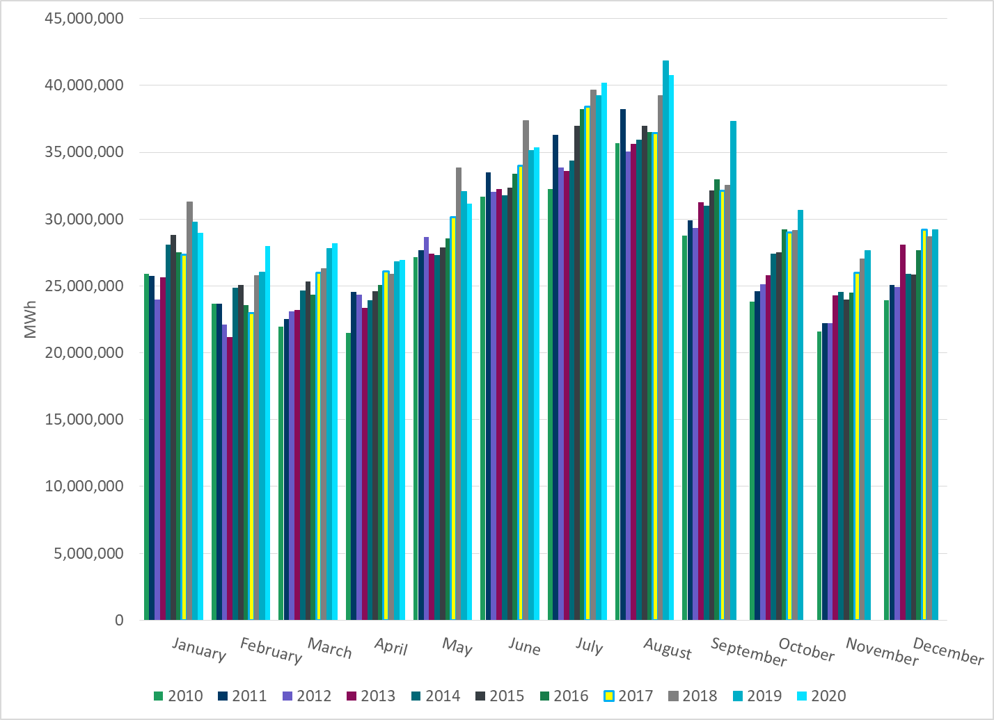
Total Energy
Notes:
40,757,122 MWh

Slide 22
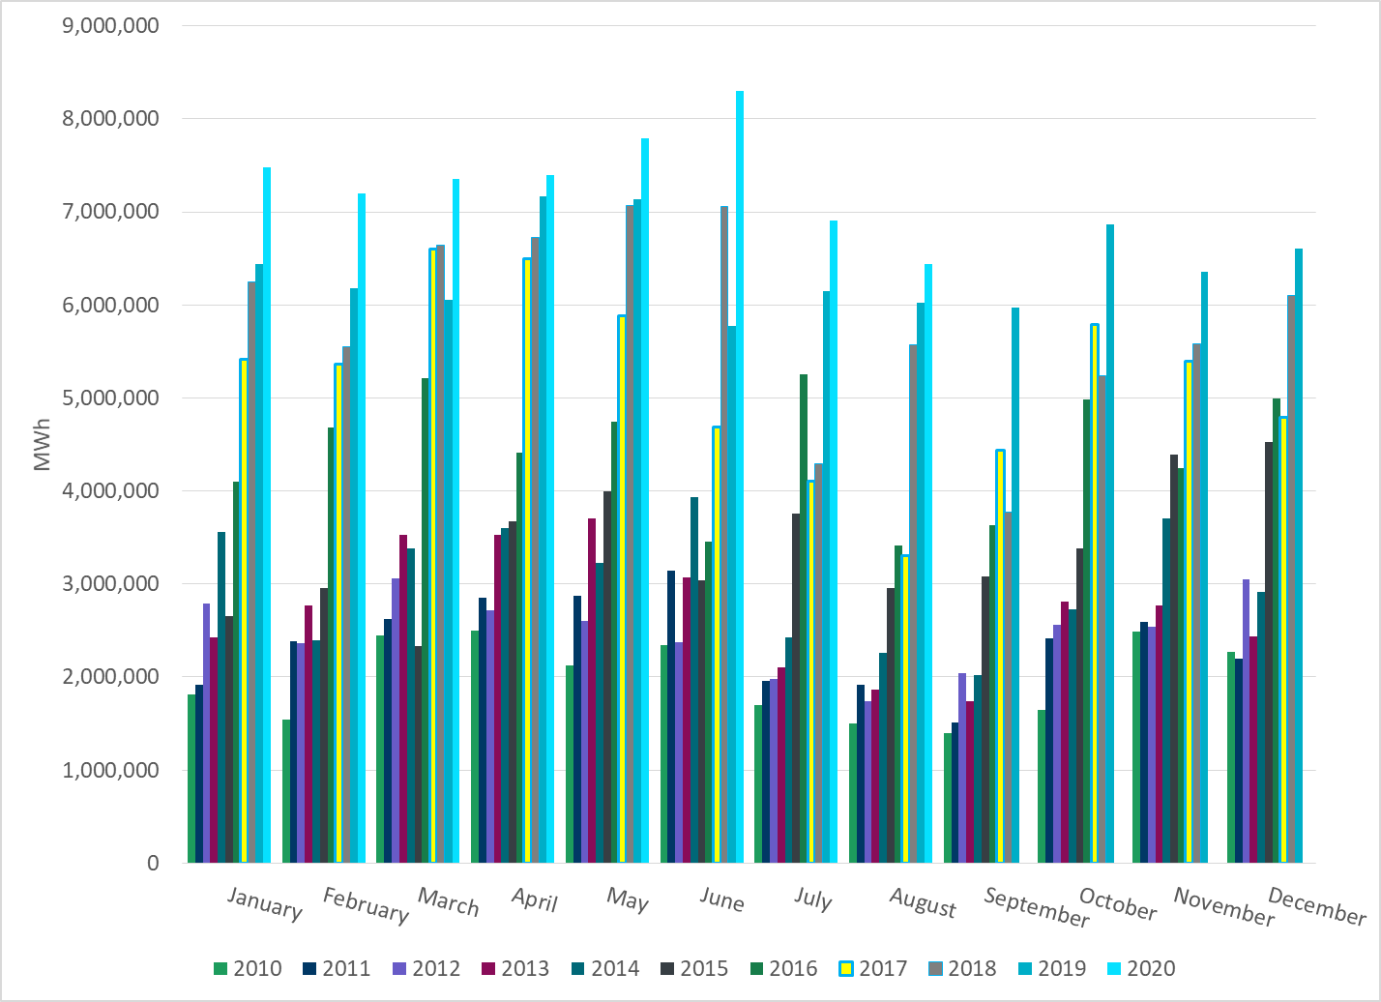
Total Energy from Wind Generation
Notes:
6,441,373 MWh

Slide 23
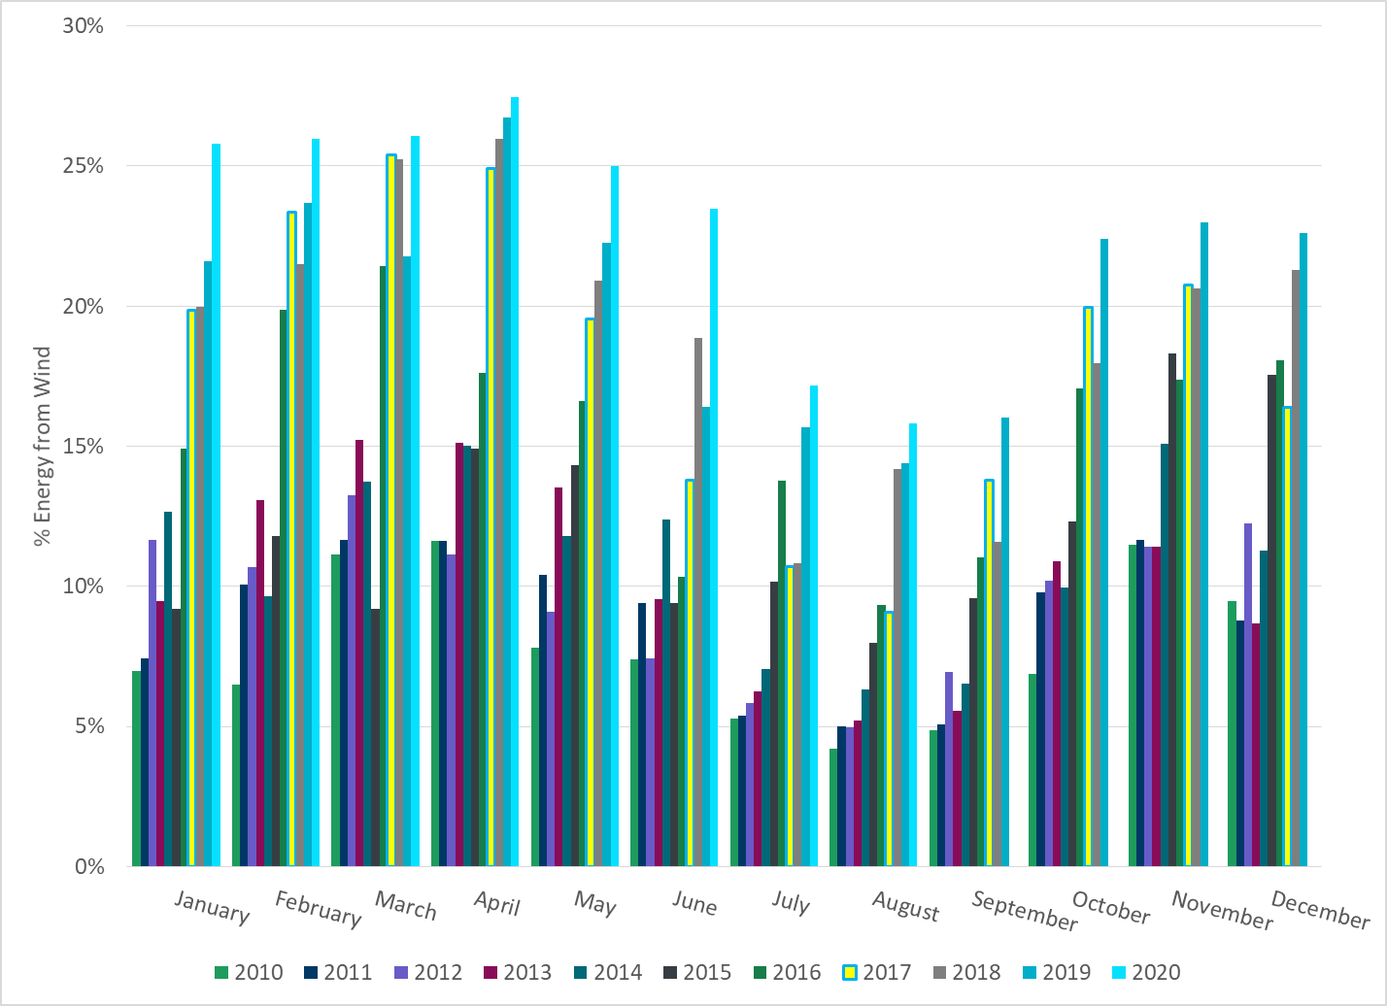
% Energy from Wind Generation
Notes:
15.80%

Slide 24
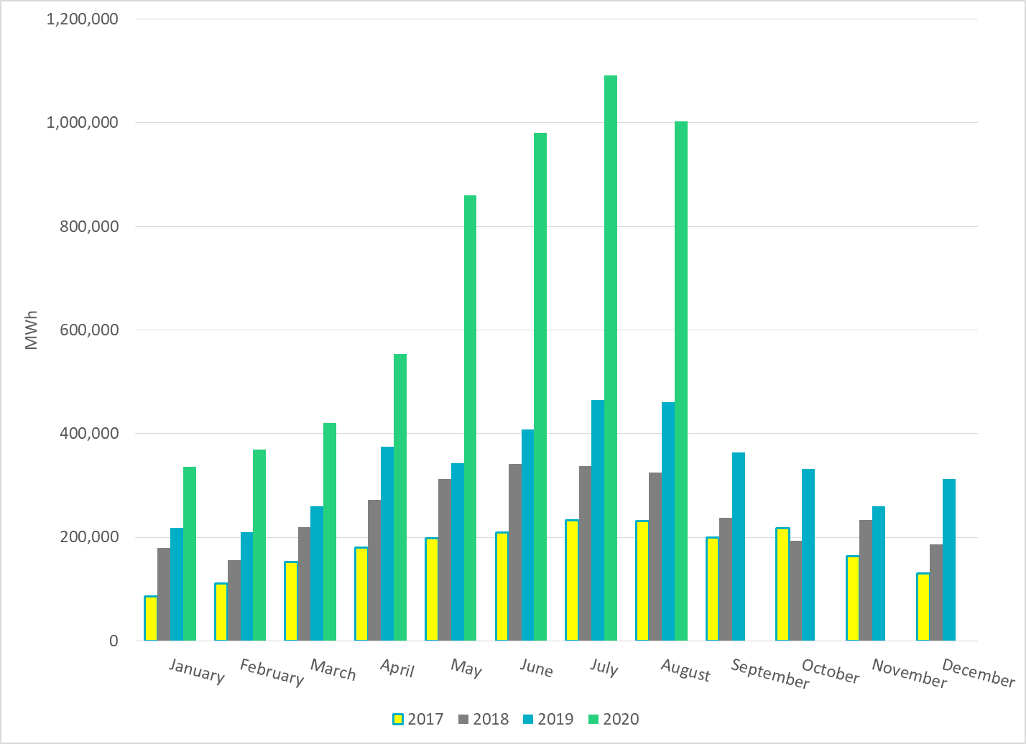
Total Energy From Solar Generation
Notes:
1,002,605 MWh

Slide 25
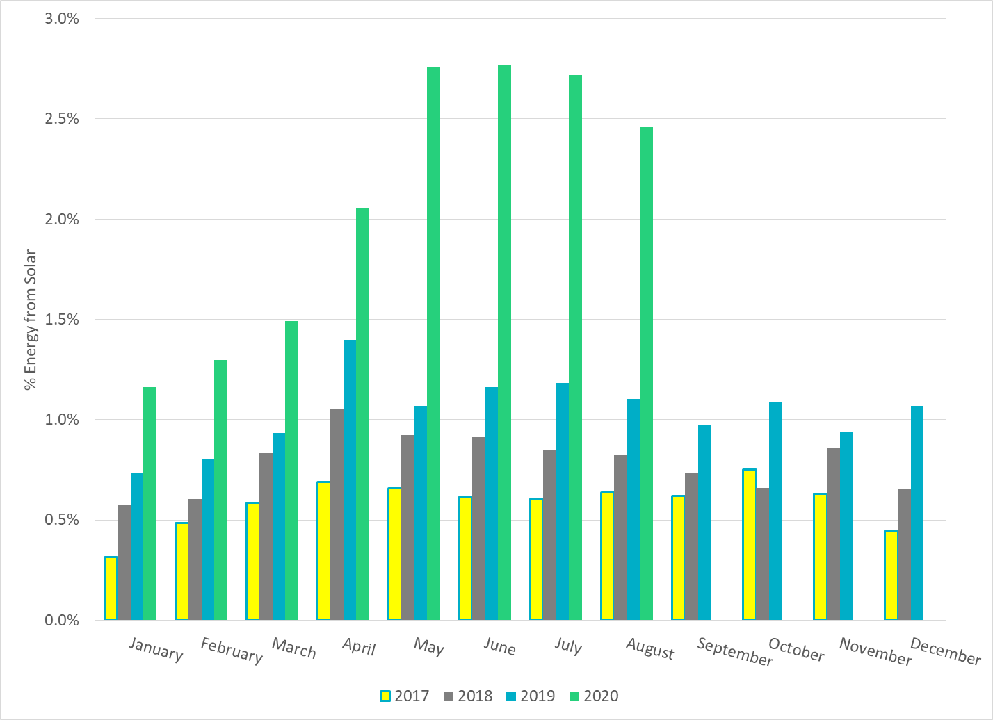
% Energy from Solar Generation
Notes:
2.46%

Slide 26
ERCOT System Inertia

Slide 27
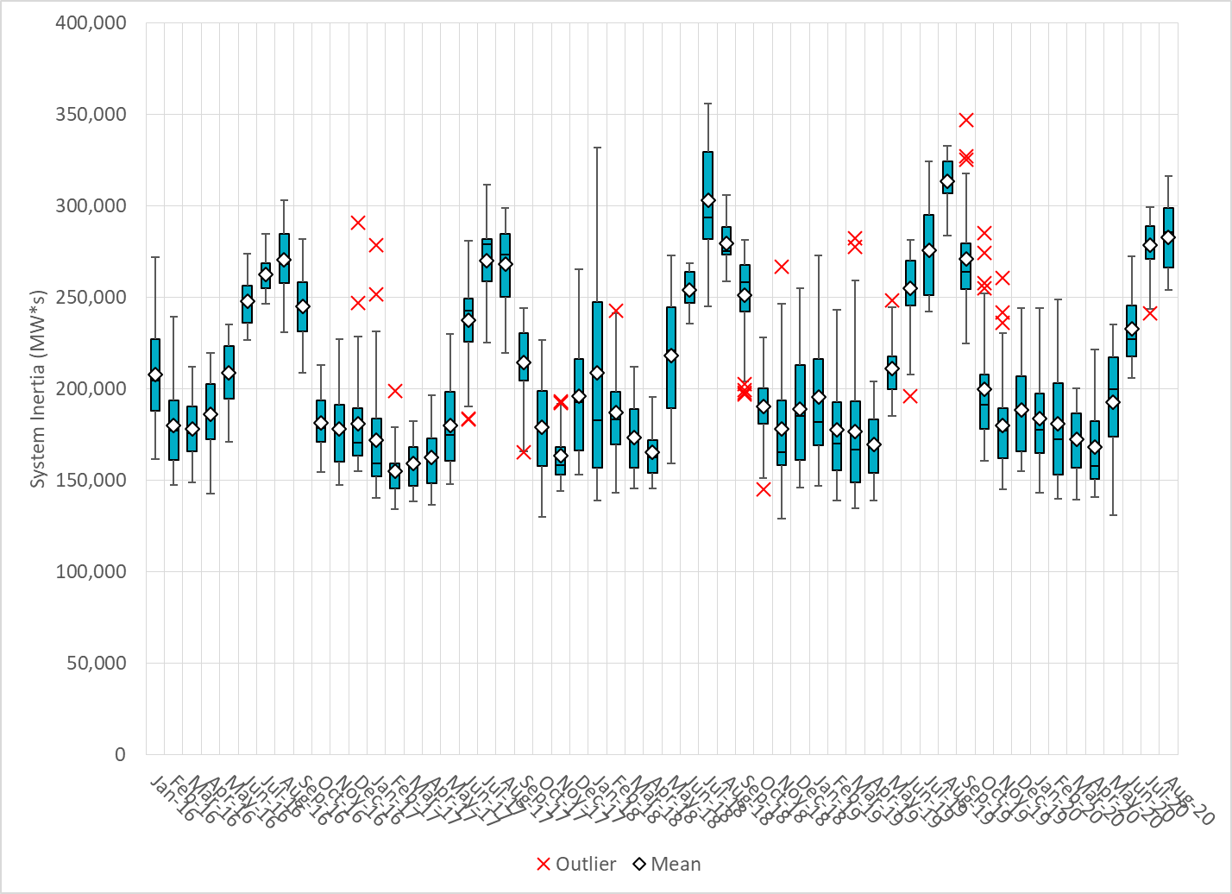
Daily Minimum System Inertia
Notes:
Minimum Inertia = 253,877 MW*s on 8/8/2020
Previous Minimum was 128,759 MW*s on 11/18/2018.
Data:
Mean: 283,054
Max: 316,104 on Aug 16th
Min: 253,877 on Aug 8th

Slide 28
Questions?
Thank you!

