Slide 1
AS Settlement Treatment for QSGRs in Startup
Luminant
September 9, 2020

Slide 2
OFFQS Status
Telemetered by an ERCOT-qualified & tested Quick Start Generation Resources (QSGRs) that can respond to an ERCOT instruction to be deployed from a cold-temperature state within a ten-minute period when off-line but available for SCED dispatch
Allows for timely delivery of additional energy during periods of scarcity and ramping constraints by letting SCED “see” additional capacity just outside of the ~5 minute SCED optimization window
Qualified QSGRs can also provide Non-Spin Reserve Service (NSRS) and ERCOT Contingency Reserve Service (ECRS)

Slide 3
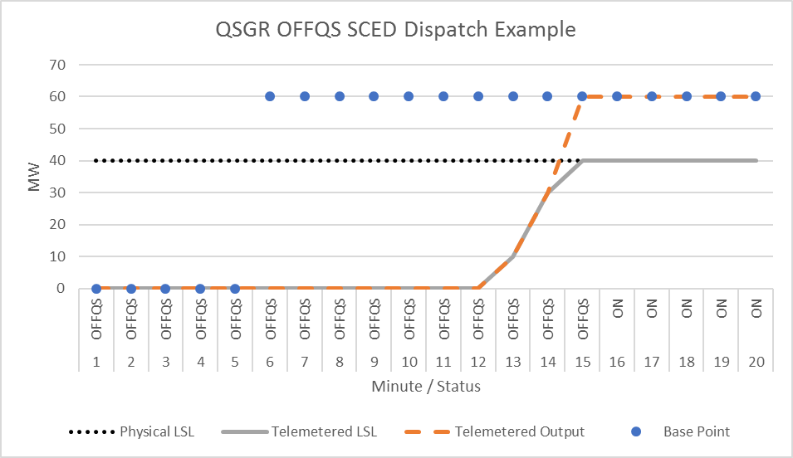
QSGR Dispatch From OFFQS Status
Area of focus for
today’s discussion

Slide 4
RTC OFFQS Dispatch Issues
During startup, QSGR only eligible for AS awards in the (HSL – BP) range; energy revenue is limited to telemetered generation output
10-minute QSGR start-up window can cover 2+ SCED runs
Opportunity cost accrued over startup period can be significant
AS Imbalance penalty accrued if AS cleared in DAM
Incentive structure could discourage QSGR participation

Slide 5
Solution for RTC OFFQS Dispatch Issues
Situation-contingent ECRS settlement credit for 1st BP > 0 MW SCED
Condition on data snapshot at time of SCED run:
  Resource Status = OFFQS
  Telemetered Output MW ≤ some small threshold value
  Previous SCED execution BP = 0 MW
ECRS credit quantity would be minimum of:
  Base Point
  ECRS capability – SCED ECRS award
  Quantity of ECRS offered at or below SCED ECRS MCPC

Slide 6
Ex. 1: OFFQS Deployed to HSL (Offers ≤ MCPC)

Slide 7
Ex. 2: OFFQS Deployed to HSL (Offers > MCPC)

Slide 8
Ex. 3: OFFQS Deployed < HSL (Offers ≤ MCPC)

Slide 9
Ex. 4: OFFQS Deployed < HSL (Offers > MCPC)

Slide 10
Questions?

