Slide 1
NPRR 995 Update
ERCOT Staff
WMS
Sept. 2, 2020

Slide 2
Recap of NPRR 995 discussions to date
At the July 8 WMS meeting, ERCOT proposed the following:
  Settlement Only Distribution Energy Storage (SODES) and Settlement Only Transmission Energy Storage (SOTES) should be settled at nodal prices for both injections and withdrawals
  SODES and SOTES should be eligible for Wholesale Storage Load (WSL) treatment
ERCOT has been preparing comments to NPRR 995 to enable these principles

Slide 3
Summary of forthcoming ERCOT comments
SODES and SOTES to be settled at nodal prices for both injections and withdrawals
  Pricing nodes identified pursuant to methods developed in NPRR 917, Nodal Pricing for Settlement Only Distribution Generators (SODGs) and Settlement Only Transmission Generators (SOTGs)
SODES and SOTES eligible for WSL treatment, as long as charging Load can be separately metered or measured
  Pursuant to current practice of separate metering, or sensor methodology approved in NPRR 1020, Allow Some Integrated Energy Storage Designs to Calculate Internal Loads

Slide 4
Summary of forthcoming ERCOT comments
SODES and SOTES should be settled on nodal prices even if not receiving WSL treatment
  Resource Entity may not request WSL
  Charging Load may not be able to be separately metered
  Preamble to PUC Rulemaking in Project 39917 implies that WSL should be optional, not mandatory
    http://interchange.puc.texas.gov/Search/Documents?controlNumber=39917&itemNumber=41
New defined term “Non-WSL Settlement Only Charging Load:”
  The metered or calculated charging Load withdrawn by a Settlement Only Distribution Energy Storage (SODES) or Settlement Only Transmission Energy Storage (SOTES) that is not receiving Wholesale Storage Load (WSL) treatment.

Slide 5
Summary of forthcoming ERCOT comments
For SODES and SOTES that do not request or do not qualify for WSL treatment, charging Load shall be determined by either:
  Separate metering
  A default percentage (in cases where separate metering is not possible)
    ERCOT proposes that the default percentage should be 85% charging Load (15% auxiliary Load)
    ERCOT requests stakeholder input on the proper default percentage

Slide 6
Summary of forthcoming ERCOT comments
For a SODES and SOTES where retail Load is present (along with charging Load and auxiliary Load), ERCOT proposes the ‘generation accumulator’ methodology to calculate charging energy eligible for nodal pricing
  Energy injected to the ERCOT System will be tabulated in the gen accumulator
  Subsequent charging energy withdrawals will be priced at nodal until the accumulator value is exhausted
  When accumulator is exhausted, withdrawals will be priced at Load Zone until future injections occur

Slide 7
Summary of forthcoming ERCOT comments
Pricing summary:
  NODAL WSL: For charging Load with approved separate metering or validated sensor methodology per NPRR 1020
    Not subject to Load Ratio Share-based charges
  NODAL Non-WSL: For charging Load by SODES or SOTES not receiving WSL treatment
    Subject to Load Ratio Share-based charges
  ZONAL: Auxiliary Load
    Subject to Load Ratio Share-based charges
  ZONAL: Any additional retail Load co-located with the SODES or SOTES
    Subject to Load Ratio Share-based charges

Slide 8
SOTSES
There is a third type of SOES
From NPRR 995, Section 2.1:
  Settlement Only Transmission Self-Energy Storage (SOTSES)
  An Energy Storage System (ESS) connected to the ERCOT transmission system with a rating of one MW or more and does not export energy to the ERCOT System.
Under this language, a SOTSES is presumed to never export, so nodal/nodal pricing is immaterial, and NPRR 995 Settlement provisions are unnecessary
SOTSES withdrawals will be settled at Load Zone and subject to applicable retail charges

Slide 9
Summary of ESS Attributes
Energy Storage System Type | Meter | Sensor option | Default % option | Pricing | Gen Accumulator Option | NPRR
ESR with WSL | Y | Y | N | Nodal | N | 986 clarification (coming soon) on top of 986 & 1020
ESR Non-WSL | Y | N | Y | Nodal | N | 986 clarification (coming soon) on top of 986 (1020 not applicable)
SODES/ SOTES with WSL | Y | Y | N | Nodal | Y | 995 (with ERCOT comments) on top of 1020
SODES/ SOTES Non-WSL | Y | N | Y | Nodal | Y | 995 with ERCOT comments (1020 not applicable)
SOTSES | N/A | N/A | N/A | Zonal (load only) | N/A | 995

Slide 10
Appendix

Slide 11
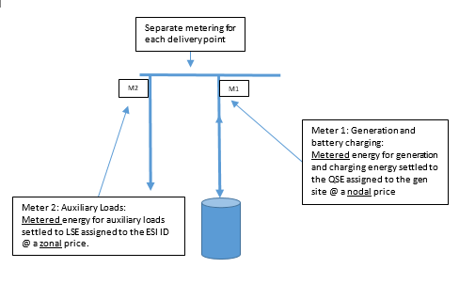
SODES / SOTES Scenario #1
Stand alone, auxiliary loads connected at a separate delivery point

Slide 12
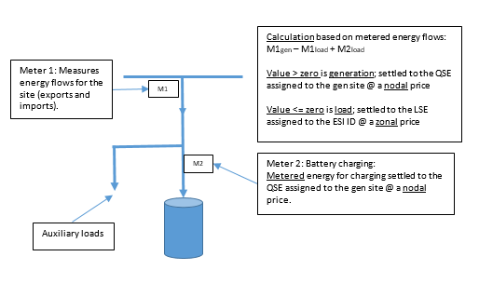
SODES / SOTES Scenario #2
Stand alone, auxiliary loads connected behind the same delivery point

Slide 13
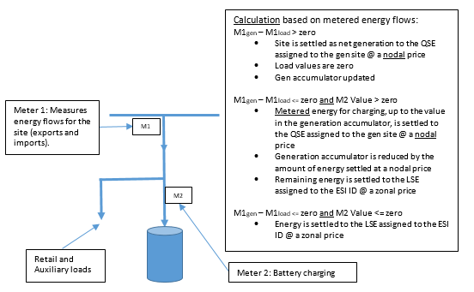
SODES / SOTES Scenario #3
Retail load and auxiliary loads connected behind the same delivery point (generation accumulator methodology)

Slide 14
Questions?

