Slide 1
MIS Integration Update
September 1, 2020

Slide 2
MIS Integration Workshop Agenda
Why are we talking about integration?
MIS Project Background
Scope of Changes
Release Plan
What Is and Isn’t Changing ?
Screen Scraping Impacts
Future Communications

Slide 3
Why are we talking about integrations?
MIS hasn’t changed since Nodal Go-Live
ERCOT isn’t aware of all integration use cases
Some integrations can cause supportability issues
We want to point users towards available resources
We want to minimize the impact at November Go-Live

Slide 4
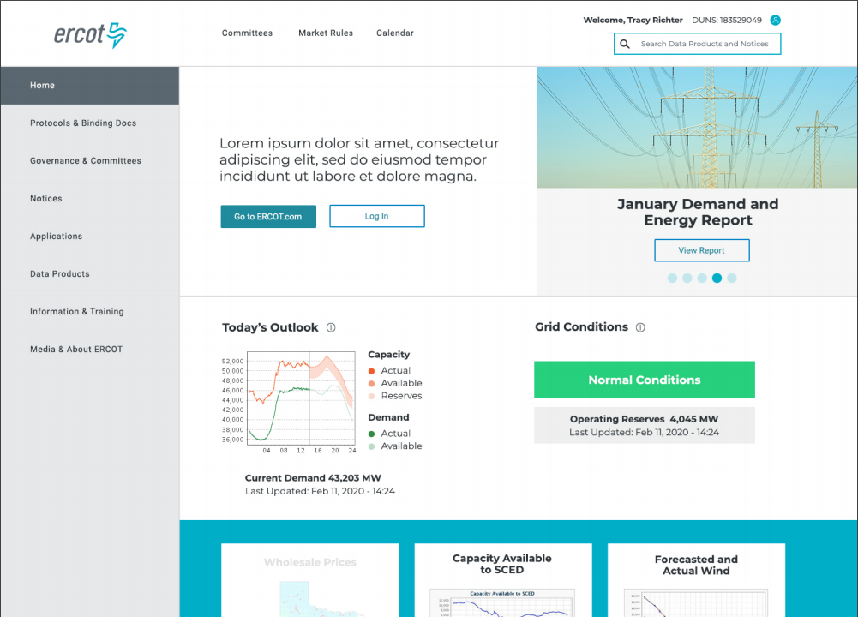
MIS Redesign Scope
Updated user interface
Improved search & metadata
Integrated EMIL & report links
Easier access to applications
Updated technology platform
More secure

Slide 5
MIS Redesign Benefits
Improved Market Data Transparency (MDT)
What data is available?
How often is data updated?
Which reports have data?
One-Stop Information Clearinghouse
Integrated platform with ERCOT.com
Responsive design for use on multiple devices
Applied taxonomy and improved search
Maintain Technical Health

Slide 6
MIS Release Timeline
EMIL Web Interface Release
Sandbox Version New MIS
MIS Production Soft Launch
MP Testing
MIS Production Go-Live
Decommission
Old MIS
Transition ERCOT.COM Content into Integrated Platform
Jan 30th
May 26th
Sept 16th
Nov 11th
Q1
Q1- Q4
2020
2021
2020
Jan 30th | EMIL web interface release ✓
May 26th | Sandbox version of new MIS ✓
Sept 16th | MIS Production soft launch for MP testing
Nov 11th | MIS Production Go-Live
2021
Q1 | Decommission old MIS
Q1 – Q4 | Transition ERCOT.COM content into integrated platform

Slide 7
Market Data Transparency (MDT) Portfolio Diagram
MIS
ERCOT.COM
APIs
Dashboards & Displays
MIS
Market Applications
(Market Trak, OS, etc.,)
Market Data Transparency
(MDT)
Reports & Extracts
Market Participants
Grid Communication
(ERCOT.COM, MIS)
Search & Metadata
MP Authentication & Authorization
(Certs, MFA)
Technical Documentation
(MIS User & Integration Guides)
Changing
Not Changing

Slide 8
Impacts to data access
URL change
/public vs /secure
No more pop-up for data links
Underlying HTML source
You will be able to see what this looks like starting on Sept 16, 2020.

Slide 9
Screen Scraping: URL Scenario
Q: We currently parse the HTML source of the predictable URL (https://mis.ercot.com/misapp/GetReports.do?reportTypeId= [6 digit REPORT TYPE ID])
in order to get a list of available files (since the source code contains <a href='/misdownload/servlets/mirDownload?mimic_duns=0805522512000&doclookupId=715089663'>zip</a>).
Can you tell me whether:
That predictable URL will continue to exist after September?
Whether there is an API call that will return the files available for download for a given Report Type number?
The following will work until January 2021 but long term discussion needed. http://mis.ercot.com/misapp/GetReports.do?reportTypeId=13057
Notes:
Demo Popup URL
Demo Portal URL

Slide 10
Screen Scraping Supportability Challenges
Users engaging in parsing data from the ERCOT Market Information System (MIS) may cause system reliability issues.
Automated systems pulling data from a GUI based system have the potential to overwhelm the GUI systems.
ERCOT will deny access to IPs using poorly written code or macros that saturated the report download bandwidth.
ERCOT will make an attempt to contact the company that is found to be the cause of the degradation.
In severe cases, ERCOT will block offending IP to maintain reliability. Blocked IP addresses will not be allowed to reconnect until corrective action is taken by the user.

Slide 11
Integration Help and Documentation
ERCOT provides documentation on the EWS API system.
ERCOT provides Terms of Use for all reports outlining the policy around download frequency.
The ERCOT Market Information List (EMIL) details all market products required to be supplied by Protocols or other binding documents.
Client Services representatives are available to assist MPs in finding information that ERCOT has made available.
ERCOT is unable to provide API code as each MPs implementation is different.
ERCOT cannot consult on implementations other than basic troubleshooting.

Slide 12
Communication Moving Forward
Monthly MIS User Workshops will resume in September.
More MP group workshops as needed.
Contact your Client Services representative with questions.
Report bugs to the ERCOT HelpDesk.
Additional communication re: MDT technical roadmap
Bi-annual Market Data Transparency Forum?
Feedback at any time to webmaster@ercot.com
Redesign info: www.ercot.com/about/redesign

