Slide 1
Market Credit Working Group update to the Wholesale Market Subcommittee
Bill Barnes, NRG, Chair
Josephine Wan, Austin Energy, Vice Chair
9/02/2020

Slide 2
MCWG update to WMS
General Update
August 19 Joint MCWG/CWG WEBEX Meeting
8 NPRRs reviewed for their credit impacts
999NPRR DC Tie Ramp Limitations – No Credit Impact
1025NPRR Remove Real-Time On-Line Reliability Deployment Price from Ancillary Service Imbalance Calculation – No Credit Impact
1027NPRRRemoval of Grey-Boxed Language Related to NPRR702, Flexible Accounts, Payment of Invoices, and Disposition of Interest on Cash Collateral – No Credit Impact
1031NPRR Notices for Curtailment of Load – No Credit Impact
1033NPRR Clarification of Financial Security Interest Payment and Withholding Processes Upon Termination of Market Participant Standard Form Agreement – No Credit Impact
1035NPRR DC Tie Schedules Protected Information Expiry and Posting – No Credit Impact
1036NPRR Late Payment Enforcement Provisions – Positive Credit Impact
1037NPRR Correction to the Settlement of Switchable Generation Resources (SWGRs) Instructed to Switch to ERCOT – No Credit Impact

Slide 3
MCWG update to WMS
Real-Time Co-optimization Update to Credit Work Group
Aug 19 CWG meeting (today)
Highlight need for CWG review of NPRR1007-NPRR1013
ERCOT provides initial summary of credit impacts
Note that although RTCTF continues to meet until October 21, 2020, all Pricing and Settlement consensus items are complete and posted here: http://www.ercot.com/calendar/2020/9/9/191170-RTCTF
Sept 16 CWG meeting
ERCOT Credit will review prior materials and ask if any issues
Oct 16 CWG meeting
ERCOT Credit (Vanessa) and RTCTF Chair (Matt Mereness) asks if any questions or concerns with RTCTRRs from a credit impact perspective.
Ask CWG for agreement on comments to be filed by Nov 17.
Nov 17 CWG meeting
Last meeting before Board to file CWG comments on credit impacts

Slide 4
MCWG update to WMS
Discuss Modifications to the Settlement Timeline
After review of meter data and settlement process timelines, CWG/MCWG did not feel reductions to the current settlement timeline were feasible or necessary.
Review Forward Adjustment Factors
CWG/MCWG decided to wait until after August and early September to conduct a detailed review of the credit exposure calculations and the current forward adjustment factors.

Slide 5
MCWG update to WMS
Credit Risk Assessment and Enforcement
ERCOT is evaluating credit risk assessment models as part of the market entry qualifications initiative.
For credit scoring models, the focus has been on choosing relevant credit ratios and associated weightings to optimize the r^2 of model outcomes with respect to the agency ratings for rated entities.
To date ERCOT has reviewed models from ERCOT and MISO, as recalibrated, and Moody’s RiskCalc.
Scoring model issues: Extreme input data ranges; Bucketing methodology, if any; Qualitative factors and weighting
As discussed at the Market Entry Qualification workshops, ERCOT is drafting NPRRs to address:
Market Entry Qualifications for Participation and Continued Participation.
Credit Risk Assessment and Associated Enforcement Processes
Significant review and vetting required before approval and implementation

Slide 6
MCWG update to WMS
CRR Credit Lock Release Process
Reviewed timeline of CRR credit lock process for CRR auctions.
Requested a detailed schedule by time of day to more clearly communicate credit lock times and when credit is sent to the DAM and CRR auctions.
Intended to clear up confusion around overlapping credit lock periods.

Slide 7
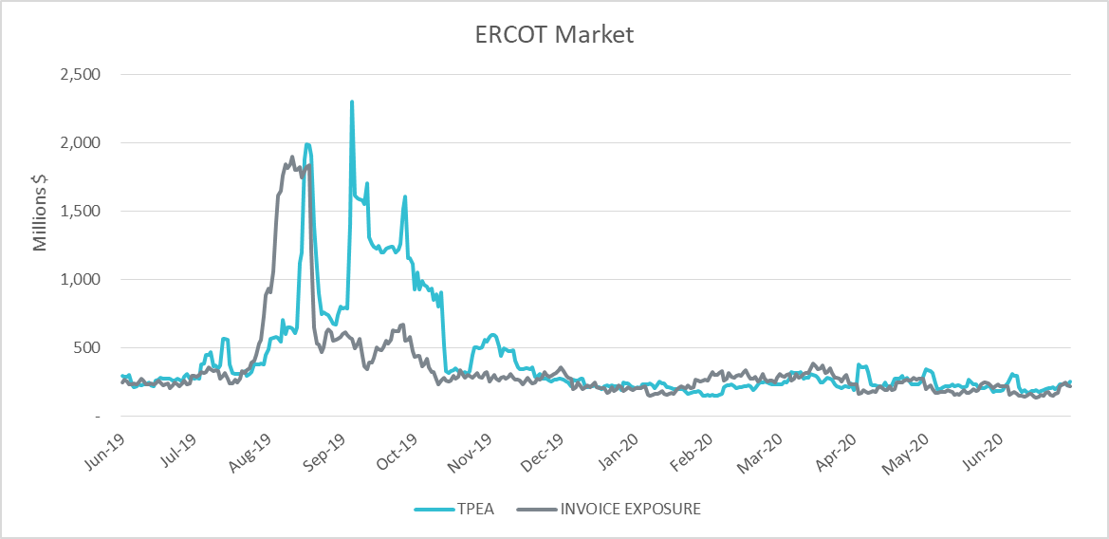
MCWG update to WMS
Credit Exposure Update

