Slide 1
Settlements and Credit Information: Related to NPRR1024
Austin Rosel, Vanessa Spells
ERCOT
WMS
September 02, 2020

Slide 2
Information Request - WMWG
During discussion of NPRR1024 Determination of Significance with Respect to Price Correction, the WMWG requested we bring information to aid in determining the proposed thresholds below:
4.5.3 Communicating DAM Results (6)
(b)…..ERCOT shall seek ERCOT Board review of prices if the change in DAM Settlement Statements(s) would result in the absolute value impact to any single Counter-Party, based on the sum of all original DAM Statement amounts of Market Participants assigned to the Counter-Party, to be greater than 2% and also greater than $500.
6.3 Adjustment Period and Real-Time Operations Timeline (7)
(b) …ERCOT shall seek ERCOT Board review of prices if the change in RTM Settlement Statement(s) would result in the absolute value impact to any single Counter-Party, based on the sum of all original RTM Statement amounts of Market Participants assigned to the Counter-Party, to be greater than 2% and also greater than $500.

Slide 3
Price Correction Impact on Settlements
The following charts show the daily changes in statement amounts for price corrections from three recent price correction events: electrical bus shift factor issue and MMS outage modeling issue both identified in October 2019 and the issue with dynamic ratings identified in July 2020.
Operating Days included
RTM
10/16/19 – 10/20/19 (bus shift factor issue)
07/01/20 (dynamic ratings issue)
DAM
9/16/19 – 9/23/19 (outage modeling issue)
6/8/20 – 6/12/20, 6/15/20 – 6/17/20, 6/19/20 – 6/20/20, 6/24/20 – 6/25/20, 6/28/20 – 7/6/20 (dynamic ratings issue)

Slide 4
Price Correction Impact on Settlements
The following graphs are histograms showing:
Number of Counter-Parties impacted at various $ thresholds.
Number of Counter-Parties impacted at various % thresholds, with all impacts less than or equal to $500 removed.
The bins are not separated evenly, the bins are smaller for the lower values than for the larger values.
Each bin value represents values less than or equal to the bin value and greater than the value of the preceding bin.

Slide 5
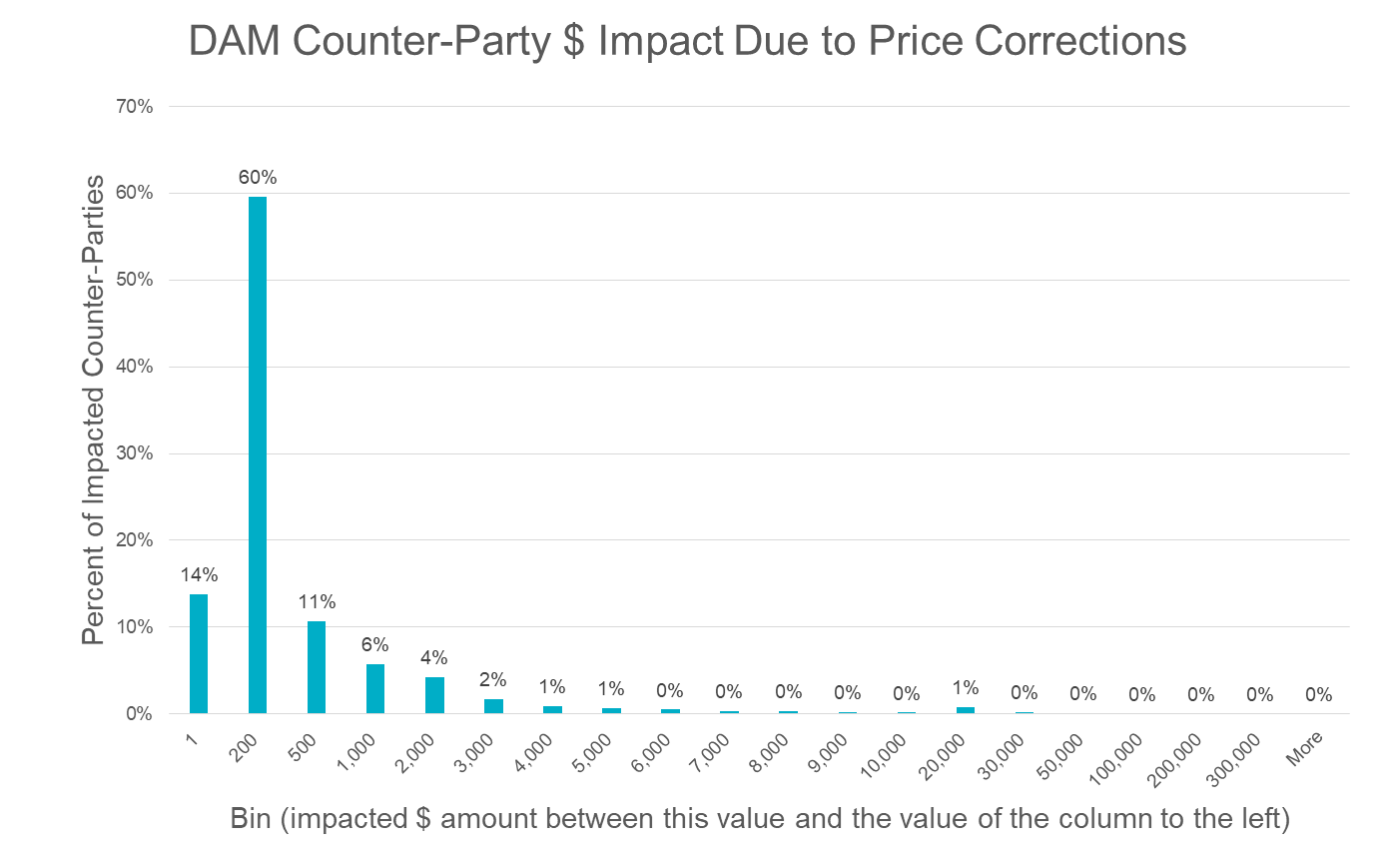
DAM Statement Impacts – $

Slide 6
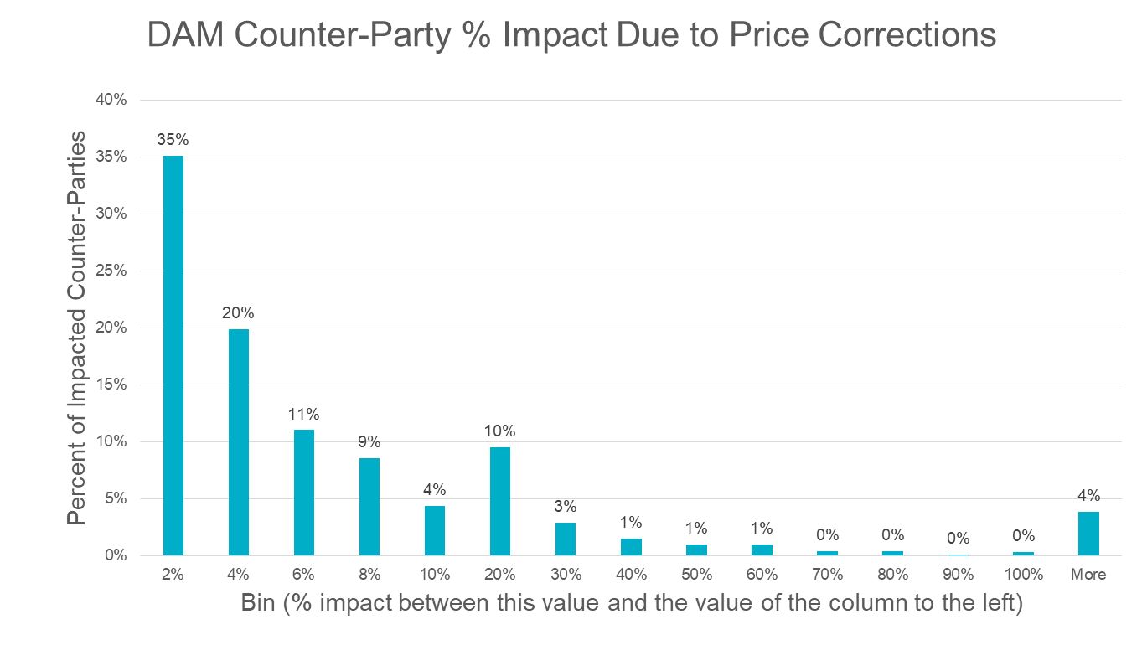
DAM Statement Impacts – %

Slide 7
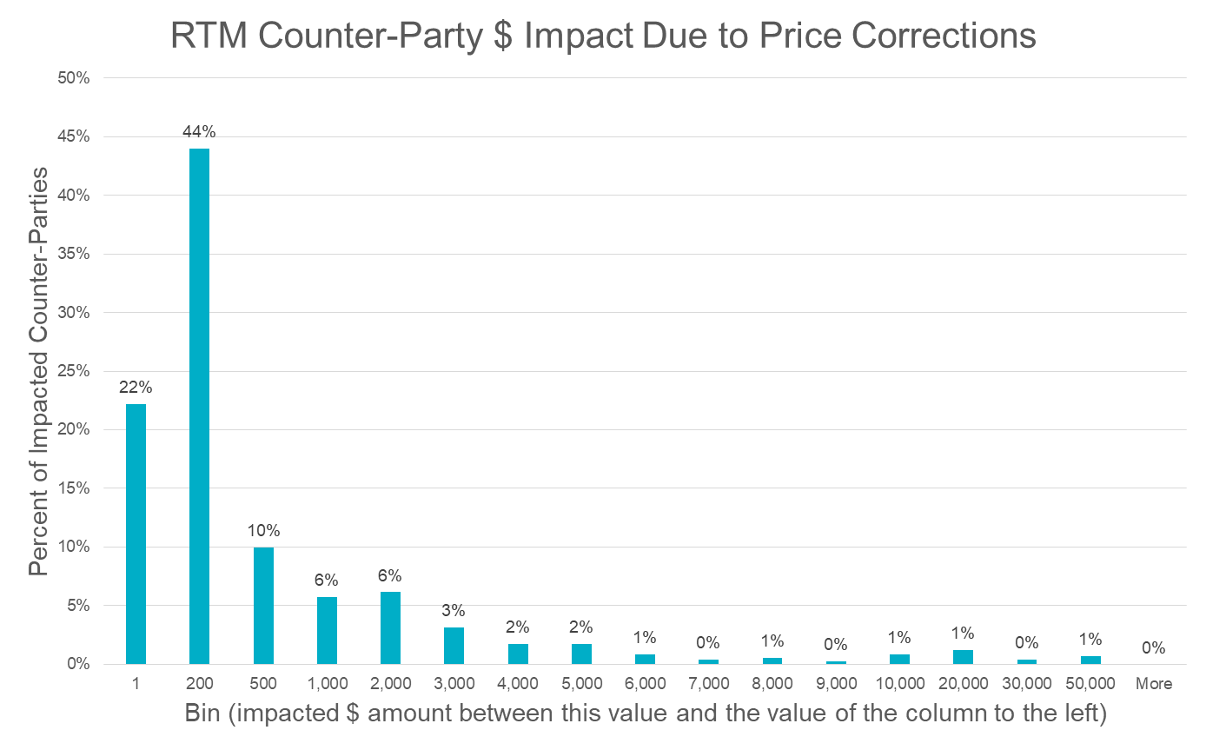
RTM Statement Impacts – $

Slide 8
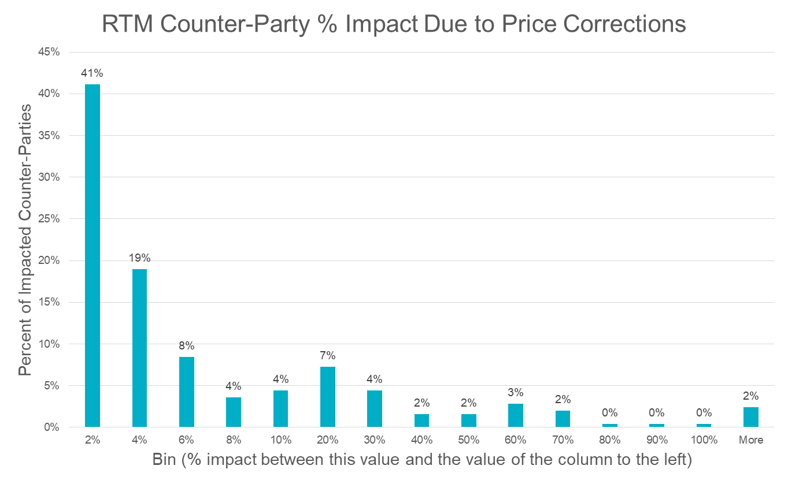
RTM Statement Impacts – %

Slide 9
Credit
The following graphs reflect the capitalization of the ERCOT market at the Counter-Party level.
Over 95% of Counter-Parties have capitalization over $1,000,000
The remaining Counter-Parties have capitalization ranging from $100,000 to $900,000

Slide 10
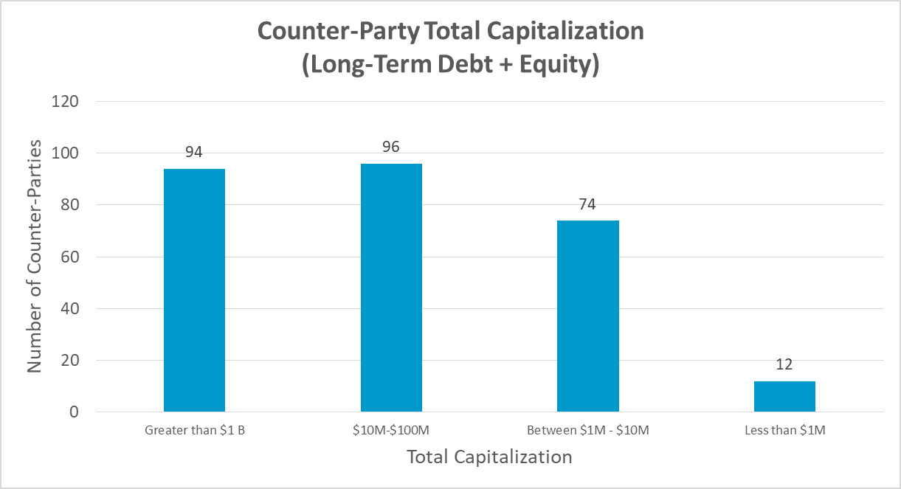
Counter-Party Capitalization
Over 95% of Counter-Parties have total capitalization over $1 Million

Slide 11
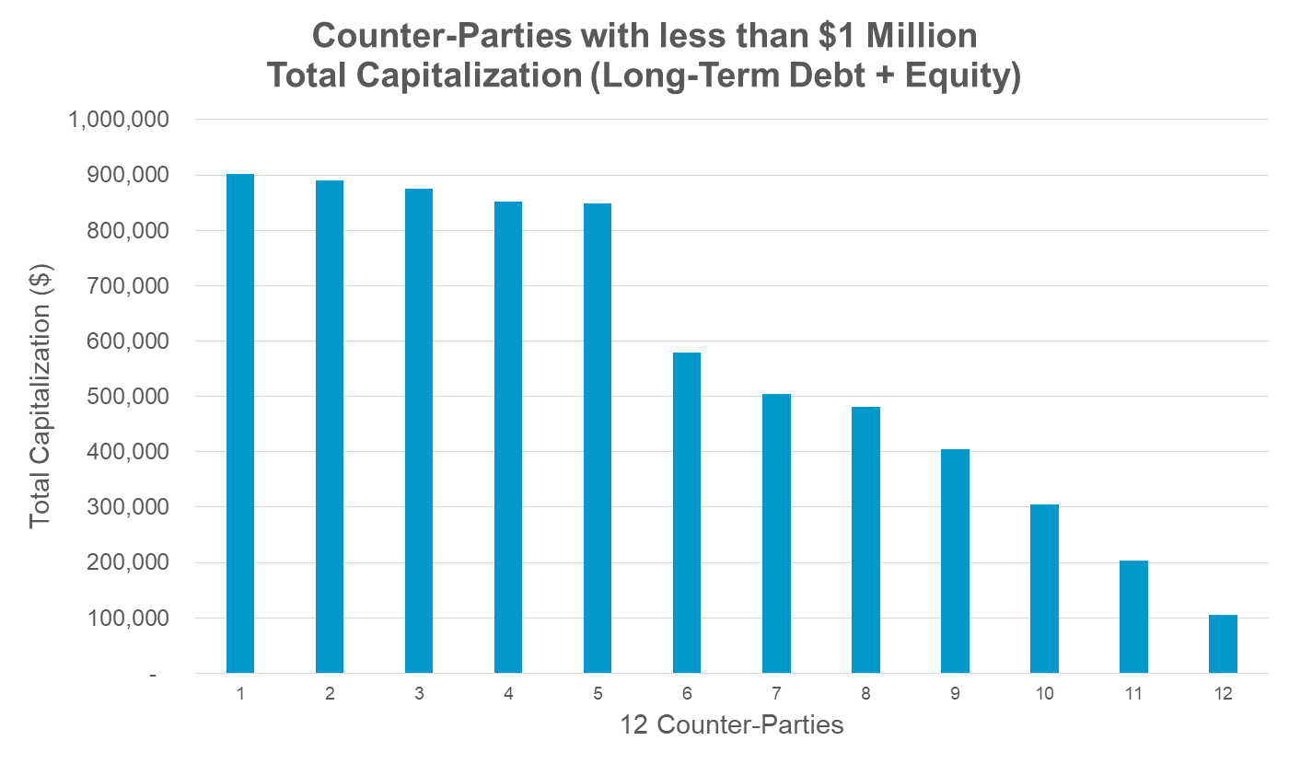
Counter-Party Capitalization

