Slide 1
MW Ratings of Solar Resources to be Submitted in the GINR Process
&
PMU Requirements for Repowering Projects
Yang Zhang
ERCOT
Resource Integration Workshop
August 25, 2020

Slide 2
Background - MW Ratings of Solar Resources
Currently, ERCOT requires that the MW ratings of solar resources submitted in RIOO be the values on the maximum temperature day (45ºC).
These are the MW ratings used in the screening study and FIS, and reflected in the RARF Real-Power Rating.
During off-peak hours, inverters and solar panels are much more efficient and capable of generating higher MW outputs at lower temperatures.
However, solar resource outputs in off-peak hours are limited by the MW ratings studied in the GINR process, which are based on the maximum temperature.

Slide 3
Discussion - MW Ratings of Solar Resources
ERCOT discussed internally the feasibility of allowing solar resource developers to submit MW ratings other than those based on the maximum temperature. The discussion covered the following topics:
  What MW ratings should be submitted?
  Seasonal Net Max Sustainable Rating?
  Studies: screening, FIS, QSA, and planning
  Network modeling: planning, operations
  Resource adequacy

Slide 4
Potential Solution - MW Ratings of Solar Resources
Solar resource developers can submit MW ratings other than those based on the maximum temperature (45ºC) for the project max MW in RIOO
  RIOO Summer MW should be 45 deg C value
  RIOO Winter MW can be a lower temp value and should match project max MW
  IA, RIOO payment, SS, FIS, QSA and reactive requirements will use the project max MW
  HRL should be less than or equal to project max MW
For the purpose of resource adequacy
  The temperatures used for Seasonal Net Max Sustainable Ratings in RARF do not change

Slide 5
PMU Requirements for Repowering Projects
ERCOT proposes to require PMU installation for repowering projects for the following reasons:
  PMU data is needed for model validation;
  PMU data is needed for post-event analysis;
  PMU data is needed to increase situational awareness, and enable operators to take prompt actions in case of abnormal system behaviors like oscillations;

Slide 6
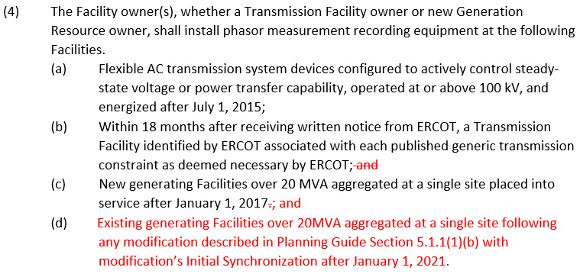
Nodal Operating Guide 6.1.3.2

Slide 7


