Slide 1
NERC 2020 LTRA Preparation Update
Pete Warnken
Manager, Resource Adequacy
August 24, 2020

Slide 2
Tier 1, 2 and 3 Resource Categorization
Tier 1 – Same as CDR criteria
Tier 2 – All projects for which an ERCOT steady-state Security Screening Study has been completed and a Full Interconnection has been requested
Tier 3 – Projects for which an interconnection application has been completed, and that do not meet Tier 1 or Tier 2 criteria
July 15th is the summer cut-off date for including resources

Slide 3
ERCOT/SPP Imports and Exports, Summer
For 2021 and beyond:
DC Tie East: Firm Imports = 50 MW, Firm Exports = 0 MW
DC Tie North: Firm Imports = 190 MW, Firm Exports = 30 MW
Oklaunion retires after 2020 summer season; 30 MW Firm Exports reflect an SPP modeling assumption
DC Ties with Mexican Grid: Net Imports = 28 MW
Non-firm per NERC accounting rules, treated as “Expected Imports”
Not included in Anticipated Reserve Margin calculation

Slide 4
LTRA 2020 vs. 2019 Line Item Comparison
Anticipated – Includes existing and CDR planned resources
Prospective – Includes Anticipated and Tier 2 resources, as well as Net Expected Imports/Exports

Slide 5
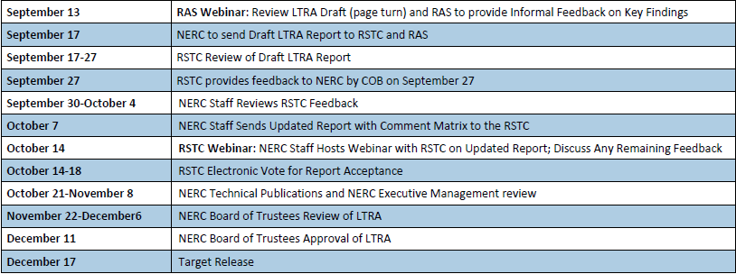
Remaining LTRA Preparation Schedule

