Slide 1
RRS Limits For Non-Thermal Resources and A few others
ERCOT Staff
PDCWG
August 20, 2020

Slide 2
Introduction
Per Section 4 in the Other Binding Document (OBD), Procedure for Calculating Responsive Reserve (RRS) Limits for Individual Resources, RRS limit for non-thermal Resources or Generation Resources with a Resource Category of either (i) aeroderivative simple cycle commissioned after 1996, or (ii) Reciprocating Engine (“fast resources”) may be updated to be higher or lower than 20% threshold based on their
droop performance characteristics,
actual tests, and
the need to keep the frequency responsive capability fairly distributed across multiple Resources
Once established these RRS limits are subject to change based on performance during FMEs as specified in Section 5 of the same OBD.
PDCWG at its April 2020 meeting had asked ERCOT to provide
background on how RRS limits are currently being established on “fast resources”
a range that the PDCWG may consider to establish a RRS limit on “fast resources” such that the frequency responsive capability will be fairly distributed across multiple Resources

Slide 3
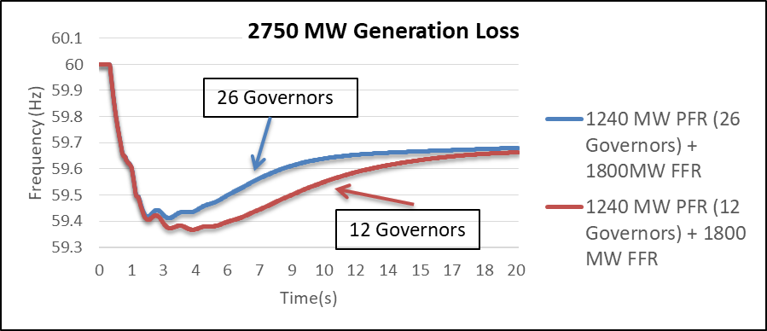
Background
In a report titled Frequency Control Requirements for Reliable Interconnection Frequency Response for a study conducted for FERC (also presented at the May 2018 ROS), the Lawrence Berkeley National Laboratory (LBNL) had recommended that the Responsibility for Frequency Response must be carried by allocating Frequency Response duty as
a small fraction of the operational range
of a sufficiently large number of turbines
This recommendation is consistent with a study that ERCOT had conducted in 2015 to demonstrate the effectiveness of distributing RRS-PFR across several governors.

Slide 4
Historical RRS Responsibility Analysis
ERCOT reviewed the RRS Responsibilities that have been provided by (non-ONRR) Generation Resources in Real Time in the recent past. The table below provides a summary of this data.
The average RRS Responsibility a Generation Resource provided in any given hour varies between 11 - 63 MW
The maximum RRS Responsibility a Generation Resource in any given hour is typically set by a Combined Cycle Resource. The median of the max RRS Responsibility provided in any given hour is 125 MW.
RRS Resp. | Min | Median | 98th Percentile | Max
Hourly Avg. (MW) | 11 | 32 | 47 | 63
Hourly Max. (MW) | 45 | 125 | 180 | 189

Slide 5
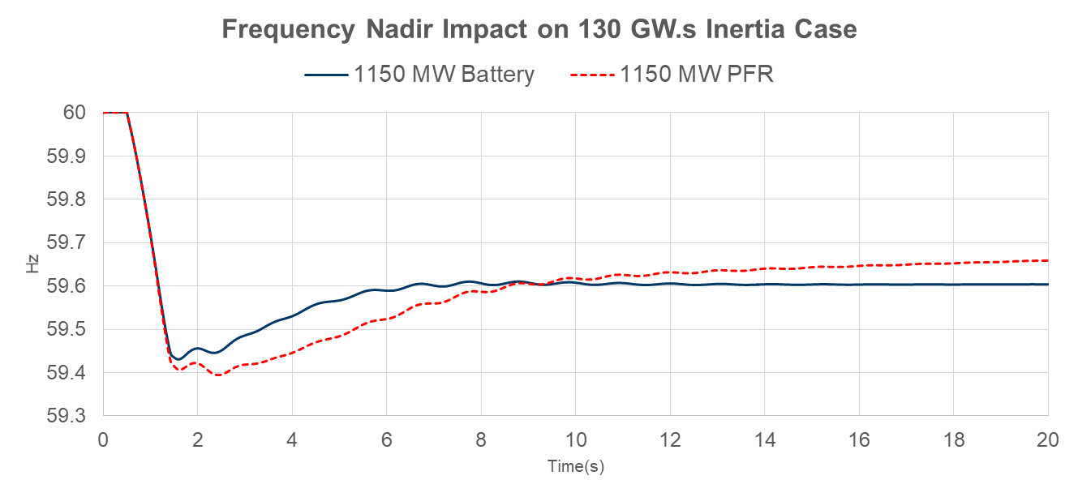
Impact on Frequency Stability
Currently ERCOT does not have the verified dynamic models that directly reflect the frequency response of these “fast resources”.
As a result, in order to assess the impact of replacing thermal RRS providers with “fast resources” on frequency stability, ERCOT created a model by tweaking the parameters within a generic model to simulate the frequency response from the “fast resources”.
Simulations were run using these models on the 130 GW·s inertia case that was used in the 2017 RRS Study.
A very small improvement was noticed in the frequency nadir if all 1150 MW RRS-PFR was provided by these “fast resources”.
*ERCOT will continue to monitor the results of this study as more models for “fast resources” become available.

Slide 6
Summary
In order to help ensure RRS-PFR is distributed across several Generation Resources, currently ERCOT is comfortable with if a RRS Limit between 65 MW and 125 MW is chosen as maximum for RRS-PFR from a single “fast resource”.
ERCOT is open to revisiting this value in future once more operational data is available.
Based on some cursory studies that have been conducted using representative models, ERCOT did not observe any significant negative impact on frequency stability with “fast resources” providing RRS-PFR during low inertia conditions and does not see a need to impose a system level limit on total RRS-PFR from “fast resources”.
ERCOT will continue to monitor the results of this study as more models for “fast resources” become available

