Slide 1
ERCOT Frequency Control Report
July 2020
ERCOT
Operations Planning
PDCWG | August 19th, 2020

Slide 2
Summary of July 2020
CPS1: 168.35%
Current CPS1 12-Month Rolling Average: 173.03%
4 BAAL Exceedance
13 hourly CPS1 score below 100%
BAAL-003 Events have updated through 2019
2019 BAAL-003 FRM Performance: -811.14
2020 RMS1 Statistics
Mean: 16.12 mHz
Min: 12.25 mHz
Max: 20.4 mHz
Energy Statistics
Total Energy: 40,193,479 MWh
Wind Energy: 6,904,465 MWh
Percent Energy from Wind: 17.18%
Solar Energy: 1,092,033 MWh
Percent Energy from Solar: 2,72%
Minimum System Inertia
Mean: 278, 431 MW*s
Max: 299,461 MW*s on July 31st
Min: 241,311 MW*s on July 1st
Notes:
2018 BAAL-003 FRM Performance: -843.17

Slide 3
Frequency Control
CPS1, BAAL, & RMS1

Slide 4
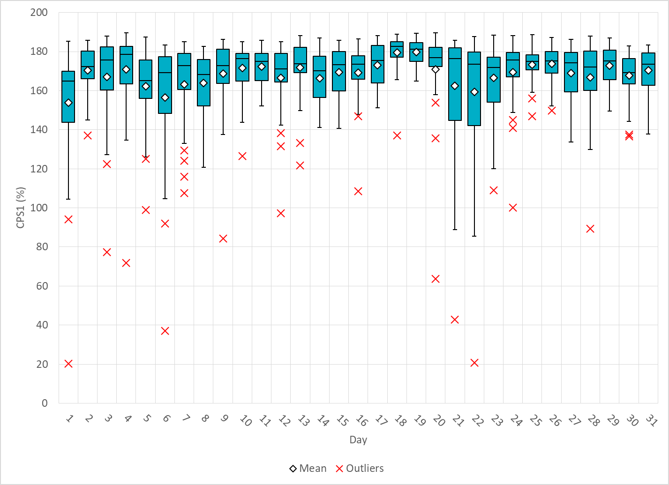
Hourly CPS1 by Day
Jul-20 CPS1 (%): 168.35
Notes:
Outliers:
1. 20.27% @ 7/1/2020 18:00
Frequency Event: at the start of the hour with about 801 MWs lost and nadir of 59.847Hz
Expected Gen Dev:
Large exp. Gen. dev of -1035 @ 18:33 mostly due to wind, Large expected gen dev of -2466 @ 18:53 mostly due
To wind and solar
Wind/Solar Ramp: Solar ramp from 2225 to 1358 MW between 18:32 and 19:00
Regulation: Regulation up exhausted throughout the hour
2. 20.72% @ 7/22/2020 18:00
Expected Gen Dev:
Large exp. Gen. dev of -1642 @ 18:19 mostly due to wind and solar, Large expected gen dev of -2204 @ 18:45 mostly due to wind and solar
Wind/Solar Ramp: Solar ramp from 2262 to 1356 MW between 18:28 and 18:45
Regulation: Regulation up exhausted from 18:00-18:22 and 18:33-18:46
3. 37.13% @ 7/6/2020 15:00
Frequency Event: @ 15:09, loss of about 762 MWs lost, and nadir of 59.808Hz
Expected Gen Dev:
Large exp. Gen. dev of -1076 @ 15:15 mostly due to thermal resources being slow to reach BP after responding to low frequency event
Wind/Solar Ramp: Solar ramp from 3327 to 2968 MW between 15:36 and 15:48
Regulation: Regulation up exhausted from 15:10 – 15:16, Reg down exhausted from 15:22 to 16:00
4. 42.82% @ 7/21/2020 18:00
Expected Gen Dev:
Large exp. Gen. dev of -1059 @ 18:28 mostly due to wind and solar, Large Exp. Gen. Dev of -1836 @ 18:54 mostly due to wind and solar with some thermal contributions
Wind/Solar Ramp: Solar ramp from 1869 to 1460 MW between 18:12 and 18:27, Wind ramp from 9043 to 7766 MW between 18:33 and 18:56 (PWRR capped out to -30MW/min)
Regulation: Regulation up exhausted throughout the hour
5. 63.69% @ 7/20/2020 11:00
Frequency Event: @ 11:47, loss of about 806 MWs lost, and nadir of 59.815Hz
Expected Gen Dev:
Large exp. Gen. dev of -1381 @ 11:53 mostly due to thermal resources being slow to reach BP after responding to low frequency event
Wind/Solar Ramp: Wind on down ramp from 3997 to 3082 MW between 11:14 and 11:53
Regulation: Regulation up and down exhausted for short intervals throughout
6. 71.89% @ 7/4/2020 19:00
Expected Gen Dev:
Large exp. Gen. dev of -1601 @ 19:09 mostly due to thermal resources shutting down
Wind/Solar Ramp: Solar on down ramp throughout hour from 2449 to 778 MW between 19:00 and 20:00
Regulation: Regulation up exhausted throughout the hour
7. 77.24% @ 7/3/2020 18:00
Expected Gen Dev:
Large exp. Gen. dev of -1315 @ 18:54 mostly due to thermal resources shutting down (~800 MW in shutdown)
Wind/Solar Ramp: Solar on down from 2878 to 2197 MW between 18:24 and 19:00
Regulation: Regulation up exhausted throughout the hour
84.40% @ 7/9/2020 20:00
Expected Gen Dev:
Large exp. Gen. dev of -1003 @ 20:19 mostly due to thermal resources being slow to reach BP after responding to low frequency event
Wind/Solar Ramp: Wind on down ramp from 17168 to 16684 MW between 20:09 and 20:22, solar down ramp from 730 to 220 MW between 20:00 and 20:23
Regulation: Regulation up exhausted throughout the hour
89.37% @ 7/28/2020 17:00
Expected Gen Dev:
Large exp. Gen. dev of -1517@ 17:16 mostly due to wind and solar resources with some CCPs transitioning configurations
Wind/Solar Ramp: Solar ramp down from 2745 to 2265 MW between 17:08 and 17:27, wind ramp up from 4673 to 5526 MW between 17:38 and 18:00
Regulation: Regulation up exhausted throughout the first half of the hour, Reg down exhausted during second half of hour
10. 91.91% @ 7/6/2020 2:00
Expected Gen Dev:
Large exp. Gen. dev of -1823 @ 02:20 top contributions from thermal resources shutting down and from wind resources
Wind/Solar Ramp: wind down ramp from 7659 to 5207 MW between 02:00 and 03:00
Regulation: Regulation up exhausted throughout the hour
94.16% @ 7/1/2020 17:00
Expected Gen Dev:
Large exp. Gen. dev of -1863 @ 17:09 due to wind and solar resources
Wind/Solar Ramp: solar ramp down of about 120MW between 17:00 and 17:05
Regulation: Regulation up exhausted in the first half of hour, reg down in second half of hour
97.18% @ 7/12/2020 14:00
Expected Gen Dev:
Large exp. Gen. dev of -1381 @ 14:54 from thermal resources
Wind/Solar Ramp: solar ramp down of about 100MW between 14:15 and 14:20, solar ramp down of about 130 MW between 14:46 and 14:51
Regulation: Regulation up exhausted for short periods in the first half of hour, exhausted for entire second half of hour
13. 98.88% @ 7/5/2020 17:00
Expected Gen Dev:
Large exp. Gen. dev of -851 @ 17:39 from solar resources
Wind/Solar Ramp: solar ramp down of about 200 MW between 17:33 and 17:35
Regulation: Regulation up exhausted at the start and end of the hour, reg down exhausted in the middle of the hour

Slide 5
BAAL Exceedances & Violations
There was 4 BAAL exceedances in July
Notes:
1 on 7/1 (loss of 801 MW), 2 on 7/6 (Loss of 762 MW), and 1 on 7/9 (Loss of 843 MW)

Slide 6
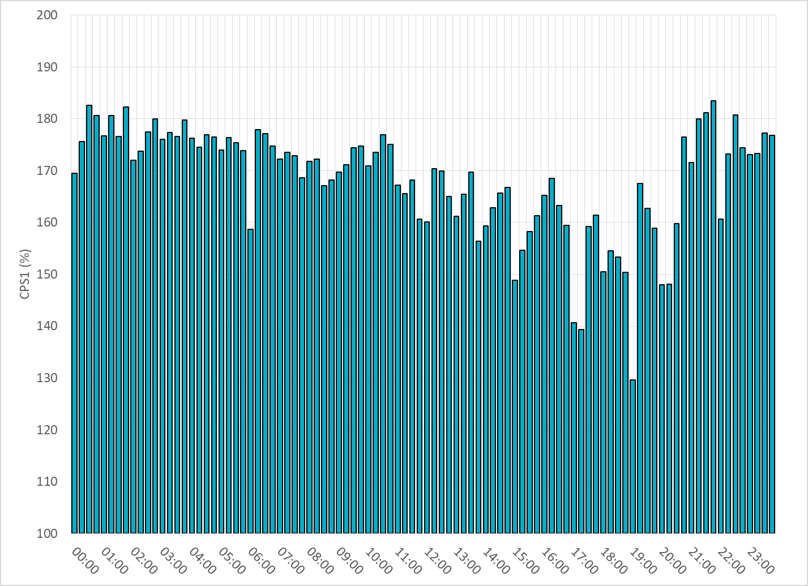
15-Minute Average CPS1%
Jul-20 CPS1 (%): 168.35

Slide 7
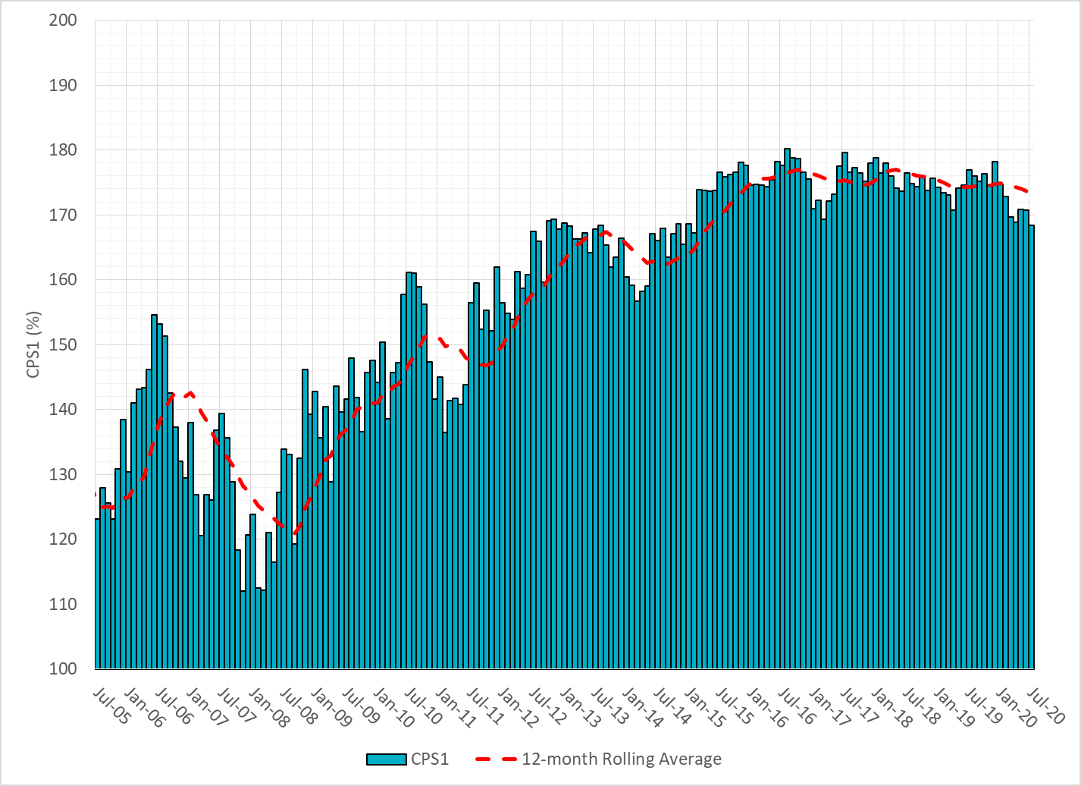
12-Month Rolling Average CPS1
Current 12-Month Rolling Average: 173.03%

Slide 8
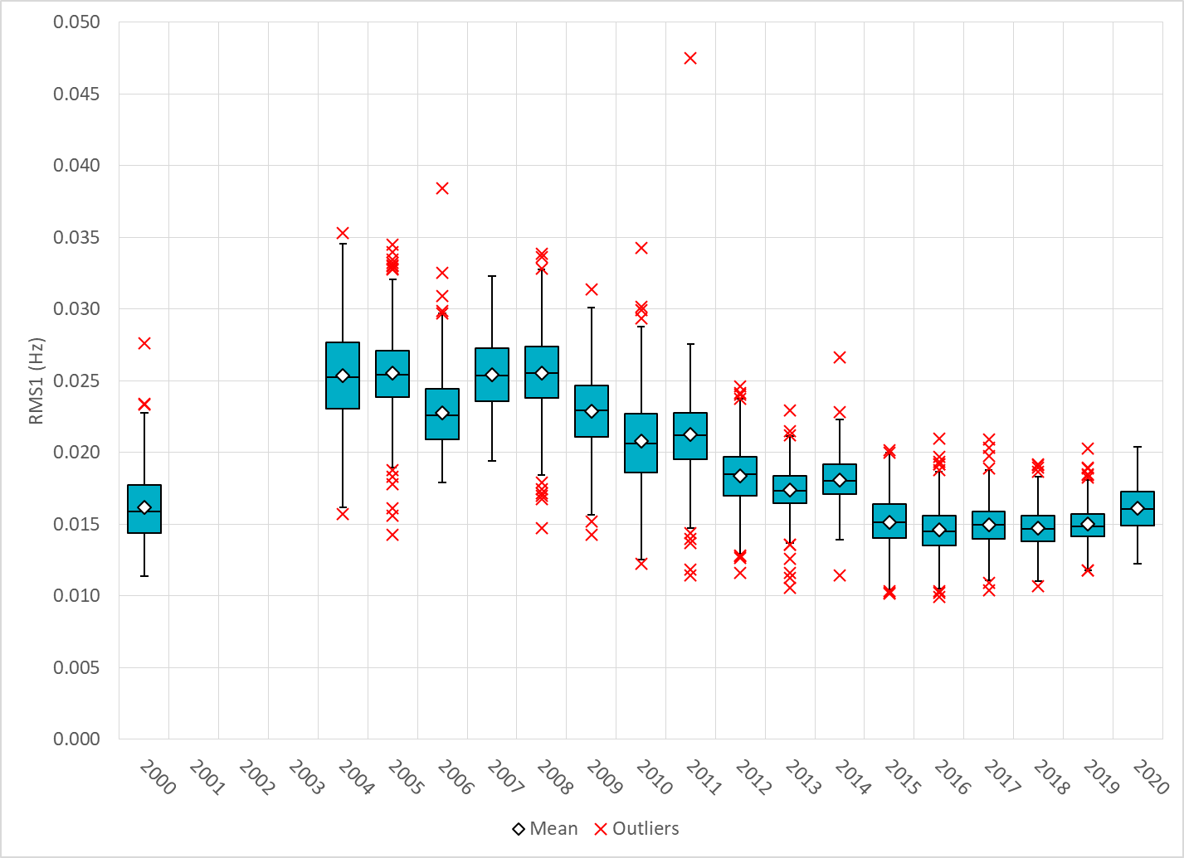
Daily RMS1 of ERCOT Frequency by Year

Slide 9
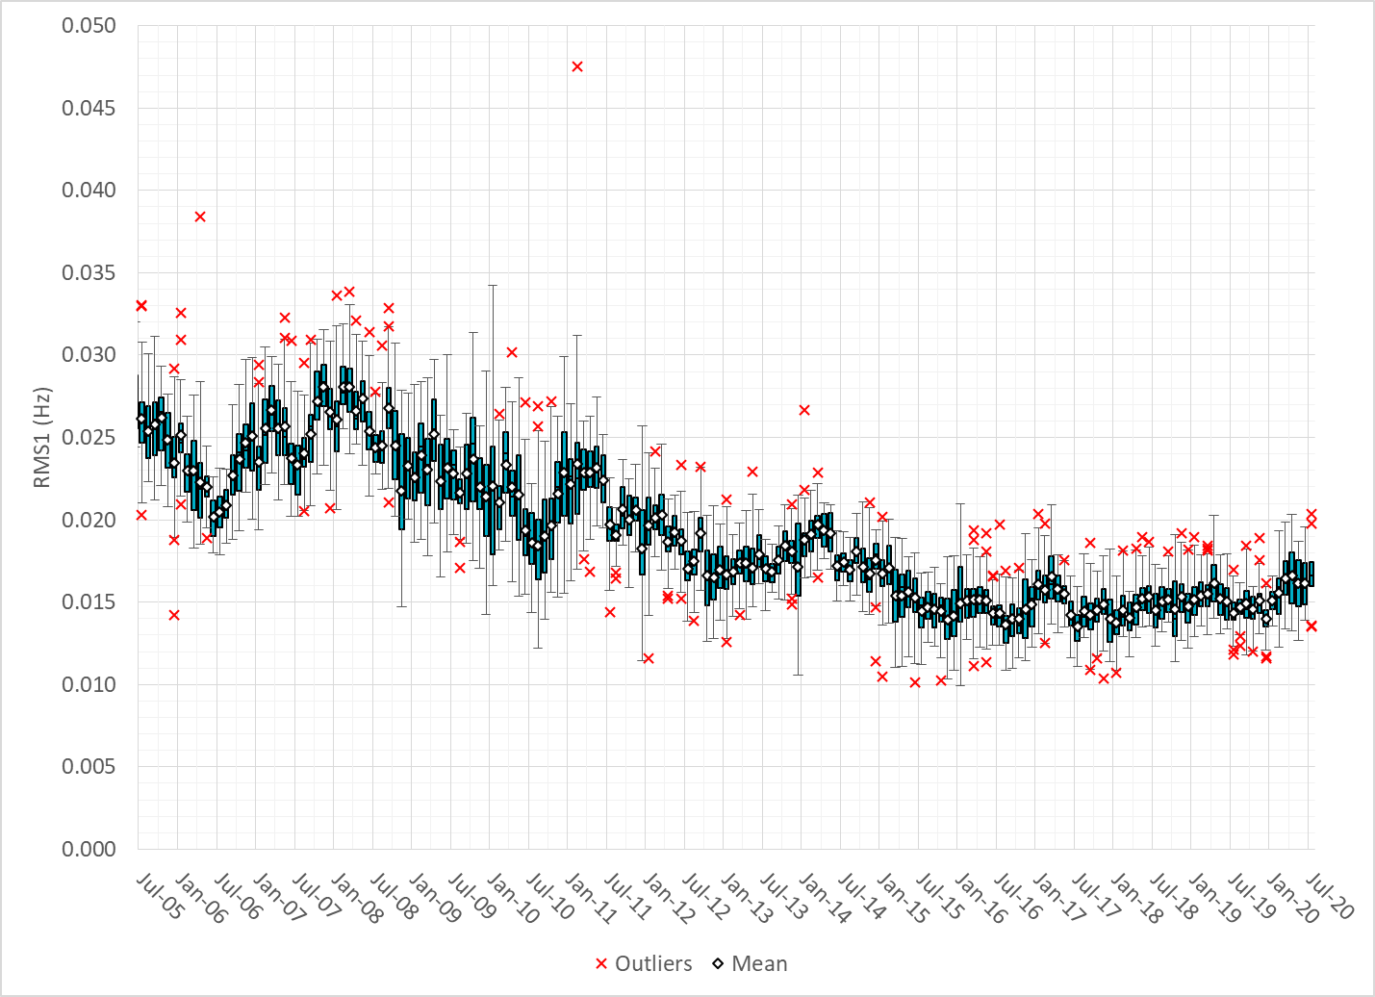
Daily RMS1 of ERCOT Frequency by Month

Slide 10
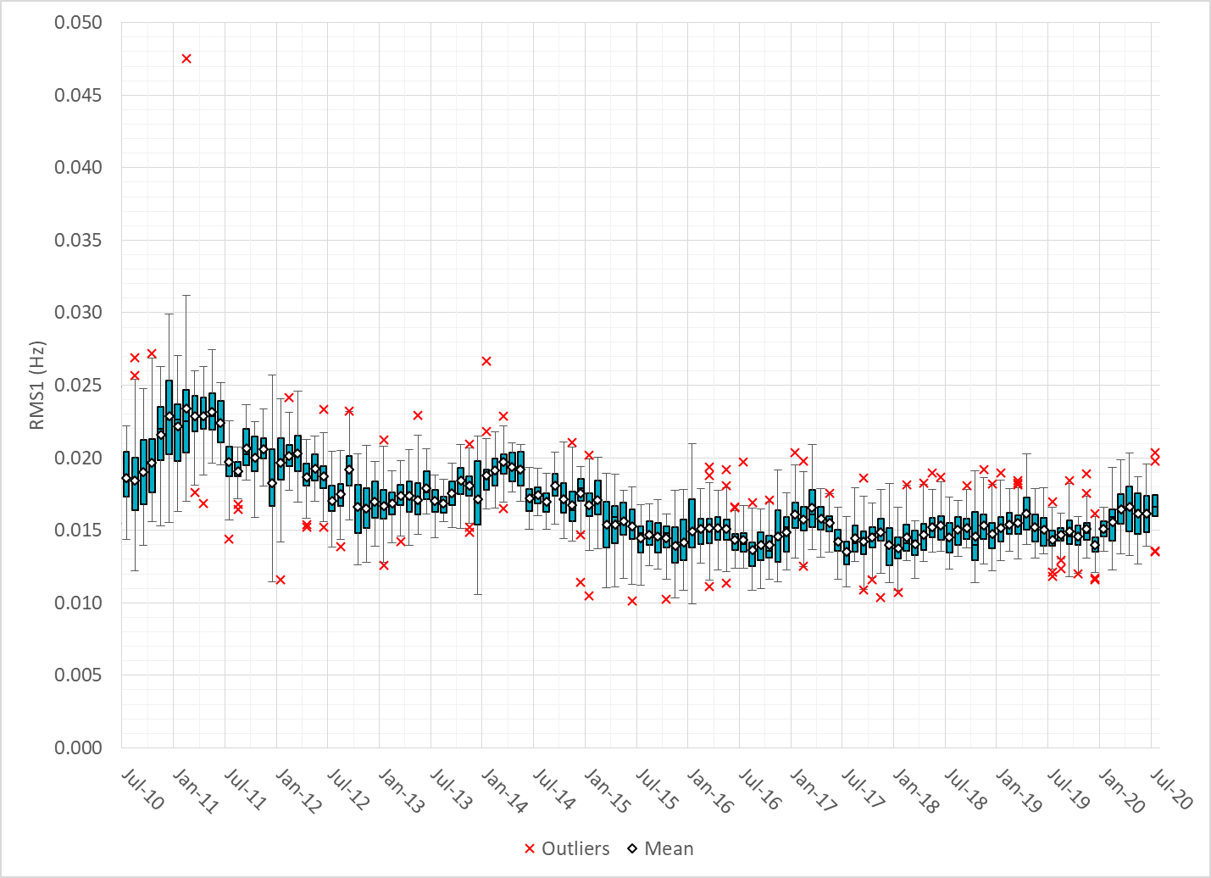
Daily RMS1 of ERCOT Frequency by Month

Slide 11
Frequency Profile Comparison

Slide 12
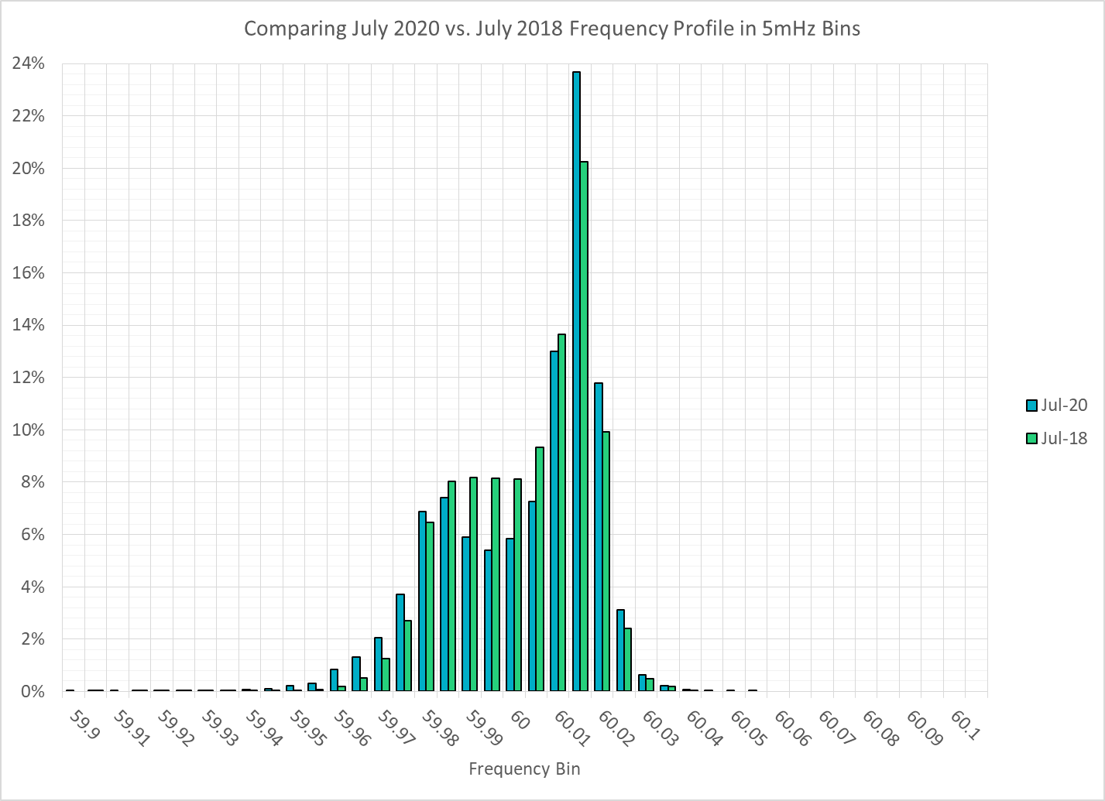
Frequency Profile Comparison

Slide 13
Frequency Profile Comparison

Slide 14
Time Error Correction

Slide 15
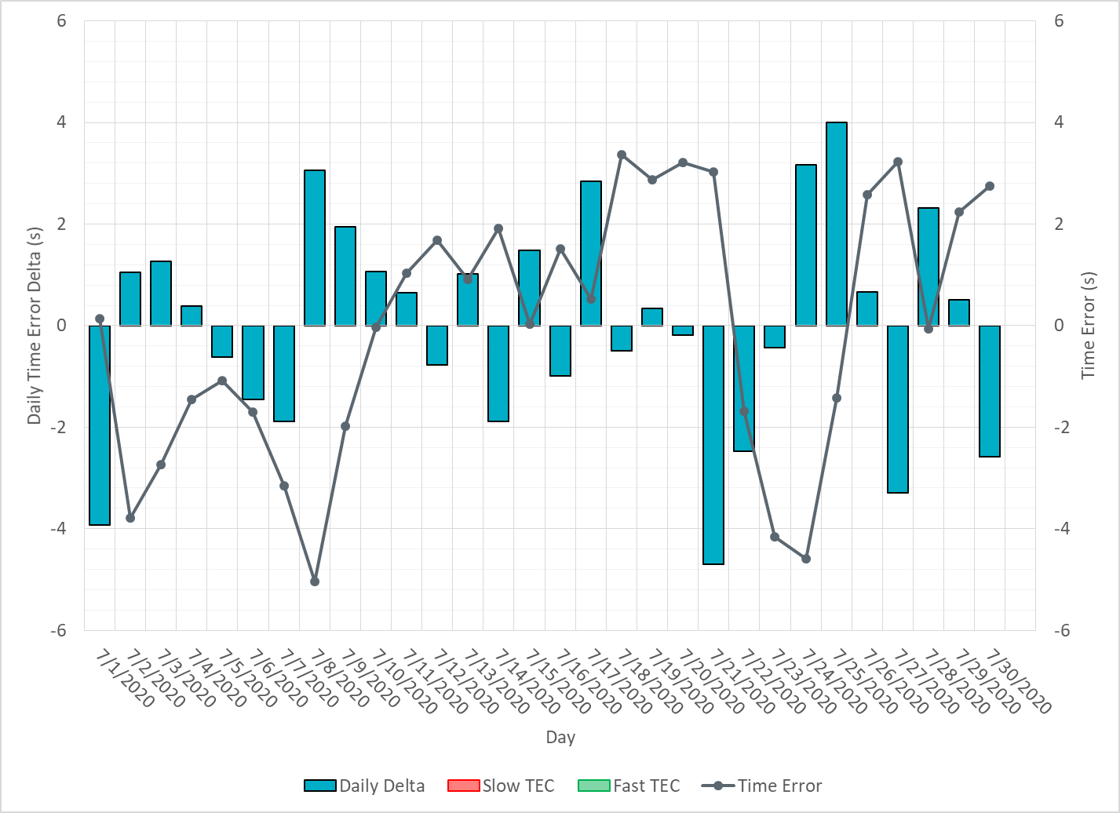
ERCOT Daily Time Error

Slide 16
Time Error Corrections Log Summary
There have been no time error corrections since December 2016

Slide 17
BAL-003 Performance

Slide 18
Op. Year 2019 BAL-003 Selected Events – Update
Notes:
BAL-003

Slide 19
Op. Year 2018 BAL-003 FRM Performance - Update
Notes:
OP2018: FRO = -381.0, FRM_median = -843.17, FRM_average = -959.7
OP2019: FRO = -381.0, FRM_median = -811.14, FRM_average = -892.5
OP2020: FRO = -425.0,

Slide 20
ERCOT Energy Statistics

Slide 21
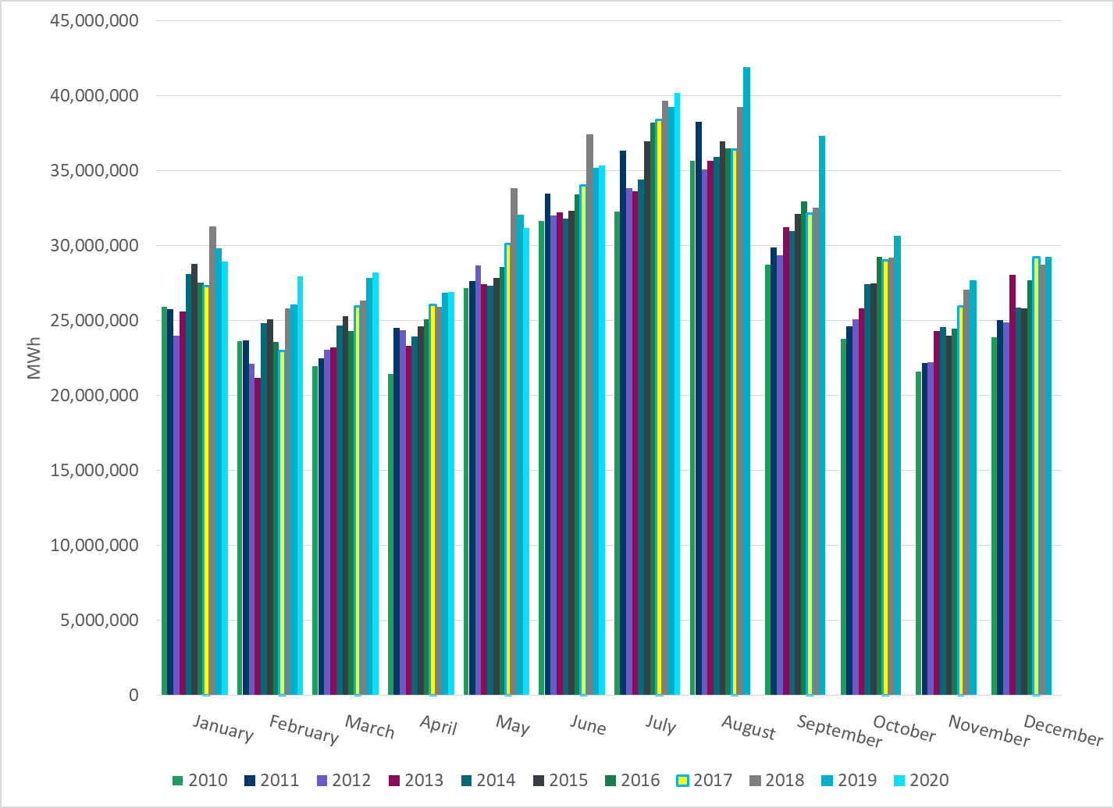
Total Energy
Notes:
40,193,479 MWh

Slide 22
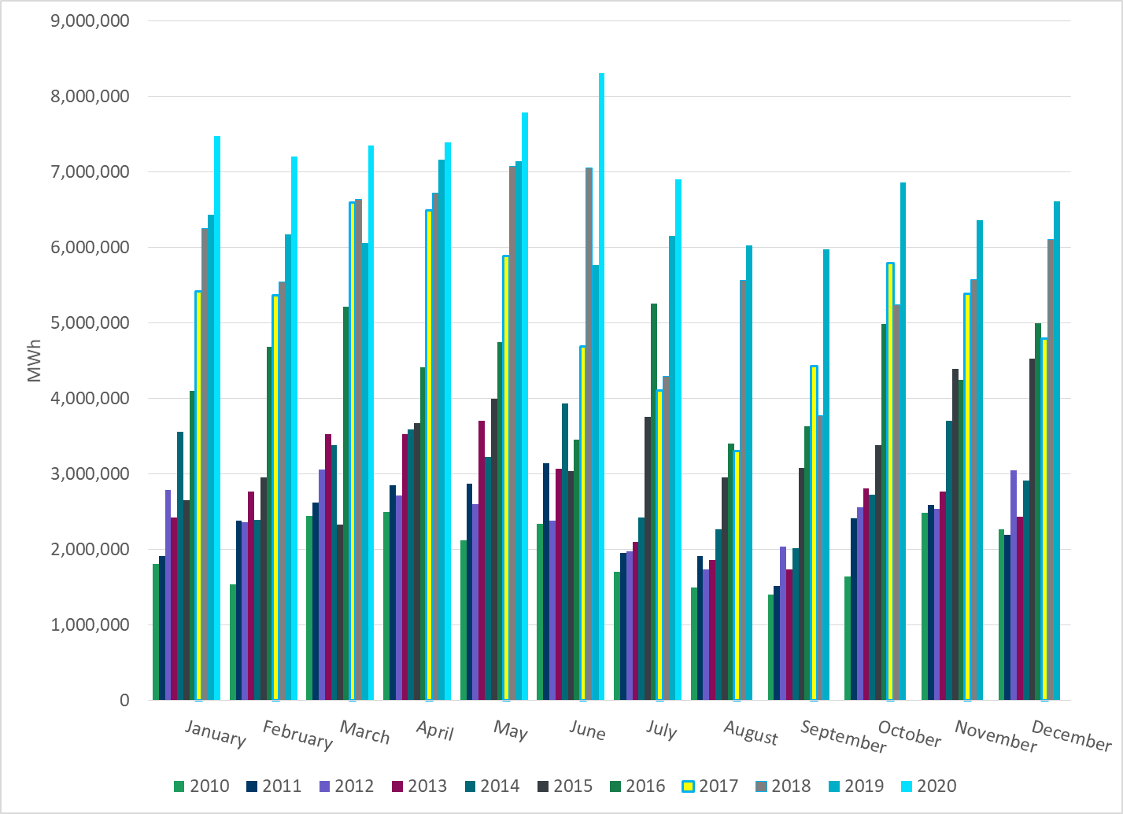
Total Energy from Wind Generation
Notes:
6,904,465 MWh

Slide 23
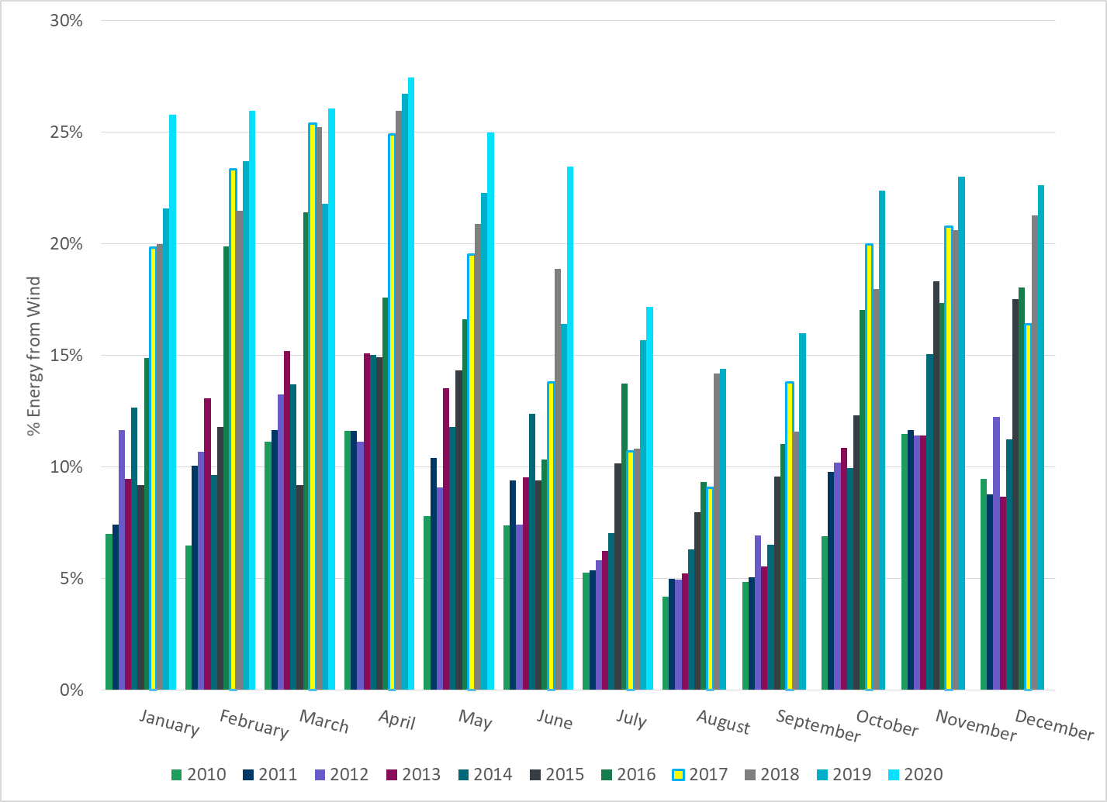
% Energy from Wind Generation
Notes:
17.18%

Slide 24
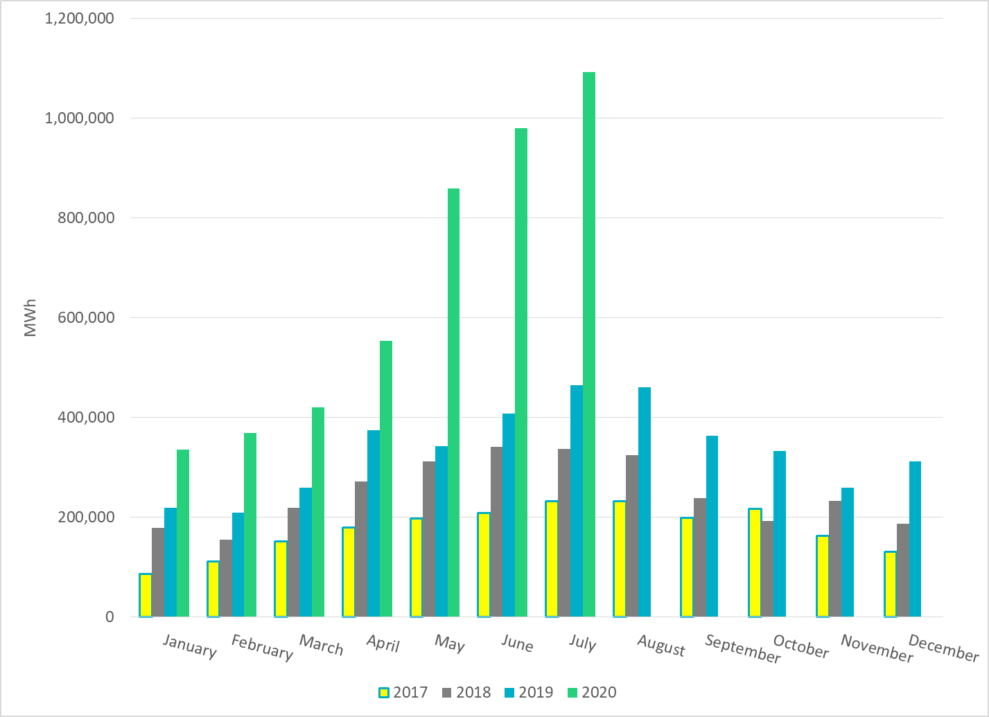
Total Energy From Solar Generation
Notes:
1,092,033 MWh

Slide 25
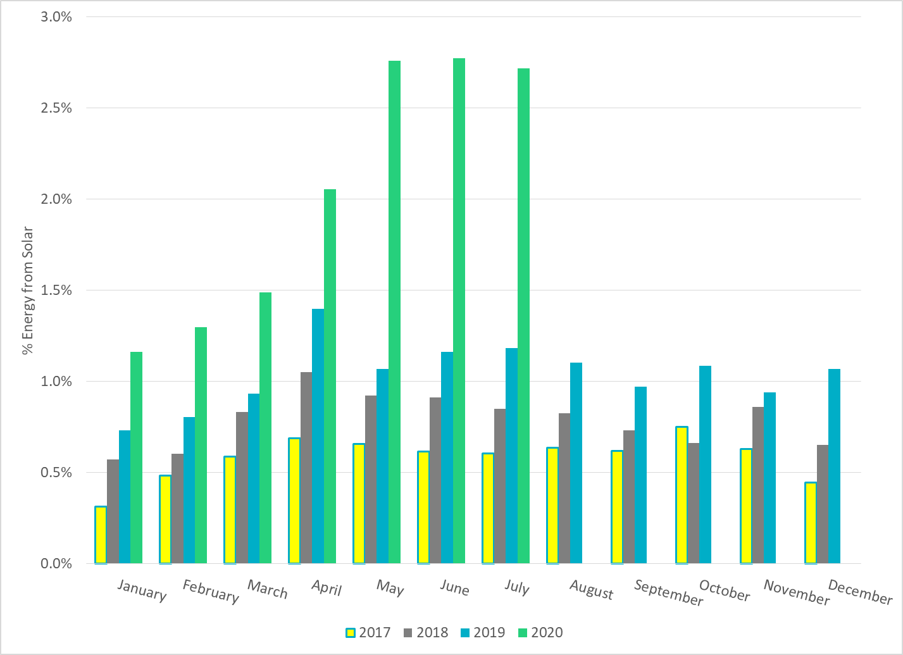
% Energy from Solar Generation
Notes:
2.72%

Slide 26
ERCOT System Inertia

Slide 27
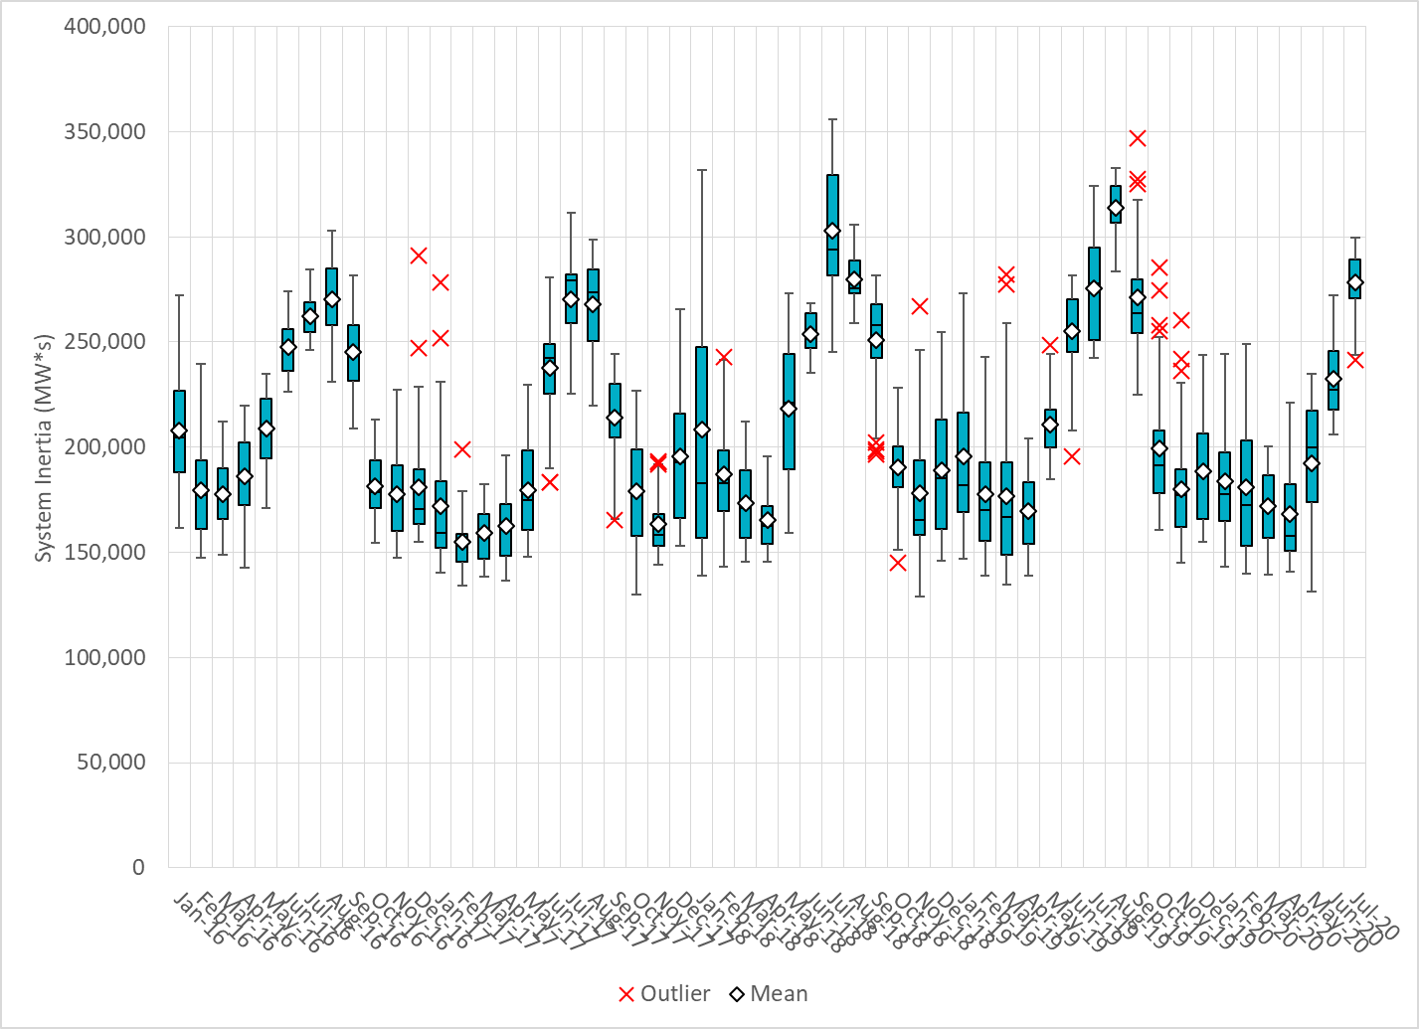
Daily Minimum System Inertia
Notes:
Minimum Inertia = 241,311 MW*s on 7/1/2020
Previous Minimum was 128,759 MW*s on 11/18/2018.
Data:
Mean: 278,431
Max: 299,461 on July 31st
Min: 241,311 on July 1st

Slide 28
Questions?
Thank you!

