Slide 1
SCR 811 to Add Solar Ramp Into GTBD
Operations Analysis
August 17, 2020
WMWG

Slide 2
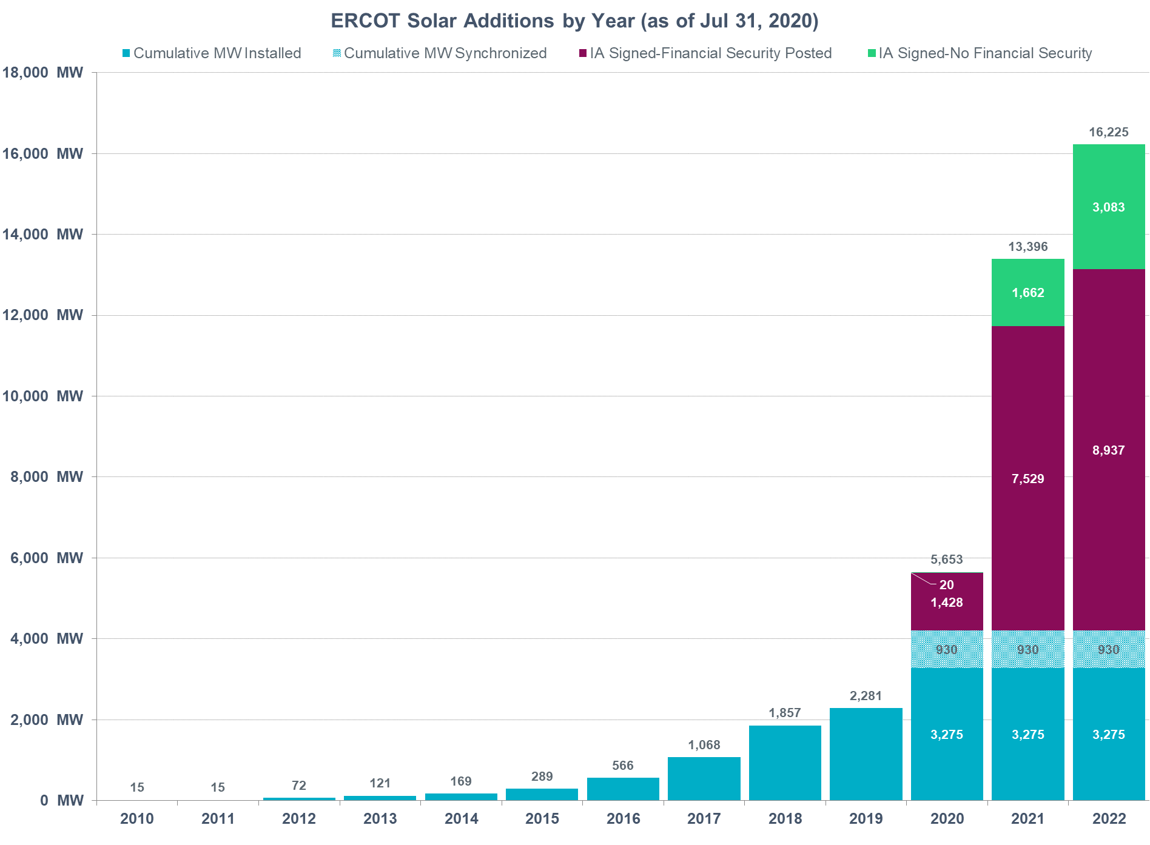
Solar Installed Capacity Projections (July 2020 GIS)

Slide 3
Description
Include intra-hour solar forecast into Generation To Be Dispatched (GTBD) to give SCED a indication of how the solar units may ramp.
Currently: uncurtailed solar units a dispatched to their HSL.
  Assumes solar will stay the same at their HSL for next 5-min.
  What if solar ramps?
    Regulation used to make up for gain/loss of solar MW
      As the installed capacity of solar grows, regulation could be exhausted more frequently due to solar ramps.
  What if an FME occurs as the sun is setting?
    Regulation will be relied upon but depending upon the circumstance frequency recovery could potentially be delayed.
Equation
GTBD = Total Gen + K1*10*System Load Frequency Bias + K2*[(net non-conforming Load) – (net filtered non-conforming Load)] + K3*5*PLDRR + K4*Regulation Deployed + K5*ACE Integral – K6*5*PWRR + K7*5*DCTRR – K8*5*PSRR
|PSRR| ≤ Max PSRR Feedback
NEW ADDITIONS

Slide 4
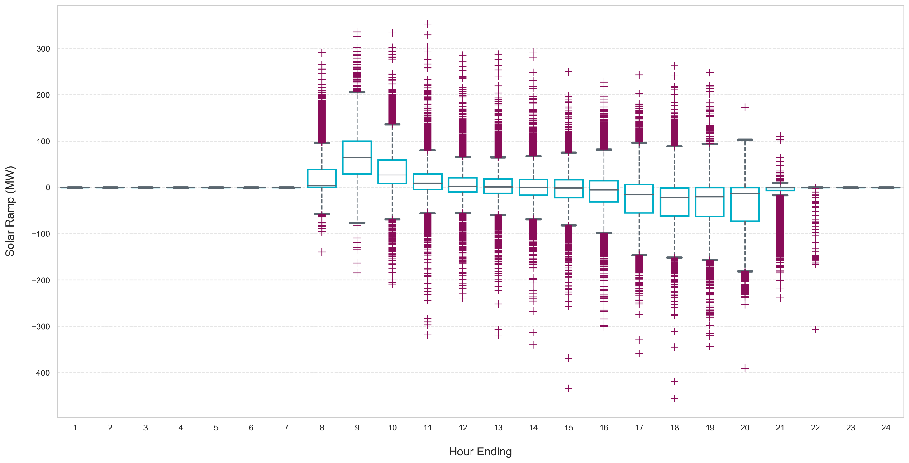
Solar Ramping
Data* shows a noticeable trend with solar ramping up in the mornings and ramping down in the evening, while fairly flat in between
* Solar ramping data from 1/1/2020 to 7/14/2020

Slide 5
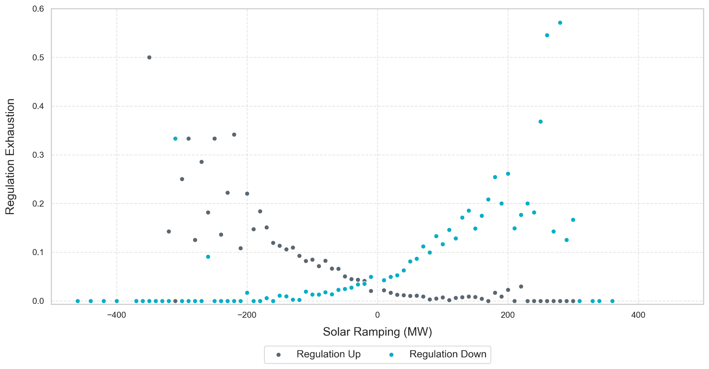
5-min Exhaustion Rates vs Solar Ramp
Solar ramp data grouped into 10 MW bins and average Regulation exhaustion taken for each bin*
Regulation up exhaustion as solar ramps down, Regulation down exhaustion when solar ramps up
* Solar and Regulation data obtained between 1/1/2020 to 7/14/2020

Slide 6
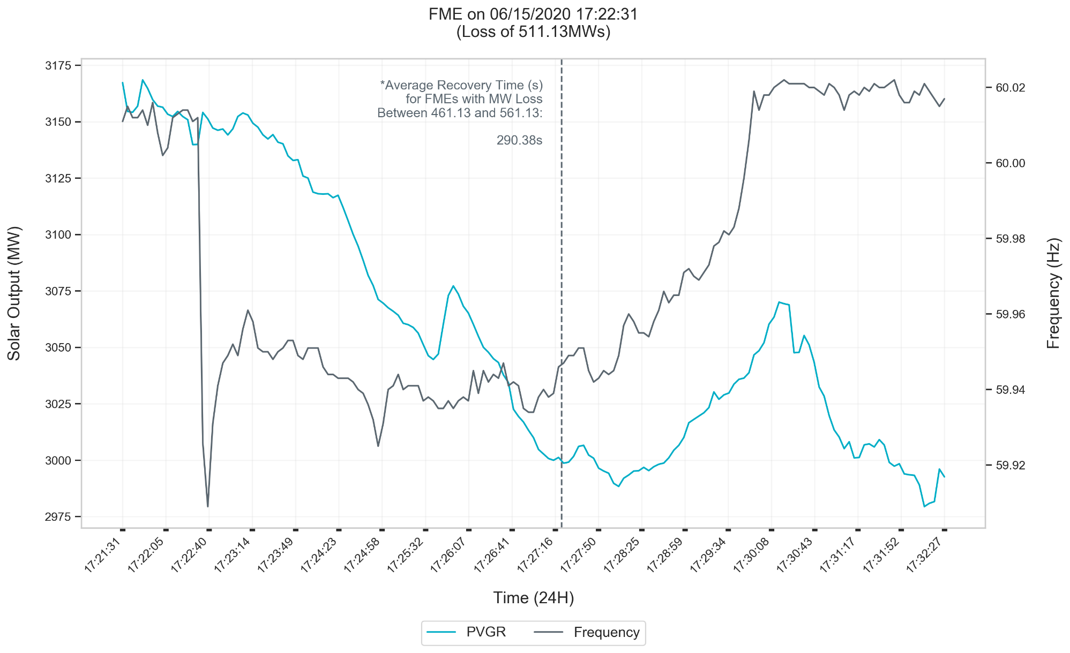
FME 1 – Jun 15, 2020
* Events occurred outside of a solar ramp
Notes:
For this event,
Recovery: 438s or 7minutes and 18 seconds,
Solar Noon: 13:31:44,
Sunset: 20:34:34,
Constant curtailment of ~170 MW

Slide 7
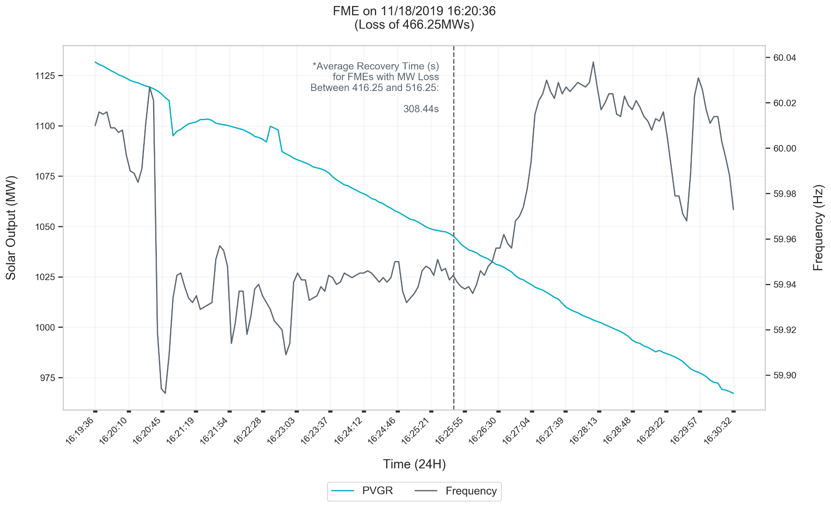
FME 2 – Nov 18, 2020
* Events occurred outside of a solar ramp
Notes:
For this event,
Recovery: 389s or 6 minutes and 29 seconds,
Solar Noon: 12:16:14,
Sunset: 17:33:04,
No curtailment

Slide 8
General Statistics for FMEs*
During Solar Down Ramp? | Metric | Frequency at A (Hz) | Frequency at C (Hz) | A-C Time (sec) | A to C Frequency (mHz) | Total Recovery Time (sec) | Max RRS Deployed
False | Min | 59.966 | 59.738 | 3 | 65 | 159 | 0
 | 25th Percentile | 59.986 | 59.854 | 5 | 105 | 229 | 254
 | Mean | 59.998 | 59.869 | 5.8 | 129 | 293 | 508
 | 75th Percentile | 60.012 | 59.898 | 6.3 | 151 | 320.5 | 722
 | Max | 60.028 | 59.933 | 11 | 268 | 935 | 1657.3
True | Min | 59.956 | 59.79 | 4 | 72 | 135 | 0
 | 25th Percentile | 59.979 | 59.857 | 5 | 91 | 266.5 | 316
 | Mean | 59.992 | 59.875 | 6.1 | 116.9 | 319.7 | 484
 | 75th Percentile | 60.007 | 59.899 | 6.5 | 133.5 | 379.5 | 637
 | Max | 60.022 | 59.915 | 10 | 180 | 475 | 1156.6
* Included FMEs between 2/11/2016 to 7/14/2020
Notes:
Ramp identified as the delta PVGR output between the start of the event and recovery time
80 events outside solar ramp down period
35 during solar ramp down period
Recovery Time increased by ~26.7s
11 second A-C Event: 2/6/2020 21:22:53, 622.643 MW Loss, C Point of 59.863 Hz, Recovery Time of 6 min, 49 seconds
10 second A-C Event: 11/18/2018 16:20:36, 466.25 MW Loss, C Point of 59.89 Hz, Recovery Time of 6 min, 29 seconds

Slide 9
Summary
Propose including intra-hour solar forecast into Generation To Be Dispatched (GTBD) to give SCED a indication of how the solar units may ramp.
  SCR also proposes to include functionality that will compute a solar ramp using the hourly Solar Forecast.
ERCOT is in the process of obtaining an intra-hour solar forecast. Prior to setting a non-zero value on K8, ERCOT will share performance of the intra-hour solar forecast with WMWG.

Slide 10
Questions

Slide 11
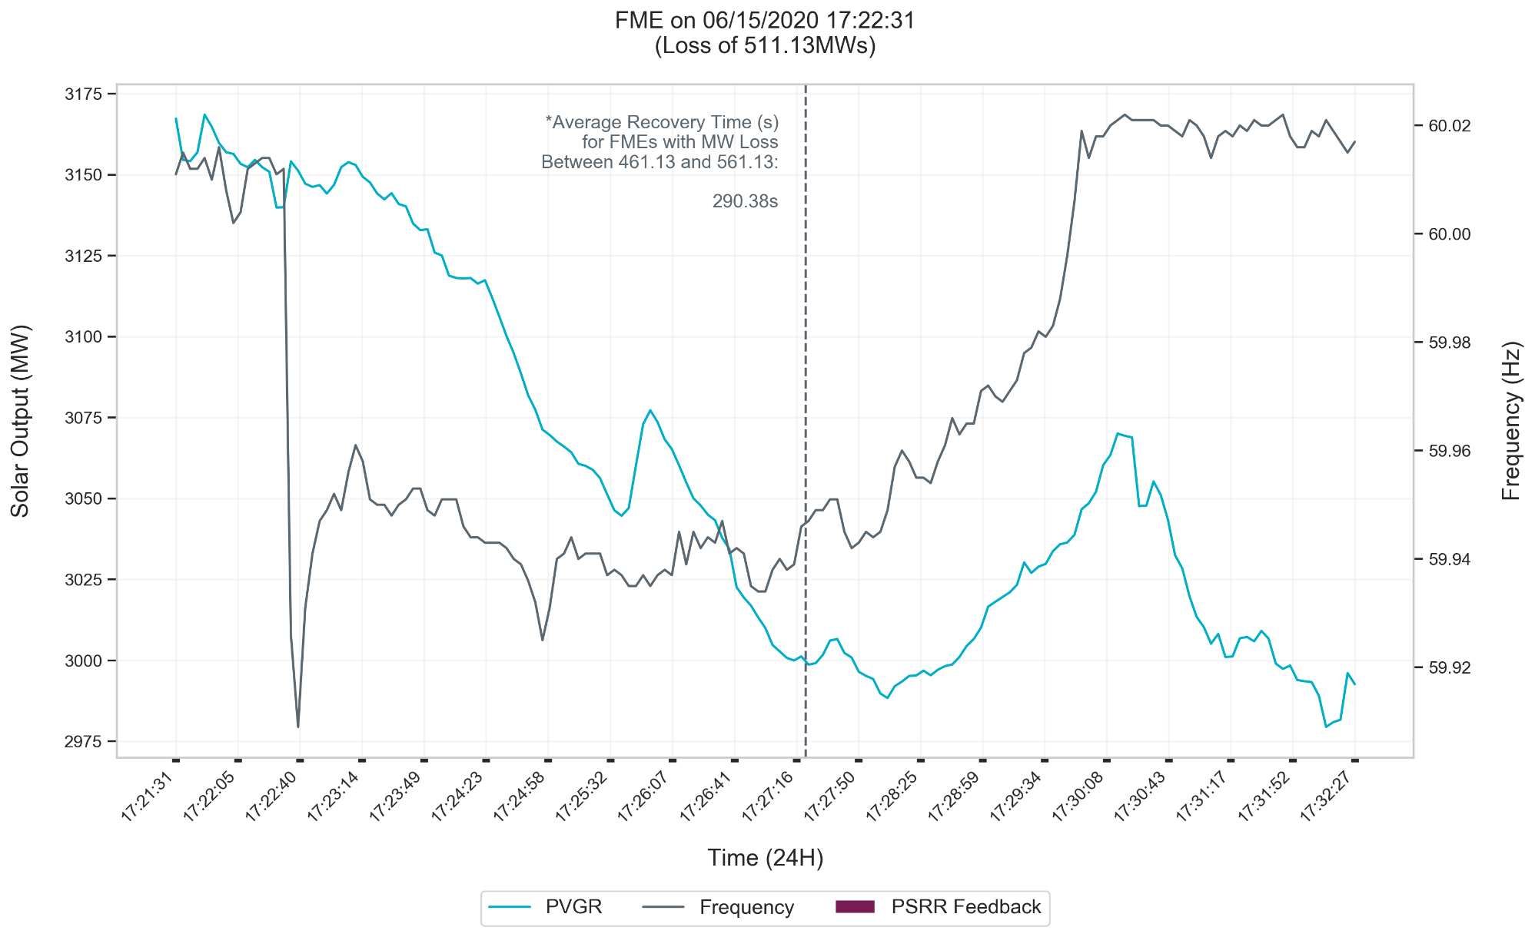
FME 1 – Jun 15, 2020 PSRR Estimation
A representative PSRR has been computed using hourly PVGR forecast.
PSRR Feedback =
-1*5*PSRR (no cap applied)
155.7 MW
76.4 MW
* Events occurred outside of a solar ramp
Notes:
For this event,
Recovery: 438s or 7minutes and 18 seconds,
Solar Noon: 13:31:44,
Sunset: 20:34:34,
Constant curtailment of ~170 MW

Slide 12
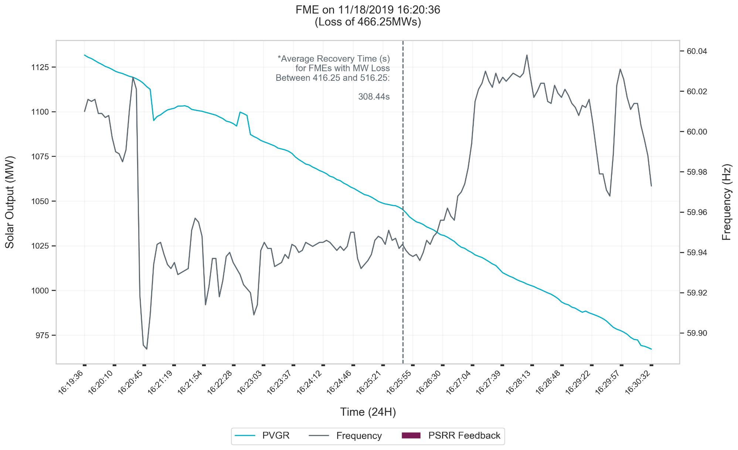
FME 2 – Nov 18, 2020 PSRR Estimation
A representative PSRR has been computed using hourly PVGR forecast.
PSRR Feedback =
-1*5*PSRR (no cap applied)
178.6 MW
196.75 MW
156.5 MW
* Events occurred outside of a solar ramp
Notes:
For this event,
Recovery: 389s or 6 minutes and 29 seconds,
Solar Noon: 12:16:14,
Sunset: 17:33:04,
No curtailment

