Slide 1
ERCOT MWG – NPRR1020 meter setup
August 2020

Slide 2
Takeaways from the presentation
Recap – How to meter BESS with integrated aux loads?
Connection method for meter telemetry signal
Meter programming to accomplish the connection
Meter programming to segregate WSL and retail load values for MV90 reporting

Slide 3
RECAP
Integrated Aux load – WSL and Retail segregation?
Aux load calculation and making it “Meterable”

Slide 4
Connection method for meter telemetry signal
DNP client
DNP outstation
Make the non-meterable internal aux load available in the meter
The Communication between RTAC & meter is over DNP3
  DNP3 point – Aux load setpoint transferred to meter.
The communication protocol is more customizable between DNP3/modbus and Ethernet IP/serial based on project basis.
Steps
Setup the RTAC as DNP client with the meter.
Setup the meter as DNP outstation.
Establish points list – Analog outputs point → Auxiliary load in MW
TNMP (Utility for GAMBIT project) is also simultaneously working on the setup using ION8650 meter

Slide 5
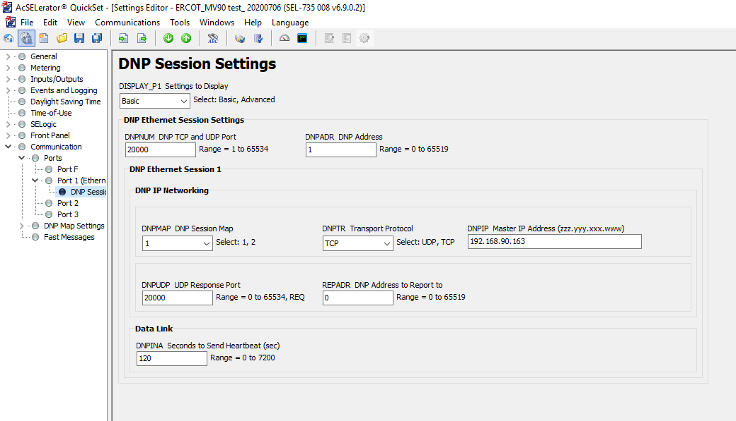
Meter programming to accomplish the connection
Functions of meter include
Setup up the meter as DNP outstation
2. Setup up the meter DNP map to receive realtime auxiliary load from DNP client(RTAC) as analog output point. (as MV01 in example)

Slide 6
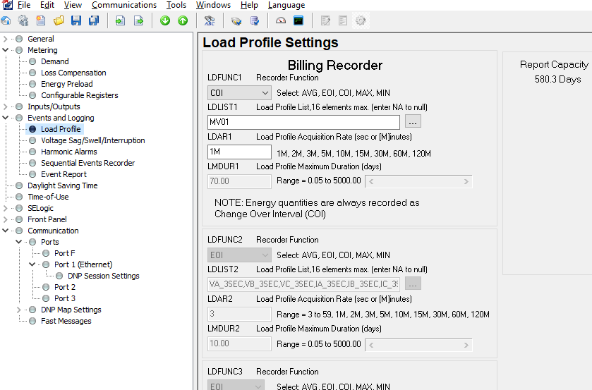
Meter programming for retail load reporting
Historize the Aux-load as load profile
Flexibility over the intervals of power integration – 1minute in this example case
Customizable MV90 recorder function. Change of interval function (COI) used as a standard for Energy reporting
The recorder function can include multiple elements to be reported in single Function
  Real Power
  Reactive power
  Aux load power
  WSL Energy
  Aux load Energy

Slide 7
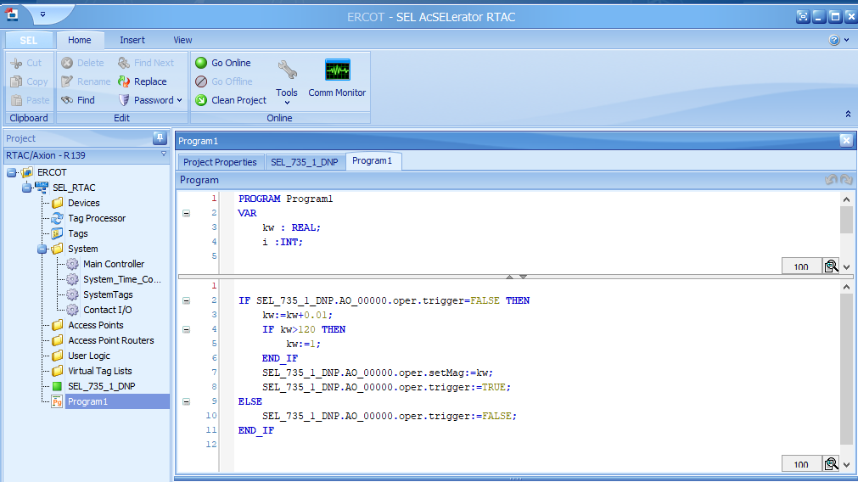
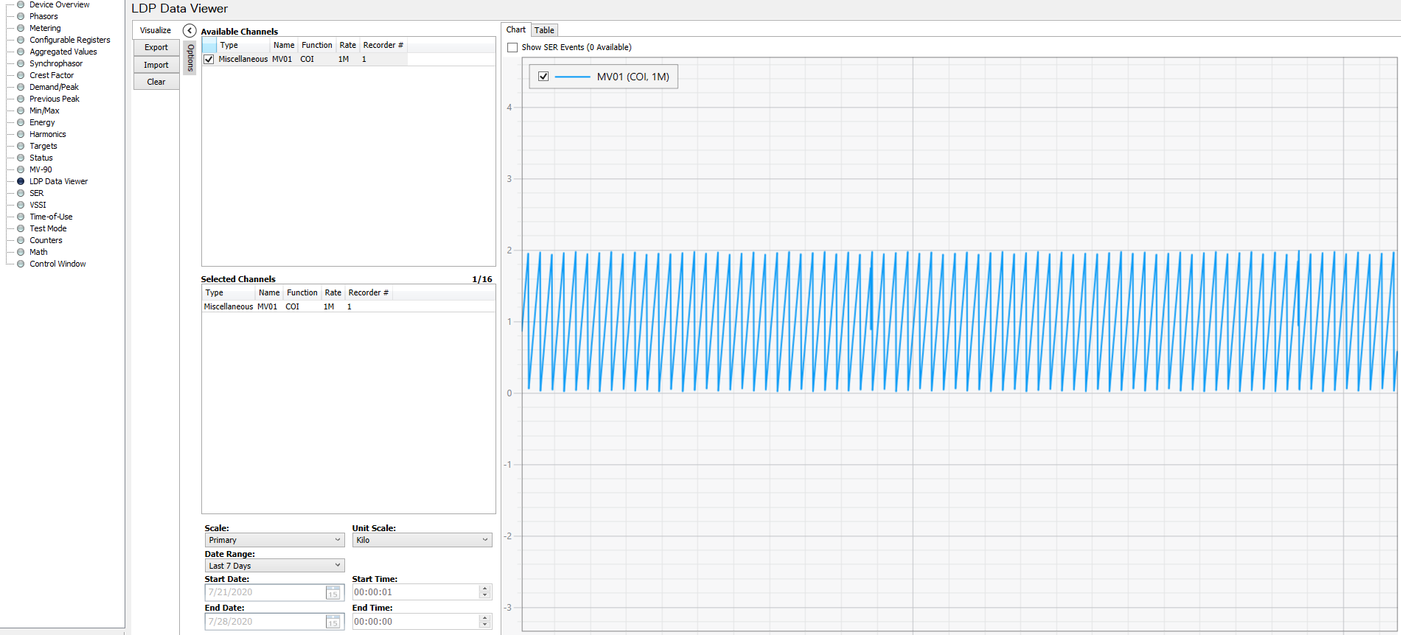
Pertaining RTAC Programming
1. Setup RTAC to Tesla site controller communication interface. The communication is established to receive the Raw_ real time_Aux load of the integrated ESS
2. Add Data validation and scaling to calculate a conditioned_realtime_Auxload
3. Setup DNP client with meter to send the conditioned_realtime_Auxload to the meter
EXAMPLE
RTAC program to mimic a 1minute incremental Aux load calculation of the ESS and Results as seen in the meter in MV90 format

Slide 8
Data conditioning as it relates to NPRR1020
Logic consideration and implementation to address a NPRR1020 requirement :“The Resource Entity may telemeter a zero Load value only when the ESR is discharging” .
Conditioned_realtime_Auxload := Data Conditioning in the RTAC (Raw_ real time_Aux load)
Consideration involved
Monitor Raw_ real time_Aux load value.
Monitoring the mode of ESS i.e Charging / Discharge
Set Conditioned_realtime_Auxload := Raw_ real time_Aux load IF charging
Set Conditioned_realtime_Auxload := 0 IF discharging.
Data scaling and loss of communication data handling

