Slide 1
Remove RUC opt-out: A recommendation from the 2019 State of the Market Report
by the Independent Market Monitor (IMM)
Carrie Bivens
ERCOT IMM Director
cbivens@potomaceconomics.com
Wholesale Market Working Group
ERCOT Public
August 17, 2020

Slide 2
2019 State of the Market Recommendation No. 1
Remove the “opt out” option for resources receiving RUC instructions.
History: The ability to opt out of RUC settlement was NPRR416, filed in 2011 and implemented in 2014
RUC instructions were far less frequent in 2019 than in 2011 due to a number of improvements made over the years.
Issue: Provides an unintended incentive for resource owners to show as “off and available” in the COP for future hours some resources that they reasonably expect to commit. There are reduced incentives to submit accurate COPs.
A resource owner may expect to commit a resource to solve a local congestion problem, but is not sure that that decision will be profitable, perhaps due to the unknown commitment decisions of other resources.
If ERCOT issues a RUC instruction for the resource, the resource owner’s assumptions regarding the status of other unit or units are confirmed, and the resource owner can use the opt-out provision to proceed with the commitment as originally planned with no negative consequences.
Consequences:
Less generation was committed in the COP after RUC opt out option added.
Reduces ERCOT’s situational awareness and ability to effectively manage the grid.
ERCOT’s market design relies on individual resource owners making commitment decisions based on available information. This COP behavior distorts that information.

Slide 3
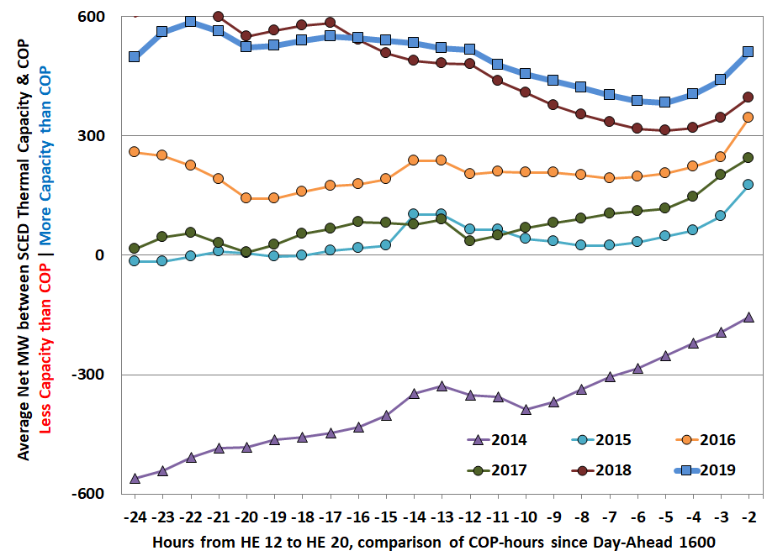
SOM Figure 38: Capacity Commitment Timing – July and August HE 12 through 20

Slide 4
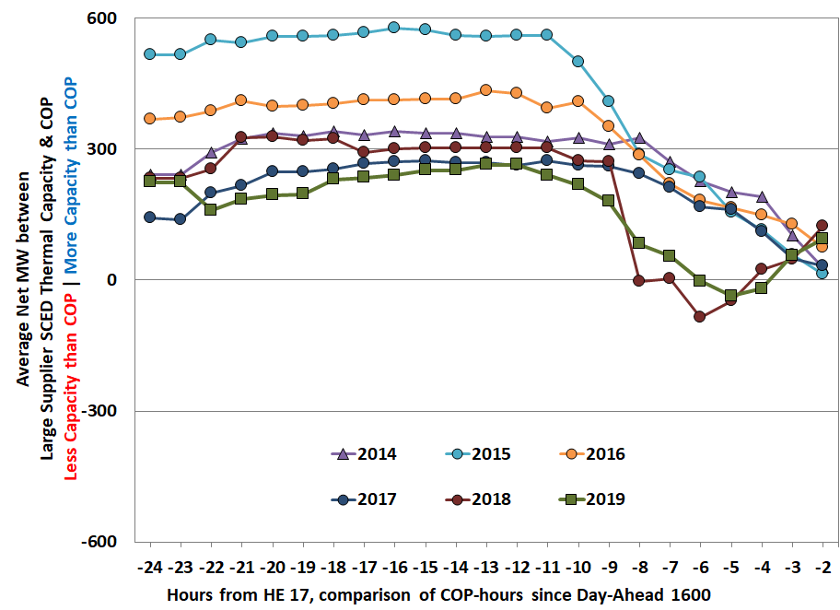
SOM Appendix Figure A40: Large Supplier Capacity Commitment Timing – July and August HE 17

Slide 5
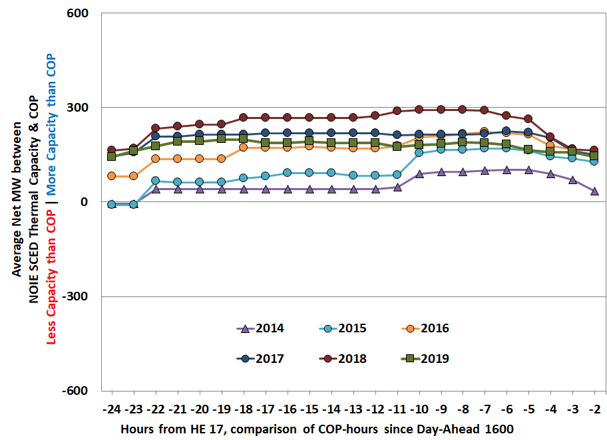
SOM Appendix Figure A41: NOIE Capacity Commitment Timing – July and August HE 17

Slide 6
Recommendation
Remove the RUC opt-out option to increase reliability for loads and improve market efficiency

