Slide 1
Credit Exposure Update
Spoorthy Papudesi
Credit Work Group
ERCOT Public
August 19, 2020

Slide 2
Monthly Highlights Jun 2020- Jul 2020
Market-wide average TPE increased from $ 439.5 million to $ 544.53 million
TPE increased mainly due to higher Forward Adjustment Factors in July compared to June
Discretionary Collateral is defined as Secured Collateral in excess of TPE,CRR Locked ACL and DAM Exposure
Average Discretionary Collateral increased from $ 1,243.6 million to $1,422.18 million
The increase in Discretionary Collateral is largely due to increase in Secured Collateral and decrease in CRR Locked ACL
Number of active Counter-Parties increased by 2
No unusual collateral call activity

Slide 3
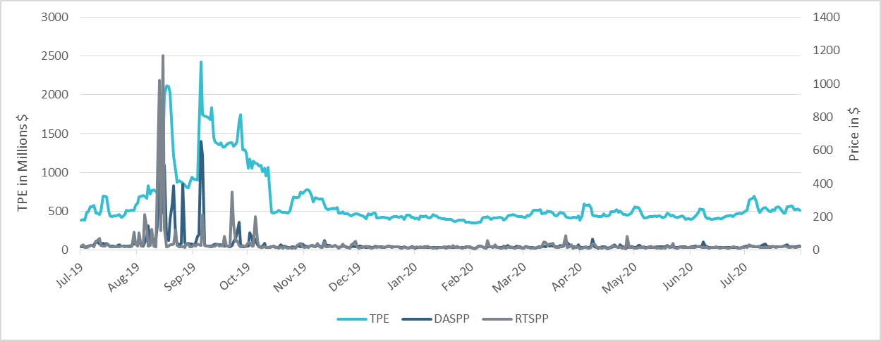
TPE/Real-Time & Day-Ahead Daily Average Settlement Point Prices for HB_NORTH Jul 2019- Jul 2020

Slide 4
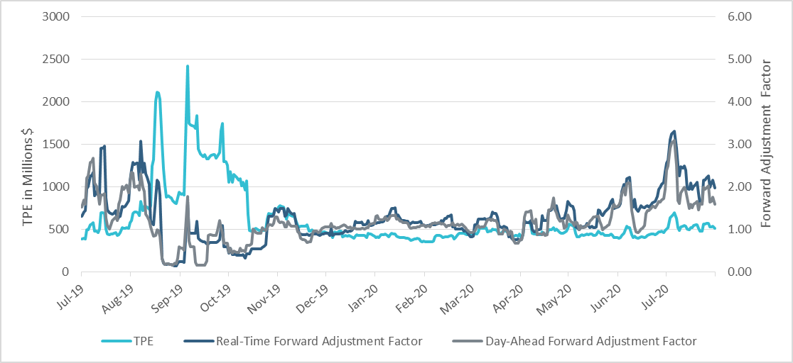
TPE and Forward Adjustment Factors Jul 2019- Jul 2020

Slide 5
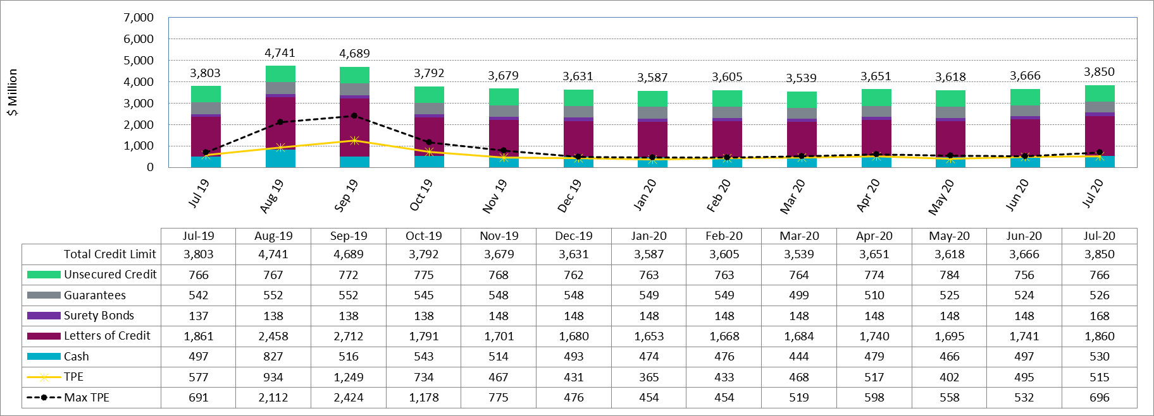
Available Credit by Type Compared to Total Potential Exposure (TPE)
* Numbers are as of month-end except for Max TPE

Slide 6
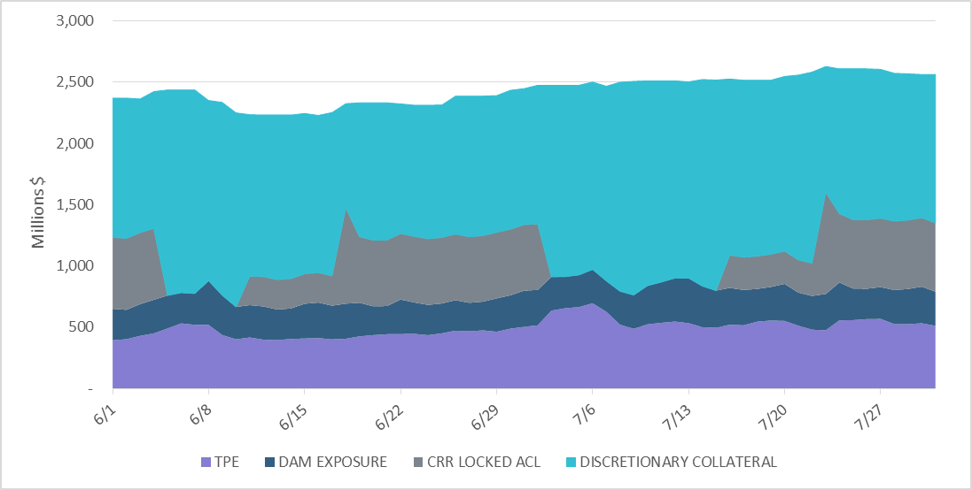
Discretionary Collateral Jun 2020- Jul 2020
At a Counter-Party level, no unusual changes were noted
Note: Discretionary collateral doesn’t include Unsecured Credit Limit or parent guarantees

Slide 7
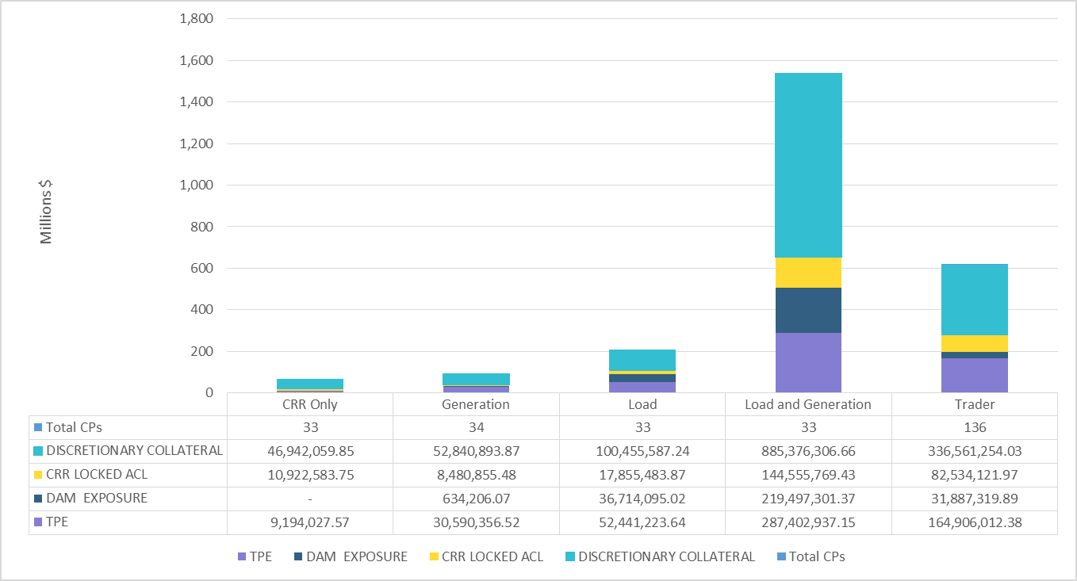
TPE and Discretionary Collateral by Market Segment- Jul 2020
Load and Generation entities accounted for the largest portion of discretionary collateral

Slide 8
TPE Coverage of Settlements
TPEA covers Settlement/Invoice exposure and estimated Real-Time and Day- Ahead completed but not settled activity (RTLCNS and UDAA)
The analysis was performed for the period, Jun 2019 - Jun 2020
Only Settlement invoices due to ERCOT are considered in the calculation
M1 values as of May 28, 2020 were used for the period Jun 2019 - May 2020 and M1 values effective as of each day were used since Jun 2020
Example
For business date 2/1/2020, if a Counter-Party has M1 value of 20, then all the charge invoices till 2/21/2020 including RTLCNS and UDAA as of 2/1/2020 is summed up to arrive at “Invoice Exposure”

Slide 9
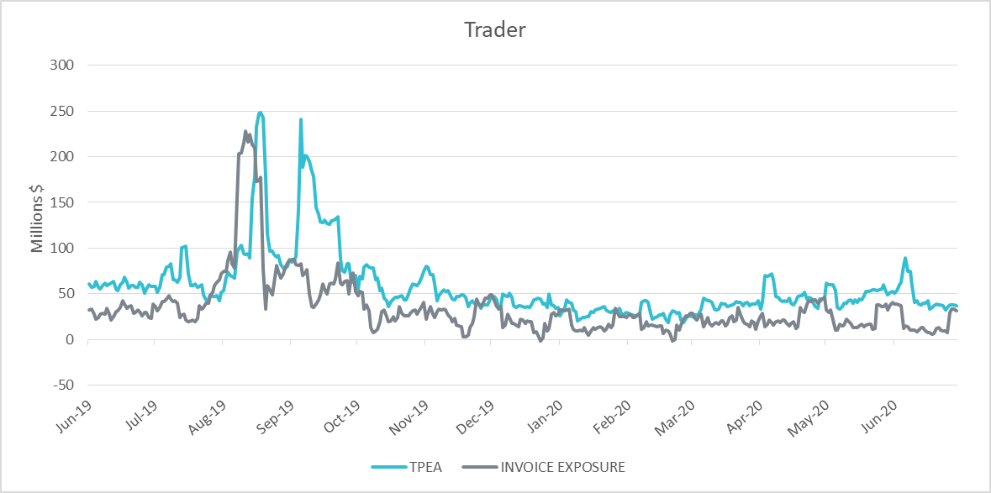
TPE Coverage of Settlements Jun 2019 - Jun 2020
TPEA generally exceeds actual/invoice exposure

Slide 10
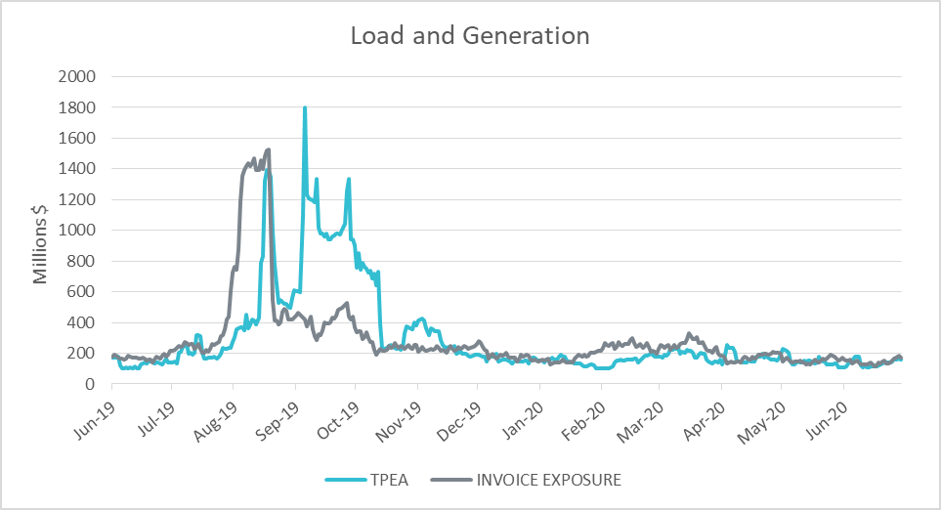
TPE Coverage of Settlements Jun 2019 - Jun 2020
Actual/invoice exposure slightly higher than TPEA except during summer peak and fall

Slide 11
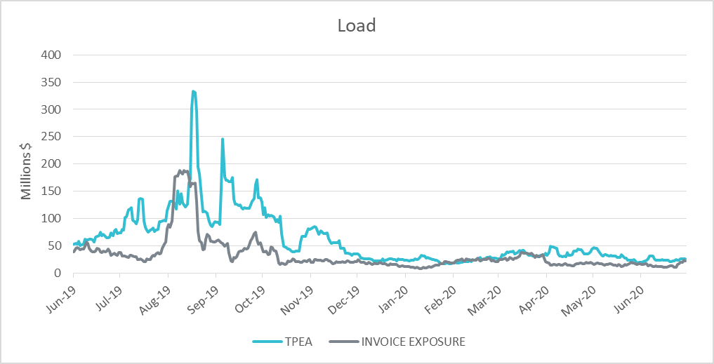
TPE Coverage of Settlements Jun 2019 - Jun 2020
TPEA closely approximates actual/invoice exposure except during summer peak and fall

Slide 12
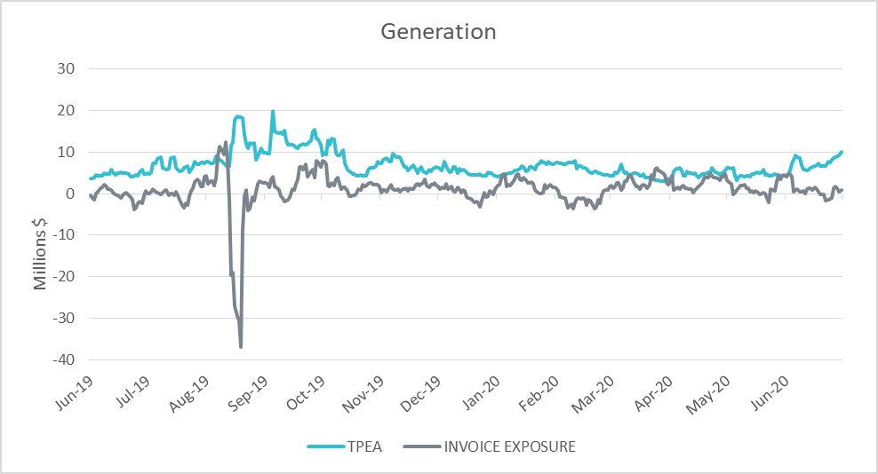
TPE Coverage of Settlements Jun 2019 - Jun 2020
TPEA generally exceeds actual/invoice exposure

Slide 13
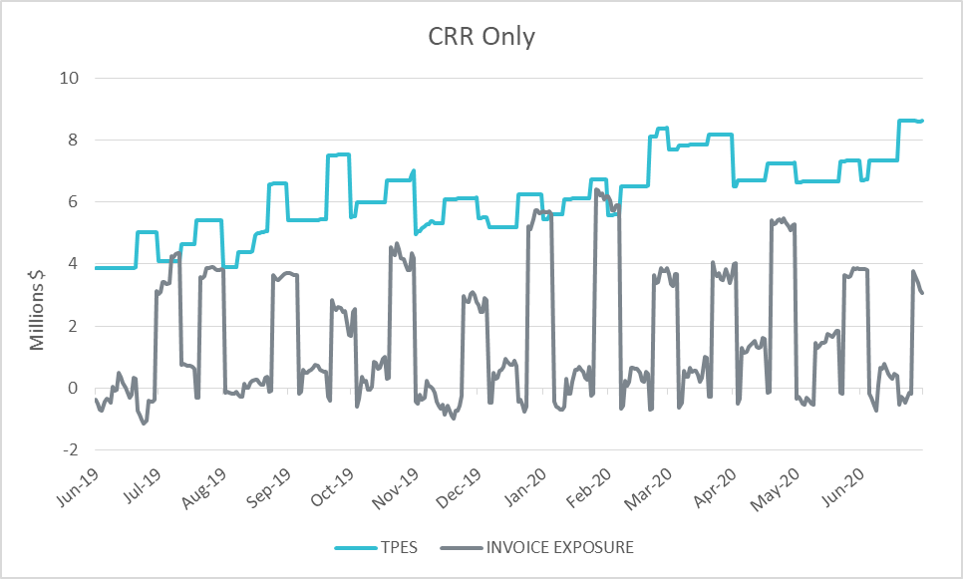
TPE Coverage of Settlements Jun 2019 - Jun 2020
TPES mostly exceeds actual/invoice exposure

Slide 14
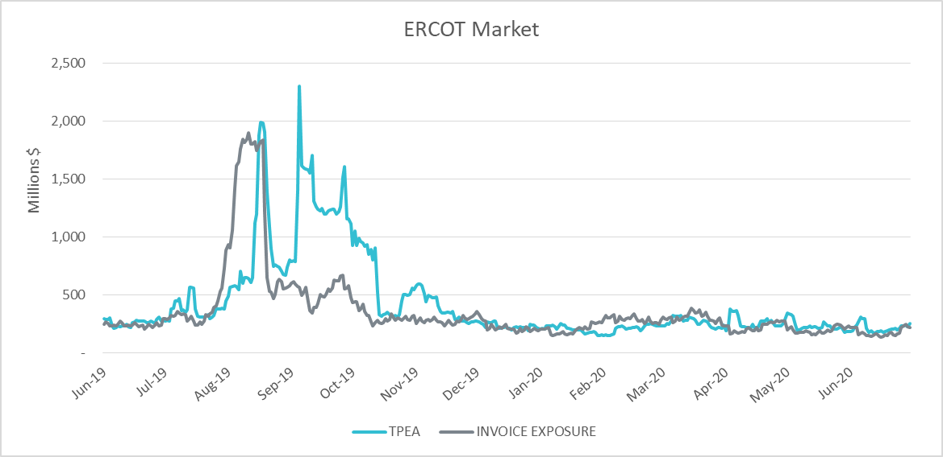
TPE Coverage of Settlements Jun 2019 - Jun 2020
TPEA closely approximates actual/invoice exposure during winter and shoulder months

Slide 15
Appendix

Slide 16
Summary of Distribution by Market Segment
Note: Excess collateral doesn’t include Unsecured Credit Limit and is defined as Collateral in excess of TPE

Slide 17
Summary of Distribution by Rating Group

Slide 18
Distribution of TPE by Rating and Category

Slide 19
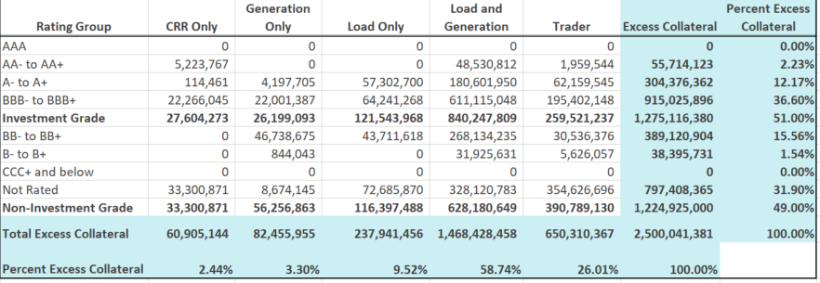
Distribution of Excess Collateral by Rating and Category
Note: Excess collateral doesn’t include Unsecured Credit Limit

Slide 20
Questions

