Slide 1
Wholesale Storage Load Metering of losses
By:
Ted Holcombe
Dotty DiSanto
South Texas Electric Cooperative

Slide 2
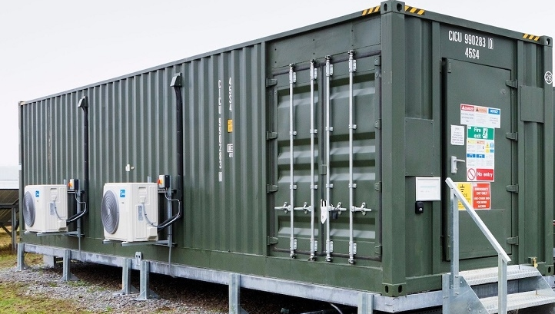
A Distributed Interconnected Generation
Battery Storage Facility in ERCOT can be any of the following:
Electrical Storage System (ESS)
Electrical Storage Resource (ESR)
A Whole Sale Storage Load (WSL)
Generation Resource (GR)
Distribution Generation (DG)

Slide 3
Example System Configuration
Service Delivery Point
POI
* Change of ownership and SDP from Coop to ESR
* Settlement Point for DG and WSL
Distribution Station
Battery Units
WSL to Charge Battery
(EPS Channel 1)
Generation from Discharge of Battery
(EPS Channel 4)
TDSP Substation transformer
EPS Metering
TDSP Metering
Feeder
Breaker
Transmission
Voltage
20’ Distribution Line
200’ Distribution Line
Owned by cooperative
Owned by cooperative
Distribution
Load
Feeder
Breaker
Distribution (DSP) Metering
Auxiliary Load
AC, Lighting, security, etc.
TDSP kWh settled as:
TDSP Ch1 Del - TDSP Ch4 Rec - EPS CH1 Del + EPS Ch4 Rec
Battery Facility
Coop

Slide 4
Example System Configuration
Loss of TDSP Transformer cannot be determined by the EPS meter
due to the transformer carrying the WSL/ES and the distribution load of the station.
Service Delivery Point
* Change of ownership and SDP from Coop to ESR
* Settlement Point for DG and WSL
POI
Loss of 200’ of distribution line loss cannot be determined by the EPS meter due to the line carrying the WSL/ES and the auxiliary load
Distribution Station
Battery Units
WSL to Charge Battery
(EPS Channel 1)
Generation from Discharge of Battery
(EPS Channel 4)
TDSP Substation transformer
EPS Metering
TDSP Metering
Feeder
Breaker
Transmission
Voltage
20’ Distribution Line
200’ Distribution Line
Owned by cooperative
Owned by cooperative
Distribution
Load
Feeder
Breaker
Distribution (DSP) Metering
Auxiliary Load
AC, Lighting, security, etc.
TDSP kWh settled as:
TDSP Ch1 Del - TDSP Ch4 Rec - EPS CH1 Del + EPS Ch4 Rec
Battery Facility
Coop

Slide 5
TDSP kWh settled as:
kWh= TDSP Ch1 Del - TDSP Ch4 Rec - EPS CH1 Del + EPS Ch4 Rec
Notes:
When the battery charges:
TDSP incurs distribution line loss and increased transformer loss.
WSL incurs no losses
When the battery discharges at a rate less than station load:
TDSP incurs no distribution line loss and decreased transformer loss
ES incurs no losses
When the battery discharges at a rate greater than station load:
TDSP incurs no distribution line loss and increased transformer loss depending on meter programing.
ES incurs no losses.

Slide 6
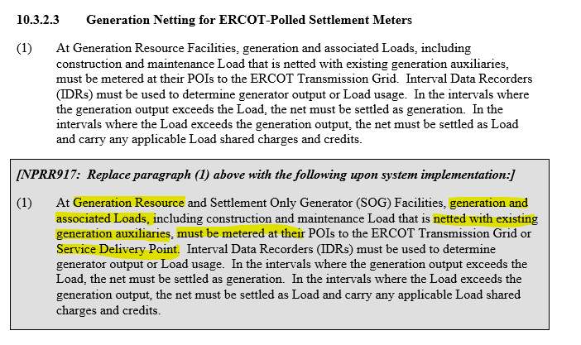
Vague rewording of 10.3.2.3 may be the premise of metering at a distribution generator's SDP.

Slide 7
Topics for Discussion
What is the INTENT of ERCOT?
Distribution connected Generation is settled at the SDP(Service Delivery Point)
WSL is settled at the SDP (Service Delivery Point)
Both points are at the SDP
Is clarification needed in Protocol or SMOG to better define the settlement point of WSL/ES metering as the POI or SDP?
Because watts loss is a function of I^2R, accurate division of losses between two entities sharing a common line or transformer cannot be accomplished.
A loss splitting calculation method must be developed and programmed into the TDSP meter. The splitting algorithm may need to be determined by the MWG and placed in Protocols or the SMOG.
Depending on loss splitting algorithms, communications between the WSL EPS meter and the TDSP meter may be required for real time data transfer.
The TDSP meter will need to calculate losses whether it is located at the ERCOT POI or at any other location. The calculated losses must be accessible in order to apply splitting algorithms.
Meters with such complex programming are difficult to test and lend themselves to technician error.
When thinking about transformer and distribution line loss, is this a give and take? When the battery charges, the TDSP incurs increased transformer and distribution line loss. When the battery discharges, the TDSP incurs decreased transformer loss and no line loss. This is not a perfect break-even because of battery efficiency but is it enough to be concerned about?
Are large or different operational WSL/ES facilities arriving in the future that could result in losses captured by TDSP metering being more substantial?
Is STEC the only entity that has interest in this topic?

Slide 8
Questions or Comments

