Slide 1
MIS Integration Workshop
August 12, 2020

Slide 2
MIS Integration Workshop Agenda
Why are we talking about integration?
MIS Project Background
  Scope of Changes
  Release Plan
  What Is and Isn’t Changing ?
Frequently Asked Questions
Screen Scraping Impacts
Future Communications

Slide 3
Why are we talking about integrations?
MIS hasn’t changed since Nodal Go-Live
ERCOT isn’t aware of all integration use cases
Some integrations can cause supportability issues
We want to point users towards available resources
We want to minimize the impact at November Go-Live

Slide 4
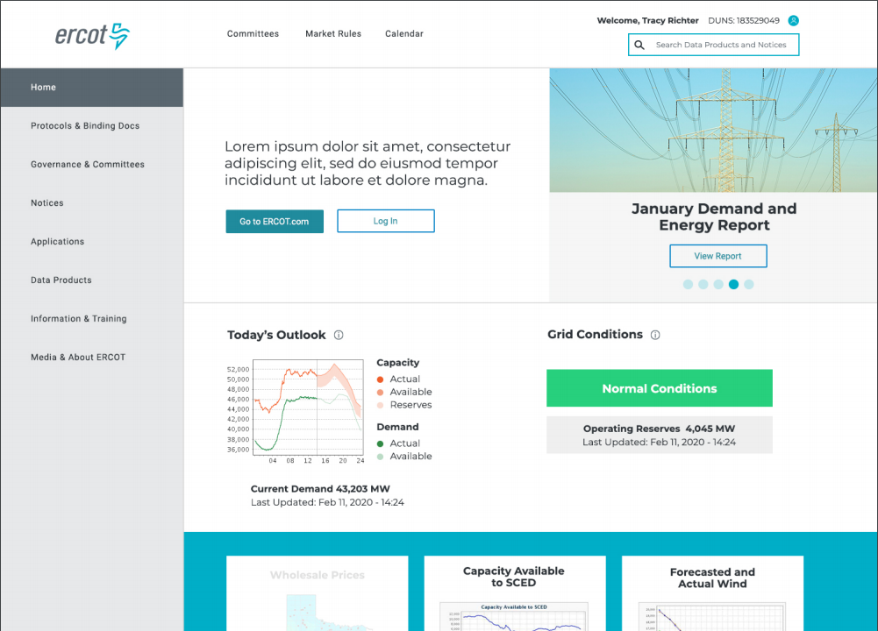
MIS Redesign Scope
Updated user interface
Improved search & metadata
Integrated EMIL & report links
Easier access to applications
Updated technology platform
More secure

Slide 5
MIS Redesign Benefits
Improved Market Data Transparency (MDT)
  What data is available?
  How often is data updated?
  Which reports have data?
One-Stop Information Clearinghouse
  Integrated platform with ERCOT.com
  Responsive design for use on multiple devices
  Applied taxonomy and improved search
Maintain Technical Health

Slide 6

MIS Release Timeline
EMIL Web Interface Release
Sandbox Version New MIS
MIS Production Soft Launch
MP Testing
MIS Production Go-Live
Decommission
Old MIS
Transition ERCOT.COM Content into Integrated Platform
Jan 30th
May 26th
Sept 16th
Nov 11th
Q1
Q1- Q4
2020
2021
2020
Jan 30th | EMIL web interface release ✓
May 26th | Sandbox version of new MIS ✓
Sept 16th | MIS Production soft launch for MP testing
Nov 11th | MIS Production Go-Live
2021
Q1 | Decommission old MIS
Q1 – Q4 | Transition ERCOT.COM content into integrated platform

Slide 7

Market Data Transparency (MDT) Portfolio Diagram
MIS
ERCOT.COM
APIs
Dashboards & Displays
MIS
Market Applications
(Market Trak, OS, etc.,)
Market Data Transparency
(MDT)
Reports & Extracts
Market Participants
Grid Communication
(ERCOT.COM, MIS)
Search & Metadata
MP Authentication & Authorization
(Certs, MFA)
Technical Documentation
(MIS User & Integration Guides)
Changing
Not Changing
Notes:
Diagram will show all components at a high level
We know access data in a lot of different ways
We can show what is changing and what is not
We are concentrating on these small pieces

Slide 8

Integration Questions

Slide 9
Integration Question
Q: Will the new MIS continue to work in IE?
The new site will continue to work in Internet Explorer versions X.XX but does not work well in IE8.0 Compatibility Mode.
Please refer to ERCOT’s IE Browser Configuration Guide.

Slide 10
Integration Question
Q: Will Digital Certificates continue to work on my Mac?
No changes to the use of Digital Certificates are part of the MIS project.

Slide 11
Integration Question
Q: Can you do anything about how hard it is to switch between Digital Certificates?
The user interface where you switch certificates is presented by the web browser which is why there are differences between IE and Chrome. There is some ability for our developers to access the data presented to the web browsers but it’s a different code depending on the browser. We are still working on MVP (Minimally Viable Product) functionality for the September and November releases. Looking more closely at improvements to Certificate Switching is in our Product Backlog.

Slide 12
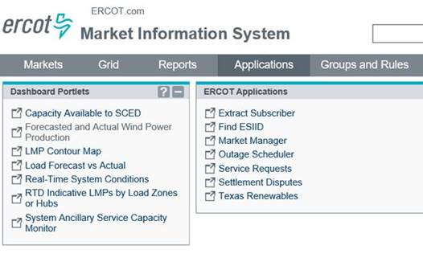
Integration Question
Q: When the new MIS goes live, will MPs have to reschedule reports and extracts to confirm that any existing connections, histories or subscriptions would not be interrupted by the September changes.
Market facing applications will not be modified as part of the MIS project.

Slide 13
Integration Question
Q: Are you planning to fix the long filename issue as part of the MIS project?
The system that delivers the reports and extracts is not under scope for the MIS project.
We should also note that no reports or extracts are being taken away.

Slide 14
Integration Question
Q: How about the APIs that move data between ERCOT and MPs?
No changes to the ERCOT API will be made as part of the MIS project.
Helpful API Resources
EIP External Interfaces Specifications
http://www.ercot.com/content/wcm/lists/89535/eip_external_interfaces_specification_v1_20N.zip
EIP Digital Certificate Security Information
http://www.ercot.com/services/mdt/webservices

Slide 15
Integration Question
Q: What about Mailing lists?
The mailing lists at lists.ercot.com will not be changed.
Helpful Mailing List & Market Notices Resources
Market Notice Archives
http://www.ercot.com/services/comm/mkt_notices/archives
Market Notice Email Distribution Lists
http://www.ercot.com/services/comm/mkt_notices/archives/lists

Slide 16

Are there additional questions?

Slide 17
Let’s talk about Screen Scraping
Scenarios
Supportability Issues
Resources

Slide 18
Impacts to data access
URL change
/public vs /secure
No more pop-up for data links
Underlying HTML source
You will be able to see what this looks like starting on Sept 16, 2020.

Slide 19
Screen Scraping: URL Scenario
Q: We currently parse the HTML source of the predictable URL (https://mis.ercot.com/misapp/GetReports.do?reportTypeId= [6 digit REPORT TYPE ID])
in order to get a list of available files (since the source code contains <a href='/misdownload/servlets/mirDownload?mimic_duns=0805522512000&doclookupId=715089663'>zip</a>).
Can you tell me whether:
That predictable URL will continue to exist after September?
Whether there is an API call that will return the files available for download for a given Report Type number?
The following will work until January 2021 but long term discussion needed.
http://mis.ercot.com/misapp/GetReports.do?reportTypeId=13057
Notes:
Demo Popup URL
Demo Portal URL

Slide 20
Integration Help and Documentation
ERCOT provides documentation on the EWS API system.
ERCOT provides Terms of Use for all reports outlining the policy around download frequency.
The ERCOT Market Information List (EMIL) details all market products required to be supplied by Protocols or other binding documents.
Client Services representatives are available to assist MPs in finding information that ERCOT has made available.
ERCOT is unable to provide API code as each MPs implementation is different.
ERCOT cannot consult on implementations other than basic troubleshooting.
Notes:
Share the TOU.
Open http://mis.ercot.com/emil to show where to find frequency using EMIL ID

Slide 21
Screen Scraping Supportability Challenges
Users engaging in parsing data from the ERCOT Market Information System (MIS) may cause system reliability issues.
Automated systems pulling data from a GUI based system have the potential to overwhelm the GUI systems.
ERCOT will deny access to IPs using poorly written code or macros that saturated the report download bandwidth.
ERCOT will make an attempt to contact the company that is found to be the cause of the degradation.
In severe cases, ERCOT will block offending IP to maintain reliability. Blocked IP addresses will not be allowed to reconnect until corrective action is taken by the user.

Slide 22
Communication Moving Forward
Monthly MIS User Workshops will resume in September.
More MP group workshops as needed.
Contact your Client Services representative with questions.
Report bugs to the ERCOT HelpDesk.
Additional communication re: MDT technical roadmap
  Bi-annual Market Data Transparency Forum?
Feedback at any time to webmaster@ercot.com
Redesign info: www.ercot.com/about/redesign

