Slide 1
PDCWG Report to ROS
Chair: Chad Mulholland, NRG
Vice Chair: Jimmy Jackson, CPS
ROS
August 6th, 2020

Slide 2
Report Overview & Notes
Report Overview
Meeting Minutes
BAL-001-TRE-2 FMEs & IMFR
2 FMEs in the month of June
Frequency Control Report

Slide 3
Meeting Minutes
PDCWG Meeting 7/15/2020
SAR 12 for BAL-001-TRE
Draft SCR to add Solar Feedback Component to GTBD Calculation
High Frequency Event Follow-up Discussion (Event from 3/16/20)
ERCOT Reports and FME Discussion

Slide 4
Frequency Measurable Events Performance

Slide 5
Frequency Measurable Events
There were 2 FMEs in June
6/13/2020 12:00:48
Loss of 679 MW
Interconnection Frequency Response: 1293 MW/0.1 Hz
8 of 54 Evaluated Generation Resources had less than 75% of their expected Initial Primary Frequency Response.
9 of 54 Evaluated Generation Resources had less than 75% of their expected Sustained Primary Frequency Response.
6/15/2020
Loss of 511 MW
Interconnection Frequency Response: 1087 MW/0.1 Hz
15 of 54 Evaluated Generation Resources had less than 75% of their expected Initial Primary Frequency Response.
11 of 54 Evaluated Generation Resources had less than 75% of their expected Sustained Primary Frequency Response.

Slide 6
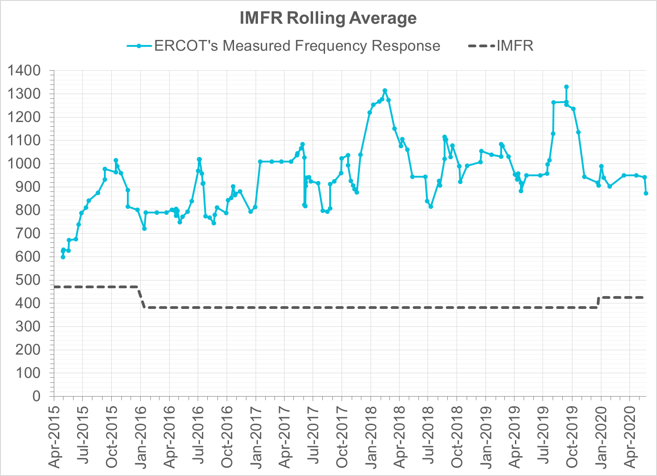
Interconnection Minimum Frequency Response (IMFR) Performance
IMFR Performance currently 872.75 MW/0.1Hz
Frequency Response Obligation (FRO): 425 MW/0.1 Hz

Slide 7
Frequency Control Report
May 2020

Slide 8
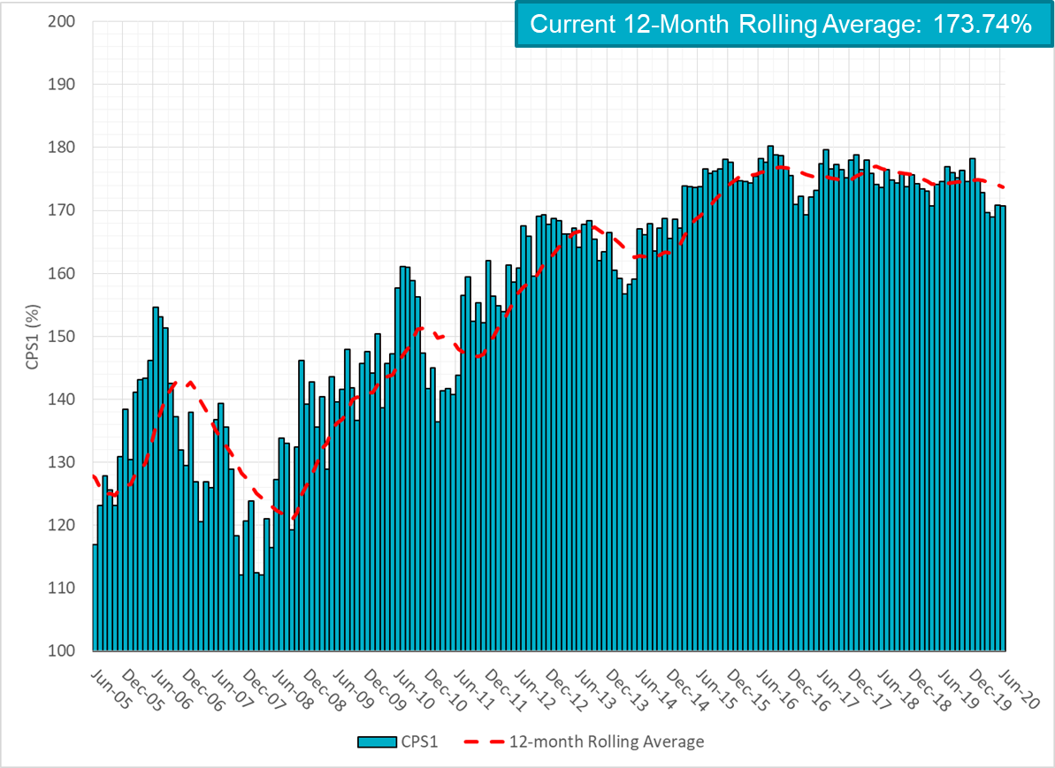
CPS1 Performance

Slide 9
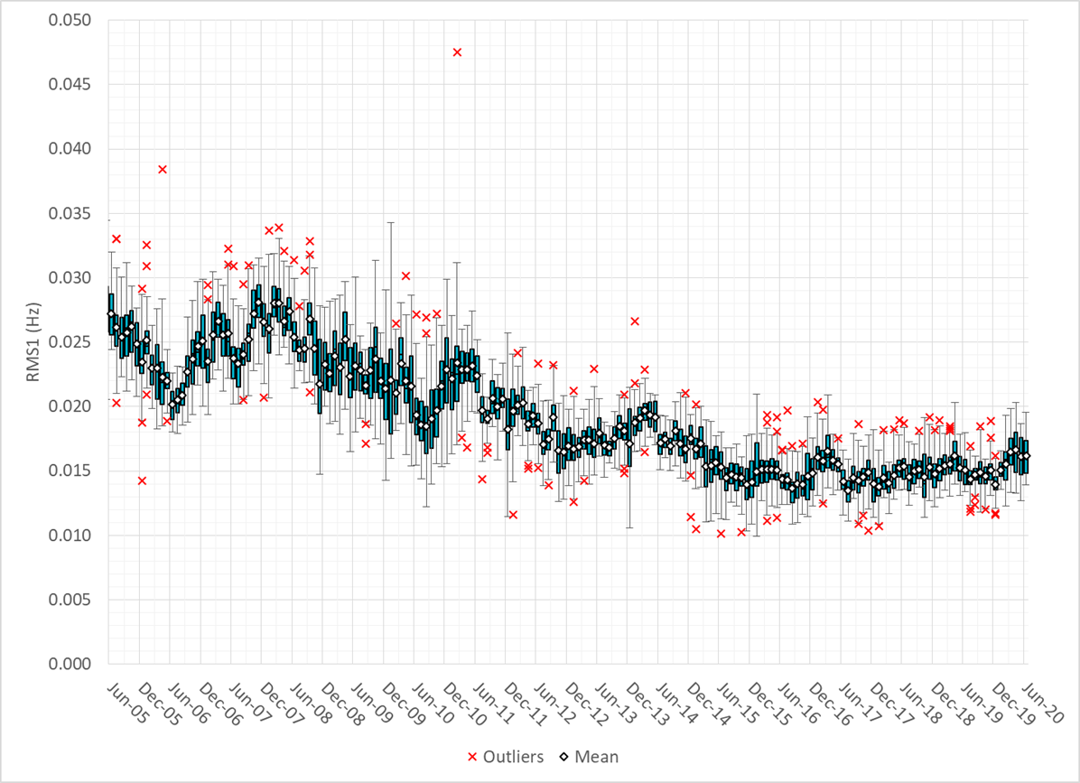
RMS1 Performance of ERCOT Frequency

Slide 10
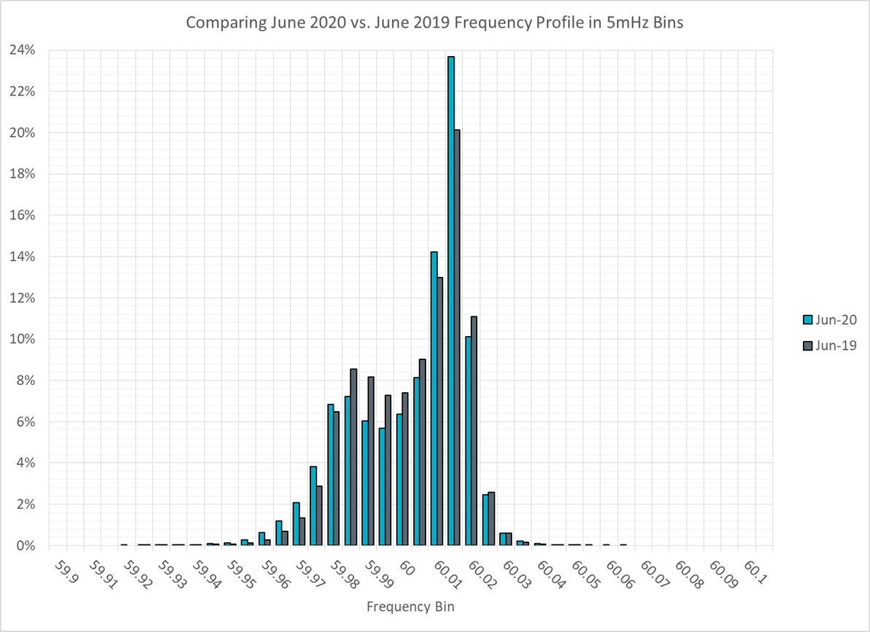
Frequency Profile Analysis

Slide 11
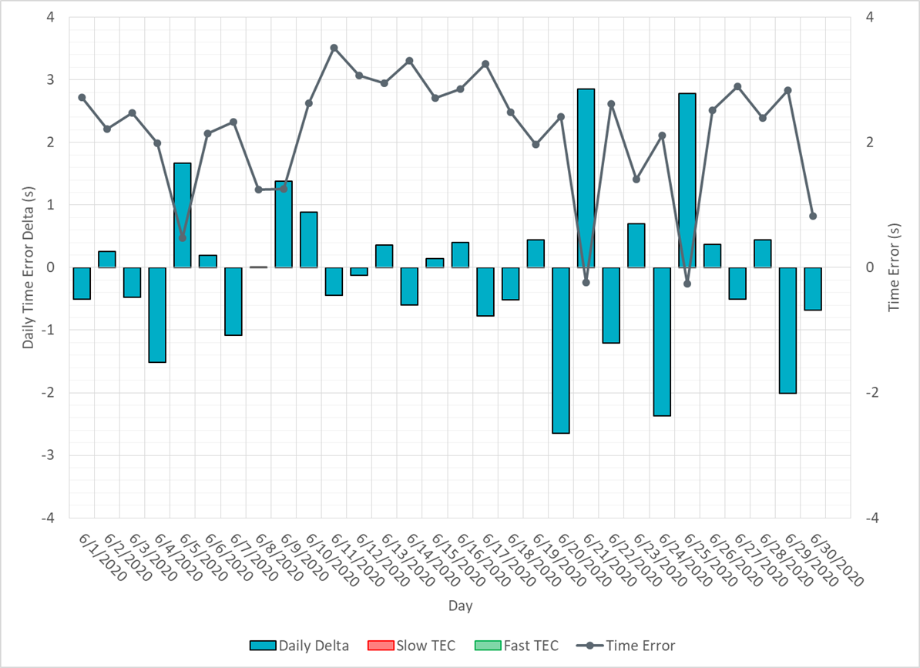
Time Error Corrections

Slide 12
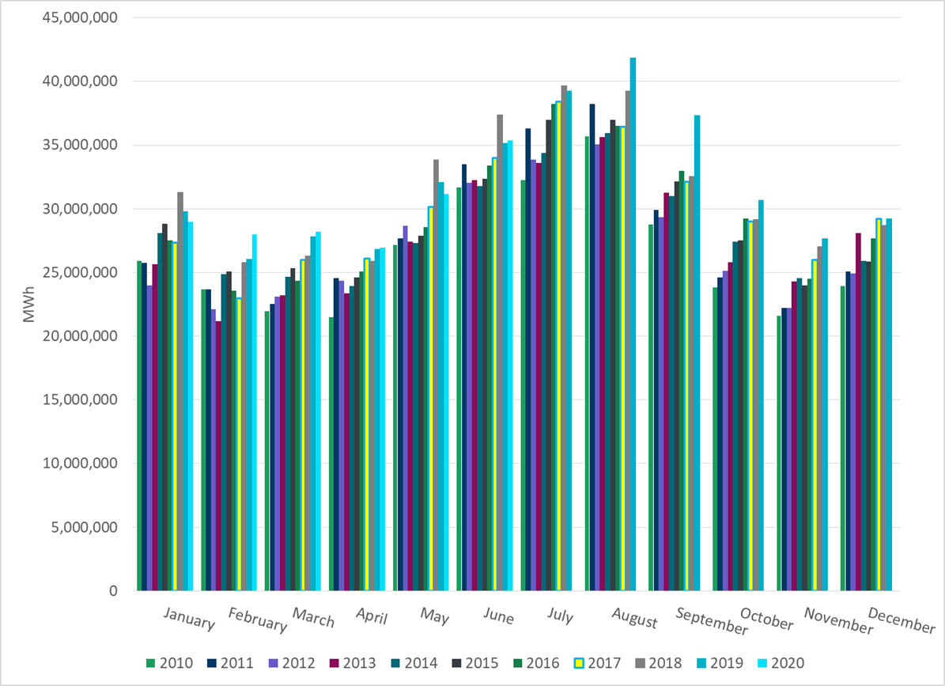
ERCOT Total Energy

Slide 13
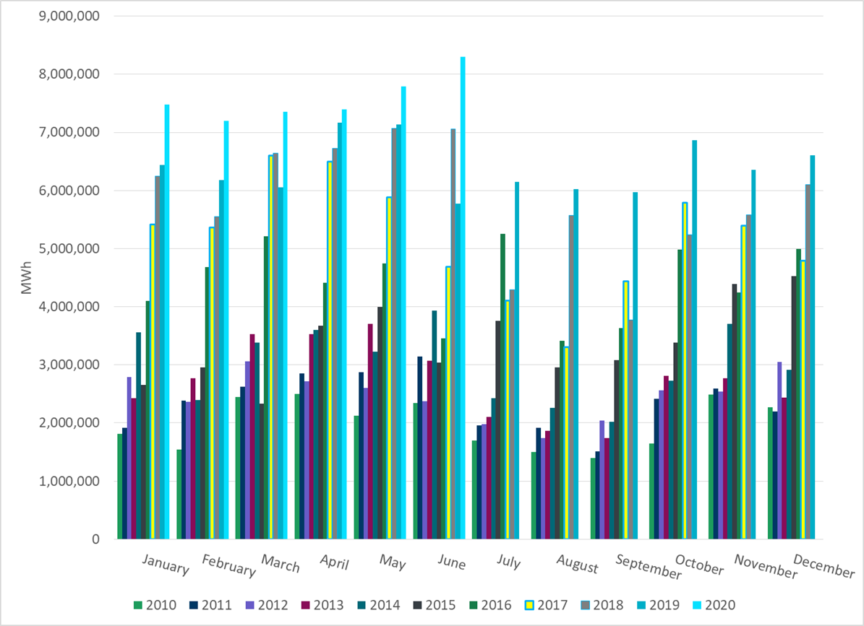
ERCOT Total Energy from Wind Generation

Slide 14
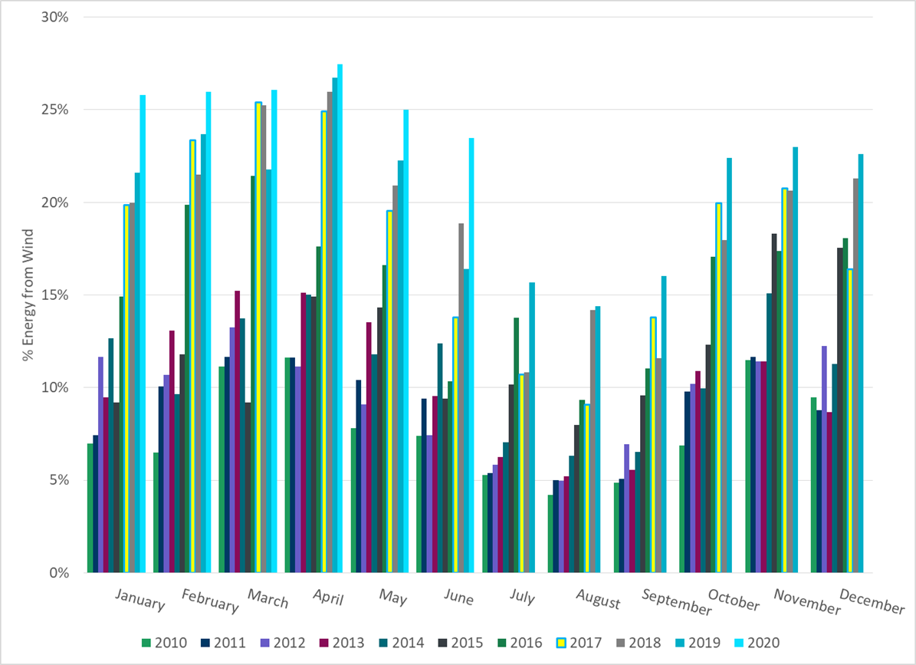
ERCOT % Energy from Wind Generation

Slide 15
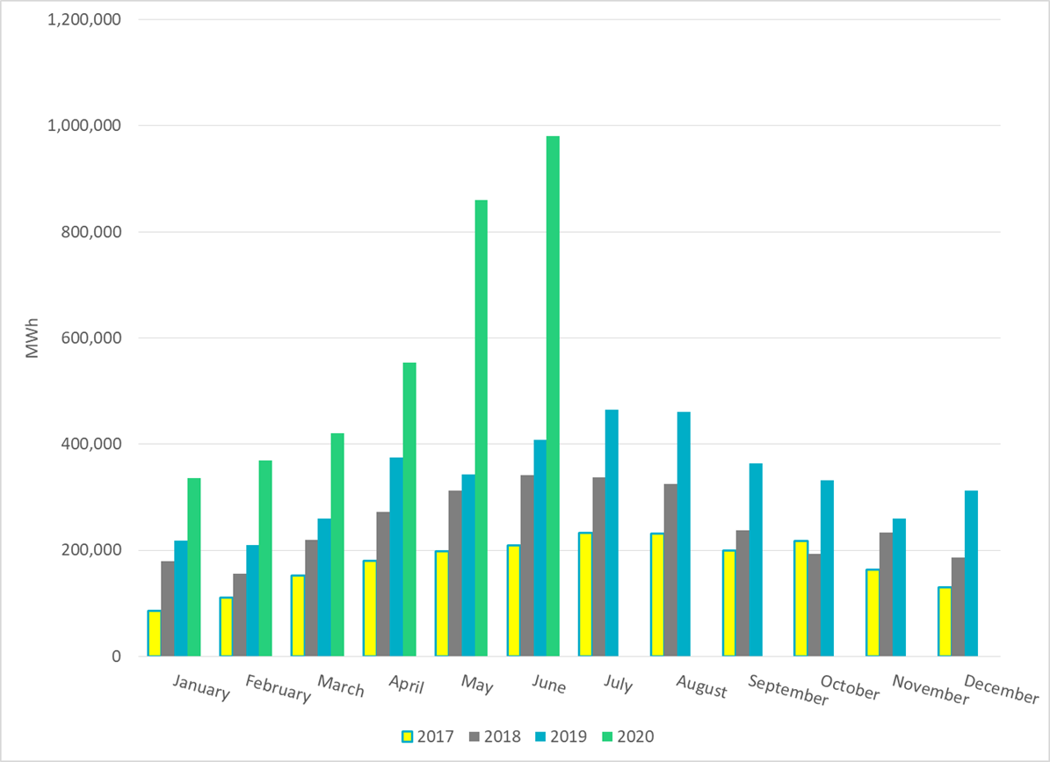
ERCOT Total Energy from Solar Generation

Slide 16
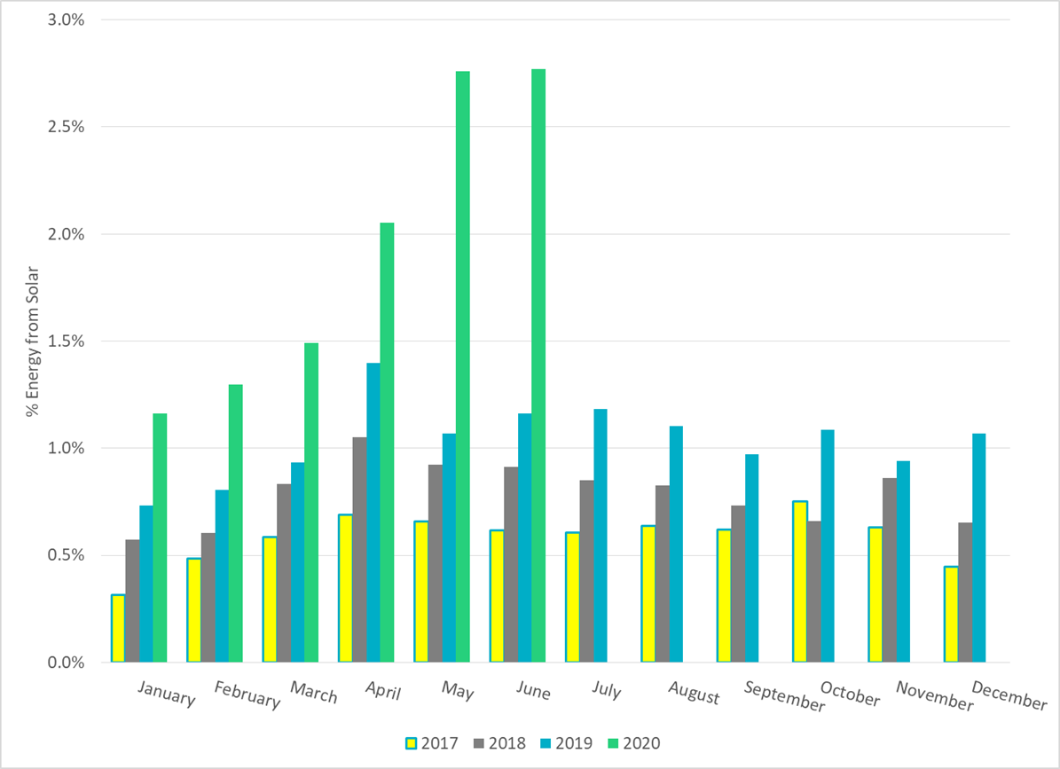
ERCOT % Energy from Solar Generation

Slide 17
Questions?

